Slide 1
Engaging Government Agencies in Your TZD Program
Notes:
Thank you for viewing the “Engaging Government Agencies in your TZD program” online tutorial. A successful Toward Zero Deaths, or TZD, program requires many partners. In an ideal world, engaging multiple government agencies would be easy, but sometimes competing priorities, a lack of resources, or a lack of communication stand in the way. This tutorial will showcase examples where organizations have successfully closed these gaps between agencies.

Slide 2
Engaging With Local Agencies: California
Notes:
Let’s start with examining how a state-sponsored program can collaborate with local government.

Slide 3
David Prasad via Creative Commons: https://flic.kr/p/9xmsGQ
Notes:
California’s Office of Traffic Safety, or OTS, administers a grant program to help local government agencies implement traffic-safety improvements. The state advertises the grant program to more than 3,000 local agencies each year. OTS staff coordinators act as liaisons to help agencies develop effective plans and innovative partnerships to make their applications competitive.

Slide 4
http://www.techtransfer.berkeley.edu/services
Notes:
One of OTS’s grant-funded programs is operated in partnership with the University of California, Berkeley. This program is in itself an outreach program for local agencies. Using tools developed at the university, the Technology Transfer program provides free traffic, pedestrian, and bicycle safety assessments for any city or county agency within the state. Safety experts visit the community, meet with key staff, conduct research and field evaluations, and provide a customized safety plan. These safety plans often contain recommendations that the local agency could use to apply for their own OTS implementation grant.
California’s grant program is designed to make it easier and more attractive for local agencies to engage in zero-fatalities efforts. By providing a high level of customer service and personalized guidance, cities and counties with limited resources can tap into the expertise they need.

Slide 5
Engaging With the Courts: Minnesota
Notes:
Minnesota’s TZD program is a leader in engaging the court system.

Slide 6
www.minnesotatzd.org
Notes:
Judges and prosecutors hold power in enforcing traffic safety laws, particularly in the area of reckless, impaired, or distracted driving. Online resources, workshops, and training manuals have been developed to support judges and prosecutors in their efforts to appropriately address traffic safety violations.
Minnesota has a strong DWI Court programs that offers chronic drunken drivers the opportunity to participate in a highly-supervised treatment and support program rather than receive jail time. A national two-year study showed that Minnesota’s DWI Courts among the nation’s best at reducing recidivism and saving taxpayer dollars. The state’s TZD program has supported these courts and advocated for their expansion.

Slide 7
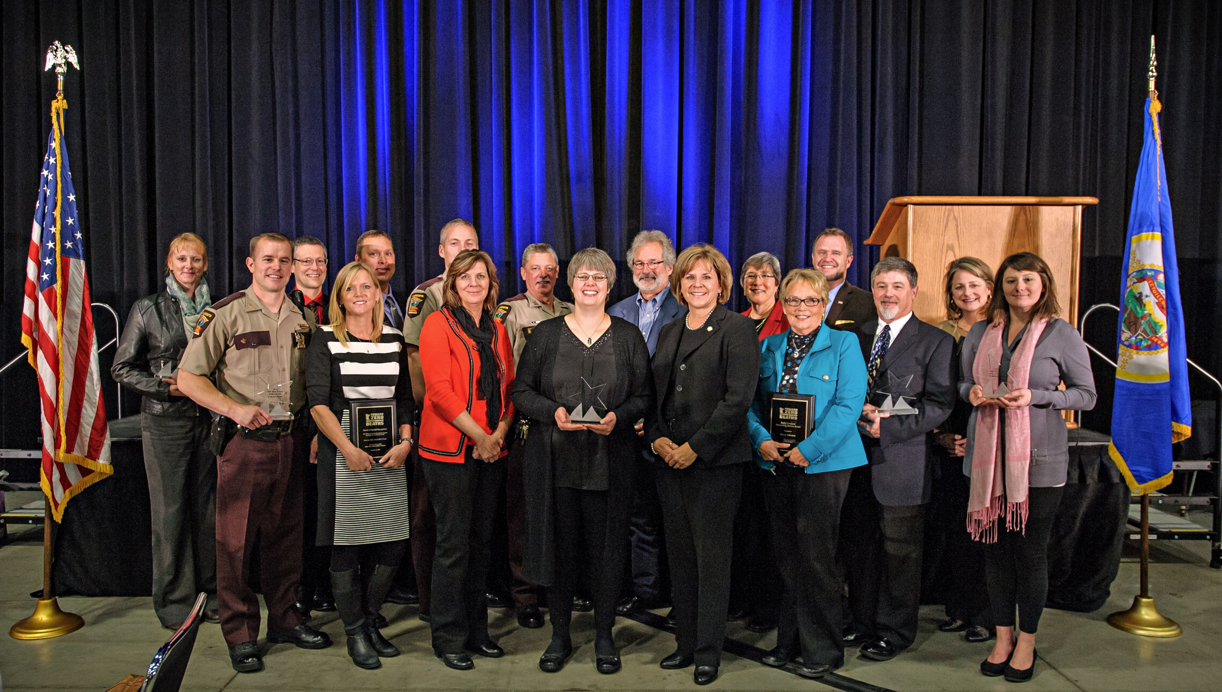
www.minnesotatzd.org
Notes:
Minnesota’s TZD program also has an annual awards ceremony recognizing accomplishments in promoting traffic safety. Awards are given to personnel in different categories, including the judicial system, law enforcement, media, medical services, engineering, and more. Adopting a similar awards program can help your agency highlight how different public- and private-sector professions contribute to traffic safety.

Slide 8
Engaging With Elected Officials: Los Angeles
Notes:
Of course, a successful TZD program requires buy-in from elected officials as well. When the city of Los Angeles adopted its zero-fatalities goal, city leaders knew that success requires support from many city agencies as well as elected officials.

Slide 9
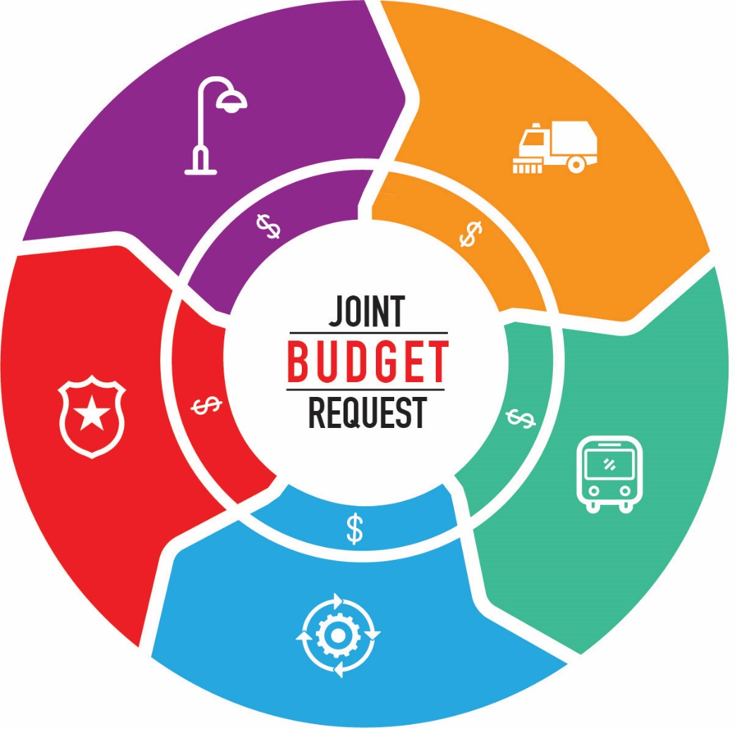
Notes:
To demonstrate early strength, the program brought together several city departments to submit joint budget requests for the Vision Zero program. Departments used a simple cover sheet to demonstrate how their budget requests would leverage investments in other departments, rather than compete against them. These joint budgets were given extra preference during the budget review process. For instance, the Health Department might show how an education campaign about safe bicycling can enhance the Transportation Department’s investments in better bike infrastructure.
By using this innovative new budget process, L.A.’s Vision Zero program gained favor with elected officials under pressure to demonstrate that the city’s budget is efficient. Vision Zero became a program that elected leaders could point to as being a thoughtful and well-coordinated use of government funds. In this way the program attracted attention from elected and departmental leaders, bringing the program early allies and early success.

Slide 10
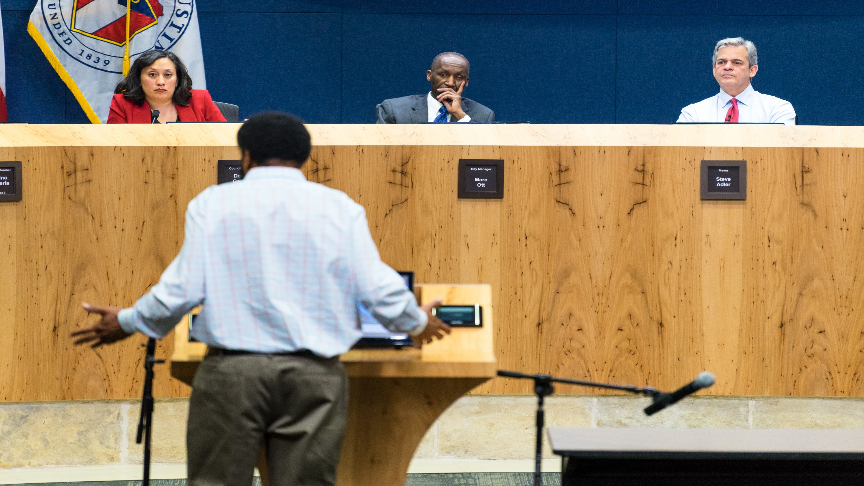
shutterstock.com
Notes:
Another strategy to engage with elected officials is to present the zero-deaths program mission and vision at City and/or County Board meetings. Having a representative from the program attend a meeting, share program goals, and answer questions from Board members helps garner support of safety improvements and reinforces the importance of local agencies making traffic safety a priority.

Slide 11
Available at www.TowardZeroDeaths.org:
California: http://www.ots.ca.gov/Grants/default.asp
Minnesota: http://www.minnesotatzd.org/whatistzd/foures/courts/
Los Angeles: http://visionzeronetwork.org/project/joint-departmental-vision-zero-budget-requests-an-l-a-case-study
Self-assessment tools:
TZD program implementation
Stakeholder engagement
Additional tutorial videos:
Engaging the Private Sector
Engaging Public Agencies
How-to Guide: Implementing the TZD Strategic Communications Plan
Roadmap for Implementing the TZD National Strategy on Highway Safety
Notes:
For further information about these programs, please visit these links. Additional resources are also available at www.towardzerodeaths.org.

Slide 12
This work was sponsored by the American Association of State Highway and Transportation Officials, in cooperation with the Federal Highway Administration, and was conducted in the National Cooperative Highway Research Program, which is administered by the Transportation Research Board of the National Academies of Sciences, Engineering, and Medicine.
Disclaimer: This is an uncorrected draft as submitted by the Contractor. The opinions and conclusions expressed or implied herein are those of the Contractor. They are not necessarily those of the Transportation Research Board, the Academies, or the program sponsors.
Notes:
NO AUDIO.

