Slide 1
Engaging the Private Sector in Your TZD Program
Notes:
Thank you for viewing the “Engaging the Private Sector in your TZD Program” online tutorial. In this tutorial, we’ll discuss strategies for engaging the private sector in your TZD program.

Slide 2
Why the Private Sector?
Notes:
Why should you consider adding private-sector organizations to your partnership? Corporate partners have much to offer. Money might be the first thing that comes to your mind, and for good reason. Private-sector organizations often have community-benefit funds that they can spend at their discretion, with more flexibility and fewer restrictions than public dollars. But don’t limit your thinking because your partners can also offer many other things. For instance, they might be able to provide pro-bono services in areas where you don’t have enough in-house expertise. They might have large groups of volunteers to support your one-day outreach event. Their marketing departments can reach different audiences beyond those you already have, and some audiences may find a message more credible or memorable when it comes from a variety of sources.

Slide 3
Establishing Mutual Benefit
Notes:
Establishing benefit to all parties in any kind of partnership is important. When reaching out to potential new partners, be sure to identify benefits both parties would gain from the relationship.

Slide 4
Potential Partners
Healthcare organizations
Auto and health insurance companies
Vehicle manufacturers
Restaurants and bars
Fleet and shipping providers
Notes:
It is also important to consider the kinds of organizations that would make ideal partners. Consider those who have a motive to improve road safety and/or have existing safety programs that could complement yours. Partners could include healthcare organizations, auto and health insurance companies, vehicle manufacturers, restaurants and bars that serve alcohol, or companies with fleet or shipping services. Each one of these organizations will have a different reason to care about your TZD program, and it’s your task to identify what that reason could be.

Slide 5
Potential Benefits to Partners
Reduced costs
Insurance
Health care
Lost time
Damages
Employee or customer safety
Positive PR
Employee morale and engagement
Notes:
Your goal is to establish a mutual benefit. For a private company, that benefit might be reduced costs, improved employee or customer safety, or good PR. While it might feel awkward to you to describe your TZD program in terms of saving money or preventing bad press for a company, it’s a good tactic for engaging the private sector. Many companies are motivated by “doing the right thing” but they are also required to provide a return to their shareholders. You can help your partners identify tactics to reach both of those goals at once. Your organization can also do its part to make the partnership easy and rewarding by providing pre-written materials and good publicity for your partners.

Slide 6
http://trafficsafety.org/road-safety-resources/public-resources/cost-of-motor-vehicle-crashes-to-employers-2015
Notes:
The Network of Employers for Traffic Safety, or NETS, offers resources for employers seeking to reduce traffic crashes both on- and off- the job. Check out their report on the “Cost of Motor Vehicle Crashes to Employers” to understand how their messages are framed.

Slide 7
“Protecting employees from motor vehicle crash injury can be a profitable investment of time and resources.
Traffic safety programs are an alternative to reduce health care expenses to employers without reducing the benefits offered to employees.”
- Cost of Motor Vehicle Crashes to Employers 2015
Notes:
For instance, the report states that “protecting employees from motor vehicle crash injury can be a profitable investment of time and resources. Traffic safety programs are an alternative to reduce health care expenses to employers without reducing the benefits offered to employees.” Notice how that statement connects the important goal of traffic safety to a bottom-line outcome that companies can easily relate to. How can your TZD program use similar messaging tactics to bring new allies onboard?

Slide 8
National Examples
Notes:
Now let’s explore examples of this work in action.

Slide 9
Notes:
Agencies across the nation are using creative strategies for engaging private-sector partners in TZD. For instance, New York City’s Vision Zero program holds an annual safety forum. Leaders of public and private fleet services meet together to exchange best practices, learn about new research, and develop ideas for improving traffic safety. Both the private and city fleet services have adopted new safety techniques that they learned from each other at the forum. This is a great example of mutual benefit.

Slide 10
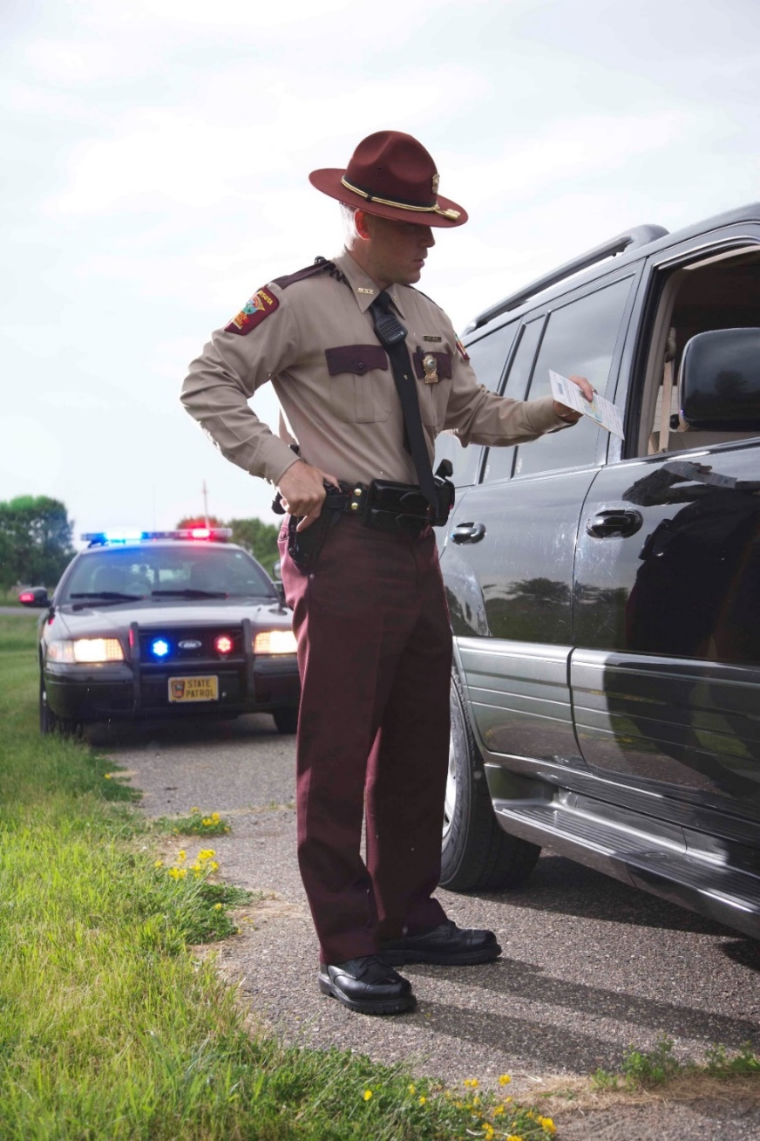
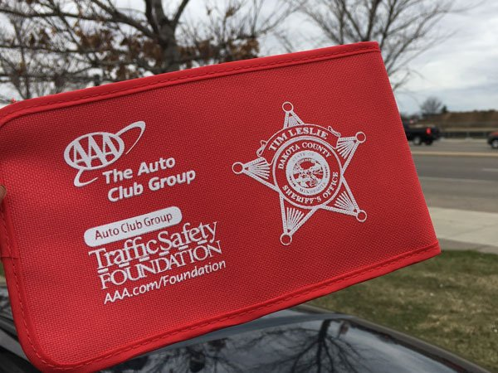
Notes:
In Minnesota, AAA partnered with a company called Cell Slip and law-enforcement agencies across the state by providing cell-phone pouches that block calls and texts while a driver is behind the wheel. Officers distributed thousands of pouches. This provided a way for AAA to share its brand and its commitment to safety with a large, statewide audience while providing officers with a new tool for promoting traffic safety.

Slide 11
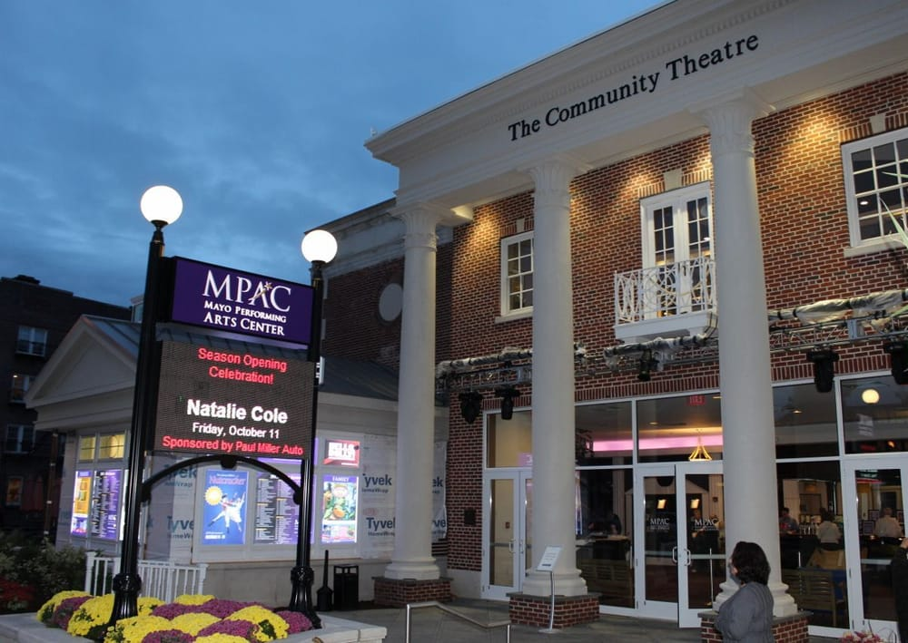
Notes:
Great partners can come in all shapes and sizes. New Jersey officials reached out to the MAYO Performing Arts Center in Morristown because its marquee sign is adjacent to a busy road. The theater posted a traffic-safety message on its marquee and also included a TZD advertisement in its playbills. By providing the advertisement design and language, New Jersey’s TZD program made it easy for the theater to participate in this outreach.

Slide 12
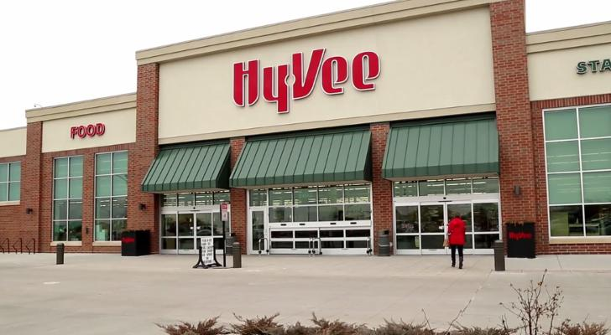
Notes:
Iowa also found a unique partner for TZD program. The Governor's Traffic Safety Bureau partnered with the Hy-Vee grocery store chain to place flyers about the dangers of drowsy driving in all grocery bags for a three-week period. Hy-Vee also contributed funding for the production of public service announcements.

Slide 13
Available at www.TowardZeroDeaths.org
Self-assessment tools:
TZD program implementation
Stakeholder engagement
Additional tutorial videos:
Engaging the Public Sector
Engaging Public Agencies
How-to Guide: Implementing the TZD Strategic Communications Plan
Roadmap for Implementing the TZD National Strategy on Highway Safety
Notes:
For more ideas about engaging private-sector partners in spreading your TZD message, download the “How-to Guide: Implementing the TZD Strategic Communications Plan” from www.towardzerodeaths.org. This guide provides further suggestions for identifying partners, establishing mutual benefit, and securing private-sector support.

Slide 14
This work was sponsored by the American Association of State Highway and Transportation Officials, in cooperation with the Federal Highway Administration, and was conducted in the National Cooperative Highway Research Program, which is administered by the Transportation Research Board of the National Academies of Sciences, Engineering, and Medicine.
Disclaimer: This is an uncorrected draft as submitted by the Contractor. The opinions and conclusions expressed or implied herein are those of the Contractor. They are not necessarily those of the Transportation Research Board, the Academies, or the program sponsors.
Notes:
NO AUDIO.

