Slide 1
PRESENTATION TITLE
Name of Group
Date Given
Notes:
Presenter fills in name of presentation, the name of the group, and the date the presentation is to be given.

Slide 2
Safe System
Road to Zero
Toward Zero Deaths
Vision Zero
Sustainable Safety
Zero Fatalities
Notes:
Speaker Notes – Have you seen or heard about any of these terms? What do they have in common? They all share a common goal – zero, as in zero traffic deaths.

Slide 3
Zero
Notes:
Speaker Notes – Zero may seem unrealistic, but if zero isn’t the right number, what is: 1,000, 500, 25? What if one of those deaths was someone you know or love – a co-worker, a neighbor, your son or daughter, your spouse? When you think about it that way, wouldn’t you agree that zero is the only acceptable goal? (At this point, show the national What’s Your Goal? Video which may be downloaded and used without permissions at towardzerodeaths.org/marketing/marketing-collateral or one created specifically for your state or community.)

Slide 4
Notes:
NOTE: The national TZD logo may be substituted with a state or local program brand if preferred.
Speaker Notes – The idea of zero traffic deaths isn’t a new concept, in fact it got its start in Sweden 20 years ago. Under this approach, which the Swedes dubbed Vision Zero, it’s unacceptable to assume that loss of life or serious injury is the price we pay for mobility. U.S. traffic safety professionals first started talking about a long-term zero goal in 2009 at a meeting in Savannah, Georgia. That discussion evolved into Toward Zero Deaths, our national highway safety strategy that has been adopted by more than 40 states. In our state (community), we’ve branded it ____________________.

Slide 5
TZD Principles
Fatalities and injuries are preventable
Leverage the Safe System approach
Collectively rallying around one goal
Notes:
Speaker Notes – Zero traffic deaths and injuries seems like a lofty goal, but it’s attainable based on three driving principles:
Traffic fatalities and injuries are preventable. Ninety-four percent of crashes are the result of something a roadway user did to put him or herself and others at risk (e.g., speeding, driving impaired, texting, jaywalking, riding a bike or motorcycle without a helmet). The goal is to ensure we understand what we can do to make every trip as safe as possible by adopting specific behaviors proven to reduce our crash risk. Things like always buckling up whether you’re the driver or passenger, stowing your cell phone before turning the key in the ignition, using crosswalks and being high visible particularly after dark, wearing a helmet whether riding a bike or a motorcycle, making advance travel arrangements if you plan to drink alcohol, obeying posted speed limits and signs and signals (share others based on the audience).
A safe system approach builds on the first TZD principle, but it goes a step further by recognizing that human error is inevitable. So it aims to create a road system that makes allowances for errors and minimizes the consequences, particularly the risk of death or serious injury. The focus is on engineering the roadway to make it safer for all users – car and truck drivers, pedestrians and bicyclists, and motorcyclists. The safe system approach also calls for safe vehicles that are equipped with protective systems such as electronic stability control, air bags, automatic braking systems, lane departure, to name just a few. And it calls for a speed limit that reflects the road safety risk to the road users. For example, a 35 mph speed limit is likely not appropriate on a roadway that is heavily used by both drivers and people on foot. These three components – the roadway, the vehicle and speed -- operate in an environment where road users are encouraged to be alert to risk and comply with the rules. That’s addressed through legislation and enforcement coupled with education and information.
Finally, a coordinated effort that brings together multiple stakeholders with the same goal can achieve more than organizations and people working independently. Achieving zero is not a solitary task; it takes an army of traffic safety professionals from the four E’s – engineering, education, enforcement, emergency services – along with individuals from many other disciplines in the public and private sector to prevent crashes and save lives.

Slide 6
35,092
Notes:
NOTE: Consider updating fatality numbers with most current figures as they become available; to localize it, add the most current state or local jurisdiction fatality number.
Speaker Notes – The carnage on our nation’s roadways is staggering – 35,092 died in traffic crashes in 2015. That’s 96 people dying every day or 4 deaths an hour. What’s particularly troubling is that the death toll rose 7.2 percent in 2015, the largest increase in U.S. roadway deaths in 50 years. And the numbers continue to climb with fatalities through the first six months of last year (2016) rising another 10 percent.

Slide 7
Zero heroes needed!
Notes:
Speaker Notes – There’s no doubt “we have an immediate crisis on our hands and… a long-term challenge.” Those aren’t my words, but Dr. Mark Rosekind’s, former administrator of the National Highway Traffic Safety Administration, the federal agency that partners with states to make our roadways safer. But if we’re going to reverse this trend and move toward zero deaths, I need everyone’s help. I need your help. I’m asking you to be a zero hero? What does that entail? That means you always model safe behavior whether you’re traveling by car or truck, on foot, or riding a bicycle or motorcycle. And you encourage the people in your circle of influence – family members, co-workers, neighbors, and friends – to follow your lead. The end game is to change the social norm so that engaging in safe behavior is the only accepted practice when on the road.
Keep in mind, however, that change doesn’t happen overnight. In fact, recent research led by a team at the University College London say it takes an average of 66 days for something to become a habit. So stay the course and be patient.

Slide 8
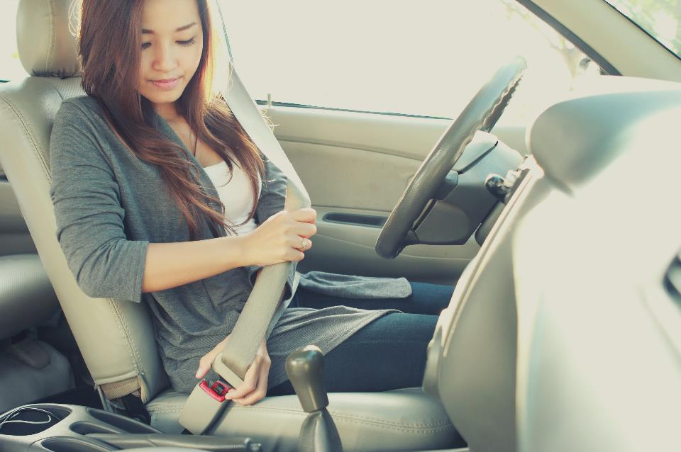
Notes:
Speaker Notes – So what does it mean to model safe behaviors? Make sure you and all your passengers buckle up every trip regardless of seating position – even the back seat. Nearly half of vehicle occupants killed in traffic crashes in 2015 (or most current year), weren’t properly restrained in a seat belt or car seat. It seems hard to believe there are people who still don’t click their seat belt, but imagine how many lives could be saved with this simple action.

Slide 9
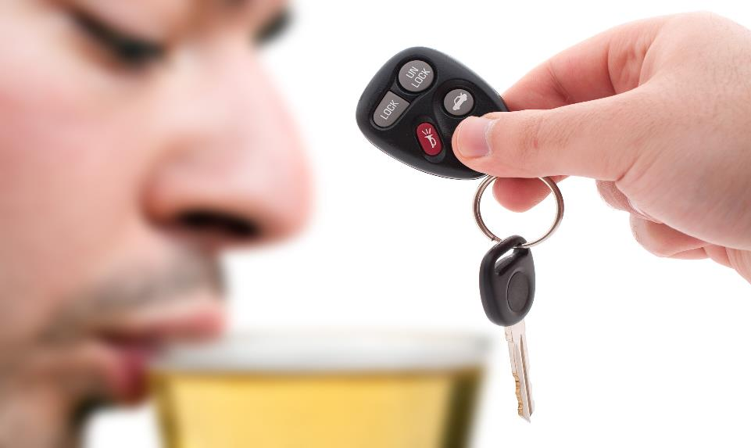
Notes:
Speaker Notes – Designate an alcohol- and drug-free driver or arrange alternate transportation if you plan to consume alcohol or are taking medication that impacts your ability to safely operate a motor vehicle. And keep in mind that alcohol and drugs impact your ability to travel safely by foot, too. The percentage of fatally injured pedestrians and bicyclists 16 years of age and older who were impaired has declined over the past four decades, but not as dramatically as the percentage of impaired drivers. That’s why regardless of how you’re traveling, make plans in advance to get to your door step safely. In 2015 (or most recent year), a third of all traffic fatalities involved alcohol and/or drugs.

Slide 10
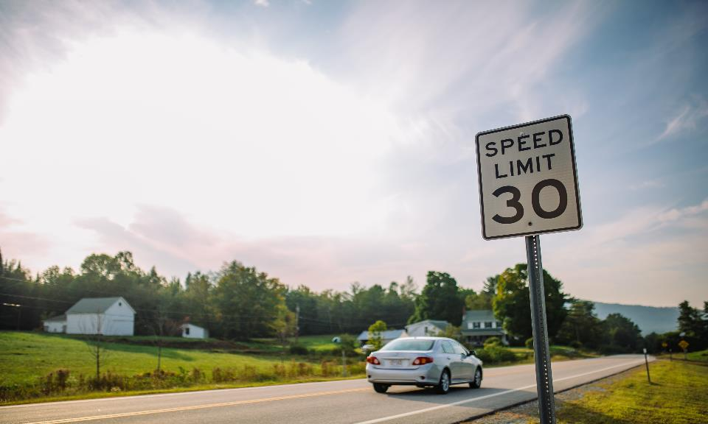
Notes:
Speaker Notes – Reduce your speed. Speeding makes crashes more likely – and more likely to be deadly. Even low rates of speed can kill or seriously injure you, so slowing down when sharing the road with others – particularly pedestrians and bicyclists – is critical. Consider this, if you were driving at 40 mph and hit a pedestrian, his or her chances of survival would be one in ten. Reduce your speed by 10 mph and the survival rate increases 50 percent. And if you reduce your speed even more to 20 mph, that person’s survival rate climbs to 90 percent. The next time you see a pedestrian through your windshield, image he or she is someone you care about and slow down below the posted speed limit.

Slide 11
Notes:
Speaker Notes – Get plenty of sleep and take regular breaks while driving to avoid fatigue. Contrary to what you might think, sleep isn’t overrated. Experts say we should devote one third of our day to catching those all important Zzzzz’s. But research confirms we aren’t getting enough sleep. According to the U.S. Centers for Disease Control, more than one-third of adults sleep less than seven hours a day. That means that nearly 83.6 million sleep-deprived people are in the workplace, at school and on the road. So how much sleep are you getting?

Slide 12
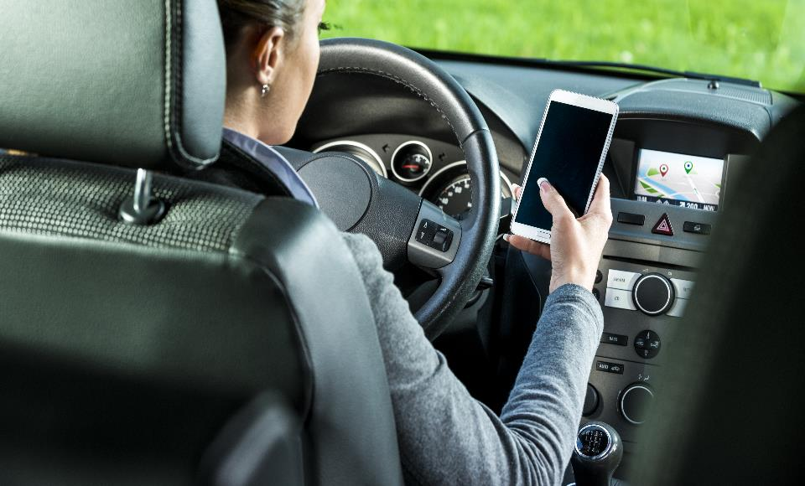
Notes:
Speaker Notes – Never use a cell phone behind the wheel, even hands-free. Keeping both hands on the wheel is important, but these devices and in-vehicle technology also prompt you to take your mind off of driving and your eyes off the road. Keeping your head up and putting your phone down applies not only when you’re driving, but walking and bicycling, too. Researchers found that pedestrians who are using their cell phones – that includes listening to music – take longer to cross the street and are involved in more near misses than their non-phone using counterparts. Ask yourself is that call or text really worth putting yourself or others at risk?

Slide 13
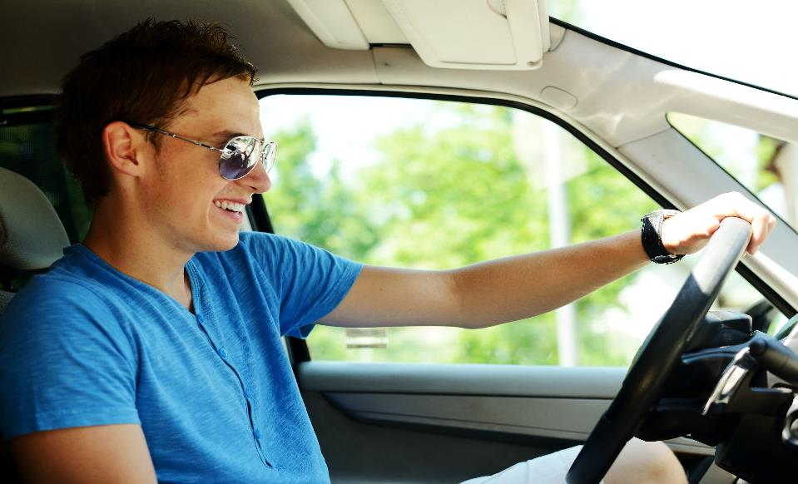
Notes:
NOTE: Highlight provisions in your state’s novice driver law as part of the narrative.
Speaker Notes – Stay engaged in teens’ driving habits, even if you don’t have a teen in your household. Teens are three times more likely to crash than an experienced driver, so they need coaching and monitoring. Every state has a novice driver law – ours is called ________ -- that is designed to address those things that cause the greatest risk for new drivers – distractions caused by passengers and cell phones and late night driving. (Reference other provisions here.) Learn about our state’s law and engage the teens and parents in your circle of influence in a discussion about its importance and effectiveness. Research has shown that novice driver laws reduce teen crashes by as much as 40 percent.

Slide 14
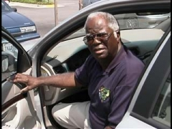
Notes:
Note for CTS -- You’ll need to find a photo with a higher resolution; this is here as a place holder.
Speaker Notes – Unlike teens, older drivers have significant experience behind the wheel. But when they’re involved in a crash, they are often hurt more seriously than younger drivers. Driving is a complicated task that requires you to see and hear clearly; pay close attention to other cars, traffic signs and signals and pedestrians and bicyclists; and react quickly. Age-related declines in vision, hearing and mobility as well as health conditions and medications can affect our driving skills. In fact, older drivers are more likely than younger ones to have trouble making left turns, changing lanes and navigating through intersections. With older drivers representing the fastest-growing segment of motorists – a quarter of all drivers will be over 65 by 2025 – monitoring our own driving skills as well as those of family members as we and/or they age is critical. There are online tools and community-based resources to help seniors continue driving for as long as safely possible, but it’s also a good idea to begin exploring alternate transportation such as mass transit, on-demand services like Uber and Lyft, and paratransit well in advance of any decision to give up the keys. Remaining mobile even after no longer driving is the key to independence.

Slide 15
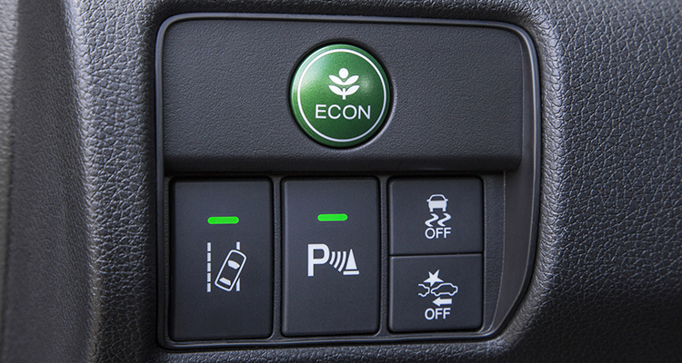
MyCarDoesWhat.org
Notes:
NOTE: There are short video clips online at https://mycardoeswhat.org that could be used to supplement this slide.
Speaker Notes – So how many of you have electronic stability control, side curtain airbags, or lane departure warning in your vehicle? How many of you have no clue if your vehicle is equipped with these safety systems or others? Cars have become safer, there’s no doubt about it. But imagine how many lives could be saved, if we learned about our vehicle’s safety systems and how to use them. The best place to start is your vehicle owner’s manual – sure it’s not the most exciting read. You can also check out the website MyCarDoesWhat.org, which uses videos, graphics and animation to explain how your car’s safety systems work.

Slide 16
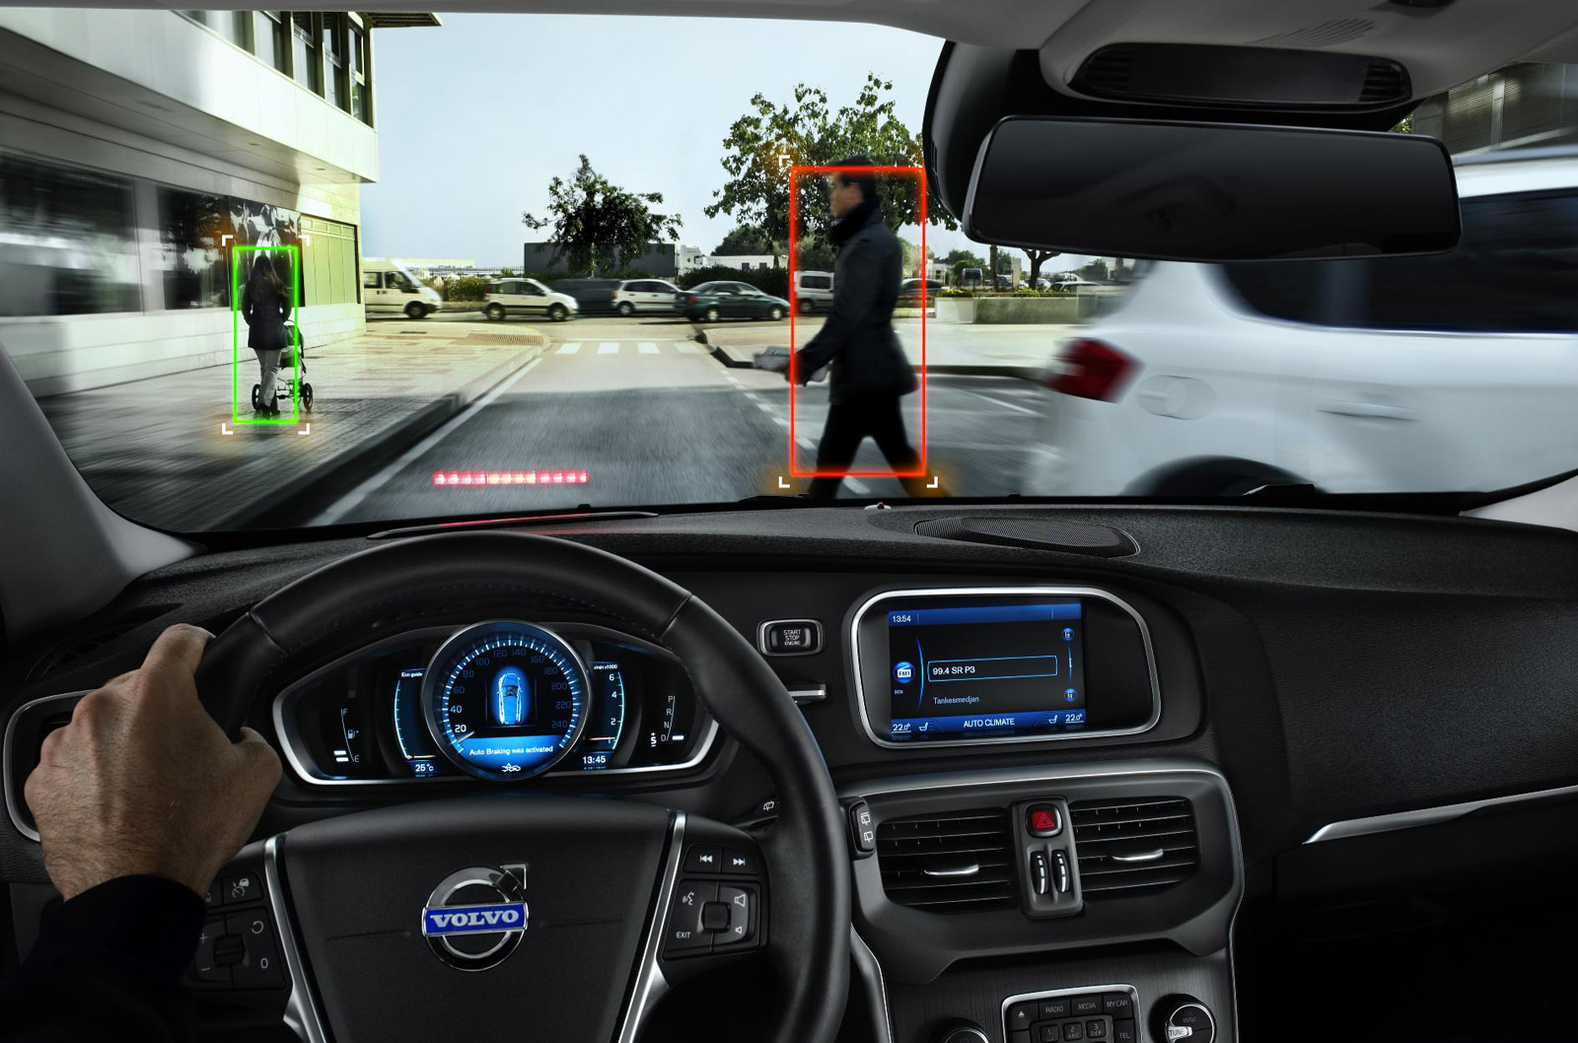
Notes:
Speaker Notes – While all of the safety features in your car are critical, one that’s getting a lot of attention is automatic braking. Recently, twenty automakers pledged to make it a standard safety feature by 2022. It uses cameras, radar and other sensors to determine if a crash is imminent and automatically apply the brakes. The Insurance Institute for Highway Safety said that implementing this across all makes and models will save thousands of lives and prevent millions of crashes. Not all safety systems, however, are created equal nor are they replacement for a safe, focused driver. That’s why learning what each system does and doesn’t do is critical. For example, if your car is equipped with Forward Collision Mitigation or FMC, it will detect how far and fast the vehicle in front of you may be moving and automatically apply the brakes if you don’t respond. On the other hand, if your car has Forward Collision Warning or FCW, it will alert you when your vehicle is about to collide with another, but it won’t automatically apply the brakes. Investing the time in getting to know exactly how your car’s safety systems work, including what the in-dash board warnings or cues means, could just save your life.

Slide 17
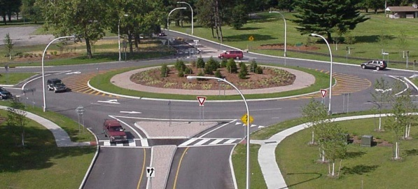
Notes:
Speaker Notes – Roadways like cars are also employing the latest safety features. Do you know what this is? Some people call them traffic circles, others roundabouts. Regardless of what you call them, what you need to know is that they’re safer than traditional stop sign or signal-controlled intersections. In fact, they reduce crashes where people are seriously hurt or killed by as much 82 percent when compared to conventional intersections. That’s because a roundabout reduces the number and severity of conflict points and forces people to slow down. Which begs the question do you know who has the right of way in a roundabout? (Ask for audience input.) As you approach the roundabout, you have to look to your left and yield to drivers already in the roundabout. In a multi-lane roundabout, you must yield to both lanes of traffic. Once a gap in traffic appears, you merge into the roundabout and proceed to your exit. Be sure to look for pedestrians and use your turn signal before you exit.

Slide 18
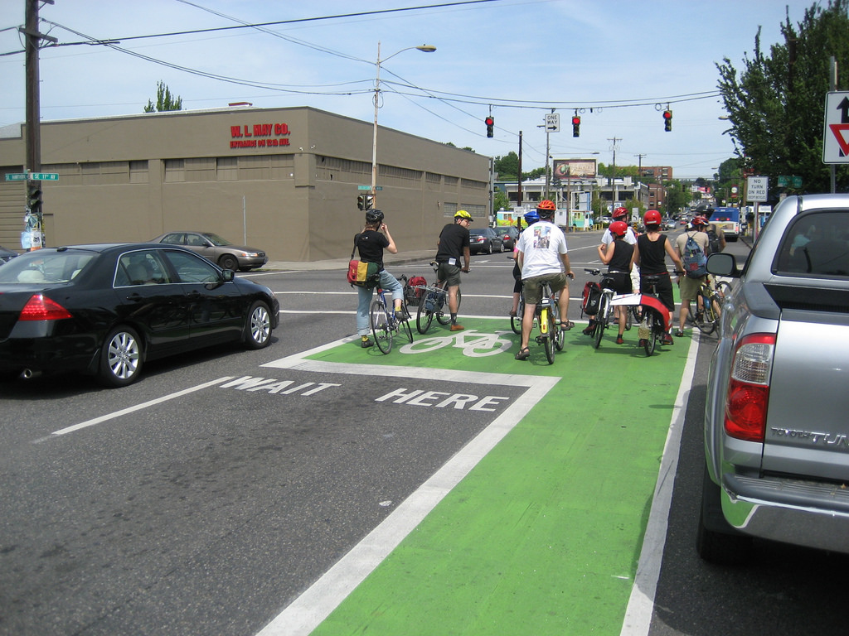
Notes:
NOTE: The “How to Use a Bike Box” short video produced by Street Films, http://www.streetfilms.org/how-to-use-a-bike-box/, could be shown to illustrate how a bike box works.
Speaker Notes – Here’s one more example of a roadway safety feature, that you may not be familiar. Does anyone have a guess as to what this is? It’s a bike box, a space in the intersection that allows a bicyclist to position himself ahead of vehicle traffic at an intersection. Typically it’s painted a difference color, this one is green. Motor vehicle traffic at an intersection with a bike box has to stop a few feet farther back than normal to give legal space to cyclists. Here’s why this roadway safety feature is important, crashes between bicyclists and vehicle drivers usually come in two forms. The left-hand turn, where a vehicle turns directly into the path of a cyclist going in the opposite direction. The other is the right-hook, where a vehicle passes a cyclist riding in the bike lane or right shoulder going the same direction and then immediately makes a right turn into the cyclist’s path. The second one – the right-hook – is minimized by the bike box because drivers can clearly see riders ahead and will have to wait for them to advance before moving.

Slide 19
towardzerodeaths.org
Notes:
NOTE: The national TZD logo and website URL may be substituted with a state or local program brand if preferred.
Speaker Notes – Before I close, I encourage you to visit the (state)’s Toward Zero Death’s website (or state or local program website) to learn more about the work that’s being done to get us to zero. I’m counting on you to be a zero hero and focus on addressing any unsafe behaviors you may engage in as well as learn about your vehicle and roadway safety featrues so you put them to work for you. I also invite you to consider how you can help deliver this message in your workplace, at your child’s school, or in your community. Remember, it takes an army to get to zero!

Slide 20
QUESTIONS?
Name
Contact Information

