Slide 1
NCHRP 20-126(01)
PROGRAMMATIC ISSUES OF FUTURE SYSTEM PERFORMANCE
Project Summary
May 2022

Slide 2
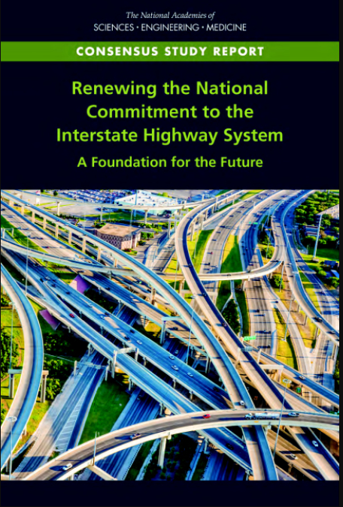
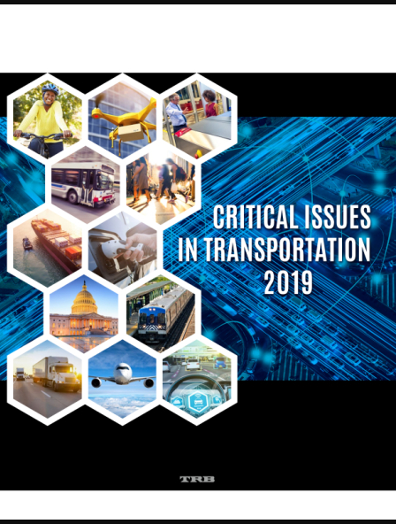
Purpose of Research
Develop a unified framework to understand and address the issues raised in:
Renewing the National Commitment to the Interstate Highway System: A Foundation for the Future (CIHS)
Critical Issues in Transportation 2019 (CIT2019)
Characterize the threats and opportunities posed to transportation system performance over the next 10–20 years
Identify:
Priority research needs
A method to assist state transportation agencies in addressing issues, threats, and opportunities in their programmatic initiatives

Slide 3
Research Approach
Analysis and initial research questions
Unified Framework: 6 Interest Areas
Literature review
Listening sessions
Analytical procedure, survey and workshop
State DOT self-assessment
  CIHS
  CIT2019
  Transformational Technologies
  System Performance and Condition
  System Use
  System Impacts and Externalities
  Organizational Capacity
  Equity
  Research gaps
  Threats and opportunities
  White papers by Interest Area
  From: 165 refined research gaps
  To: Shortlist of 18
  Research Problem Statements
  Interactive Self-Assessment Tool
  Guidebook
Notes:
Note: shaded text = key products of the project
Conducted crosswalk of CIHS and CIT2019 to identify issues and an initial set of research questions
Developed “unified framework” consisting of 6 interest areas and key research questions raised by the reports
Conducted literature review on the contents of the unified framework (nearly 300 publications)
Held listening sessions organized around unified framework (15 sessions with more than 50 transportation SMEs)
Identified research gaps (augmenting the initial unified framework questions) and threats and opportunities from literature review and listening sessions
Documented the findings of the above steps in 6 White Papers by interest area
Developed a list of 165 refined research gaps
Developed and applied an analytical procedure to reduce 165 gaps to longlist of 43 for consideration in a survey
Developed 18 draft research problems statements based on the priorities revealed by the survey and validated the RPS at a virtual workshop with transportation SMEs
Adapted and applied the analytical procedure to develop a self-assessment tool built on an offline web-based platform and designed to be used in a facilitated workshop
Prepared guidebook to accompany tool

Slide 4
Final Products
  Final Report
  Implementation Plan
  Interactive Self-Assessment Tool
  Guidebook
Notes:
Note that the three major products are inter-related. The final report describes the research approach and the major findings, including the recommended research problem statements. The Guidebook for the self-assessment process/tool is based on the critical issues reported in the final report, as well as the identification of typical strategies for considering these issues. The implementation plan presents strategies for implementing both the research problem statements and the self-assessment process/tool.

Slide 5
Unified Framework: Interest Areas
Transformational Technologies – Focus on vehicle automation technologies for passenger autos and freight, application-based new mobility services (e.g., connected and automated vehicles [AVs], ride sharing services), electric vehicles (EVs) and system electrification, drones, robotics and artificial intelligence in highway construction, remote and ubiquitous sensors, and telework options.
System Performance and Condition – Focus on system management strategies relating to performance and asset condition. This could relate to design and construction challenges and the ability to project future performance given travel demands or future conditions given asset condition parameters.
System Use – Focus on the changing characteristics of the demand for transportation and its relationship to needed infrastructure/services, including analysis tools and models for predicting future demand given different parameters.

Slide 6
Unified Framework: Interest Areas (cont.)
System Impacts and Externalities – Focus on the impacts of transportation system construction and operations on the system and on society. This category also covers the potential impacts of external stresses on the performance and condition of the transportation system (e.g., climate change-related vulnerabilities) and methods and tools to predict future impacts due to changes in the transportation system and in travel demand.
Organizational Capacity and Governance – Focus on the workforce and analysis capabilities needed by agencies to address current and future challenges, which could include decision support for the areas listed above (e.g., system performance and condition, system use, and system impacts).
Equity – Focus on population groups that are disproportionally affected by transportation system design, operations, and finance, including older adults, people with disabilities, low-income individuals, and minority groups. Issues could include transportation availability, access, affordability, and effectiveness of transportation operations and service.

Slide 7
Literature Review and Listening Sessions Outcomes: Research Gaps
Interest Area | Subtopics | Research Gaps
Transformational Technologies | All transformational technologies | 57
System Performance and Condition | Performance management | 13
 | System resilience | 7
 | Data management | 5
System Use | Multimodal connectivity and system integration | 13
 | Socio-demographic factors and land use | 11
System Impacts and Externalities | Land use policy and planning | 7
 | Mitigating negative social outcomes | 1
 | Sustainability and GHG reduction | 14
Organizational Capacity and Governance | Multi-jurisdictional partnerships | 7
 | Organizational capacity | 11
Equity | Equity in transportation | 19
 | Total | 165
Notes:
Six white papers (Appendix B of the Final Report) summarize the pertinent findings of analyzing the CIHS and CIT2019 reports, the literature review, and the listening sessions, all organized around the unified framework. Each white paper assesses the threats to and opportunities for system performance and agency effectiveness within the unified framework’s six interest areas. The white papers conclude with a set of research gaps that reflect an evolution of the original key research questions posed by the unified framework to include the findings of the literature review and listening sessions. This set of 165 “Refined Research Gaps” is the outcome of analyzing if current and developing research and activities are adequately addressing the threats and opportunities. In the table shown, subtopics are organizational categories that helped the research team in the research gap refinement process. These “subtopics” evolved into a set of 4 to 6 “critical issues” per interest area. While there is variability in the research gaps by subtopic, there is much crossover among them.

Slide 8
Analytical Procedure
Notes:
The research team developed a simple analytical procedure to organize and prioritize the full set of 165 refined research gaps presented in the white papers. This analytical procedure allowed the research team to:
Further refine the full set of research gaps into a more manageable “longlist” of 30–50 research gaps (ultimately 43) from which a set of proposed RPS was identified through a survey and workshop with SMEs who participated in the listening sessions.
Structure components of a self-assessment tool designed to aid STAs to identify and prioritize critical issues and associated threats and opportunities that characterize the same future transportation challenges embodied by the research gaps. The tool also facilitates the development of strategies to address these challenges in agencies’ programmatic initiatives.

Slide 9
Research Problem Statements
Transformational Technologies | 1. Perspectives and needs of disadvantaged communities, groups, or organizations on connected and/or automated vehicles (CAVs) and CAV-based services or applications (e.g., AV shuttle routes/access, ADA needs)
 | 2. Prioritizing the implications of evolving to an electric transportation system future and developing responsive strategies
 | 3. Public policy and regulatory needs for safe and effective automated truck operations
System Performance and Condition | 4. Identifying the best data sources, data systems, tools, and methodologies to quantify positive and negative impacts of congestion pricing
 | 5. Quantifying the relationship between transportation options/services (including ridesharing, public transit, on-demand transportation, and nonmotorized transportation) and public health outcomes, and informing related policy and investment decisions
 | 6. Effective practices on integrating dynamic risk management and resilience considerations in transportation asset management business processes
 | 7. Identifying opportunities for state DOTs to advance system performance objectives by partnering with private entities that collect or aggregate system mapping and system performance data
Notes:
A primary product of the study is 18 RPS proposed for consideration as future NCHRP research projects or other research initiatives. These RPS are a product of a series of analyses beginning with the review of the CIHS and CIT2019 reports and concluding with a second round of engagement with transportation SMEs to prioritize and refine them (survey and workshop). The analytical procedure was used to narrow down from 165 research gaps to these 18 RPS. They are presented in standard NCHRP RPS format.

Slide 10
Research Problem Statements (cont.)
System Use | 8. Short- and long-term transportation impacts of the Covid-19 pandemic and similar public health emergencies: Lessons learned for preparing transportation agencies for future disruptions
 | 9. Identifying and assessing the relative benefits and costs of transportation investments in the context of what urban/suburban/rural areas require in terms of high quality of life and equity
System Impact and Externalities | 10. Transportation infrastructure owner-operator (IOO) actions supporting advancements in the renewable energy sector and reductions in greenhouse gases (GHG) that complement policies to shift vehicle fleets to electric vehicles (EVs)
 | 11. Identifying energy infrastructure needs for the freight transportation sector to support sustainability and GHG emission reductions
 | 12. Operationalizing equity and social vulnerability considerations in system rightsizing policies and decisions
Notes:
18 RPS are proposed for consideration as future NCHRP research projects or other research initiatives. These RPS are a product of a series of analyses beginning with the review of the CIHS and CIT2019 reports and concluding with a second round of engagement with transportation SMEs to prioritize and refine them (survey and workshop). The analytical procedure was used to narrow down from 165 research gaps to these 18 RPS. They are presented in standard NCHRP RPS format.

Slide 11
Research Problem Statements (cont.)
Organizational Capacity and Governance | 13. Preparing agency workforce through education and retraining in light of an increased role of automation and technology
 | 14. Strategies to address issues of equity and diversity among underrepresented or disadvantaged groups in a transportation agency, and how to evaluate them for effectiveness
Equity | 15. Quantifying transportation-related equity implications, including the consequences of the introduction of transformational technologies, to different population groups and communities (e.g., rural, suburban, and urban regions)
 | 16. Best practices for public engagement of economically and socially disadvantaged groups in transportation planning and through project development given lessons from Covid-19
 | 17. Incorporating equity considerations into performance-based planning and decision-making in transportation agencies
 | 18. Challenges facing mobility-impaired and technologically-challenged population groups in accessing app-based services
Notes:
18 RPS are proposed for consideration as future NCHRP research projects or other research initiatives. These RPS are a product of a series of analyses beginning with the review of the CIHS and CIT2019 reports and concluding with a second round of engagement with transportation SMEs to prioritize and refine them (survey and workshop). The analytical procedure was used to narrow down from 165 research gaps to these 18 RPS. They are presented in standard NCHRP RPS format.

Slide 12
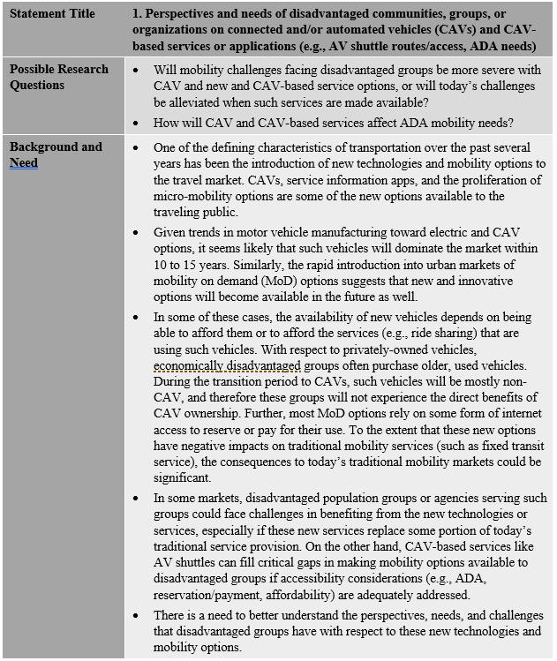
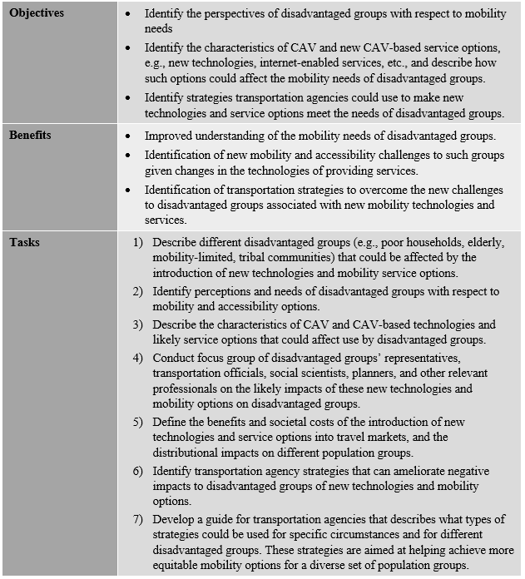
Example Research Problem Statement
Notes:
RPS follow the NCHRP RPS format: Title, Possible Research Questions, Background and Need, Objectives, Benefits, Tasks

Slide 13
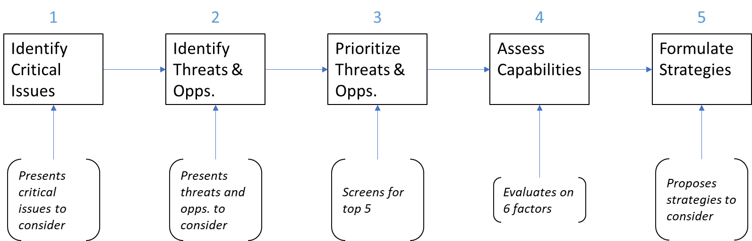
State Transportation Agency Self-Assessment Tool
Notes:
Another product of the project is an interactive self-assessment tool based on the analytical procedure that STAs can use to plan for the future transportation challenges embodied by the research gaps identified by this project. The purpose of the self-assessment process is to:
Identify priority future threats and opportunities as they relate to programmatic issues affecting transportation system performance.
Help officials understand what their agency is capable of doing to address these threats and opportunities.
Identify where new or modified strategies could be adopted and actions taken to enhance agency efforts.
Recommend steps to implement these actions.
The tool is not overly prescriptive and offers state transportation officials flexibility in the format of the self-assessment exercise, the issues they wish to explore, and the outcomes of the process in terms of action planning and strategy development. It is designed to be used in a facilitated workshop environment with a multidisciplinary set of agency executives and managers.
A Guidebook accompanies the tool and explains its applications and how to use it within an agency, details each steps with illustrations, and provides and example.
The steps in the self-assessment process are:
Identify critical issues of interest within one or more interest area. (Note: The tool permits assessment of only one interest area at a time.)
Identify threats and opportunities from those built into the tool or identified by the user.
Prioritize and screen the top five threats and top five opportunities for assessment.
Assess agency capabilities to address threats and opportunities.
Identify strategies and actions and implementation steps to improve agency capabilities and determine agency posture to the threats and opportunities.

Slide 14
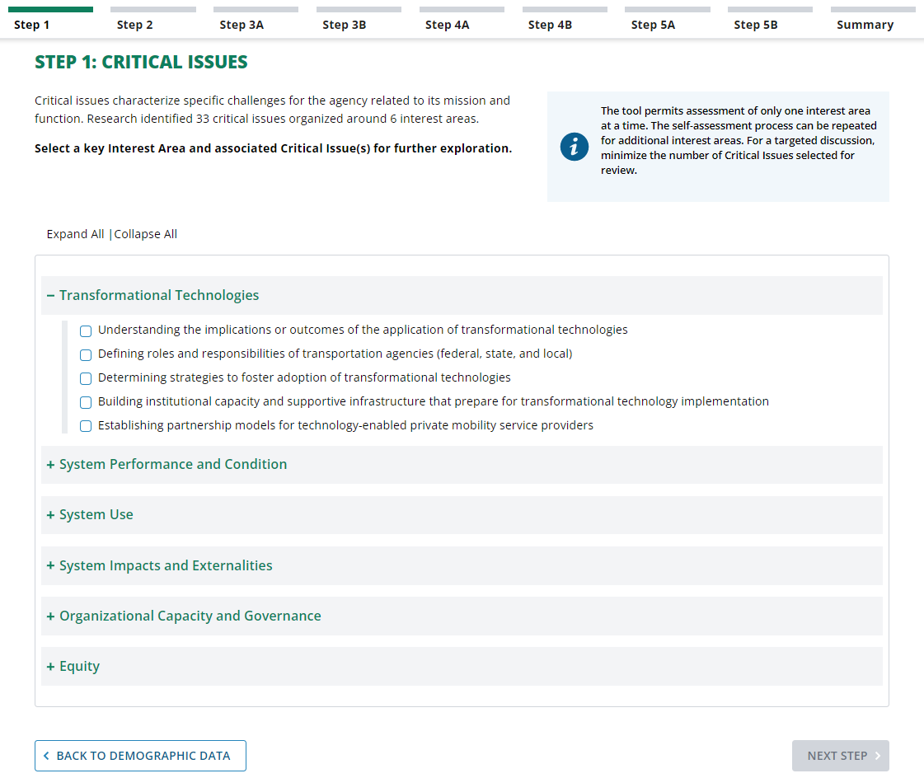
Self-Assessment Tool Illustrations: Step 1
Notes:
Step 1: Selection of interest area and critical issues

Slide 15
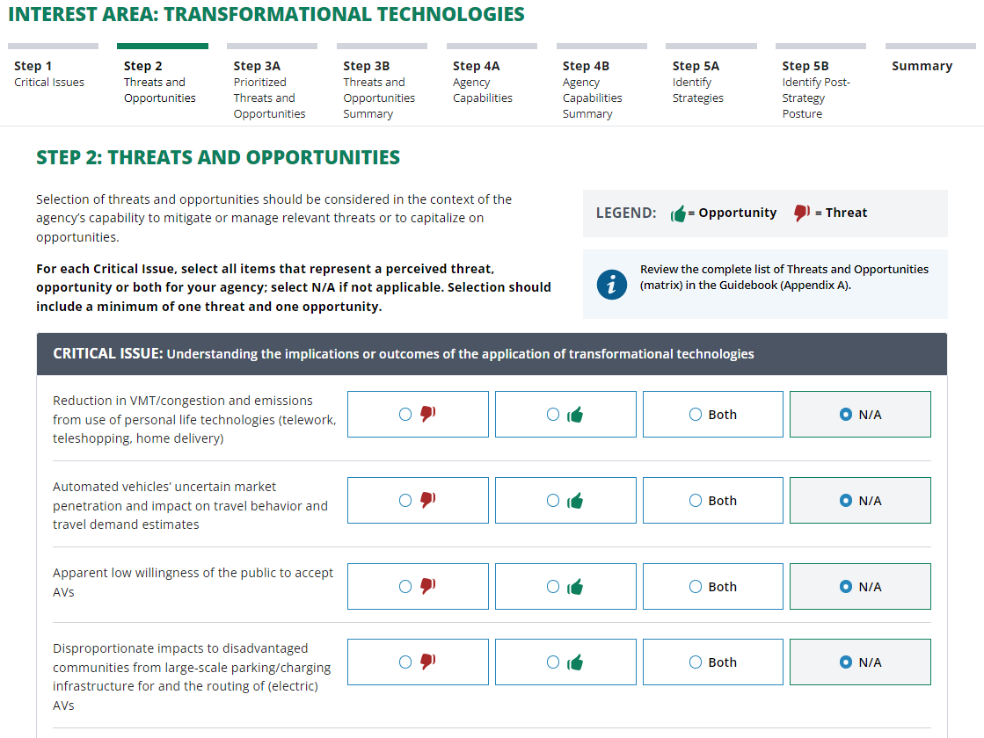
Self-Assessment Tool Illustrations: Step 2
Notes:
Step 2: Selection of threats and opportunities for each critical issue

Slide 16
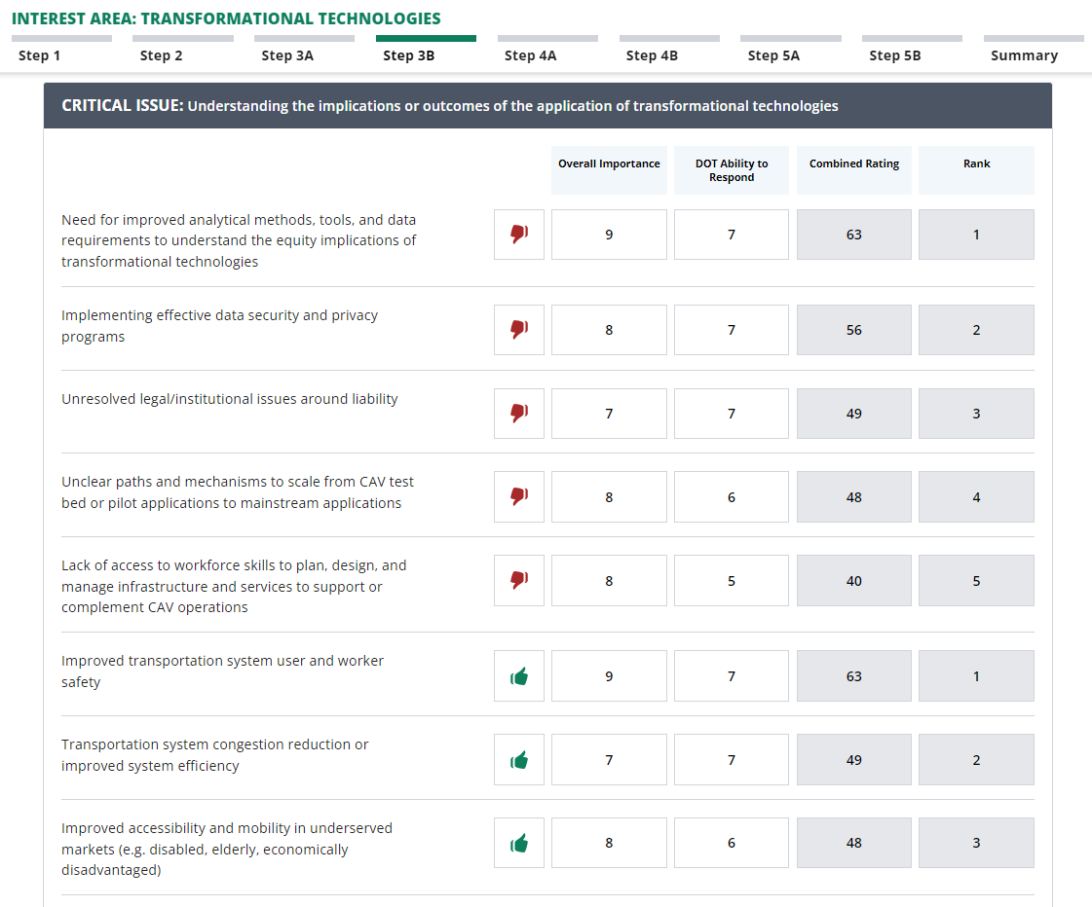
Self-Assessment Tool Illustrations: Step 3
Notes:
Step 3: Prioritizing threats and opportunities

Slide 17
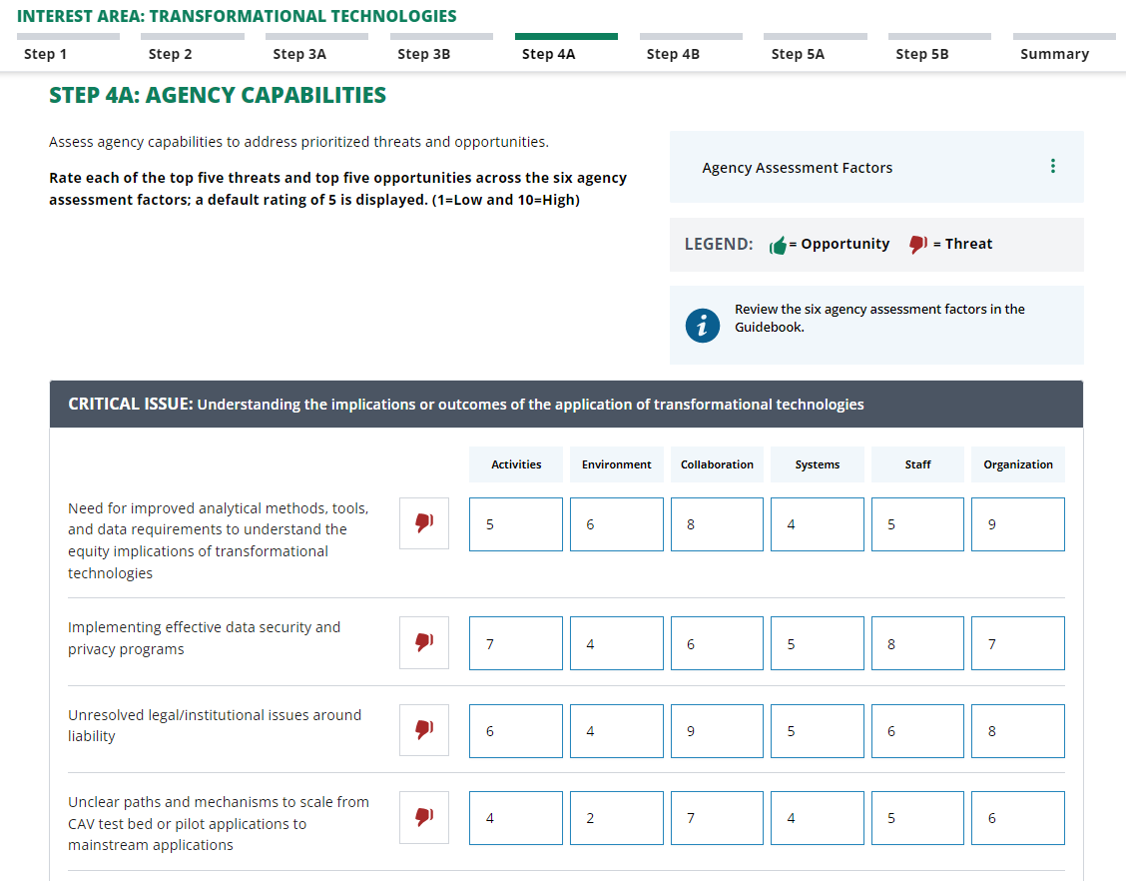
Self-Assessment Tool Illustrations: Step 4
Assessment Factors
Activities: Awareness, understanding and relevant activities underway or accomplished
Environment: Legal, regulatory, and policy environment
Collaboration: External collaboration (interagency, academic, and private sector)
Systems: Supportive systems and funding (processes, tools/models, internal functions, budgets)
Staff: Staff (champions, quantity, knowledge, skills and abilities [KSAs])
Organization: Culture and organization (leadership support, organizational barriers)
Notes:
Step 4: Assessment of agency capabilities

Slide 18
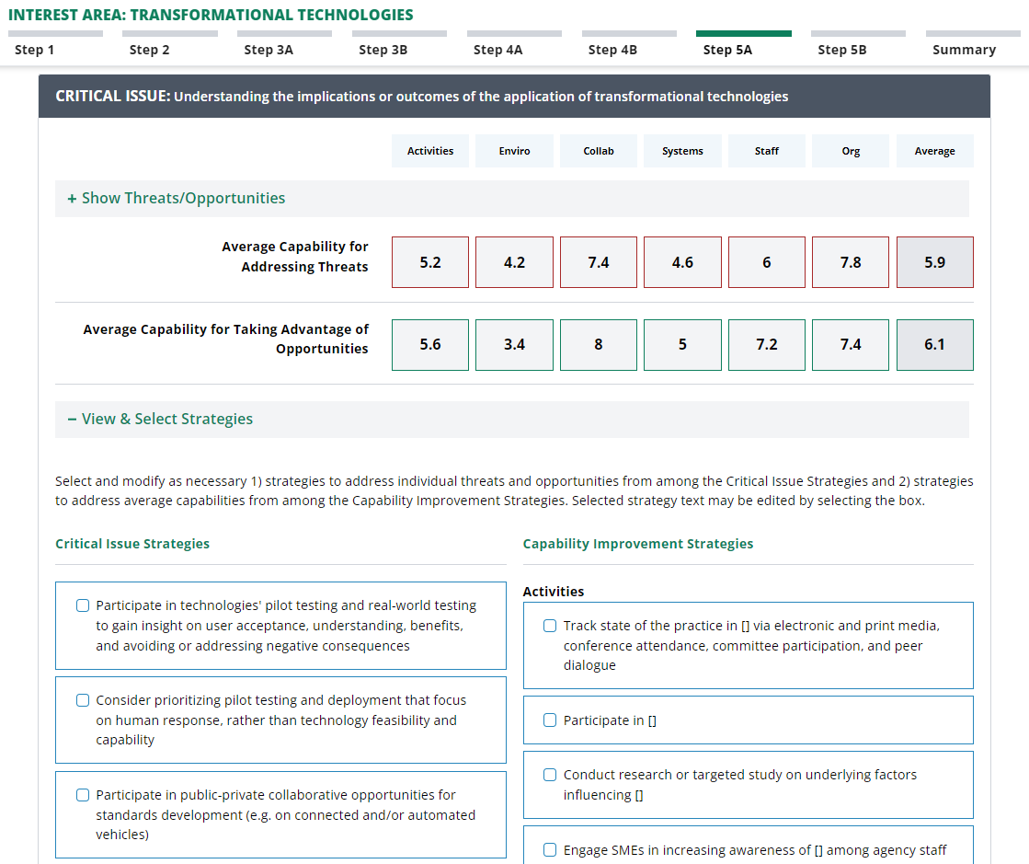
Self-Assessment Tool Illustrations: Step 5
Notes:
Step 5: Selection of strategies to respond to critical issues (threats and opportunities) and need for capability improvements

Slide 19
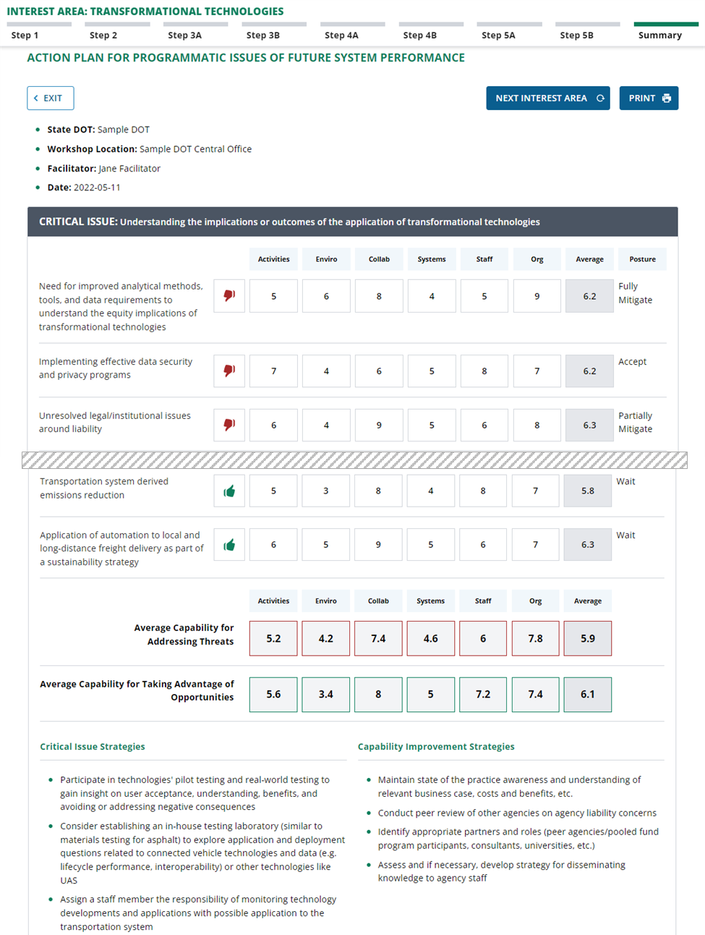
Self-Assessment Tool Illustrations: Summary Action Plan
Notes:
All information is presented in a summary at the end and can form the basis of an action plan

Slide 20
Recommendations
Advance the proposed set of 18 Research Problem Statements as the foundation for a new research series (NCHRP 20-126) to address the priority research gaps.
Disseminate and encourage use of the self-assessment tool among STAs to aid in their strategic planning and programmatic initiatives to address the critical issues, threats, and opportunities related to system performance and agency effectiveness.
Notes:
RPS: The creation of such a research series would require the approval of the American Association of State Highway and Transportation Officials (AASHTO) Special Committee on Research and Innovation (R&I), which oversees NCHRP; the TRB Executive Committee; and the AASHTO Board of Directors. The Committee on R&I consists of representatives of state DOTs and FHWA. The steps to implementing this research series are laid out in this project’s Implementation Plan. The NCHRP Project 20-126(01) panel should play a lead role in catalyzing this process by laying the groundwork within the AASHTO research structure and with individual state DOTs or AASHTO committees.
In addition to STAs, other organizations may have compelling interest in the RPS and the results of this research. Such organizations include the Association of Metropolitan Planning Organizations (AMPO), National Association of Regional Councils (NARC), American Public Transportation Association (APTA), Council of University Transportation Centers (CUTC), as well as FHWA and the Federal Transit Administration. The project panel could ensure that the RPS are sent to the appropriate organizations for consideration and dissemination among their members.
Tool: Efforts need to be made to discuss the availability of the tool, provide exposure to how it can be used, and overview the types of strategies that could be considered by transportation officials with respect to specific types of issues. Initiatives to support this recommendation include:
Cultivating the active engagement of a core group of state DOT executives and career agency leaders who can become advocates for analyzing policy issues and in identifying actions for best positioning their agency in meeting the challenges.
Highlighting leading states via peer exchanges, newsletter articles, and national recognition awards (from AASHTO and FHWA) to identify which states are leading examples of applying the tool. Identifying these leaders requires the commitment of agencies and organizations that support peer exchanges and a presence at the national level (e.g., AASHTO, FHWA, and TRB).
Implementing a system for providing updates on the latest information on the policy issues, some of which would occur via the proposed research series.

