Slide 1
NCHRP 03-132
Guidance for Safe and Effective Temporary Traffic Control for Two-Lane Roadways
DRAFT
SUBJECT TO REVISION BASED ON PANEL FEEDBACK AND EDITIORIAL REVIEW OF DRAFT RESEARCH REPORT
Electronic Presentation of Research Results

Slide 2
Research Team
LuAnn Theiss, TTI
Gerald Ullman, TTI
Geza Pesti, TTI
Jon Jackels, SRF Consulting
This work was sponsored by AASHTO, in cooperation with FHWA, and was conducted in the NCHRP.
This document, not released for publication, is furnished only for review to members of or participants in the work of the NCHRP. This document is to be regarded as fully privileged, and dissemination of the information included herein must be approved by NCHRP.
This is an uncorrected draft as submitted by the contractor. The opinions and conclusions expressed or implied herein are those of the contractor. They are not necessarily those of the Transportation Research Board, the Academies, or the program sponsors.

Slide 3
Background
Mobile operations on two-lane two-way (2L2W) roads present unique challenges.
Communicating conditions can reduce undesirable behaviors by motorists.
Solutions are needed to improve safety and operations.
Notes:
Mobile operations on 2L2W roads present unique challenges. This is primarily due to the variable conditions (such as number of vehicles in the work convoy, travel speed of the work convoy, posted speed, roadway geometry, time of day, weather, traffic volume, etc.). A single typical application in the MUTCD does not address all of these conditions.
Motorists often make poor decisions around 2L2W mobile operations. This includes speeding, cutting between vehicles, driving on wet paint, and making unsafe passing maneuvers. Improving communication of the conditions may help alleviate chances for these poor decisions.
This research project is intended to find solutions.

Slide 4
Research Objectives
The objective of this research is to develop guidance to enhance safety and effectiveness of mobile operations on two-lane, two-way roadways under variable conditions.
Includes all aspects of mobile operations from planning (when to use mobile operations vs. other methods for lane closures) through implementation, and be useable by any entity involved in mobile operations.

Slide 5
Work Tasks
Phase I work plan
State-of-the-practice documentation
Analysis of potential solutions
Interim report & phase II work plan
Evaluations
Guidance
Reports
Notes:
The research project consisted of seven tasks over two phases. We will cover the research outcomes in detail during this presentation. Tasks in bold are covered in detail in this presentation.

Slide 6
State of the Practice Documentatiion
Task 2

Slide 7
State of the Practice
Reviewed national and state guidance for conducting mobile operations on two-lane roads
Documentation of 71 state transportation agency typical applications for a variety of work activities, including:
Paint striping
Herbicide spraying
Patching/chip sealing
Raised pavement marker installation
Strip sealing
Edge rut repair
Conduct Focus Group Discussions with Practitioners

Slide 8
Definitions for Mobile Operations
Many agencies have included maximum allowable stopping period
Many agencies use 15 minutes
Some as low as 5 minutes
Some base their definition on work progression speed
3 mph
moves at least the decision sight distance every 15 minutes
moves at least 100 feet every 15 minutes
Some prohibit mobile operations if workers are on foot
State-specific typical applications define additional criteria for performing mobile operations

Slide 9
Variations in Typical Applications
Number of work vehicles (1 to 5)
Length of convoy (100 ft to 1500 ft)
Use of arrow boards in caution mode
Use of changeable message signs
Use of static warning signs
Use of traffic cones (to reduce tracking of paint on edgelines or centerlines)
Methods to control driver passing
Self-regulated (uncontrolled) passing
Passing prohibited
Right shoulder passing permitted
Passing controlled by flaggers (various strategies)

Slide 10
Focus Group Discussions
Goals
Identify work activities performed on two-lane roads
Discuss temporary traffic control (TTC) strategies used for work activities
Document any decision-making factors considered
Identify worker challenges with deploying selected TTC
Document suggestions for improving safety and effectiveness of work operations.
Locations
Montana (5 focus groups; 27 participants)
Ohio (3 focus groups; 13 participants)
Virginia (listening session at National Work Zone Management Conference; 44 participants)
Texas (listening session at American Traffic Safety Services Association Texas Chapter meeting; 44 participants)

Slide 11
Work Activities Identified
Berming/shoulder work
Chip sealing
Core drilling
Crack sealing
Debris removal
Delineator maintenance
Guardrail work
Herbicide spraying
Litter pickup
RPM installation/replacement
Sign installation/maintenance
Snow/ice activities
Striping
Sweeping
Tree trimming
TTC setup & removal

Slide 12
Factors Affecting TTC Decisions
Land use
Terrain
Sight distance
Speed limit
Pavement width
Shoulder availability
Traffic volume & mix
Side roads/driveways
Time of day
Season/weather conditions
Location of work
Progression of work
Length of required work space
Opportunities for passing
Workers on foot
Agency policies
Foreman’s institutional knowledge
Observation of traffic

Slide 13
Worker Challenges
Unpredictable driver behavior
Disobeying DO NOT PASS signs, passing errors, distracted/inattentive, impaired, speeding, tailgating, etc.)
Communicating passing instructions to drivers
Managing side road traffic
Determining maximum acceptable distance from stationary signs
Insufficient staffing and equipment resources
Managing length of convoy

Slide 14
Summary
Mobile operation characteristics (convoy length, speed, and number of vehicles to pass) can be challenging for drivers to estimate.
There are many different types of work activities performed as mobile operations.
TTC decisions are typically based on knowledge of and past experiences on each roadway.
These TTC decisions consider many different factors, so it is a complex process.

Slide 15
Analysis of Potential Solutions
Task 4

Slide 16
Root Cause Analysis
Step 1: Problem Investigation and Identification
Step 2: Problem Organization and Mapping
Step 3: Analysis
Step 4: Select Solutions
Step 5: Check Solutions
What are the problem(s)?
Why do they occur?
What are the consequences?
What are the solutions?

Slide 17
Problem Investigation and Identification
Focus groups identified three common problematic driver behaviors:
Disobeying DO NOT PASS signs
Cutting between work vehicles
Being unaware of the presence of the work operation
Step 1

Slide 18
Problem 1. Disobeying DO NOT PASS Signs
Why do these events occur?
Intentional
Convoy is blocking their destination (driveway, exit, or cross-street turn lane)
Impatient driver wants to pass, even incrementally
Unintentional
Driver does not notice sign
Driver confused as to whether the sign applies at all times (i.e. when sufficient sight distance is available)
Step 2

Slide 19
Problem 2. Cutting Between Work Vehicles
Why do these events occur?
Intentional
Convoy is blocking their destination (driveway, exit, or cross-street turn lane)
Impatient driver wants to pass, even incrementally
Unintentional
Driver confused after entering from side road
Driver uncertainty of convoy length or number of vehicles to pass
Driver uncertainty if incremental passing is permitted
Queue of vehicles follows the first vehicle that passes
Driver unaware of wet paint
Step 2

Slide 20
Problem 3. Being Unaware of Presence of Work Operation
Why do these events occur?
Intentional
Distracted/inattentive driver
Impaired driver
Speeding
Tailgating
Unintentional
Warning signs missing or too far away
Warning signs not credible
Failure to recognize closing speed
Insufficient sign distance for driver response
Step 2

Slide 21
Analysis
What are the consequences?
Problem 1. Disobeying DO NOT PASS signs
Collision with oncoming traffic
Secondary collision with workers or equipment
Emergency/evasive maneuver may result in convoy intrusion
Tracking of wet paint
Problem 2. Cutting between work vehicles
Striking workers or equipment
Tracking of wet paint
Problem 3. Being unaware of the presence of the work operation
Driver impacts trailing vehicle or end of queue
Emergency/evasive maneuver may result in other crash
Striking workers or equipment
Step 3

Slide 22
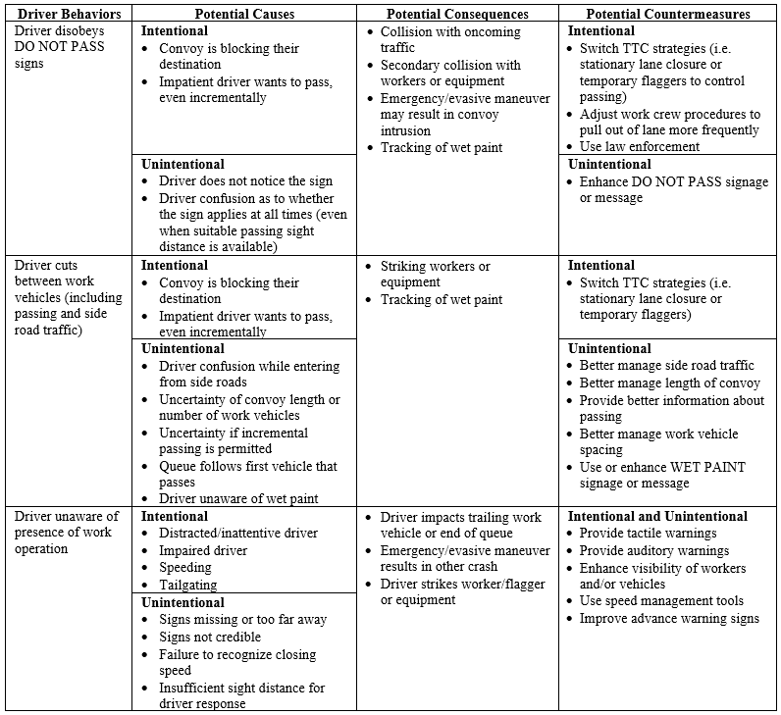
Select Solutions
What are the solutions?
Countermeasures were identified and tabulated
Specific strategies for each countermeasure are documented in Appendix B of report
Step 4

Slide 23
Select Solutions
Project panel considered research needs for each strategy
Many already studied
Others were simple enhancements to established practices
The most significant research need identified was more definitive criteria on when a work operation can be performed as a mobile operation vs. when more positive traffic control is needed.
Step 4

Slide 24
Check Solutions (Evaluations)
The research team proposed to conduct a two-phase evaluation:
Field study of mobile operations to gather data
Microsimulation analysis of mobile operations with field data as inputs
Step 5

Slide 25
Evaluations
Task 5

Slide 26
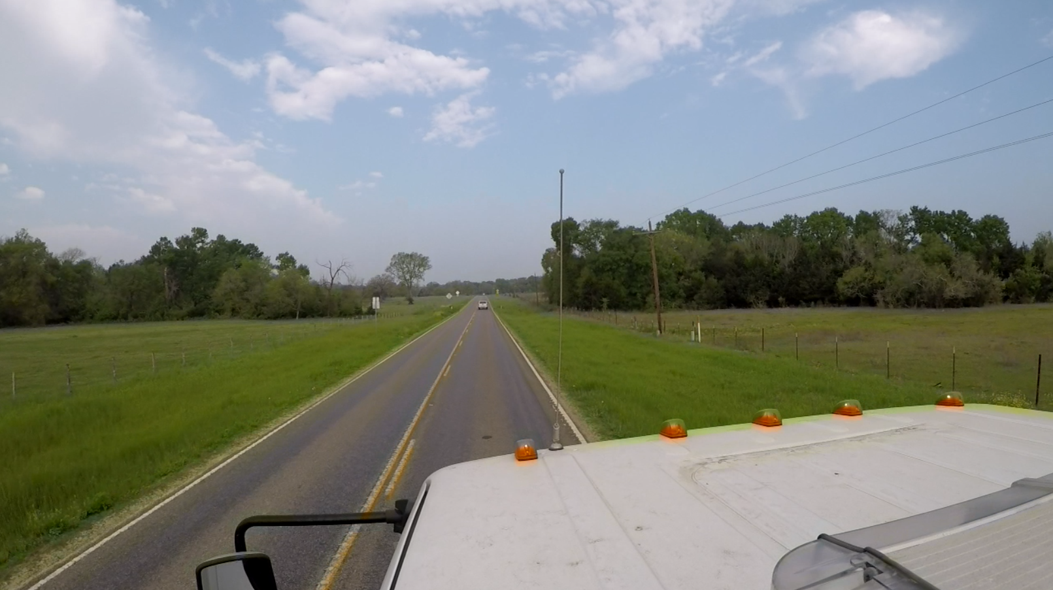
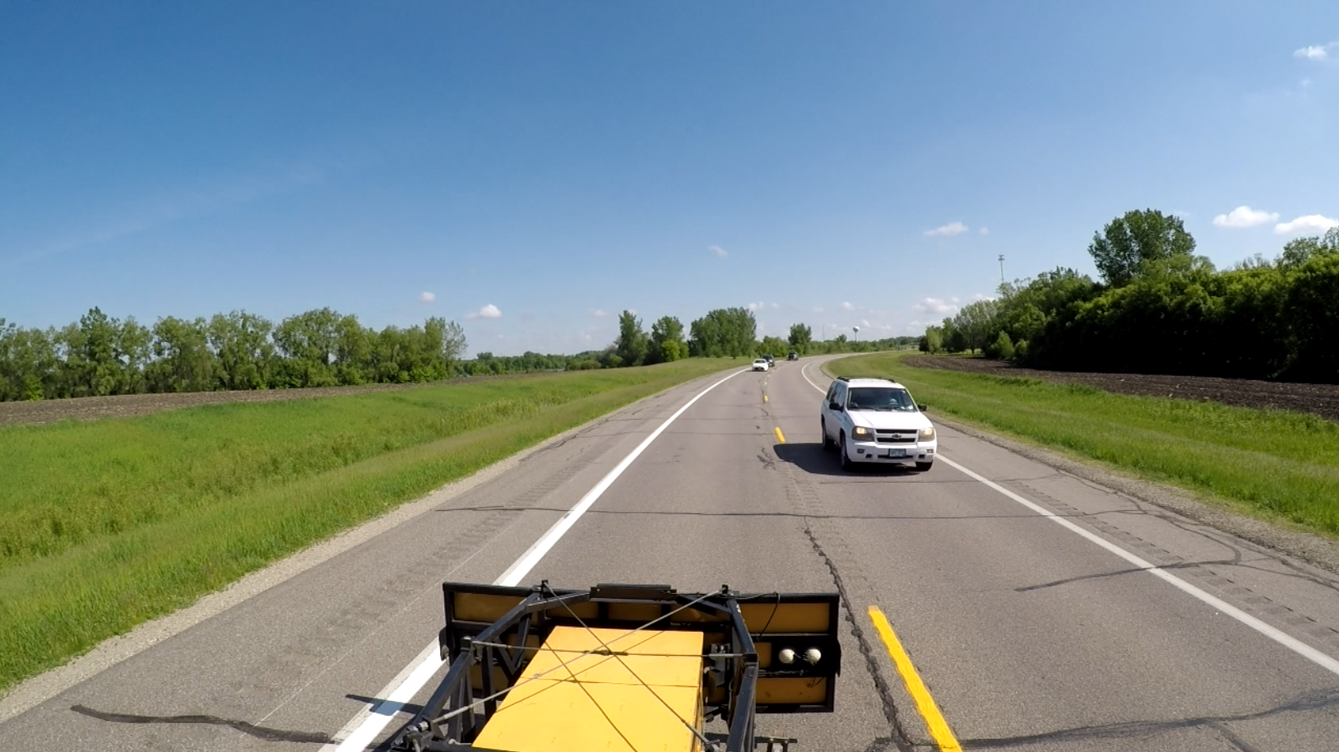
Field Study
17 sites in Texas and Minnesota
3 work activities
Rumble strip installation
Herbicide spraying
Striping
GPS-enabled video cameras
Forward-facing on lead vehicle
Rear-facing on trailing vehicle
>1,600 minutes of data
1,209 passing maneuvers

Slide 27
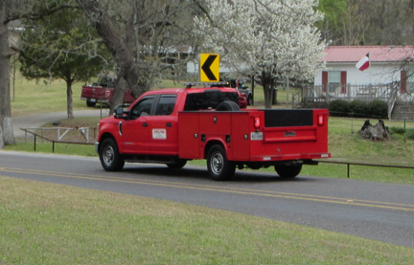
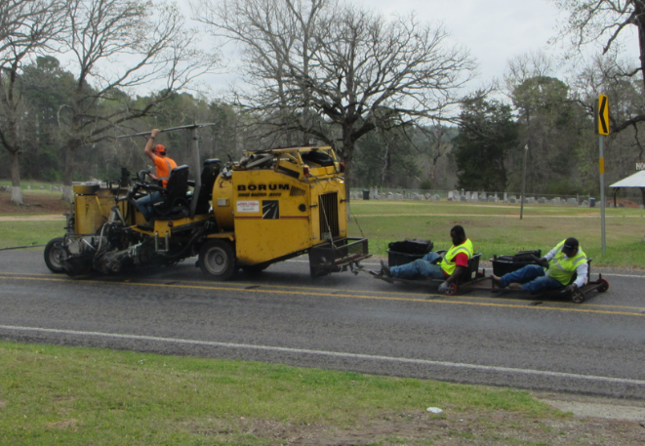
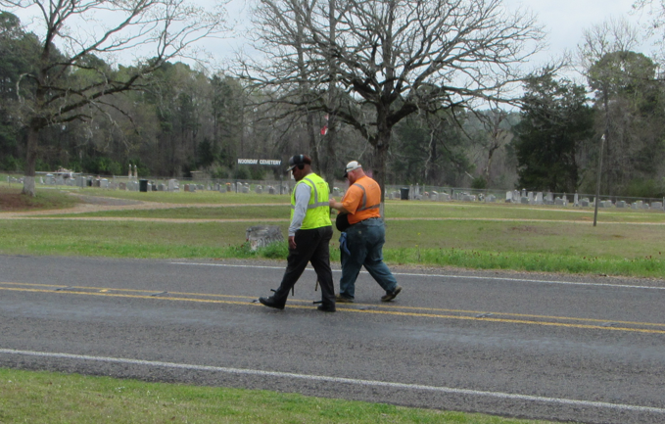
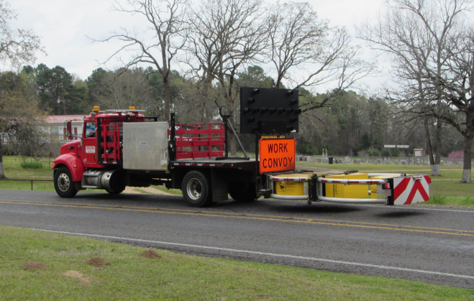
Rumble Strip Installation
3 sites in TxDOT Atlanta District
Low traffic volumes (50-72 vehicles per hour)
Periodic pauses to refill adhesive with occasional flagging of traffic by workers
66% to 100% marked as no passing zones
4 vehicles + 2 workers on foot in convoy
259 passing maneuvers (64% flagged by workers)
X 2

Slide 28
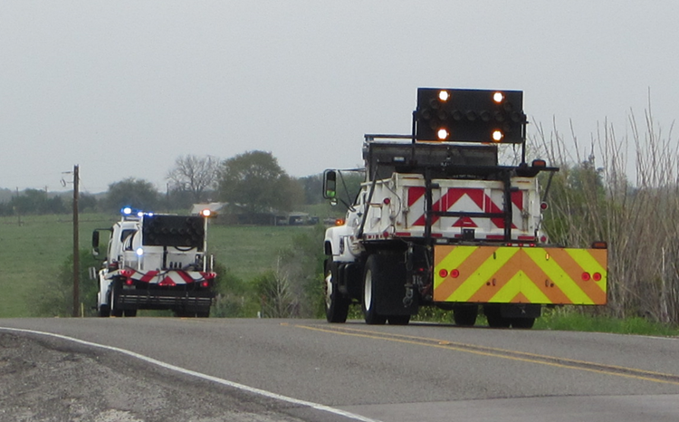
Herbicide Spraying
8 sites in TxDOT Bryan District
Low traffic volumes (30-76 vehicles per hour)
Periodic pauses to vacate lane and allow traffic to pass
72% to 81% marked as no passing zones
2 vehicles
132 passing maneuvers (46% while convoy vacated lane)

Slide 29
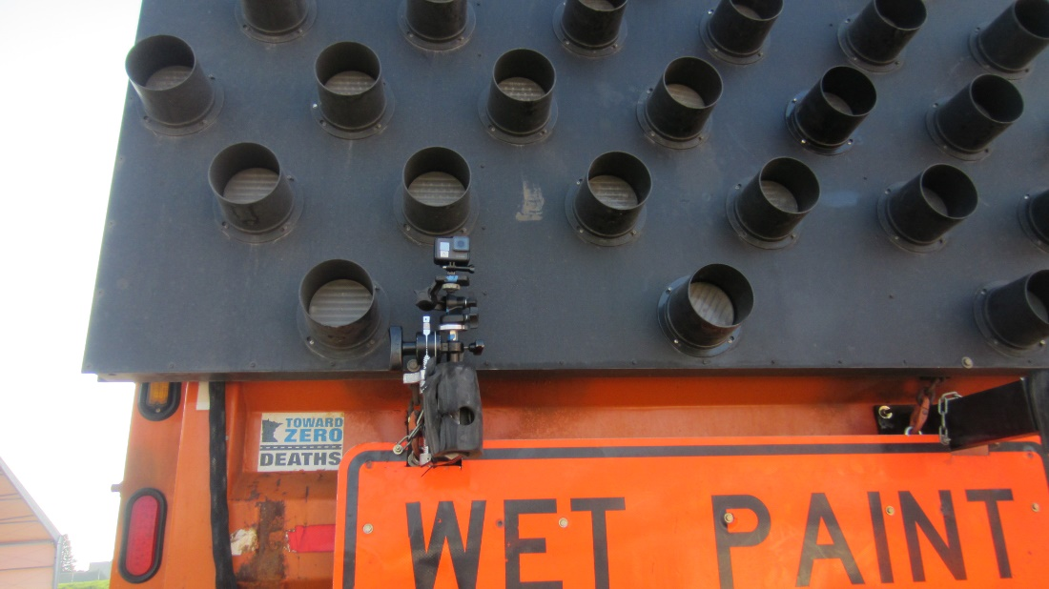
Striping
6 sites in MnDOT District 8
Higher traffic volumes (256 to 350 vehicles per hour)
Periodic pauses for striping of auxiliary (bypass) lanes
15% to 19% marked as no passing zones
2 vehicles
818 passing maneuvers (65% in the auxiliary lane areas)
X 2

Slide 30
GPS Data Reduction
Date, time, latitude, longitude, speed continuously recorded.
Speed of trailing vehicle reflects apparent convoy movement that drivers see as they approach the operation.
Using matching timestamps from leading and trailing vehicle GPS files, the distance between lead and trailing vehicles was calculated to determine convoy length.
Date and Time | GPS Latitude (degrees) | GPS Longitude (degrees) | GPS Speed (m/s)
2022-06-06T18:17:40.844Z | 44.9081146 | −94.3676663 | 0.052
2022-06-06T18:17:40.899Z | 44.9081139 | −94.3676679 | 0.027
2022-06-06T18:17:40.954Z | 44.9081139 | −94.3676694 | 0.020
2022-06-06T18:17:41.009Z | 44.9081137 | −94.3676704 | 0.025
2022-06-06T18:17:41.064Z | 44.9081135 | −94.3676714 | 0.023
2022-06-06T18:17:41.119Z | 44.9081132 | −94.3676724 | 0.023
2022-06-06T18:17:41.174Z | 44.9081124 | −94.3676752 | 0.014
2022-06-06T18:17:41.229Z | 44.9081127 | −94.3676743 | 0.009
2022-06-06T18:17:41.284Z | 44.9081124 | −94.3676752 | 0.014
2022-06-06T18:17:41.339Z | 44.9081122 | −94.3676762 | 0.026
2022-06-06T18:17:41.394Z | 44.9081119 | −94.3676771 | 0.029

Slide 31
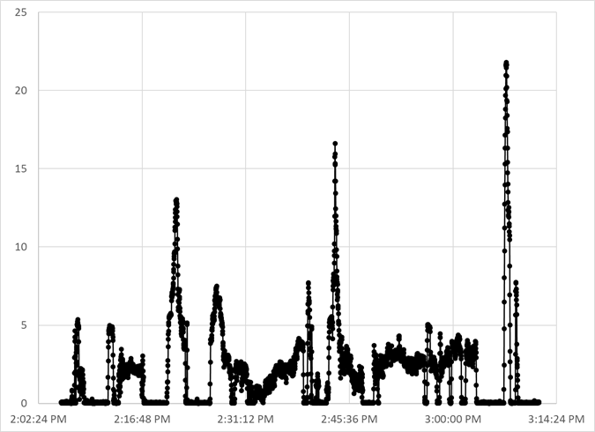
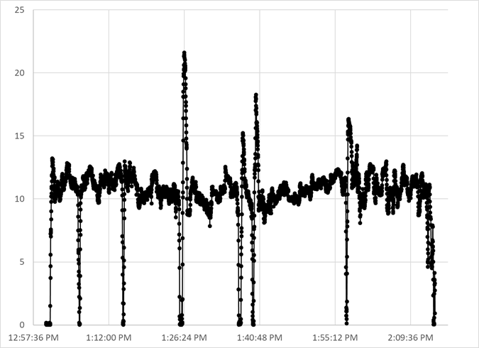
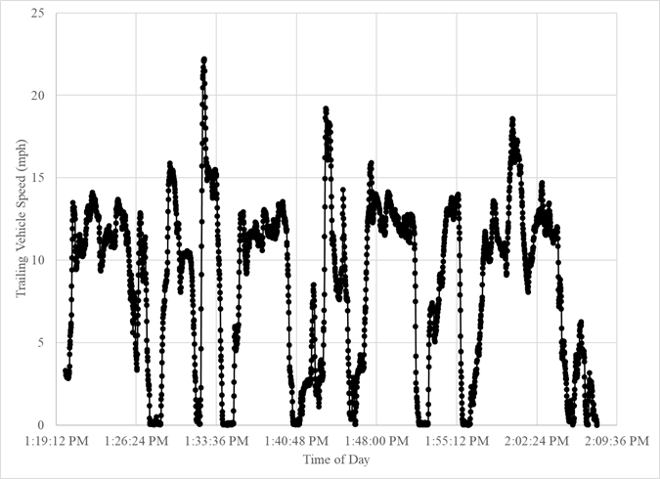
Speed Profiles of Trailing Vehicles
Rumble Strips
Herbicide Spraying
Paint Striping
2.0 mph average
10.5 mph average
8.6 mph average
Convoy speeds constantly changed throughout these operations.
It can be difficult for drivers to judge their closing speed.

Slide 32
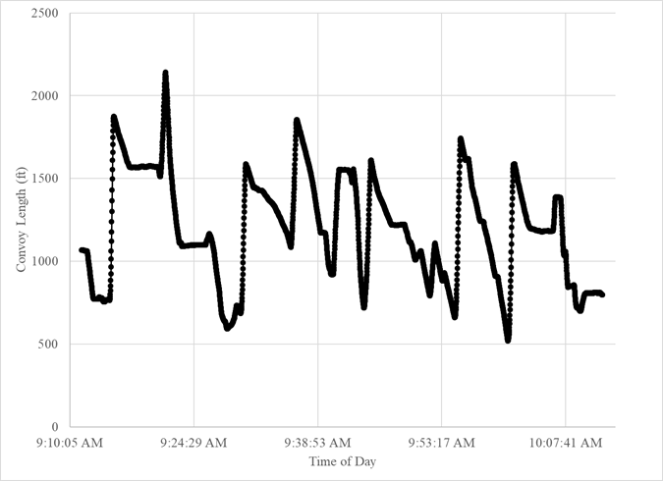
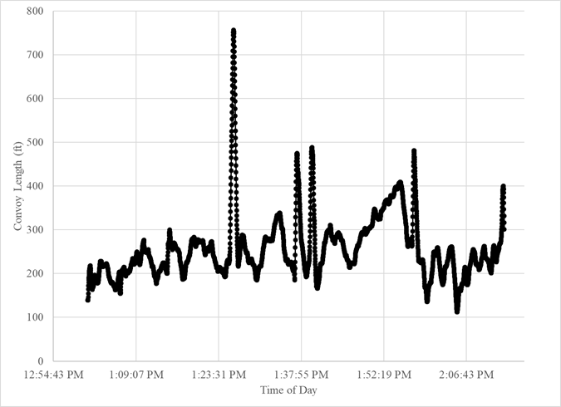
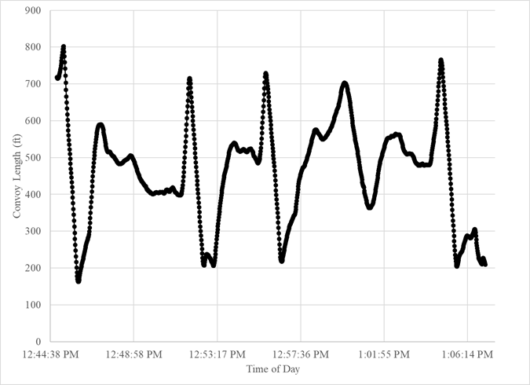
Convoy Length Profiles
Rumble Strips
Herbicide Spraying
Paint Striping
1,198 ft average
257 ft average
465 ft average
Convoy lengths constantly changed throughout these operations.
Driver risk tolerance for passing long convoys is not well understood.

Slide 33
Passing Sight Distance
Minimum passing sight distance calculations for roadway design are based on some assumptions about driver behavior and the overtaken vehicle
Speed and length profiles show that mobile operations do not conform to these assumptions
Element | Roadway Design | Mobile Operations
Overtaken vehicle description | Single vehicle | Multi-vehicle convoy of varying length
Overtaken vehicle speed | Uniform and typically the average running speed of traffic at a volume near capacity | Varies considerably and is relatively low
Passing vehicle average speed | 10 mph greater than the overtaken vehicle’s speed | Likely considerably higher than the overtaken vehicle’s speed

Slide 34
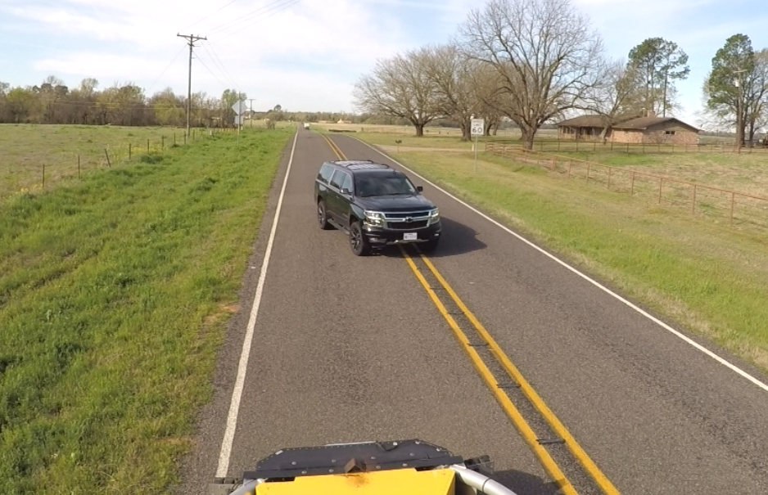
No Passing Zones
Some drivers strictly adhered to the no passing zone markings and refused to pass on their own
Other drivers ignored the markings and passed the convoy at their own discretion
Thus, the passing maneuver data were reduced without regard to the presence of no passing zone markings

Slide 35
Video Data Reduction of Passing Maneuvers
Trailing vehicle videos used to tabulate:
Description of approaching vehicles
Arrival timestamps for approaching vehicles
Timestamps for initiation of all passing maneuvers
Queue position from which all passing maneuvers were initiated
Timestamps for arrival of all vehicle travelling in the opposite direction
Researchers calculated:
Time spent in the queue for each vehicle (from arrival to passing)
Time spent in queue waiting to reach first position (front of queue)
Passing gap durations (headways of opposing traffic)
449 of 1,209 passing maneuvers were unassisted (no flagging by workers or use of auxiliary lanes)

Slide 36
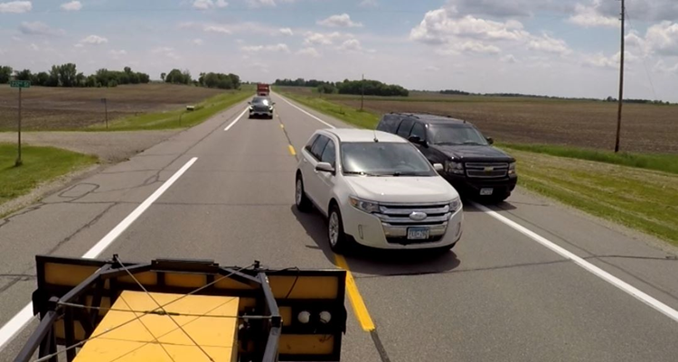
Undesirable Passing Maneuvers
Some drivers passed before reaching the first position in the queue
Creates potential conflicts around the trailing vehicle
Consequences include:
collisions with other traffic
secondary collisions with workers and/or equipment
unpredictable evasive maneuvers that may lead to work zone intrusions

Slide 37
Analysis of Undesirable Passing Maneuvers
Time Increment (min) | Number and Percentage of Vehicles Waiting to Reach First Position in Queue | Number and Percentage of Vehicles Passing From Undesirable Position in Queue | Totals
>0 and ≤ 1 | 109 (79%) | 29 (21%) | 138
>1 and ≤ 2 | 45 (85%) | 8 (15%) | 53
>2 and ≤ 3 | 25 (71%) | 10 (29%) | 35
>3 and ≤ 4 | 7 (58%) | 5 (42%) | 12
>4 and ≤ 5 | 1 (25%) | 3 (75%) | 4
>5 and ≤ 6 | 3 (33%) | 6 (67%) | 9
>6 and ≤ 7 | 0 (0%) | 6 (100%) | 6
>7 and ≤ 16 | 4 (24%) | 13 (76%) | 17
TOTALS | 194 (71%) | 80 (29%) | 274
Wait times are shown (by time increment) for all vehicles arriving in other queue positions (274 of 449).
The longer time drivers spent waiting to reach the front of the queue, the greater the likelihood they will initiate an undesirable passing maneuver.
Notes:
175 of 449 vehicles arrived as first in the queue (not used in the analysis)
194 vehicles arrived in other queue positions (2nd, 3rd, 4th, etc.) and waited to reach first position in the queue before passing
80 vehicles arrived in other queue positions and impatiently passed before reaching the first position in the queue

Slide 38
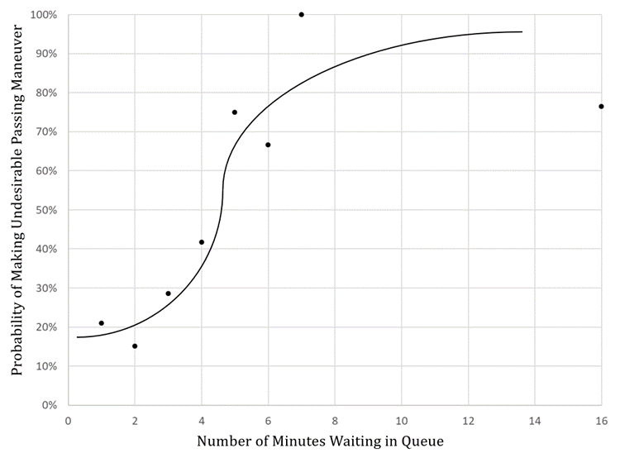
Analysis of Undesirable Passing Maneuvers
Passing maneuvers made from undesirable queue positions occurred over all wait time increments.
Even when wait times were short, about 20% of vehicles chose to pass rather than wait for first queue position.
Once time spent waiting reached 4 to 5 minutes, the probability of undesirable passes exceeds 50%.

Slide 39
Microsimulation Analysis
VISSIM® 2022 Advanced software was used
6-mile two-lane roadway segment without any passing restrictions
Equal traffic volumes in both directions (100, 150, 200, 250 vph)
Convoy speed was 8 mph
Convoy length was 300 ft (software limitation)
Arriving vehicle speed threshold of 15 mph used to identify vehicles experiencing wait time in queue

Slide 40
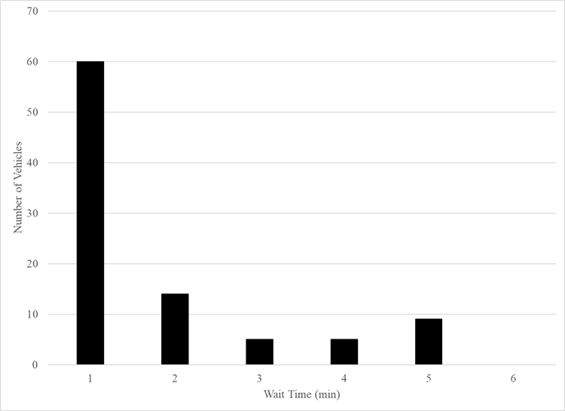
Microsimulation Analysis
As a way to simulate a sight distance restriction that inhibited passing of the convoy, one 0.5-mile passing-restricted segment was inserted after the first 2.5 miles of the 6-mile segment.
At 250 vph, 93 vehicles experienced wait times.
Nine vehicles (10%) had wait times >4 minutes.

Slide 41
Microsimulation Analysis Findings
Areas of insufficient sight distance for passing (a function of convoy speed and length) have a dramatic effect on the length of time that vehicles wait in the queue.
The location of areas of insufficient sight distance for passing mobile operations are not known to most agencies.
The development of simple volume-based guidelines for mobile operations was not possible.

Slide 42
Microsimulation Analysis Findings
TTC decisions will continue to require local knowledge of the roadway segments and traffic conditions.
Study results support the use of wait time in queue to guide decisions about when mobile operations are appropriate, as well as whether traffic volumes are such that switching TTC strategies is appropriate.

Slide 43
Conclusions and Recommendations
Mobile operation definitions and practices vary considerably among agencies nationally.
Traffic volumes and roadway topography appear to be key factors in TTC decision-making for mobile operations, but few solid, objective thresholds exist. Instead, local knowledge and past experiences conducting mobile operations on roadway segments are relied upon.
Field studies showed that a major safety concern exists when vehicles farther back in the queue pass other vehicles before reaching the work operation, creating a potential collision risk.

Slide 44
Conclusions and Recommendations (continued)
The likelihood of undesirable passing maneuvers occurring increases as the amount of time in the queue increases.
Nearly 50% of drivers who wait in the queue longer than 4 minutes will attempt an impatient pass.
After 6 minutes, 85% of drivers will attempt an impatient pass.
Time spent in the queue waiting to pass a mobile operation is influenced by:
convoy characteristics (speed and length),
traffic volumes, and
roadway topography (which dictates where sufficient sight distance exists for passing).
Simple volume-based guidance cannot be established.

Slide 45
Guidance
Task 6

Slide 46
Guidance
Work crews should strive to avoid creating conditions drivers remain in a queue for more than 4 minutes.
If wait times are longer, the work crew should plan to periodically vacate the travel lane to allow vehicles to pass.
If longer wait times will occur and the crew is unable to vacate the travel lane, a stationary work zone with positive traffic control methods should be considered.

Slide 47
For more information
LuAnn Theiss
l-theiss@tti.tamu.edu
(979) 317-2146

