Slide 1
Cybersecurity Issues and Protection Strategies for State Transportation Agency CEOs
NCHRP Web-Only Document 355
Overview

Slide 2
Agenda
Team Introductions
Program Goal
Program Process
Program Research Approach (Tasks)
Program Schedule
Task Overviews (Task 1 - 7)
Open Discussion

Slide 3
Research Team
Southwest Research Institute
San Antonio, TX
Over 70 years in research and development
Staff on numerous standards committees
25+ years ATMS development for multiple states
Ongoing Cybersecurity efforts with local TMSs
Secure development lifecycles and red team methodologies
Industry leaders in Connected & Automated Vehicle (CAV) and Vehicle-to-Everything (V2X) Deployments
Global Dynamic Group I, LLC (GDG IoT)
New York, NY
Since 2005, served senior executive leaders in Federal, State and Local governments and private-sector clients
Extensive experience with stakeholder engagement, public elicitation and outreach, and public communications
Staff have held several senior leadership positions in State and Local government and been former elected official
Notes:
CAV = Connected and Automated Vehicle
V2X = Vehicle to Infrastructure or Vehicle (V2V/V2I)
ATMS = Advanced Traffic Management System
TMS = Traffic Management System

Slide 4
Program Goal
Goal:
Develop guidance that focus on state transportation agencies’ unique cybersecurity challenges, particularly affecting OT, and provide direction on protection and incident management strategies.
How?
Engage stakeholders and industry SMEs to address:
Organizational motivations for cybersecurity initiatives and how these initiatives address needs
Concerns how security and information integrity can restrict and/or complicate business objectives
Focus research to support informing state leadership about
Tools and guidance to assess, classify, and respond to transportation system cybersecurity risks
Prevention of incidents affecting OT, what to do when incidents occur and how to recover
Balance between information access and protection
Tradeoffs between the risks associated with information security and the needs for information sharing as it related to the OT environments

Slide 5
Program Process
Identify
What executives and senior managers at state transportation agencies need to know about managing the confluence of transportation OT and IT cybersecurity risks
Develop
Easy-to-use Guide that enables state transportation agency executives and senior managers to
Verify
Guide is addressing the needs of users through stakeholder engagement.
Guide, first in a draft and then a final version, ensuring usability and buy-in from participants.
Deliver
assess, classify, and respond to transportation system cybersecurity risks
Classify
Transportation functions, services, and assets that may be targets of cyberattacks and cyber incidents
Notes:
Identify what executives and senior managers at state transportation agencies need to know about managing the confluence of transportation OT and IT cybersecurity risks,
Classify transportation functions, services, and assets that may be targets of cyberattacks and cyber incidents, and
Develop an easy-to-use guide for state transportation agency executives and senior managers that will help them assess, classify, and respond to transportation system cybersecurity risks.

Slide 6
Program’s Research Approach
Research Approach broken down into following tasks:
Task 1: Identify and Summarize State Transportation Agencies’ Cybersecurity Initiatives
Task 2: Conduct a Review of Relevant Cybersecurity Literature
Task 3: Identify Transportation Technology and Cybersecurity Subject Matter Experts (SMEs)
Task 4: Prepare Interim Reporting
Task 5: Develop Guidance and Transportation Cyber Risk Framework
Task 6: Develop Draft Project Summary Report
Task 7: Finalize Project Summary Report

Slide 7
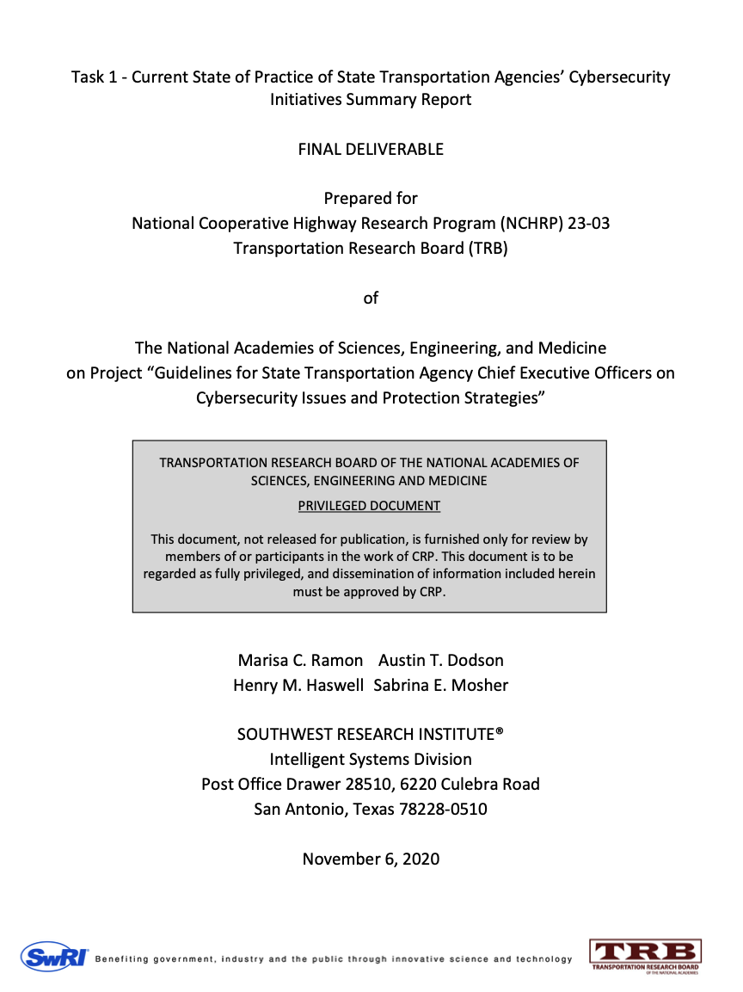
Task 1 – Identify and Summarize State Transportation Agencies’ Cybersecurity Initiatives
Goal:
Review of previously administered surveys for information and insights into the current state-of-practice (SOP) of state transportation agencies, with emphasis on:
Cybersecurity initiatives
How cybersecurity initiatives address OT-related needs
If necessary, develop new survey/interview instruments to interview state agencies
Process:
Conducted outreach engaging leadership and management of state DOTs and other transportation agencies to assess their SOP of cybersecurity initiatives
Summarized interview findings into report

Slide 8
Task 1 – Identify and Summarize State Transportation Agencies’ Cybersecurity Initiatives
Report Highlights:
Current awareness about cybersecurity initiatives and management strategies used by state transportation agencies.
How these initiatives address real operations’ and technologies’ needs with respect to barriers, opportunities, lessons learned, and successful practices.
Interviewed 14 state transportation agency representatives and reviewed publicly available information, finding:
Common theme - securing systems as more devices that were previously unnetworked are connected to the larger enterprise network.
Many had not applied IT initiatives to OT, and if they had, were doing so in a reactive manner.
No method for quantifying risk associated with a device, and thus cannot make proactive initiatives based on risk understanding.
Lessons learned and successful practices across DOTs - many have had successes based on the implementation of cybersecurity initiatives.

Slide 9
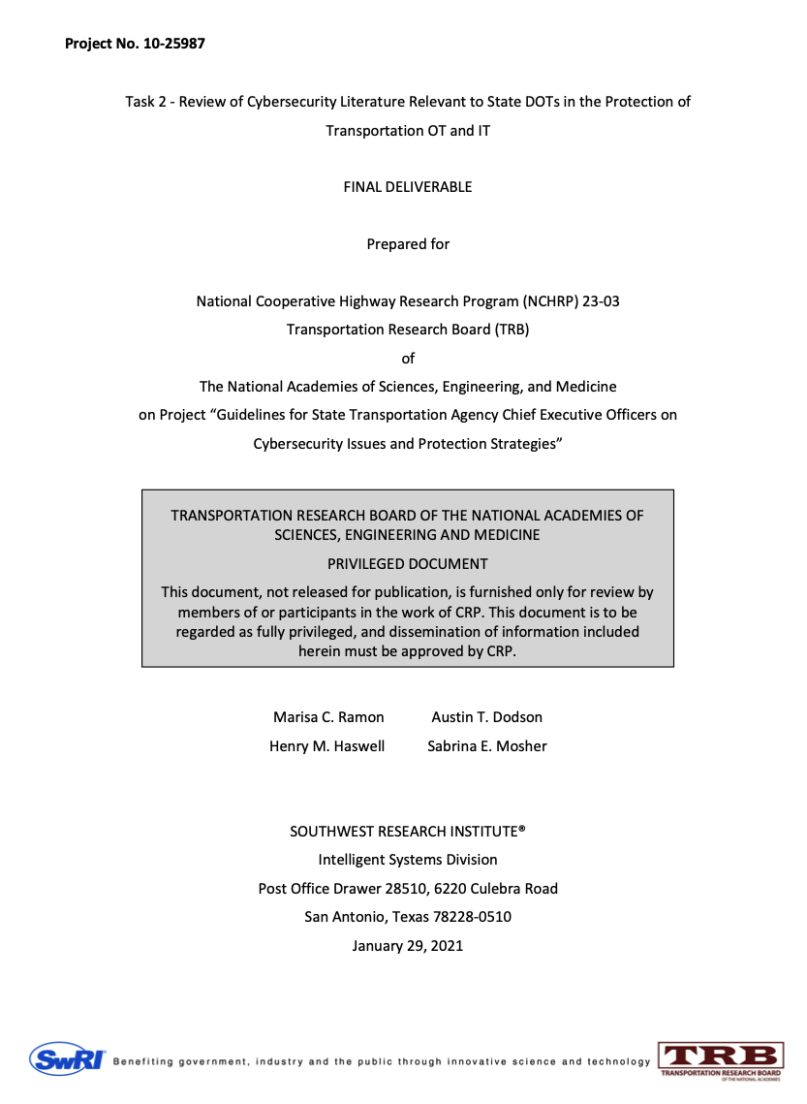
Task 2 - Conduct a Review of Relevant Cybersecurity Literature
Goal:
Review and summarize relevant literature on transportation cybersecurity practices
Process:
Started by collecting relevant literature
TRB 03-127 Security Literature Review
2019 NCHRP Research Report 930: Security 101: A Physical and Cybersecurity Primer for Transportation Agencies
Incorporated literature recommendations from Task 1 interviews
Summarize research and interview findings.
Found few cybersecurity standards that directly address constraints of the transportation.
No standard that details what is needed to certify OT devices for field networks
Responsibility of deciding what cybersecurity implementations should be on the transportation agencies.
Cyber implementations are often aided by best practice guides or other guidance published by organizations like the DHS.

Slide 10
Task 3 - Identify Transportation Technology and Cybersecurity Subject Matter Experts (SMEs)
Goal:
Identify Transportation technology and Cybersecurity SMEs involved in transportation standards and research activities
Start with SMEs identified through Task 1 and 2
Conducted interviews with identified SMEs
Summarize SME interview findings
Process:
Developed SME criteria and created list of SMEs
Receive approval on SMEs from Program Panel
Engaged and interviewed SMEs for feedback on cybersecurity practice effectiveness and modes of classifying assets’ risk
Summarized SME feedback

Slide 11
Task 3 - Identify Transportation Technology & Cybersecurity SMEs
SME Criteria:
SME’s provided response to self-assessment questionnaire (email) containing:
Familiarity with OT vs. IT
Involvement in the OT space
Understanding of OT risk management
Understanding of presenting cyber topics to management
Involvement in cybersecurity – conferences, published articles, project deployments, etc.
Knowledge of transportation threat environment
SME Engagement:
For each participating SME, developed a brief SME profile consisting of:
Name, organizational affiliation, title, and contact information
Their role in the project and anticipated contribution
A brief biography
Curriculum Vitae or Resume (as provided)
Conducted virtual SME interviews
Enable candidates to learn about the project and to consider participation while further assessing their suitability for the research activities

Slide 12
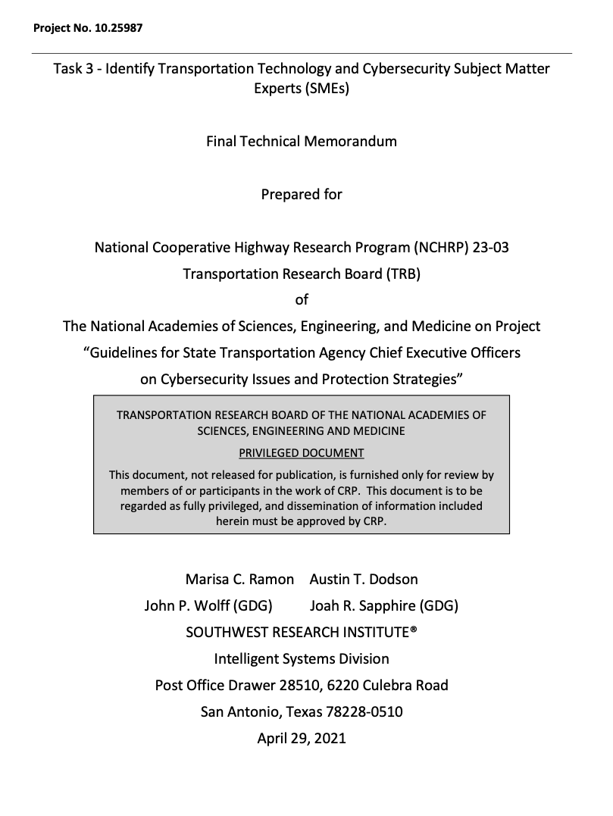
Task 3 - Identify Transportation Technology and Cybersecurity Subject Matter Experts
SME Engagement (cont.):
Interviews asked SMEs to provide feedback on:
What cybersecurity practices work in the OT environments?
Assess what gaps remain in OT and IT cybersecurity practices
Recommendations for translating or classifying critical assets and cyber risks to encourage action within relevant organizations.
Taking into consideration cyber security policy, relevant case laws, subcontracting practices, requirements for new deployments, staffing levels, training, etc. to create a comprehensive understanding of the state DOT’s current practices.
Interview findings were summarized in Task 3 report

Slide 13
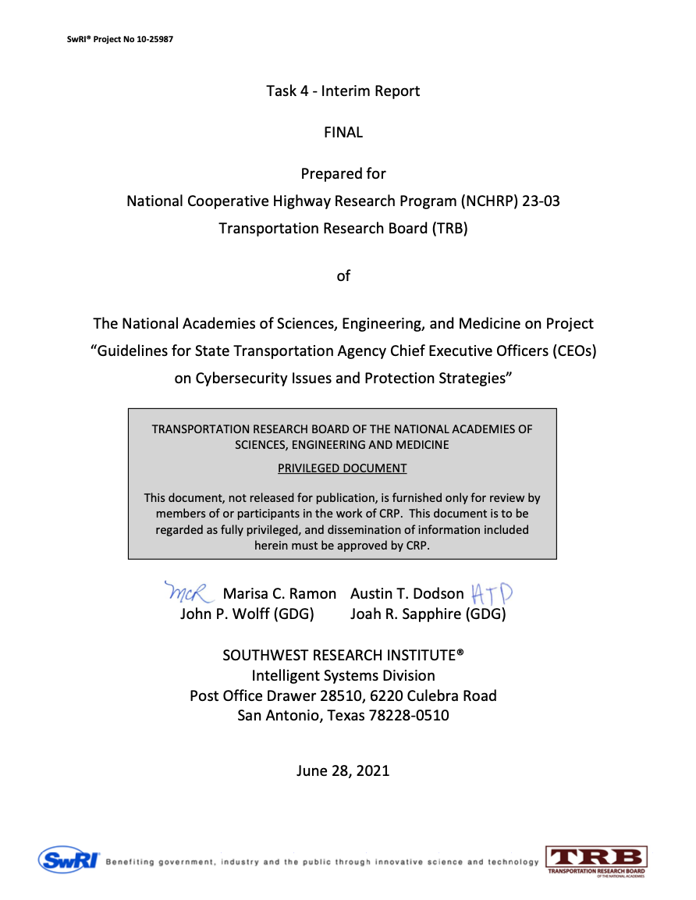
Task 4 – Project Interim Reporting
Goal:
Convey findings and conclusions of Tasks 1-3, including:
Overview summary and findings of previous tasks
Draft development plan for the Transportation Cyber Risk Guidance
Results:
Delivered Task 4 Report (Final).

Slide 14
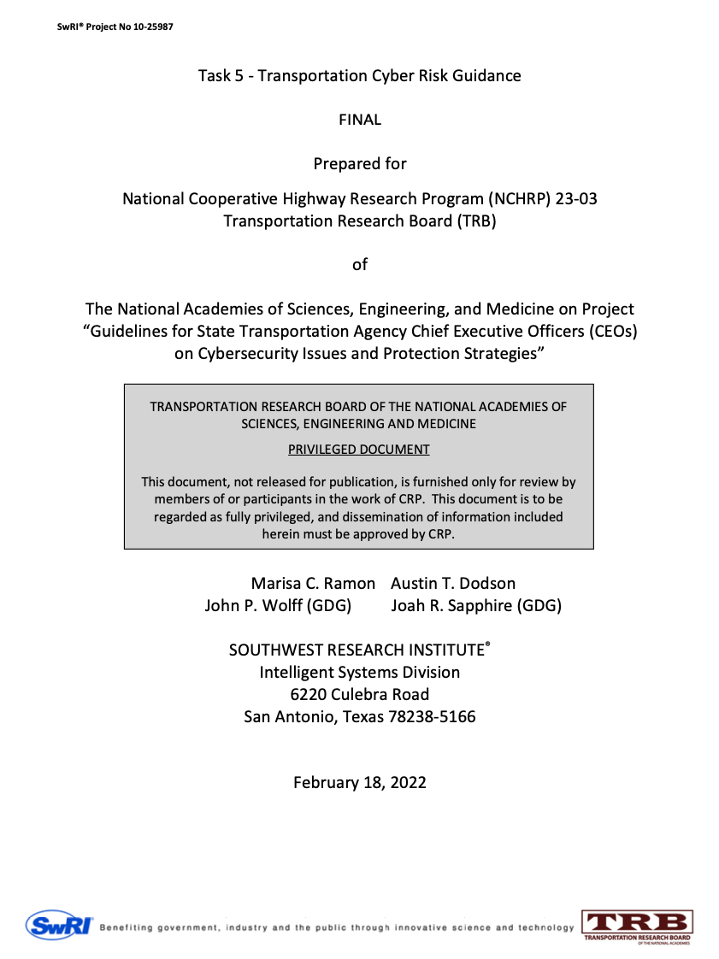
Task 5 – Develop Transportation Cyber Risk Guidance
Goal:
Develop TCRF guidance
Process:
Assess additional research needs to plan the input to be derived from each of the participating transportation technology and cybersecurity SMEs (per Subtask 3.3).
Develop corresponding schedule of mini-Workshops and SME questionnaires for each subject area (to be reviewed with project panel).
Conducted mini-Workshops and interviews with SMEs.
Compile findings to develop a Framework that will aid senior management in identifying strategies for assessing OT cyber risks and preventing and managing OT cyber incidents.
Conduct further feedback & input sessions with SMEs, as needed.

Slide 15
Task 5 – Develop Transportation Cyber Risk Guidance
Identified and defined functional areas for an Agency Chief Executive Officer(CEO):
Governance
Managing Assets
Strategic Planning
Distribute Authority
Managing People
Managing Operations
Measuring Performance

Slide 16
Task 5 – Develop Transportation Cyber Risk Guidance Governance
Primary CEO Responsibility
Define and communicate strategic and operational objectives across the agency to fulfill the mission and mandate for the DOT
Related Cyber Responsibility
Setting the priorities and agency culture related to cybersecurity needs by establishing and supporting initiatives with defined objectives

Slide 17
Task 5 – Develop Transportation Cyber Risk Guidance Managing Assets
Primary CEO Responsibility
Managing assets is the acquisition, deployment, monitoring, valuing, protecting, modifying, repairing and retiring of physical and virtual assets and equipment
Related Cyber Responsibility
Identifying the OT assets subject to cyber risk, assessing their current state of risk and defining corresponding requirements for cyber protection and risk mitigation

Slide 18
Task 5 – Develop Transportation Cyber Risk Guidance Strategic Planning
Primary CEO Responsibility
Determining the allocation of resources (e.g., financial, staff, equipment, capabilities, and management focus)
Related Cyber Responsibility
Developing plans, initiatives, programs, and policies required to address cybersecurity needs and ensuring right levels of resource allocation

Slide 19
Task 5 – Develop Transportation Cyber Risk Guidance Distribute Authority
Primary CEO Responsibility
Establishing the organizational structures within the agency empowered with the authority and mandate to deploy resources and manage DOT operations
Related Cyber Responsibility
Designating leadership to organize and deploy resources and establish and enforce standards, rules, policies, processes and procedures, etc. to achieve cybersecurity objectives

Slide 20
Task 5 – Develop Transportation Cyber Risk Guidance Managing People
Primary CEO Responsibility
Managing people is the hiring, training, supervision and seamless retirement of human resources
Related Cyber Responsibility
Ensuring the right levels of staff, tools and technical capabilities to support cybersecurity-related operations

Slide 21
Task 5 – Develop Transportation Cyber Risk Guidance Managing Operations
Primary CEO Responsibility
Managing operations is undertaking, monitoring or improving business functions, activities and processes to achieve business objectives
Related Cyber Responsibility
Deploying the plans, programs and policy designed to address cybersecurity needs and ensuring effective implementation

Slide 22
Task 5 – Develop Transportation Cyber Risk Guidance Measuring Performance
Primary CEO Responsibility
Measuring performance is collecting and assessing data to determine when, if, how, why and what outcomes occur
Related Cyber Responsibility
Defining success metrics and quantifying the impact and effectiveness of plans, programs and policy deployed to address cybersecurity needs

Slide 23
Task 5 – Develop Transportation Cyber Risk Guidance Elements of Guidance for Executive Leadership
Built upon the five elements in the NIST framework and incorporating five additional elements:
Managing Risk
(1) Identify external threats and internal weaknesses
(2) Assess to understand the likelihood of potential threats and risks
(3) Quantify the costs and extent of potential impact of threats and risks
(4) Protect assets by developing and deploying programs to reduce risk and occurrence of threats
Managing Impact
(5) Detect when cyber incidents occur with accuracy
(6) Respond when cyber incidents occur with speed
(7) Withstand to sustain resiliency when cyber incidents occur
(8) Recover capabilities and assets when cyber incidents occur
Managing Programs
(9) Define standards of risk and preparedness to which the state DOT must comply
(10) Develop and sustain management practices for cyber programs and compliance

Slide 24
Task 5 – Develop Transportation Cyber Risk Guidance Proposed Levels of Cybersecurity Capability Maturity (CMM) Levels 1-4
Sample Tables (Levels not filled out for slide brevity)
 | LEVEL 1 | LEVEL 2 | LEVEL 3 | LEVEL 4
Managing Risk (1) Identify external threats and internal weaknesses | TBD | TBD | TBD | TBD
(2) Assess to understand the likelihood of potential threats and risks | TBD | TBD | TBD | TBD
(3) Quantify the costs and extent of potential impact of threats and risks | TBD | TBD | TBD | TBD
(4) Protect assets by developing and deploying programs to reduce risk and occurrence of threats | TBD | TBD | TBD | TBD
Managing Impact (5) Detect when cyber incidents occur with accuracy | TBD | TBD | TBD | TBD
 | LEVEL 1 | LEVEL 2 | LEVEL 3 | LEVEL 4
(6) Respond when cyber incidents occur with speed | TBD | TBD | TBD | TBD
(7) Withstand to sustain resiliency when cyber incidents occur | TBD | TBD | TBD | TBD
(8) Recover capabilities and assets when cyber incidents occur | TBD | TBD | TBD | TBD
Managing Programs (9) Define standards of risk and preparedness to which the state DOT must comply | TBD | TBD | TBD | TBD
(10) Develop and sustain management practices for cyber programs and compliance | TBD | TBD | TBD | TBD

Slide 25
Task 5 – Develop Transportation Cyber Risk Guidance CMM Level 1-4: Managing Risk (Example)
 | LEVEL 1 | LEVEL 2 | LEVEL 3 | LEVEL 4
Managing Risk (1) Identify external threats and internal weaknesses | Ad-hoc approach to identifying external cyber threats and internal weaknesses | Commence formal practices to identify external cyber threats and internal weaknesses | Extensive but incomplete practices to identify external cyber threats and internal weaknesses | Comprehensive practices to identify external cyber threats and internal weaknesses

Slide 26
Task 5 – Develop Transportation Cyber Risk Guidance Key OT Assets and Operational Functions
Physical equipment and hardware that performs a specified operational function
Virtual equipment, such as industrial control applications which manage, or which send and receive specific data to and from physical devices over electronic networks
Connectivity, with focus on the network connections that enable the distribution of electronic data to and from OT equipment
Power, focusing on supply and distribution of power, such as electricity or fuel, to OT equipment
People, focusing on who manages OT equipment, connectivity, and power
External resources with respect to modes of supply, managing, or engaging with OT assets and thus present vulnerabilities

Slide 27
Task 5 – Develop Transportation Cyber Risk Guidance Conclusions / Key Leadership Takeaways
CEOs must manage Cybersecurity for their Agency - Cannot delegate or outsource leadership
CEOs must have awareness of their agency’s posture and provide clear direction to lead their agency toward improving their protection procedures and risk management processes.
Managing Cybersecurity Risk is a Dynamic, Ongoing Process and not a static destination to be achieved
Intersection of cybersecurity best practices and chief executive-level management functions for key OT assets and operations to identify and address gaps.
Cybersecurity Risk Represents a Critical Threat to State DOTs
Implement process and assess using capability maturity model (CMM). Will provide CEOs what their current state of cybersecurity capabilities and help set agency objectives.

Slide 28
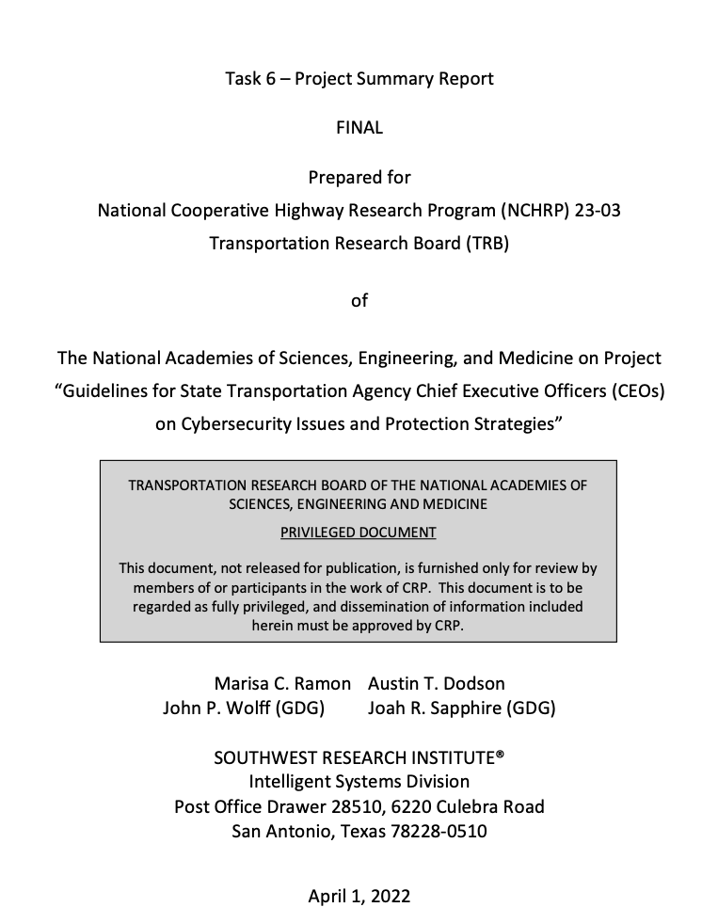
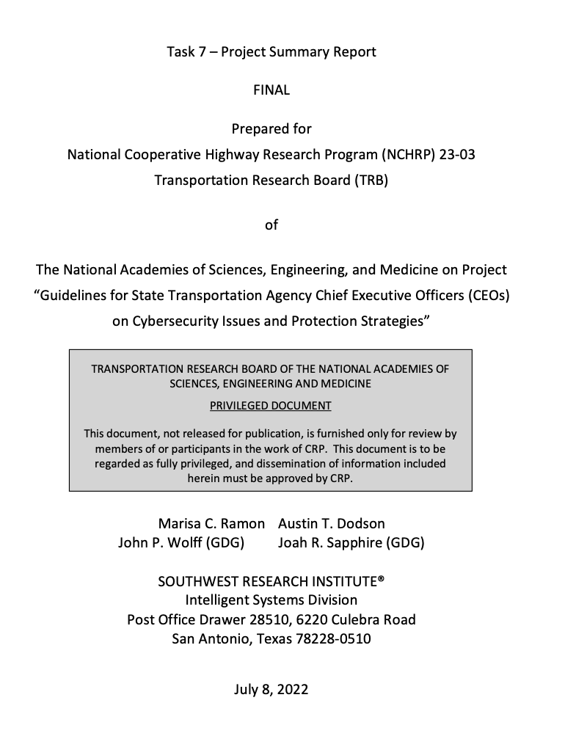
Task 6 & 7 – Develop Transportation Cyber Risk Guidance Final Report
Goal:
Summarize program into final summary report
Process:
Task 1-5 updates summarized into Task 6 & 7
Reviewed Final Report progress with panel
Developed Final Report, including:
Project Executive Summary
Future research recommendations
Technical memorandum on implications of research findings
Developed PowerPoint presentation on findings

Slide 29
Questions?
The National Cooperative Highway Research Program (NCHRP) is sponsored by the individual state departments of transportation of the American Association of State Highway and Transportation Officials. NCHRP is administered by the Transportation Research Board (TRB), part of the National Academies of Sciences, Engineering, and Medicine, under a cooperative agreement with the Federal Highway Administration (FHWA). Any opinions and conclusions expressed or implied in resulting research products are those of the individuals and organizations who performed the research and are not necessarily those of TRB; the National Academies of Sciences, Engineering, and Medicine; the FHWA; or NCHRP sponsors.

