Slide 1

This presentation was developed under NCHRP Project 14-43.
More information is available in NCHRP Web-Only Document 363: Construction Guidelines for Cold Central Plant Recycling and Cold In-Place Recycling, which can be obtained from the National Academies Press website (https://nap.nationalacademies.org/).

Slide 2
NCHRP Project 14-43:
Construction Guide Specifications for Cold Central Plant Recycling and
Cold In-Place Recycling
Benjamin F. Bowers, PhD, PE | Auburn University
Brian K. Diefenderfer, PhD, PE | VTRC
Stephen A. Cross, PhD, PE | S. Cross & Associates, LLC
Adriana Vargas, PhD | NCAT
Fan Gu, PhD, PE | Changsha University of Science and Technology
Notes:
This training was designed for the contractors, producers, consultants, or agencies leading the project to use as training materials for Just In Time Training or while scoping projects. The training is expected to take up to 2 hours and should be accompanied by a knowledgeable instructor as well as the Best Practices Guide included in the final report and copies of the AASHTO Construction Guide Specifications for Cold Central Plant Recycling and Cold In-place Recycling.

Slide 3
Training Design
What: This training is designed to cover the Construction Guide Specifications for Cold Central Plant Recycling (CCPR) and Cold In-Place Recycling (CIR), the products from NCHRP Project 14-43, and some key Best Practices.
Who: Agencies, Producers, Construction personnel, and Quality Assurance Personnel.

Slide 4
How were the Construction Guide Specifications Developed?
The contractors for NCHRP 14-43 completed the following:
  An intensive literature review of Cold Recycling practice
  A review and summary of all searchable CCPR and CIR specifications, 97 in total:
    73 state/provincial specifications, 12 local agency specifications (remaining 12 specifications were identical to state specifications)
  A survey to agencies (43 US DOT’s, 1 Canadian Province, 31 US counties, and 2 US cities) on their experience with Cold Recycling techniques
  Focused interviews with 10 agency and 6 industry partners on their specifications, what were deemed critical elements of the specification, etc.

Slide 5
Description: What is covered?
These guide specifications are intended to provide information needed for agencies and contractors for the construction of cold in-place recycling (CIR) and cold central plant recycling (CCPR) mixtures
These guide specifications refer to quality requirements for materials and design methods for cold recycled mixtures available in other AASHTO documents
Commentaries are included in the AASHTO Construction Guide Specifications where emphasis or explanations were deemed necessary
Notes:
This training will cover the draft AASHTO Guide Specifications for Cold In-Place Recycling and Cold Central Plant Recycled asphalt mixtures.
Guide specifications refer to quality requirements for materials and design methods for cold recycled mixtures available in other AASHTO documents.
Commentaries are included in the Guide Specifications and may be referenced throughout this training.
For more information, it is recommended that you refer to the Construction Guide Specifications themselves, the NCHRP 14-43 report, and the Best Practice Guide located within the appendix of the NCHRP report.

Slide 6
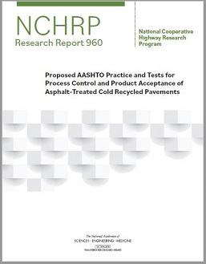

Referenced Documents
AASHTO Standards
  4 Test Methods
  3 Material Standards
  4 Provisional Material Standards
  4 Provisional Practices
Notes:
There are a number of referenced documents throughout the draft AASHTO Construction Guide Specification. These include:
AASHTO test methods, material standards, provisional material standards, and provisional practices that range from the mix design of cold recycled mixtures to component materials like portland cement and laboratory test methodologies.
Other published standards or references include documents from the Asphalt Recycling and Reclaiming Association (ARRA), including the Basic Asphalt Recycling Manual, as well as the NCHRP Report.

Slide 7
Referenced Documents
Other Published Standards
  Basic Asphalt Recycling Manual (BARM)
  ARRA CR101 & CR102 Recommended Construction Guidelines for CIR and CCPR, respectively, Using Bituminous Recycling Agents
  ARRA CR301, Recommended Quality Control Sampling and Testing Guidelines for Cold Recycling Using Bituminous Recycling Agents
  ARRA CR 201, Recommended Mix Design Guidelines For Cold Recycling Using Emulsified Asphalt Recycling Agent and CR202, Recommended Mix Design Guidelines For Cold Recycling Using Foamed (Expanded) Asphalt Recycling Agent (Sampling Procedures)
  National Cooperative Highway Research Program (NCHRP) Research Report 960: Proposed AASHTO Practice and Tests for Process Control and Product Acceptance of Asphalt-Treated Cold Recycled Pavements
Notes:
There are a number of referenced documents throughout the draft AASHTO Construction Guide Specification. These include:
AASHTO test methods, material standards, provisional material standards, and provisional practices that range from the mix design of cold recycled mixtures to component materials like portland cement and laboratory test methodologies.
Other published standards or references include documents from the Asphalt Recycling and Reclaiming Association (ARRA), including the Basic Asphalt Recycling Manual, as well as the NCHRP Report.

Slide 8
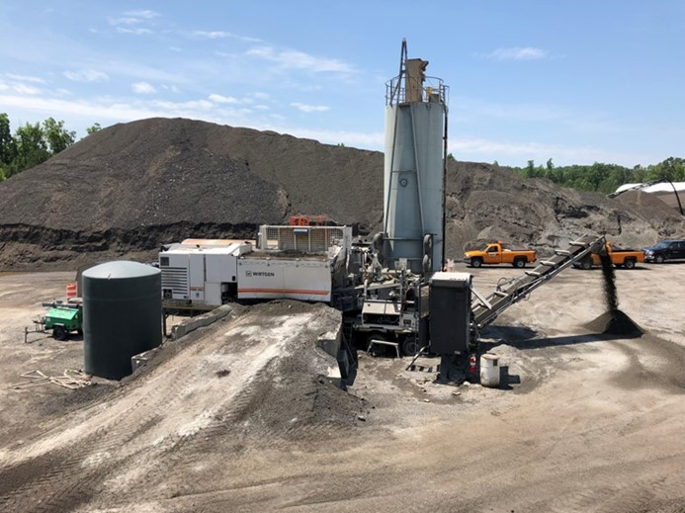
Terminology
Cold Central Plant Recycling (CCPR)
  Mixes reclaimed asphalt pavement (RAP) and additives in a central location
    Existing stockpiles, from the project, or from another project
  Additives:
    Asphalt recycling agent
    Water
    Additives if needed
      Corrective aggregates for gradation
      Active filler such as lime or cement
Photo courtesy Bowers and Diefenderfer
Notes:
Basic terminology is covered in the Guide Specifications as well as in this presentation. The first is Cold Central Plant Recycling:
CCPR consists of mixing an asphalt recycling agent, water, and additives with the reclaimed asphalt pavement (RAP) material at a central location
The RAP may be obtained from the current project, a different project, or from existing RAP stockpiles.

Slide 9
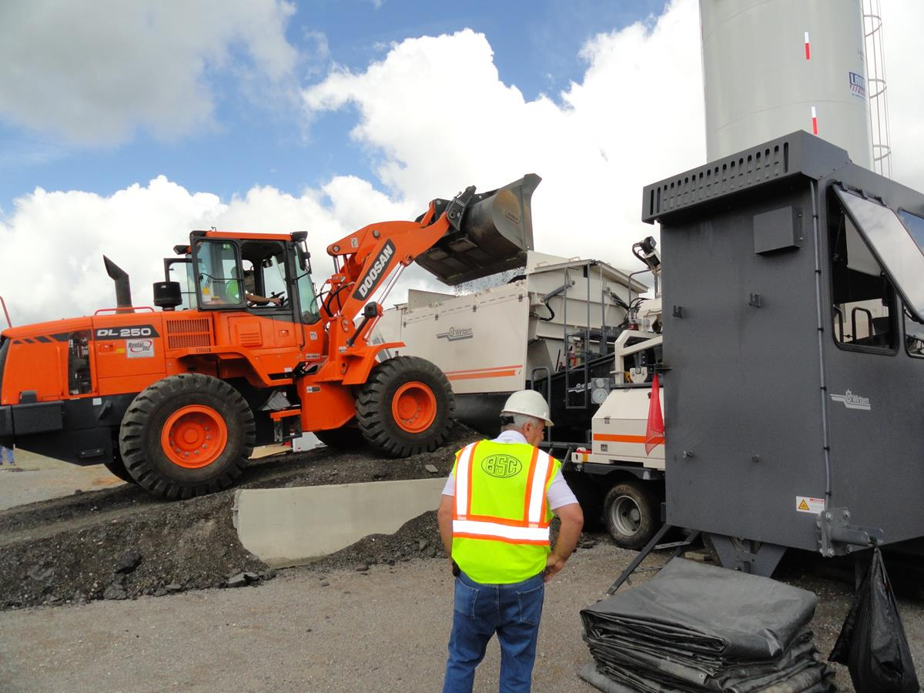
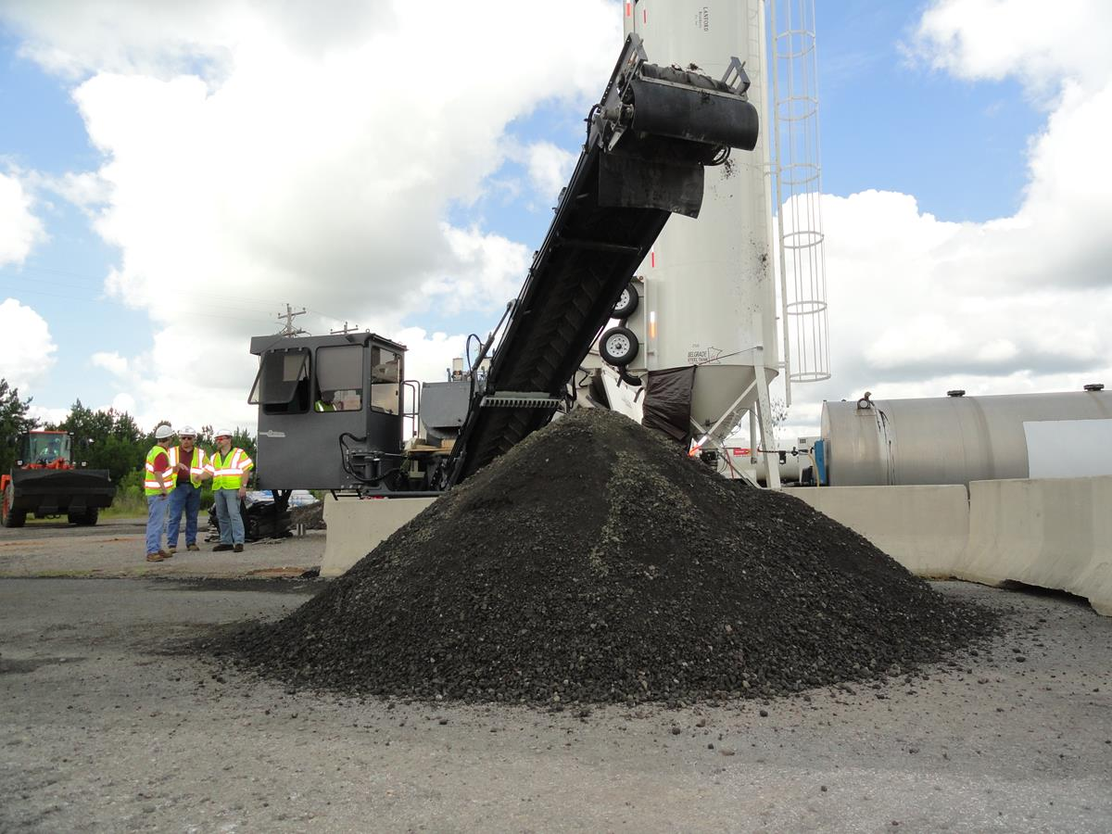
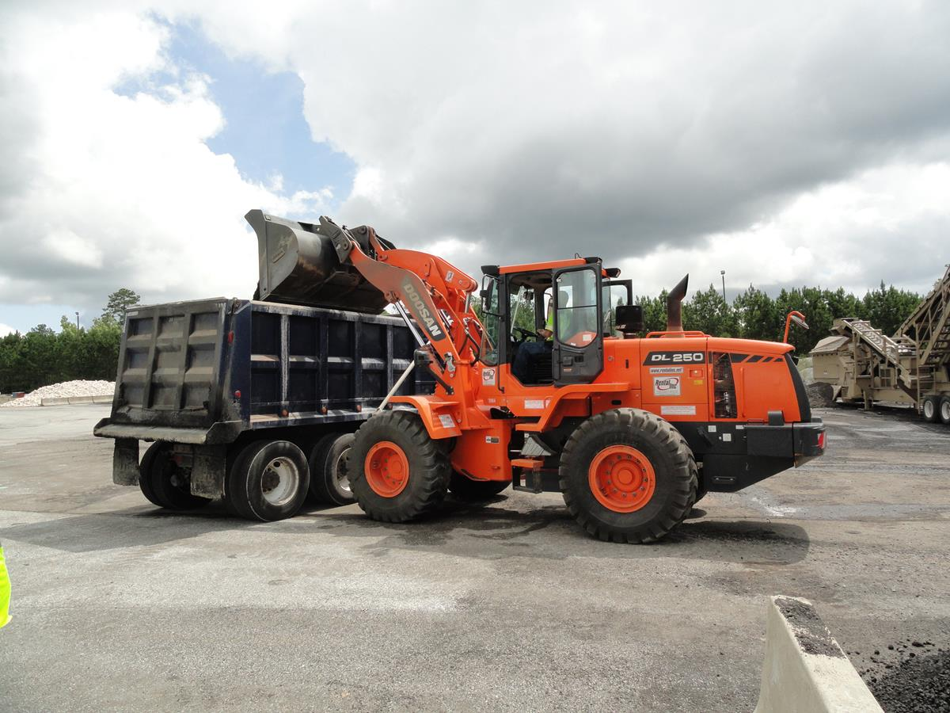
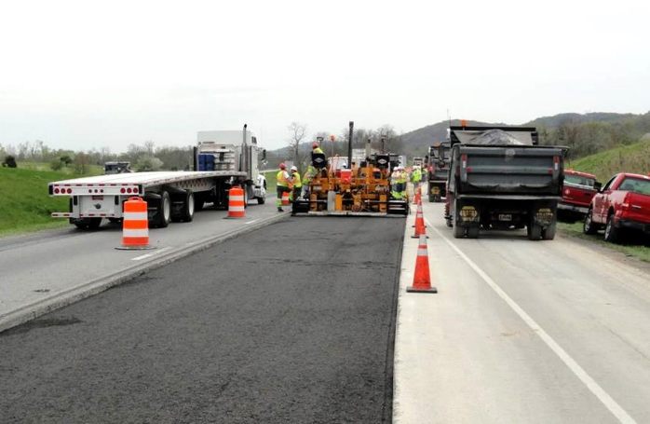
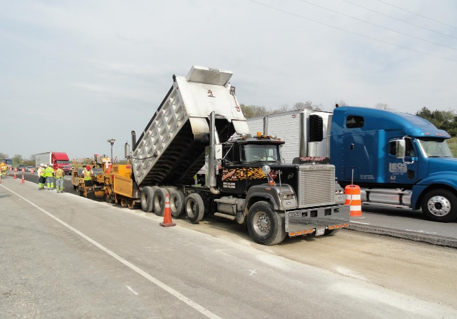
The Basic CCPR Production Process
RAP loaded into CCPR plant hopper
CCPR mixture discharged onto ground or into dump truck
Loader places mix in
dump truck
Compaction to target density
CCPR mix is paved and rolled to specification
CCPR mix is loaded into asphalt paver hopper
Photos Courtesy: Brian Diefenderfer, VTRC; ARRA
Notes:
The basic process of producing CCPR begins by loading the RAP material into the CCPR plant hopper. This may consist of multiple fractions (typically 2) depending on the plant being used. The RAP is then mixed with any additional moisture, the recycling agent, and any active filler as needed in a pugmill system on board the CCPR plant. The mixture is then discharged by a conveyor belt either onto the ground next to the plant or directly into a dump truck to be hauled to the jobsite. If discharged onto to ground, a loader can be used to place the processed CCPR mix into the dump truck. The truck is then used to haul the CCPR mix to the jobsite and it is loaded directly into a conventional asphalt paver. After placing the mixture, rolling commences using the specified rollers to achieve the target density and any other quality assurance requirements.

Slide 10
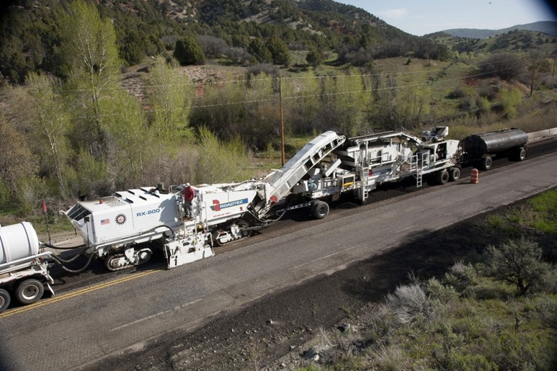
Terminology
Cold In-place Recycling (CIR)
  Mill and pulverize existing asphalt layers to a specified depth, mix additives
  Additives:
    Asphalt recycling agent
    Water
    Additives if needed
      Corrective aggregates for gradation
      Active filler such as lime or cement
Photo courtesy ARRA
Notes:
CIR consists of milling and pulverizing existing asphalt layers to a specified depth; mixing an asphalt recycling agent, water, and additives with the recycled material

Slide 11
The Basic CIR Production Process
Single unit train with attached screed
Single unit train feeding into scalping screen and hopper
Dry additive application on pavement ahead of CIR train (if needed)
Compaction to target density
CIR crushing/screening unit and pugmill
Multi-unit CIR train
Photos courtesy ARRA
Notes:
The basic CIR production process involves using a spreader unit to spread any active filler or aggregate, if needed, on the road prior to the milling/recycling unit. Next, the recycling train, which may consist of a single unit (top photos) or a combination of units (bottom photos) passes over the road, mixing in any active filler or aggregate to the mixture while also adding any necessary water and the recycling agent at the target dosage. In a single unit, all mixing occurs along with the pulverization, and an attached paving screed (top left) or a detached paving screed (top right) are used to place the mix. Multi-unit trains may involve milling the RAP and discharging it into a crushing/screening unit and a subsequent pugmill, which is used to mix any additional water and the recycling agent into the mix. The processed CIR mix is then discharged into a paver and placed. Alternatively, the processed CIR mix could be placed in a windrow followed by a pickup device that loads the mix into the paver. After placing the mixture, rolling commences using the specified rollers to achieve the target density and any other quality assurance requirements.

Slide 12
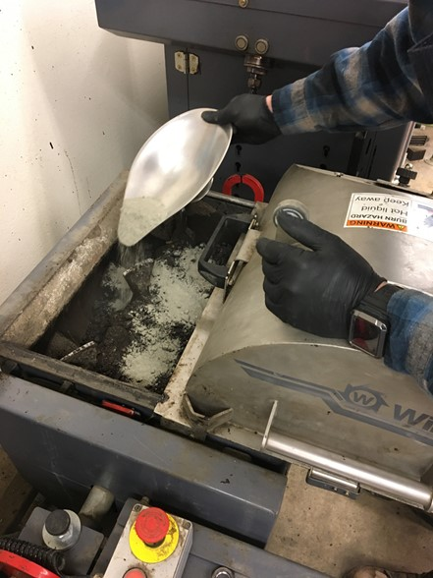
Terminology
Active Filler
  Additives such as cement, lime, etc.
Corrective Aggregate
  Consists of coarse or fine aggregate particles
Reclaimed Asphalt Pavement (RAP)
    CIR - Asphalt pavement millings being recycled
    CCPR - Asphalt pavement millings from the project
    being recycled, another project, or an existing stockpile
Photo courtesy Bowers and Diefenderfer
Notes:
Active filler is additives that are added to the mixture such as cement and lime that provide additional fines (namely for foamed mixes), early strength and stiffness, decrease in moisture susceptibility, and some long term stiffness. Active fillers should only be used when needed, but are not uncommon. These are limited to no more than 1% cement by weight of the RAP, or a ratio of 2.5:1 or 2:1 for recycling agent to cement. Lime is typically added at a rate of no more than 1% to 1.5% by weight of the RAP.
Corrective aggregates can be fine or coarse aggregates used to adjust the gradation.
Reclaimed Asphalt Pavement, or RAP, consists of pavement millings either from the project or from a stockpile that are used to create the CR mixture.

Slide 13
Terminology
Supplemental Reclaimed Asphalt Pavement (CIR specific)
  Any additional RAP added to the recycled mixture
  Must meet the requirements below:
Tests | Method | Limit
Deleterious Materials: Clay Lumps and Friable Particles in Aggregate, % max by weight | AASHTO T 112 | 0.2% Maximum
Maximum Sieve Size, ≤1.5 inches | AASHTO T 27 | 100% Passing
Notes:
Supplemental RAP may be used in CIR projects to help correct the gradation and/or adjust for yield.
Typically, rubberized crack filler, pavement markers, loop wires, thermoplastic markers, paving fabric and other similar materials are removed from the RAP as observed.
Residual materials that cannot be completely removed from the processed RAP should be appropriately sized and blended so as not to adversely affect the appearance or strength of the recycled pavement.
The maximum sieve size may vary depending on CIR train type and agency specifications.

Slide 14
Terminology
Asphalt Recycling Agent
  Emulsified asphalt, must meet AASHTO MP 31.
    Typical emulsified asphalts used for CR include CSS-1h, HFE 150, or engineered emulsions.
    Engineered emulsions are asphalt emulsion products designed for the specific project materials and application but that may not fit commodity emulsion designations.
  Foamed Asphalt, must meet AASHTO MP 38 and foamed asphalt properties of AASHTO PP 94.V
Notes:
The asphalt recycling agent is either a foamed asphalt or an emulsified asphalt, and either is used to bind the mix RAP together.
Emulsified asphalt must meet AASHTO MP 31, and typically use CSS-1H, HFE 150, or an engineered emulsion.
Engineered emulsions are designed for the specific project, but may not fit commodity emulsion designations.
If night paving, it is encouraged that the contractor work with the emulsion supplier to ensure that the proper emulsion is supplied given weather conditions or construction limitations
Foamed asphalt must be tested to ensure stability in the foaming process, meeting minimum half-life and expansion ratio requirements. If these requirements are not met, the mix likely will not perform.

Slide 15
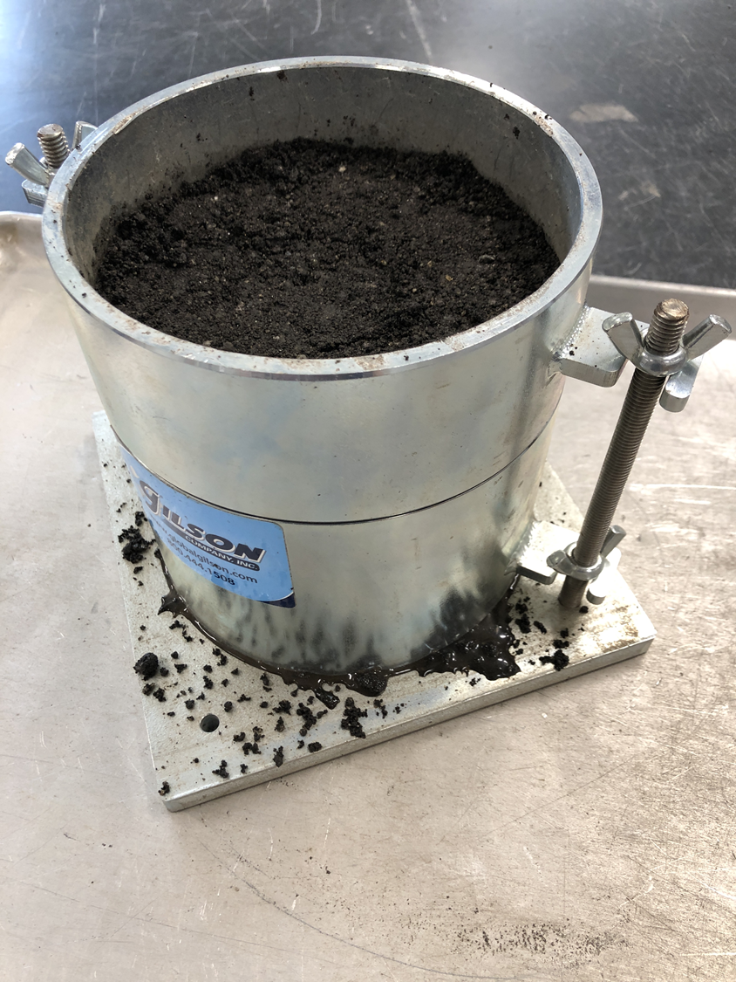
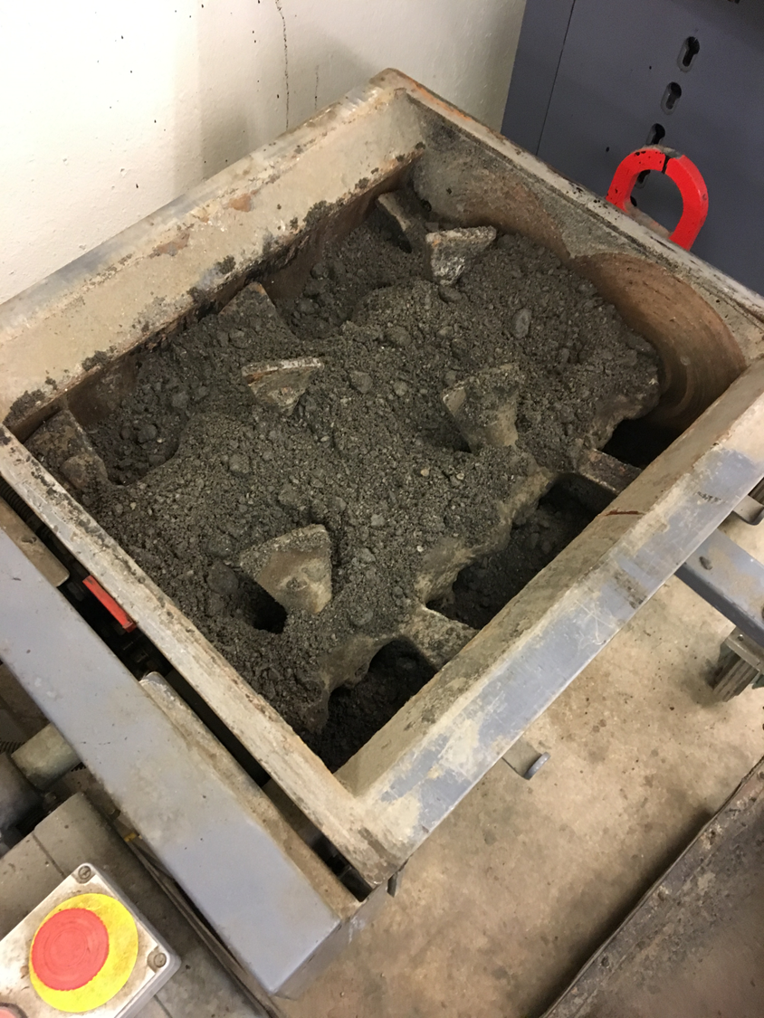
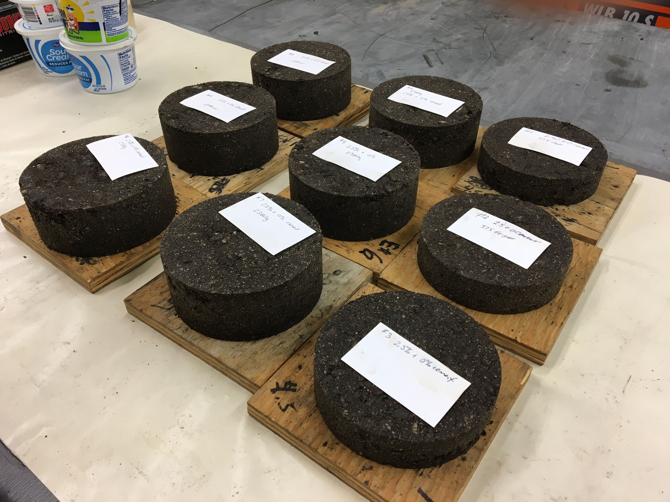
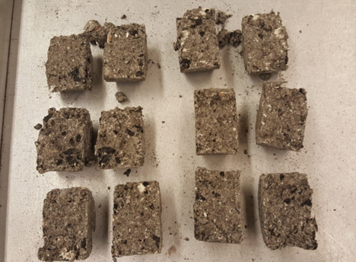
Materials and Mix Design
Design in accordance with:
  AASHTO PP 86 and MP 31 for emulsified asphalt recycling agent
  AASHTO PP 94 and MP 38 for foamed asphalt recycling agent
  or Agency specified procedure
Photo courtesy Bowers and Diefenderfer
Notes:
If a mix design is not provided by the agency, the mix design shall be submitted by the Contractor for approval by the agency.
Multiple mix designs may be needed on the same project depending on conditions encountered and should be based on materials directly sampled from the project site.
Adequate sampling and testing should be performed to understand the variability of materials within the project.
The mix design should indicate allowable tolerances for the asphalt recycling agents, additives, and water so as to not jeopardize the performance of the mix. The tolerances identify the allowable deviation the Contractor may use to adjust the mix during construction so that it may be placed and performs successfully.

Slide 16
Construction: Equipment
Cold In-place Recycling Equipment
  Single Unit Recycler
  Multi-Unit Recycler
Cold Central Plant Recycling Equipment
  Mobile plant
  Portable Pugmill Unit (emulsion only)
  Pugmill from a multi-unit CIR train located on or near the project site
  Hot/Warm mix plant
Notes:
There are varying types of equipment that can be used for CIR and CCPR; regardless, equipment must be capable of:
Milling the existing asphalt pavement to the specified depth, sizing the resulting millings/RAP, and mixing the RAP with the materials at the recommended target and within the tolerances stipulated in the mix design.
Meeting the specified sizing requirement with either the milling process or with additional sizing equipment.
Producing a homogenous CIR mixture by mixing the RAP with asphalt recycling agent, water, and any other additives.

Slide 17
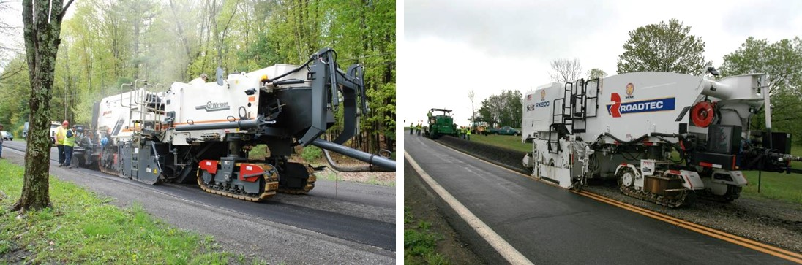
Single Unit Recycler
Controls top size of RAP with drum speed and forward speed; down cut
Adds recycling agent to cutting chamber based on assumed unit weight & volume of material
Active filler and corrective aggregate are placed ahead of the recycler
Photo courtesy Steve Cross, ARRA
Notes:
Single unit recyclers pulverize the bound pavement layers to the target depth and mix it with the recycling agent, water, and other additives.
Additives such as active filler or corrective aggregate are spread in front of the recycler prior to pulverization.

Slide 18
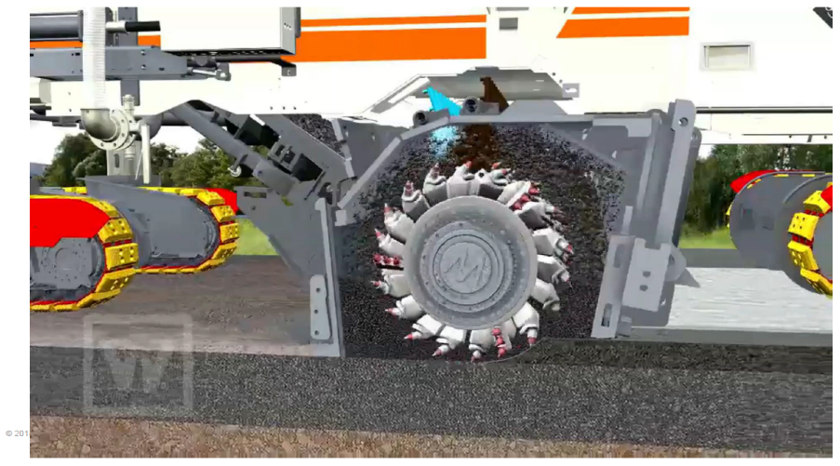
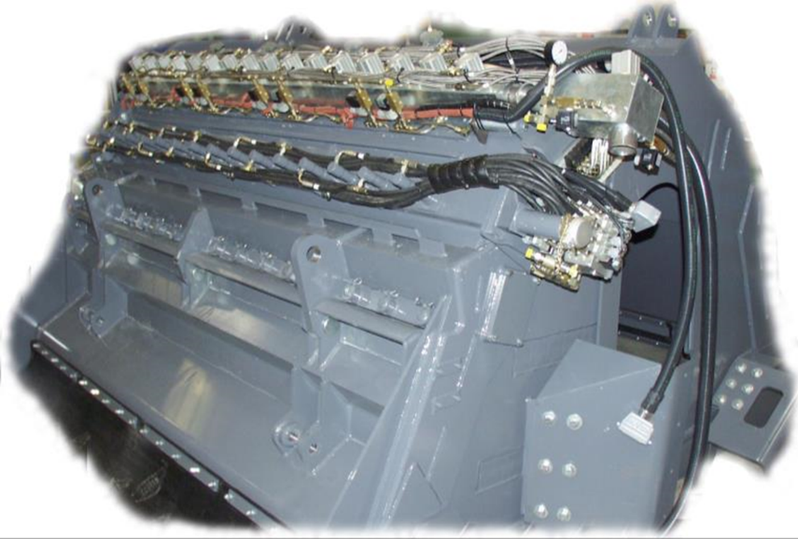
Single Unit Recycler
Ensure independent systems for adding the recycling agent and water
  Each system has spray bar the full width of the mixing chamber
  Pump system to independently set the application rate of each
Water
spraybar
Foamed asphalt
spraybar
Photo courtesy Steve Cross, ARRA
Notes:
It is required that independent systems for water and recycling agent are used.
These systems should spray water the width of the mixing chamber.
The pumping system should independently set the application rate.

Slide 19
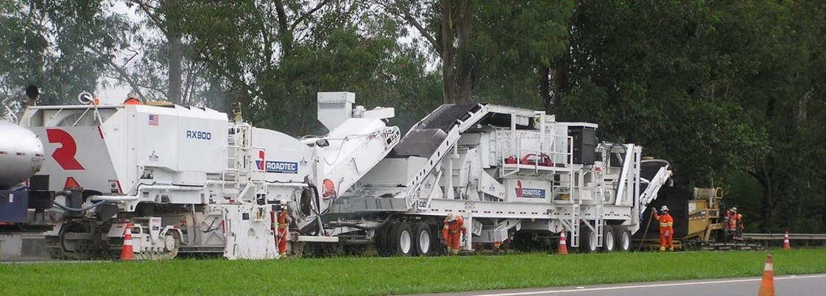
Multi-unit Recycler
Controls top size of RAP with crushing & screening unit
Adds recycling agent based on mass of material entering pugmill
Photo courtesy Steve Cross, ARRA
Notes:
Multi-unit recyclers, or “trains”, are a combination of milling machine, crushing and screening unit, mixing unit, and paving screed.
Top size of the RAP is controlled with the crushing and screening unit.
Addition of the recycling agent is based on the mass of material entering the mixing unit, or pugmill, along with any additional water and additives.
Material is either placed into a paving screed or a windrow which is picked up using a pickup unit and placed into a paver hopper.

Slide 20
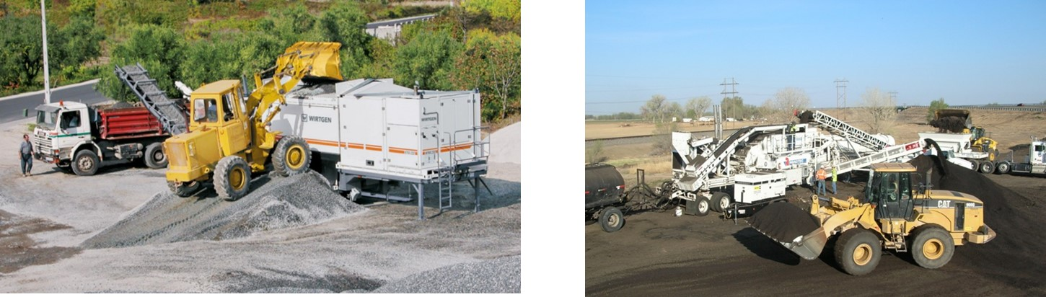
Cold Central Plant Recycling
Produced using a mobile plant, portable pugmill unit, pugmill from a multi-unit CIR train located on or near the project site, or hot/warm mix plant
Photo courtesy Steve Cross, ARRA
Notes:
The cold central plant can either be a mobile plant, as shown on the left, a portable pugmill unit, or a pugmill/mixing unit from a multi-unit CIR train located on or near the project site.
Cold central plant recycling can use any of the following RAR sources:
Same project CCPR uses RAP that is milled, recycled in the CCPR plant, and returned to the paving job
Imported project CCPR uses RAP milled from one location, recycled in the CCPR plant, and take not another location
Imported Stockpile CCPR uses RAP millings from an existing stockpile, recycled in the CCPR plant, and taken to the project site

Slide 21
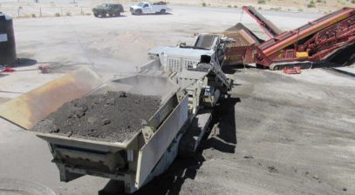
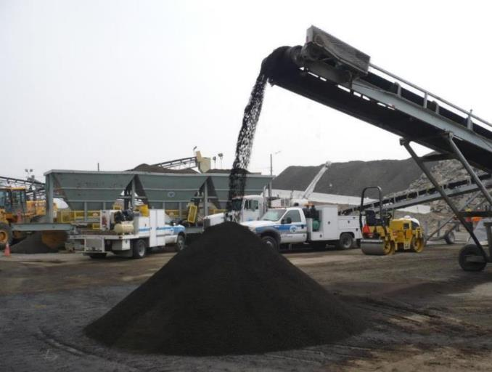
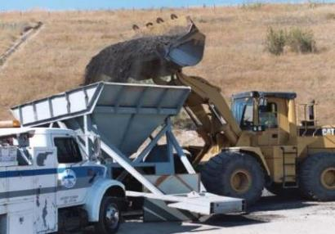
Cold Central Plant Recycling
Fractionate RAP and add new aggregate if required
No. 4 Minus RAP
1” x No. 4 RAP
3/8” New Agg.
Photo courtesy Steve Cross, ARRA
Notes:
When using CCPR, RAP can be fractionated and controlled prior to placement.

Slide 22
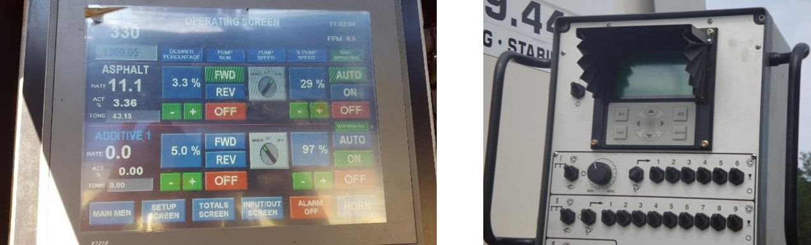
Cold Recycling Equipment
        Automatic digital readings display both the flow rate and total amount of asphalt recycling agent, liquid additives and pulverized materials (multi-unit train only) in appropriate units of weight and time
Photo courtesy Steve Cross, ARRA
Notes:
Digital readings are used to show key readouts such as flow rate, total amount of asphalt recycling agent, liquid additives, and in the case of a multi-unit train, the pulverized materials. All readings are in the appropriate units of weight and time.

Slide 23
Construction: Calibration
Calibrate recycling equipment at the start of every year
  Monitor throughout the year to ensure the field calculated yield matches within 10% of desired production rate
  Recalibrate if the field calculated yield is greater than or less than 10% or agency requirements
  Recalibrate equipment after any major repairs (e.g., replacement of pumps, belts, etc.)
Calibrate recycling equipment by producing cold recycling material using known quantities of RAP, asphalt recycling agent, and water
Verify that the materials are placed to the accuracy specified
Notes:
Recycling equipment should be calibrated at the start of every year and monitored throughout.
CR equipment should be checked for accuracy during construction by monitoring yield.
However, due to practical constraints such as varying unit weights of the existing pavement, irregular widths during recycling, and non-level surfaces for tank measurements, a 10% variation in yield is normally acceptable.
If yield is greater than 10%, recalibration should be performed.
Recalibrate if any major repairs are done to the equipment.
Calibration can b e performed by producing the CR material using known quantities of RAP, recycling agent, and water.

Slide 24
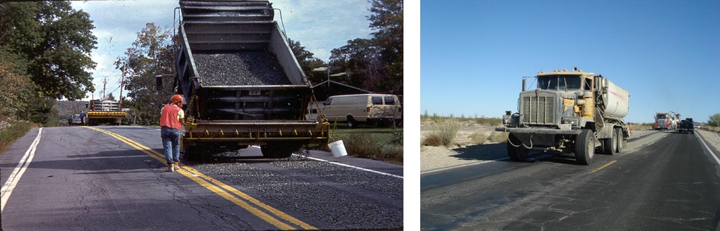
Construction: Additional CIR Equipment
  Corrective aggregate spreaders
  Dry cement and lime spreaders
  Additive slurry storage and supply equipment
  Water truck
Photo courtesy Steve Cross, ARRA
Notes:
CIR may require additional materials and/or equipment that is specific to the CIR process… these include:
Corrective aggregate and cement/lime spreaders so that any solid additives can be spread in front of the recycler to be mixed into the recycled layer
Additive slurry storage and supply equipment
A water truck to ensure that the optimum water content of the mix is achieved.

Slide 25
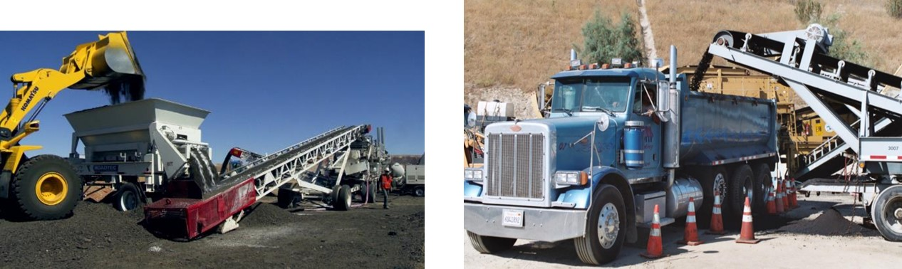
Construction: Additional CCPR Equipment
  Self-propelled milling machine
  Sizing equipment
  Additive (dry & slurry) storage and supply equipment
  Water supply
  Hauling equipment
Photo courtesy Steve Cross, ARRA
Notes:
CCPR may require additional materials and/or equipment that is specific to the CCPR process… these include:
A self-propelled milling machine to recover the RAP that is to be used in the CCPR process and/or to make space for the CCPR material
Sizing equipment to adjust gradation and ensure that no large particles, typically greater than 1.5 inches, are processed in the mixture.
Additive and water supply equipment
Hauling equipment to the jobsite.

Slide 26
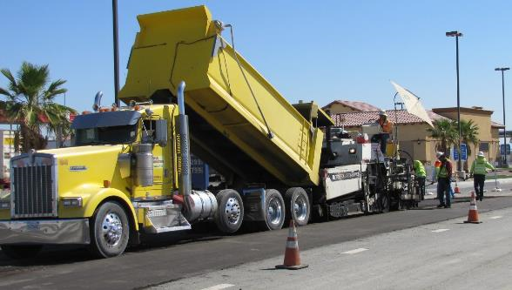
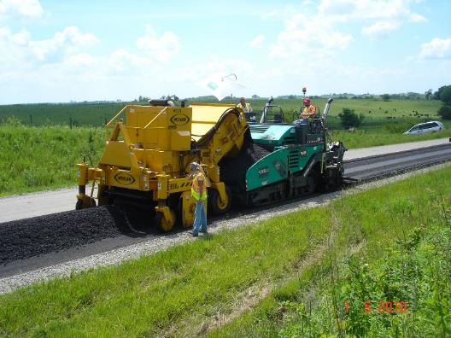
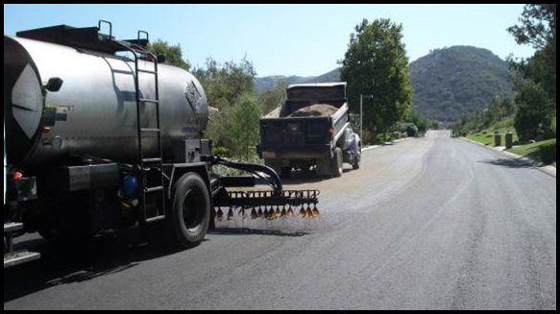
Construction: Additional CR Equipment
  Laydown equipment
  Compaction equipment
  Optional fog sealing and fine aggregate spreading equipment
Photo courtesy Steve Cross, ARRA
Notes:
Both CIR and CCPR require laydown equipment such as an asphalt paver to place the mixture. Compaction equipment is also required and will be expanded on in the next slide. In the case that the mixture is going to be trafficked, it is recommended that fog sealing and fine aggregate spreading equipment be used to apply a protective layer to prevent raveling.

Slide 27
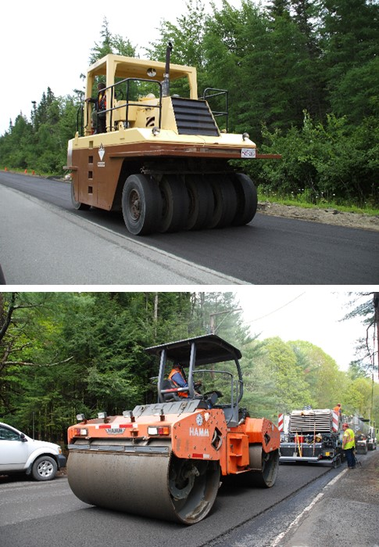
Construction: Compaction Equipment
The required number, mass, and types of rollers must be able to obtain required compaction
At a minimum, use the following rollers
  Pneumatic Tire Roller:
    One pneumatic tired roller with a minimum mass of 22 tons
  Double Drum Vibratory Roller:
    At least one double drum vibratory roller with a minimum mass of 10 tons
Photo courtesy Steve Cross, ARRA
Notes:
At a minimum, a pneumatic tire roller with a mass of at least 22 tons and a double drum vibratory roller with a minimum mass of 10 tons is required. Additional rollers can be used if deemed necessary.

Slide 28
Construction: Just-in-time Training (JITT) / Preconstruction Personnel Training
Personnel involved with the construction and quality control of CIR from both the Contractor and Agency
JITT shall be completed prior to the start of CR operations
Course instructor:
  Provided by contractor or agency, acceptable to both
  Experience in the following for CR:
    Mix design
    Construction
    Field quality control tests
Notes:
The JITT is an important element of the paving process to ensure that proper procedures are followed to construct a high-quality CIR pavement.
A general guideline is that the trainer has successfully completed a minimum of 5 CIR projects.
JITT is most often held 5 to 14 days prior to construction.
It is equally important that agency inspection staff and appropriate field personnel from the CIR contractor (e.g., recycling foreman, QC staff, etc.) both attend.

Slide 29
Construction: Just-in-time Training (JITT) / Preconstruction Personnel Training
Topics to discuss include:
  Paving plan and traffic control
  Protocol at busy intersection crossings
  Quality control plan, requirements, and responsibilities
  Contingency plan and action limits
  Weather forecast
Notes:
Example topics include general plans for paving and traffic control, protocol at busy intersection crossings, the quality control plant, requirements and responsibilities, contingency plan and action limits, and the weather forecast, among others.

Slide 30
Construction: Weather
Weather limitations and paving seasons for CR must meet agency requirements
RAP temperature after milling must be greater than 50 °F (10 °C)
CR operations are not to be performed when overnight ambient temperatures are forecast to be less than 35 °F (2 °C) for any part of the overnight period
CR may be performed during light precipitation
  So long as the Contractor can demonstrate that performance of the recycled asphalt pavement will not be adversely affected
Notes:
Weather limitations are often confined by agency requirements.
It is recommended that the RAP temperature be greater than 50F (10C). This will prevent challenges with the recycling agents such as the formation of “stringers” in foamed asphalt mixtures.
CR operations should not be performed when the overnight ambient temperatures are forecast to be less than 35F (2C) for any part of the overnight period.
CR may be performed during light precipitation, so long as the contractor can demonstrate that performance of the recycled asphalt pavement will not be adversely affected.

Slide 31
Construction: Weather
Best Practice
  CIR and CCPR should not be performed during excessively wet conditions, nor started if rain is imminent
  Sunlight is best for curing and compaction should be completed a minimum of ½ hour before sunset
Notes:
It is also a best practice that CIR and CCPR are not performed during excessively wet conditions, nor started when rain is imminent.
Curing occurs best in sunlight, and compaction should be completed a maximum of ½ before sunset if possible.

Slide 32
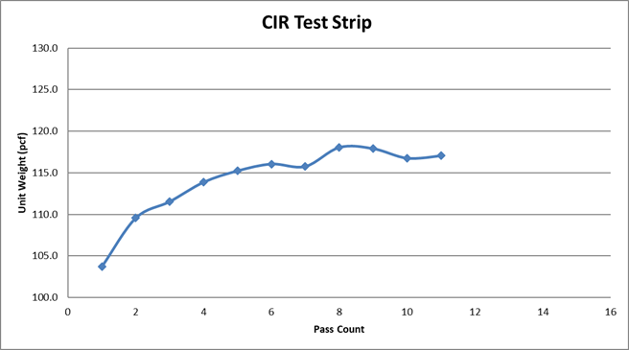
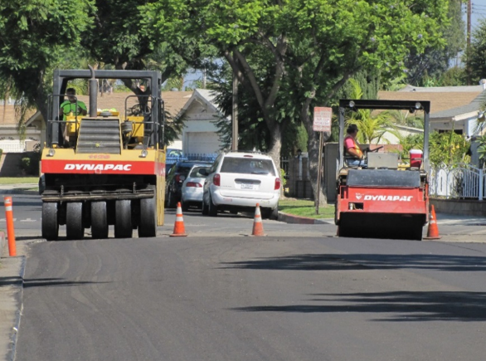
Construction: Test Strip
Construct a test strip on the project at an approved location
  Process a minimum 500-foot-long test strip with testing in the last 200 feet
  One continuous pass, to the lines and grades according to the plans and specifications.
Provide the Engineer with
  Maximum in‑place density achieved
  Percent passing maximum sieve size
  Application rates of recycling agent, water, and other additives used on the accepted test strip
Photo courtesy Steve Cross, ARRA
Notes:
Process a 500-foot long test strip.
Test, using the nuclear density gauge, the last 200 feet
The test strip should be performed in one continuous pass, to the lines and grades according to the plans and specifications
The engineer should be provided with:
The maximum in-place density achieved
The percent passing the maximum sieve size
Application rates of recycling agent, water, and other additives used on the accepted test strip

Slide 33
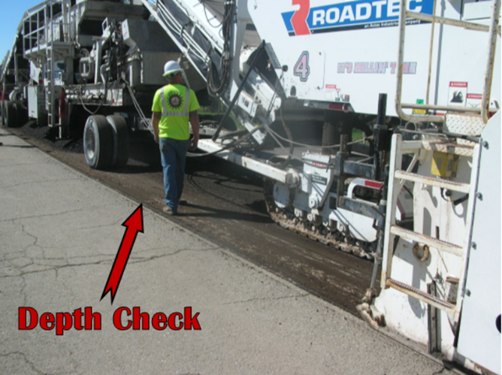
Construction: Notes on Placement
Grade and Cross Slope
  Can mill to a constant depth or to a cross slope, but not both
Typical depth tolerance is 1/4 inch
If slope correction is greater than 0.25 – 0.5%, cannot meet depth tolerance
Either pre-mill or correct slope with HMA overlay
Photo courtesy Steve Cross, ARRA
Notes:
When placing the mixture it is important to note that you can mill to a constant depth or to a cross slope, but not both.
Typical depth tolerance is ¼ of an inch.
If slope correction is greater than 0.25 to 0.5%, you cannot meet a depth tolerance
Either pre-mill or correct the slope with a hot/warm mix asphalt overlay

Slide 34
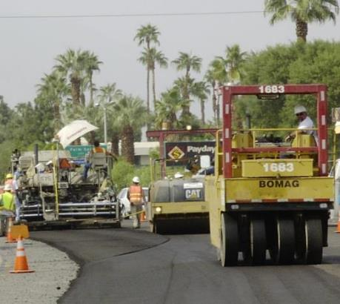
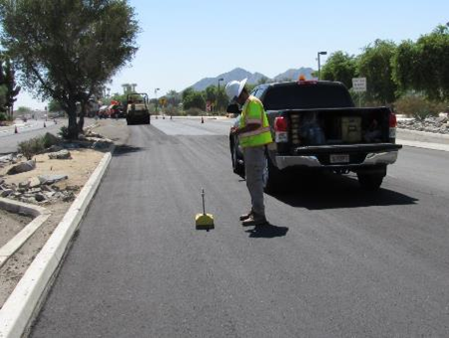
Construction: CR Primary Compaction
Compact the mixture using the same rolling patterns and equipment used to establish the target density in the test strip
Continuously monitor in accordance with AASHTO T 310 or T 355 to verify specification requirements are met
If two successive density tests fail to meet acceptance testing requirements, establish a new test strip and identify a new rolling pattern and target density
Discontinue rolling if it is found to cause cracking, major displacement, and/or any other type of pavement distress until the problem can be resolved
Photo courtesy Steve Cross, ARRA
Notes:
Primary compaction of the mixture should follow the same rolling patterns and equipment used to establish the target density on the test strip.
Continuously monitor compaction to verify it meets construction specification requirements – more on these requirements in future slides.
If two successive density tests during production fail to meet acceptance testing requirements, establish a new test strip and identify a new rolling pattern and target density
Discontinue rolling if it is found to cause cracking, major displacement, and/or any other type of pavement distress until the problem can be resolved.

Slide 35
Construction: CR Optional Secondary Compaction
Intended for emulsified asphalt mixes (not foamed asphalt)
Secondary compaction should not be performed on mixes containing active filler
Conduct optional secondary compaction after initial cure and before placing any final surfacing
Commence secondary compaction only when the pavement temperature is greater than 80 °F (27 °C)
Notes:
Secondary compaction is an option for emulsion mixes that do not have an active filler. If secondary compaction is applied to a mix with an active filler, the bonds that lead to stiffness will be broken.
Conduct optional secondary compaction after the initial cure but before the final surfacing is placed
Commence secondary compaction only when the pavement temperature is greater than 80F (27C)

Slide 36
Construction: CR Optional Secondary Compaction
Establish a new target density using a new rolling pattern following the procedures of section AASHTO XXX.05.F.2.b (NCHRP 14-43)
Density testing shall be repeated throughout the secondary compaction efforts to verify that the secondary compaction is within ± 5% of the target density established
Cease secondary compaction in the immediate area if cracking results or if there is no appreciable increase in density
Notes:
When performing secondary compaction, establish a new target density using a new rolling pattern
Density testing shall be repeated throughout secondary compaction to verify that it is within ± 5% of the target density established.
Cease secondary compaction in the immediate area if cracking results or if there is no appreciable increase in density.

Slide 37
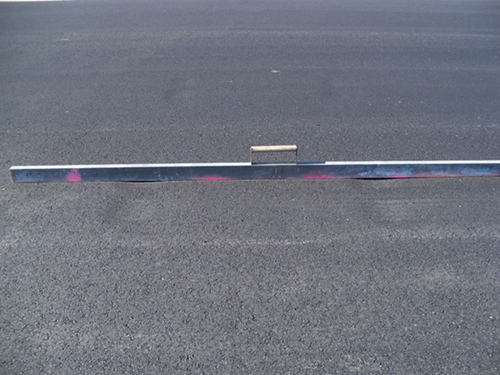
Construction: Smoothness
Check the finished surface and grade of the recycled layer at least every 500 ft during placement using a straight edge or per agency requirements
  No more than 3/8 inch (10 mm) variance using a 10-foot (3.0-m) straight edge placed in any direction or per agency requirements
Correct any humps exceeding 3/8 inch by rerolling, trimming, milling or abrasive grinding
For depressions exceeding 3/8 inch or agency
requirements
  Apply a tack coat in accordance with to AASHTO MP 36
  Fill the depressed area with a plant-produced asphalt
  mix
Photo courtesy Steve Cross, ARRA
Notes:
Check the finished surface and grade of the recycled layer at least every 500 ft during placement using a straight edge or per agency requirements.
The surface may not vary more than 3/8 inch (10 mm) from a 10-foot (3.0-m) straight edge placed in any direction or per agency requirements.
Correct any humps exceeding 3/8 inch by rerolling, trimming, milling or abrasive grinding.
For depressions exceeding 3/8 inch or agency
requirements:
Apply a tack coat in accordance with to AASHTO MP 36
Fill the depressed area with a plant-produced asphalt
mix.

Slide 38
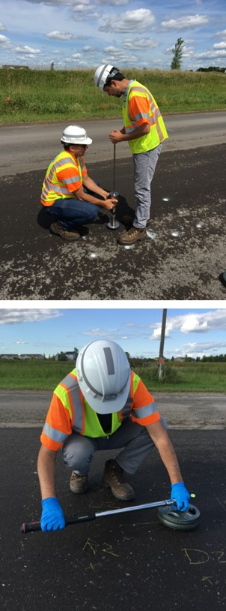
Construction: Trafficking
Do not allow traffic on the recycled layer until:
  The moisture content of the layer is reduced to 3.0 percent or less, or
  Passing values using AASHTO XXXX (NCHRP 9-62) Short-Pin Raveling Test are obtained, or
  The Engineer approves
Photo courtesy Brian Diefenderfer
Notes:
Place the specified surface course on the recycled layer after removing any loose particles by power brooming if
The moisture content of the layer is reduced to 3.0 percent or less; A moisture content of 2.0-3.0% has been used with lower percentages in more arid regions of the country.
Passing values using AASHTO XXXX (NCHRP 9-62) Short-Pin Raveling Test are obtained; or
The Engineer approves.

Slide 39
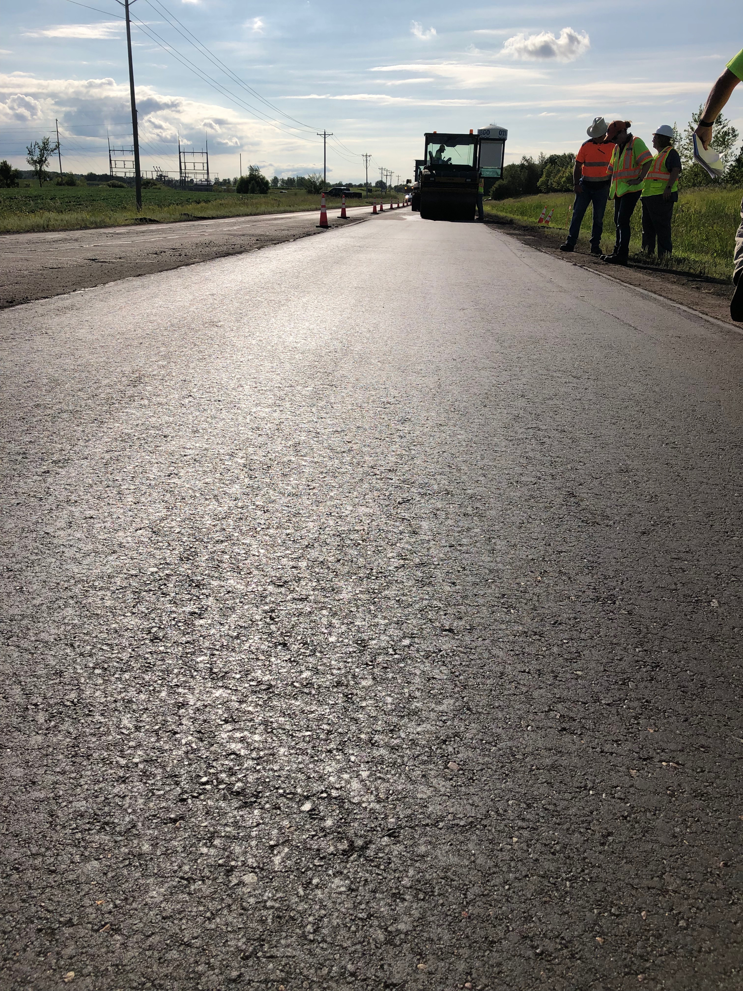
Construction: Prior to Surfacing
Maintain and protect the CR surface
  May encounter raveling in cross-traffic, high shear areas
  Fog seal and blot with aggregate can minimize raveling
Photo courtesy Steve Cross, ARRA
Notes:
Maintain and product the CR surface
May encounter raveling in cross-traffic, high shear areas
Fog seal and blot with aggregate can minimize raveling

Slide 40
Construction: Surfacing
Place the specified surface course on the recycled layer after removing any loose particles by power brooming if
  The moisture content of the layer is reduced to 3.0 percent or less
  Passing values using AASHTO XXXX (NCHRP 9-62) Long-Pin Shear Test are obtained, or
  The Engineer approves
Photo courtesy Brian Diefenderfer
Notes:
Place the specified surface course on the recycled layer after removing any loose particles by power brooming if
The moisture content of the layer is reduced to 3.0 percent or less; A moisture content of 2.0-3.0% has been used with lower percentages in more arid regions of the country.
Passing values using AASHTO XXXX (NCHRP 9-62) Long-Pin Shear Test are obtained; or
The Engineer approves.

Slide 41
Construction: Surfacing
If an asphalt mix is used as the surface course, apply a tack coat in accordance with to AASHTO MP 36 and AASHTO PP 93 to the recycled layer
  Ensure hot asphalt binder tack is cool prior to loading with construction traffic
  Do not use hot asphalt binder tack if overlaying CIR or CCPR with an additional CCPR layer
Notes:
If an asphalt mix is used as the surface course, apply a tack coat in accordance with to AASHTO MP 36 and AASHTO PP93 to the recycled layer.
Ensure hot asphalt binder tack is cool prior to loading with construction traffic.
Do not use hot asphalt binder tack if overlaying CIR or CCPR with an additional CCPR layer.

Slide 42
Contractor QC Testing
Property | Method | Minimum Frequency | Criteria
Density | AASHTO T 310 AASHTO T 355 | Twice per 1000 ft | 97-103% of target density
Gradation* | AASHTO T 27 | At least once in the first 250 ft of each day and then twice per 2500 ft thereafter | 100% passing max particle size
Cut Depth** | Agency Method | At least once in the first 250 ft of each day and then once per 500 ft thereafter (in CCPR QA document table) | ±0.25 inch of planned depth
Cross Slope** |  |  | ±0.1% of the planned percent cross slope
Surface Tolerance |  |  | Less than 3/8 inch using a 10-ft straight edge
*Measure gradation of the CIR or CCPR materials on unburned materials (i.e., do not use the ignition furnace), and due to frequency of testing may or may not include recycling agent
** If the cross slope adjustment is grater than 0.25% on a particular sublot, use either depth or cross slope as an acceptance parameter for that sublot only
Notes:
The properties, methods, frequencies, and criteria in the table above should be achieved.

Slide 43
Contractor CIR QC Testing (Con’t.)
Property | Method | Minimum Frequency | Criteria
Recycling Agent | Read Meter | At least once in the first 250 ft and then once per 500 ft thereafter (CCPR) | ±0.25% of the planned percent recycling agent content
Active Filler | Agency Method | Measure at the beginning of each load using tarp test and calculate the yield with each load | ±0.1% of the planned percent active filler
Corrective Aggregate |  |  | Within ±10% of the target corrective aggregate
Notes:
The properties, methods, frequencies, and criteria in the table above should be achieved.
The contractor shall be allowed to adjust the recycling agent dosage rate within the mix design tolerance by notifying the Engineer. Engineer approval is required if adjustments are greater than this tolerance.
Verify the amount of recycling agent and additives used by comparing the expected quantity of material used and the actual quantity of material used. If these values differ by more than 10%, check the distribution at the cold recycler and recalibrate the rate in accordance with manufacturers recommendations.

Slide 44
Contractor CCPR QC Testing (Con’t.)
Property | Method | Minimum Frequency | Criteria
Recycling Agent*** | Read Meter | At least once in the first 250 ft of each day and then twice per 1000 ft thereafter (once per 500 ft in CIR) | ±0.25% of the planned percent recycling agent content
Active Filler*** | Agency Method |  | ±0.1% of the planned percent active filler
Corrective Aggregate*** |  |  | Within ±10% of the target corrective aggregate
*** For CCPR mixes, frequency may be based on tonnage like asphalt mixes
Notes:
The properties, methods, frequencies, and criteria in the table above should be achieved.
The contractor shall be allowed to adjust the recycling agent dosage rate within the mix design tolerance by notifying the Engineer. Engineer approval is required if adjustments are greater than this tolerance.
Verify the amount of recycling agent and additives used by comparing the expected quantity of material used and the actual quantity of material used. If these values differ by more than 10%, check the distribution at the CCPR plant and recalibrate the rate in accordance with manufacturers recommendations.

Slide 45
Table 5.1 Acceptance Test Criteria
Property | Method | Minimum Frequency | Criteria
Density | AASHTO T 310 AASHTO T 355 | Once per 1000 ft | 97-103% of target density
Gradation* | AASHTO T 27 | At least once in the first 250 ft of each day and then once per 2500 ft thereafter | 100% passing max particle size
Cut Depth** (CIR only) | Agency Method | At least once in the first 250 ft of each day and then once per 500 ft thereafter | ±0.25 inch of planned depth
Cross Slope** |  |  | ±0.1% of the planned percent cross slope
Surface Tolerance |  |  | Less than 3/8 inch using a 10-ft straight edge
*Measure gradation of the CIR or CCPR materials on unburned materials (i.e., do not use the ignition furnace), and due to frequency of testing may or may not include recycling agent
** If the cross slope adjustment is grater than 0.25% on a particular sublot, use either depth or cross slope as an acceptance parameter for that sublot only
Notes:
The properties, methods, frequencies, and criteria in the table above should be achieved.

Slide 46
Table 5.1 CIR Acceptance Test Criteria (Con’t.)
Property | Method | Minimum Frequency | Criteria
Recycling Agent | Read Meter | At least once in the first 250 ft of each day and then once per 1000 ft thereafter | ±0.25% of the planned percent recycling agent content
Active Filler | Agency Method | Measure at the beginning of each load using tarp test and calculate the yield with each load | ±0.1% of the planned percent active filler
Corrective Aggregate |  |  | Within ±10% of the target corrective aggregate
Notes:
The properties, methods, frequencies, and criteria in the table above should be achieved.
The contractor shall be allowed to adjust the recycling agent dosage rate within the mix design tolerance by notifying the Engineer. Engineer approval is required if adjustments are greater than this tolerance.
Verify the amount of recycling agent and additives used by comparing the expected quantity of material used and the actual quantity of material used. If these values differ by more than 10%, check the distribution at the cold recycler and recalibrate the rate in accordance with manufacturers recommendations.

Slide 47
Table 5.1 CCPR Acceptance Test Criteria (Con’t.)
Property | Method | Minimum Frequency | Criteria
Recycling Agent*** | Read Meter | At least once in the first 250 ft of each day and then once per 1000 ft thereafter | ±0.25% of the planned percent recycling agent content
Active Filler*** | Agency Method |  | ±0.1% of the planned percent active filler
Corrective Aggregate*** |  |  | Within ±10% of the target corrective aggregate
*** For CCPR mixes, frequency may be based on tonnage like asphalt mixes
Notes:
The properties, methods, frequencies, and criteria in the table above should be achieved.
The contractor shall be allowed to adjust the recycling agent dosage rate within the mix design tolerance by notifying the Engineer. Engineer approval is required if adjustments are greater than this tolerance.
Verify the amount of recycling agent and additives used by comparing the expected quantity of material used and the actual quantity of material used. If these values differ by more than 10%, check the distribution at the CCPR plant and recalibrate the rate in accordance with manufacturers recommendations.

Slide 48
Contract Item Units of Measure
Item | Unit | CCPR | CIR
Milling | SY | X
Cold Central Plant Recycling | Ton | X
Cold In-Place Recycling | SY |  | X
Recycling Agent, Foamed Asphalt | Ton | X | X
Recycling Agent, Emulsified Asphalt | Ton or Gallon | X | X
Active Filler | Ton | X | X
Corrective Aggregate | Ton | X | X
Fog Seal and Fine Aggregate | SY | X | X
Tack Coat | Ton or Gallon | X | X
Subgrade Repair | SY | X | X
Profile Milling | SY | X | X
Notes:
The following items are measured for CIR and CCPR with their respective units. It’s worth noting that milling and CCPR/CIR produced is the only difference between the two recycling methods.

Slide 49
For additional information, refer to…
NCHRP Web-Only Document 363: Construction Guidelines for Cold Central Plant Recycling and Cold In-Place Recycling
NCHRP Project 14-43, “Construction Guide Specifications for Cold Central Plant Recycling and Cold In-Place Recycling”
  Draft AASHTO Construction Guide Specification for Cold Central Plant Recycling
  Draft AASHTO Construction Guide Specification for Cold In-Place Recycling
  Construction of Cold Central Plant Recycling and Cold In-Place Recycling of Asphalt Pavements Best Practices Guide

Slide 50
Disclaimer:
NCHRP is sponsored by the individual state departments of transportation of the American Association of State Highway and Transportation Officials. NCHRP is administered by the Transportation Research Board (TRB), part of the National Academies of Sciences, Engineering, and Medicine, under a cooperative agreement with the Federal Highway Administration (FHWA). Any opinions and conclusions expressed or implied in resulting research products are those of the individuals and organizations who performed the research and are not necessarily those of TRB; the National Academies of Sciences, Engineering, and Medicine; the FHWA; or NCHRP sponsors.

