Slide 1
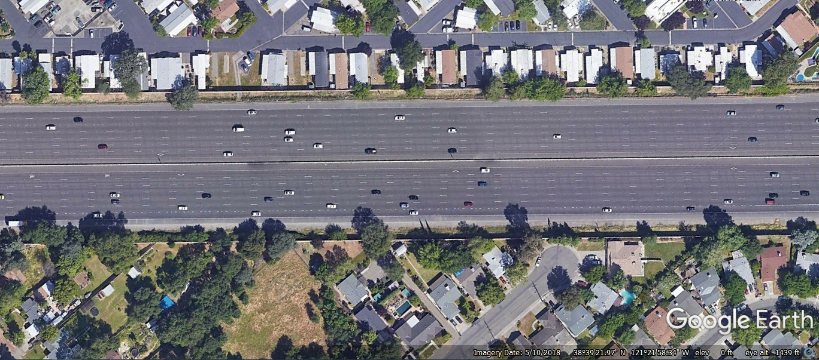
Safety Prediction Model for Freeway Facilities with High Occupancy (HO) Lanes
Source: Dwight D. Eisenhower Highway. 38deg39’21.97” N and 121deg21’58.34” W. Google Earth. May 10, 2018. December 13, 2021.

Slide 2
Disclaimer
This presentation was developed under NCHRP Project 17-89A.
More information is available in NCHRP Web-Only Document 387: Safety Prediction Model for Freeway Facilities with High Occupancy Lanes, which can be obtained from the National Academies Press website (https://nap.nationalacademies.org/).
NCHRP is sponsored by the individual state departments of transportation of the American Association of State Highway and Transportation Officials. NCHRP is administered by the Transportation Research Board (TRB), part of the National Academies of Sciences, Engineering, and Medicine, under a cooperative agreement with the Federal Highway Administration (FHWA). Any opinions and conclusions expressed or implied in resulting research products are those of the individuals and organizations who performed the research and are not necessarily those of TRB; the National Academies of Sciences, Engineering, and Medicine; the FHWA; or NCHRP sponsors.

Slide 3
Acknowledgements
Edward Harrigan, TRB Senior Program Officer
Project Panel Members
  Ida van Schalkwyk, Chair, WSDOT
  Steven Buckley, KDOT
  Casey Emoto, Santa Clara VTA
  Bryan Katz, Toxcel
  Peter Martin, CDM Smith
  Bonnie Polin, MassDOT
  Julius Rinosa, Ferrovial Services
  Guohui Zhang, University of Hawaii Manoa
  Kelly Hardy, AASHTO

Slide 4
Project Team
VHB
  Scott Himes (PI)
  Vikash Gayah
  Thanh Le
KAI
  Jim Bonneson
University of Utah
  Cathy Liu
  Zhou Chen

Slide 5
Presentation Overview
Project Background
The Predictive Method
18 Step Procedure
Segmentation Practices
Sample Problem
Implementation Spreadsheet
Takeaways and Conclusions

Slide 6
Project Background

Slide 7
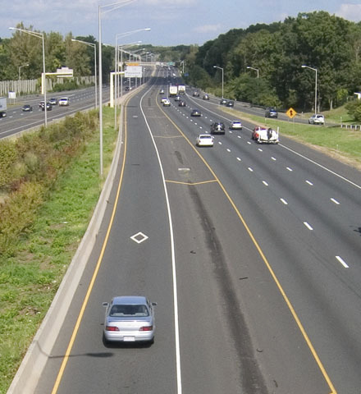
High Occupancy Vehicle (HOV) and Toll (HOT) Facilities
Intended to relieve highway congestion
Incentivize person throughput
  2 or more persons per vehicle eligibility
  3 or more persons per vehicle eligibility
HOT has electronic toll component for vehicles not meeting eligibility requirement
Restrict periods vary
  24 hours
  Directional peak period
  AM and PM peak periods
Source: VHB.
Notes:
In an effort to relieve highway congestion and promote the movement of people, some State Departments of Transportation (DOTs) have modified their freeway facilities to include high-occupancy vehicle (HOV) lanes, high occupancy toll (HOT) lanes, and other managed-lane (ML) strategies.
Fitzpatrick et al. (2016) define HOV lanes as MLs restricted to high occupancy vehicles with no tolling applied. The study estimated that about 85 percent of HOV facilities use a “2+” eligibility policy and about 50 percent of facilities operate on a time-of-day basis.

Slide 8
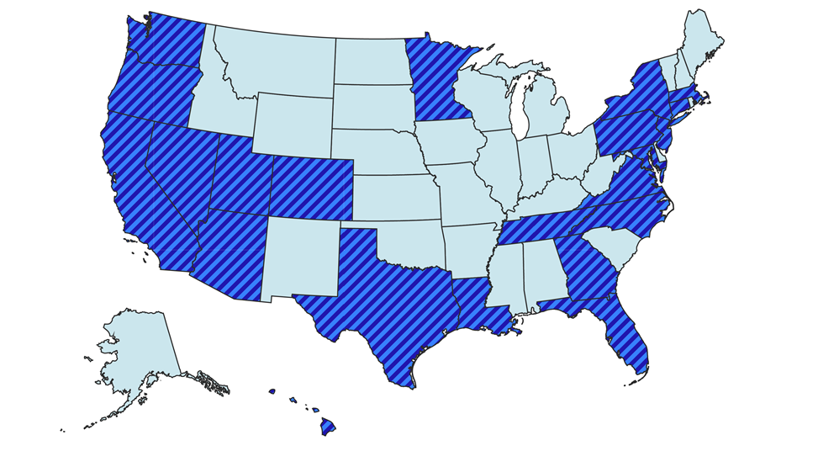
Installation of High-Occupancy (HO) Facilities
Mileage of facilities steadily increasing, as of 2021
2,875 lane-miles HOV
1,141 lane-miles HOT
  States with HOV and/or HOT facilities
Notes:
In an effort to relieve highway congestion and promote the movement of people, some State Departments of Transportation (DOTs) have modified their freeway facilities to include high-occupancy vehicle (HOV) lanes, high occupancy toll (HOT) lanes, and other managed-lane (ML) strategies.
In their review of national trends related to ML facilities, Fuhs and Obenberger (2002) found that there were about 1,200 route-miles of HOV facilities and 50 route-miles of HOT facilities in 2001. These numbers increased to 1,800 route-miles of HOV facilities and 500 route-miles of HOT facilities by 2015 (Fitzpatrick et al, 2016). In 2021, Wood et al. (2021) developed an inventory of specialty lanes and highways located on non-signalized freeway systems that are not typically for general-purpose use. The inventory identified 2,875 lane-miles of HOV facilities and 1,141 lane-miles of HOT facilities. This guide refers to facilities with HOV and HOT as high-occupancy (HO) lane facilities. Figure 1 provides a graphical representation of States with a HO lane facility as of 2021.
Fitzpatrick et al. (2016) define HOV lanes as MLs restricted to high occupancy vehicles with no tolling applied. The study estimated that about 85 percent of HOV facilities use a “2+” eligibility policy and about 50 percent of facilities operate on a time-of-day basis.

Slide 9
HSM Predictive Method for Freeway Facilities
Chapter 18 of the HSM Supplement provides predictive method for freeway facilities
Existing crash prediction methodology does not include safety impacts of HO lanes
Methodology asks users to ignore presence of those facilities
Further research was needed to address HO facilities
  NCHRP Project 17-89: Safety Performance of Part-Time Shoulder Use on Freeways
  NCHRP Project 17-89A: HOV/HOT Crash Prediction Method for the HSM
Notes:
Chapter 18 of the HSM Supplement provides the current predictive method used for freeway facilities. ISATe is used as the implementation tool for this predictive method. The existing crash prediction methodology does not include safety impacts of HO lanes. The current methodology asks users to ignore presence of those facilities when estimating safety performance on those facilities. Ignoring those lanes; however, does not ignore the potential interaction effect with general purpose lanes. Further research was needed to address HO facilities:
NCHRP Project 17-89: Safety Performance of Part-Time Shoulder Use on Freeways
NCHRP Project 17-89A: HOV/HOT Crash Prediction Method for the HSM
This presentation documents the resulting predictive method for NCHRP Project 17-89A.

Slide 10
Project Purpose
Develop a predictive method for freeway facilities with HOV/HOT lanes
  Predict total crash frequency and multiple-vehicle crash frequency
  Develop severity distribution functions to predict crash severity
  Focus on directional freeway segments
Develop proposed text for inclusion in the HSM
Develop an implementation tool for the predictive method
Notes:
The primary purpose of this project was to develop a predictive method for freeway facilities with HOV/HOT lanes including objectives to
Predict total crash frequency and multiple-vehicle crash frequency.
Develop severity distribution functions to predict crash severity.
Focus on directional freeway segments.
Further, the project objectives included developing proposed text for inclusion in the HSM and developing an implementation tool for the predictive method.

Slide 11
The Predictive Method

Slide 12
The Predictive Method (PM)
PM includes:
18-step procedure for estimating average crash frequency
Predictive model for freeway segments and speed-change lane sites
Site types addressed by PM:
One direction basic freeway segment with two to seven general-purpose through lanes and one to four concurrent HOV/HOT lanes in the subject travel direction.
Speed-change lane site (and adjacent through lanes) providing right-side freeway access for an entrance ramp or an exit ramp.
Notes:
The predictive method includes an 18-step procedure for estimating average crash frequency consistent with previous chapters in the HSM Part C. Specifically, this predictive method includes a predictive model for freeway segments and a predictive model speed-change lane sites.
The Site types addressed by the predictive method include a one direction basic freeway segment with two to seven general-purpose through lanes and one to four concurrent HOV/HOT lanes in the subject travel direction. Chapter 18 of the HSM includes a bi-directional approach for basic segments. It also includes a one-direction speed-change lane site (and adjacent through lanes) providing right-side freeway access for an entrance ramp or an exit ramp (which is consistent with Chapter 18 of the HSM).

Slide 13
Applicable Freeways
HOV and HOT lane design configurations and application frequency.
Lateral Separation | HOV and HOT Access Type | HOV and HOT Application Frequency by Lane Orientation ^{a, b}
 |  | Concurrent Lane | Separate Roadway | Reversible Lane | Contraflow Lane
Lane line | Continuous (dashed) | Often used; addressed by method | — | — | —
 | At-grade entrance and exit zones | Often used; addressed by method | — | — | —
Flush buffer | Continuous (dashed) | Occasionally used | — | — | —
 | At-grade entrance and exit zones | Often used; addressed by method | — | — | —
Pylon buffer | Grade-separated entrance and exit points | — | Often used | — | —
 | At-grade entrance and exit zones | Often used; addressed by method | — | — | Often used
Barrier | Grade-separated entrance and exit points | — | Often used | Often used | —
 | At-grade entrance and exit zones | Often used; addressed by method | — | Often used | Often used
ª Predictive method addresses combinations associated with a cell having a white background.
^{b} “—” identifies combinations not used (or rarely used).
Notes:
The table on this slide provides an overview of HOV and HOT lane design configurations, how often they are used, and whether they were addressed in this research or not. For example, reversible lanes are often used and were initially included in this research, but the sample size was very low. Therefore, this site type is not currently addressed by the method. With more data, reversible lanes can be addressed in the future.

Slide 14
How to use the Predictive Method
Evaluate freeway facilities with/without HO lanes provided jurisdiction has calibration factors for both predictive methods.
Evaluates sites serving one direction of travel
PM applies to basic freeway segments, entrance speed-change lanes, and exit speed-change lanes. Consists of:
  Base safety performance functions (SPFs)
  Adjustment factors (AFs)
  Severity distribution functions (SDFs)

Slide 15
The Predictive Method
PM used to estimate average number of crashes for individual site
Estimate summed for all sites to compute average number of crashes for entire facility
Estimate represents a given time period of interest (in years)
  Geometric design/traffic control features are unchanged
  Traffic volumes are known or forecasted
Average crash frequency is obtained by dividing the average number of crashes by the number of years during this time period of interest
Notes:
The predictive method can be used to estimate average number of crashes for an individual site. The estimate can be summed for all sites to compute the average number of crashes for the entire facility. The estimate represents a given time period of interest (in years) assuming geometric design/traffic control features are unchanged and traffic volumes are known or forecasted. The average crash frequency is obtained by dividing the average number of crashes by the number of years during this time period of interest

Slide 16
The Predictive Method
The prediction from the predictive model can be combined with observed crash data using the empirical Bayes (EB) method
Combination produces more reliable estimate of the average crash frequency than from the predictive model alone
This estimate is referred to as the “expected” average crash frequency
Guidance for applying the EB Method is provided in the appendix for Part C of the HSM
Notes:
As with other chapters of the HSM Part C, the prediction from this predictive model can be combined with observed crash data using the empirical Bayes (EB) method. The combination produces a more reliable estimate of the average crash frequency than from the predictive model alone. This estimate is referred to as the “expected” average crash frequency. Guidance for applying the EB Method is provided in the appendix for Part C of the HSM

Slide 17
The Predictive Method Equation
where
N_{p,w,x,y,z} = predicted average crash frequency for a specific year for site type w, cross section x, crash type y, and severity z (crashes/yr);
N_{spf,w,x,y,z} = predicted average crash frequency determined for base conditions of the SPF developed for site type w, cross section x, crash type y, and severity z (crashes/yr);
AF_{m,w,x,y,z} = adjustment factors specific to site type w, cross section x, crash type y, and severity z for geometric design and traffic control feature m; and
C_{w,x,y,z} = calibration factor to adjust SPF for local conditions for site type w, cross section x, crash type y, and severity z.
Notes:
The predictive model equations are of the general form shown in the equation.
$$N_{p,w,x,y,z}N_{spf,w,x,y,z}\left(F_{1,w,x,y,z}F_{2,w,x,y,z}F_{m,w,x,y,z}\right)C_{w,x,y,z}$$
where
N_{p,w,x,y,z} = predicted average crash frequency for a specific year for site type w, cross section x, crash type y, and severity z (crashes/yr);
N_{spf,w,x,y,z} = predicted average crash frequency determined for base conditions of the SPF developed for site type w, cross section x, crash type y, and severity z (crashes/yr);
AF_{m,w,x,y,z} = adjustment factors specific to site type w, cross section x, crash type y, and severity z for geometric design and traffic control feature m; and
C_{w,x,y,z} = calibration factor to adjust SPF for local conditions for site type w, cross section x, crash type y, and severity z.

Slide 18
The Predictive Method
Predictive model equations available for total and multiple-vehicle crash frequency
Single-vehicle crash frequency estimated as the difference between total and multiple-vehicle crash frequency
Since it is possible for predicted multiple-vehicle crash frequency to exceed predicted total crash frequency, multiple-vehicle crash frequency is taken as the minimum of the two
Notes:
The predictive model for freeway segments is presented in Equations (2 to (5. It consists of two predictive model equations (i.e., Equations (2 and (4) which predict total crash frequency (i.e., all crash types and severities) and multiple-vehicle crash frequency of all severities, respectively. Single-vehicle crash frequency of all severities is computed by subtracting multiple-vehicle crash frequency from total crash frequency using Equation (5.
(2)
$$N_{p,fs,n,at,as}C_{fs,ac,at,as}N_{spf,fs,n,at,as}\left({AF}_{1,fs,ac,at,as}{AF}_{m,fs,ac,at,as}\right)$$
(3)
$$N_{p,fs,n,mv,as}=\left[N_{p,fs,n,at,as},N_{p,fs,n,mv,as}^{′}\right]$$
(4)
$$N_{p,fs,n,mv,as}^{′}C_{fs,ac,mv,as}N_{spf,fs,n,mv,as}\left({AF}_{1,fs,ac,mv,as}{AF}_{m,fs,ac,mv,as}\right)$$
$N_{p,fs,n,sv,as}N_{p,fs,n,at,as}N_{p,fs,n,mv,as}$
(5)
where
N_{p,fs,n,y,as} = predicted average crash frequency of a freeway segment with n lanes, crash type y (y = sv: single vehicle, mv: multiple vehicle, at: all types), and all severities as (crashes/yr);
N’_{p,fs,n,mv,as} = unadjusted predicted average crash frequency of a freeway segment with n lanes, multiple-vehicle crash type mv, and all severities as (crashes/yr);
N_{spf,fs,n,y,as} = predicted average crash frequency of a freeway segment with base conditions, n lanes, crash type y (y = mv: multiple vehicle, at: all types), and all severities as (crashes/yr);
AF_{m,fs,ac,y,as} = adjustment factor associated with feature m in a freeway segment, any cross section ac, crash type y (y = mv: multiple vehicle, at: all types), and all severities as; and
C_{fs,ac,y,as} = calibration factor for freeway segments with any cross section ac, crash type y (y = mv: multiple vehicle, at: all types), and all severities as.
Equation (3 shows that the multiple-vehicle crash frequency is computed as the smaller of the computed total crash frequency N_{p,fs,n,at,as} and the unadjusted multiple-vehicle crash frequency N’_{p,fs,n,mv,as}. By definition, the multiple-vehicle crash frequency cannot exceed the total crash frequency. However, this relationship may not hold for some conditions because the underlying models are based on a regression analysis of observed crash data. For these relatively rare conditions, the single-vehicle crash frequency is implied to be very small and is assumed to equal 0.0 crashes per year.

Slide 19
The Predictive Method
Crash type distribution used with predictive model equations to quantify crash frequency for crash types.
SDF used to quantify crash frequency by severity levels:
  “fatal-or-injury (FI) crash” is any crash designated has having a K, A, B, or C
K
A
B
C
O
FATAL
INCAPACITATING INJURY
NON-INCAPACITATING INJURY
POSSIBLE INJURY
PROPERTY DAMAGE ONLY
Notes:
A default crash type distribution is provided to help predict crash frequency by specific type.
The severity distribution is used in the predictive model to estimate the average crash frequency for the following severity levels: fatal K, incapacitating injury A, non-incapacitating injury B, possible injury C, and property-damage-only PDO.
The severity distribution proportions are computed using a severity distribution function (SDF). The SDF was developed as a logistic regression model using observed crash data. The SDF, like all regression models, estimates the distribution value as a function of a set of independent variables. The independent variables include various geometric design and traffic control features.
There is one SDF associated with each severity level j in the predictive model. The SDF for level j predicts the proportion of crashes with severity level j, based on various geometric design and traffic control features at the subject site. The SDF also contains a calibration factor that is used to calibrate the SDF to local conditions.
The distribution value for severity level j is multiplied by the total crash frequency (all severities) to obtain the total crash frequency for the specified severity level. Similarly, the distribution value can be multiplied by the multiple-vehicle crash frequency or the single-vehicle crash frequency to obtain the predicted crash frequency for a specific crash type and severity level.

Slide 20
SPFs for Freeway Segments
Provided for one-directional freeway segments with two to seven general purpose (GP) through lanes
Applicable AADT volume is a one-direction volume
  May be estimated as ½ of the two-direction volume
  Includes volume in the HO and GP lanes combined
Cross Section (x) | Applicable AADT Volume Range (veh/day)
2 GP through lanes | 0 to 121,000
3 or more GP through lanes | 0 to 162,500
Notes:
Provided for one-directional freeway segments with two to seven general purpose (GP) through lanes. Applicable AADT volume is a one-direction volume which may be estimated as ½ of the two-direction volume and includes the traffic volume in the HO and GP lanes combined. Application of the SPFs to sites with AADT volumes substantially outside these ranges may not provide reliable results.

Slide 21
Freeway Segment Base Conditions
Variables | Base Condition
Lateral separation | Lane line
HO lane access type | Continuous
Inside shoulder width (paved) | 2 ft
Outside shoulder width (paved) | 10 ft
Median width | 22 ft
Length of inside (median) barrier | 0.0 mi (not present)
One-sided Type C weaving section | Not present
Average speed difference between HO lane and leftmost GP lane | 0.0 mi/h
Proportion of hours where volume exceeds 1,000 veh/h/ln | 0.0
Notes:
This table provides the base conditions for geometric and traffic variables included in the predictive method for basic freeway segments with HOV/HOT lanes.

Slide 22
SPFs for Speed-Change Lanes
Provided for ramp entrance and ramp exit sites adjacent to freeway segments with two to seven GP through lanes
Applicable AADT volume is a one-direction volume
  May be estimated as ½ of the two-direction volume
  Includes volume in the HO and GP lanes combined
Site Type (w) | Freeway Applicable AADT Volume Range (veh/day) | Ramp Applicable AADT Volume Range (veh/day)
Entrance Speed-Change Lane | 0 to 162,500 | 0 to 79,000
Exit Speed-Change Lane | 0 to 162,500 | 0 to 91,000
Notes:
Provided for ramp entrance and ramp exit sites adjacent to freeway segments with two to seven GP through lanes. Applicable AADT volume is a one-direction volume which may be estimated as ½ of the two-direction volume and includes the traffic volume in the HO and GP lanes combined. Application of the SPFs to sites with AADT volumes substantially outside these ranges may not provide reliable results.

Slide 23
Speed-Change Lane Base Conditions
Variables | Base Condition
Lateral separation | Lane line
HO lane access type | Continuous
Inside shoulder width (paved) | 2 ft
Outside shoulder width (paved) | 10 ft
Median width | 22 ft
Length of inside (median) barrier | 0.0 mi (not present)
Length of outside (roadside) barrier | 0.0 mi (not present)
Average speed difference between HO lane and leftmost GP lane | 0.0 mi/h
Number of HO lanes | 1 lane
Notes:
This table provides the base conditions for geometric and traffic variables included in the predictive method for speed-change lane segments with HOV/HOT lanes.

Slide 24
18 Step Procedure

Slide 25
The Steps
Step 1—Define the limits of the project
  Define limits of roadway section of interest
    May be limited to one specific site or to a group of contiguous sites
    Project limits should be the same for all alternatives
  Define reference line
    Specific to travel direction
    Used as inner edge of inside GP through lane
Notes:
A project can be a freeway network, a freeway facility, or a site. A site is either a speed-change lane or a freeway segment. Both site types represent one direction of travel.
The project limits are defined in this step. They will depend on the purpose of the study. The study may be limited to one specific site or to a group of contiguous sites. Alternatively, the limits can be expanded to include a very long corridor for the purposes of network screening
For comparative analysis of design alternatives, the project limits should be the same for all alternatives.
The analyst should identify (or establish) a reference line for the freeway in the subject direction of travel. For this predictive method, the reference line is defined as the inner edge line of the inside GP through lane for the subject direction of travel, where the inner edge line is the line separating the inside GP through lane and one of the following cross section elements: (a) the HO lane if lane line separation is used, (b) the buffer if buffer separation is used, or (c) the pavement supporting the barrier if barrier separation is used. The location of the reference line is shown in the figure. Locations along the reference line are specified using a linear referencing system, and are identified using the label “milepost X,” where the number for X has units of miles (e.g., milepost 1.4).

Slide 26
The Steps
Step 2—Define the period of interest
  May be future period or past period depending on purpose of study
  Study period
    Consecutive years for which estimate of average crash frequency is desired
  Crash period
    Consecutive years for which observed crash data are available
  Evaluation period
    Combined set of years represented by the study period and crash period
    Combines study period and crash period
Notes:
All periods are measured in years.
If the EB Method is not used, then the study period is the same as the evaluation period.
If the EB Method is used and the crash period is not fully included in the study period, then the predictive models need to be applied to the study years plus each year of the crash period not represented in the study period. In this situation, the evaluation period includes the study period and any additional years represented by the crash data not in the study period. For example, let the study period be defined as the years 2010, 2011, and 2012. If crash data are available for 2008, 2009, and 2010, then the evaluation period is 2008, 2009, 2010, 2011, and 2012.
The study period can represent either a past time period or a future time period and depends upon the purpose of the study:
A past period for:
An existing freeway network, facility, or site. If observed crash data are available, the study period is the period of time for which the observed crash data are available and the site geometric design features, traffic control features, and traffic volumes are known.
An existing freeway network, facility, or site for which alternative geometric design or traffic control features are proposed (for near-term conditions) and site traffic volumes are known.
A future period for:
An existing freeway network, facility, or site for a future period where forecast traffic volumes are available.
An existing freeway network, facility, or site for which alternative geometric design or traffic control features are proposed and forecast traffic volumes are available.
A new freeway network, facility, or site that does not currently exist but is proposed for construction and for which forecast traffic volumes are available.

Slide 27
The Steps
Step 3—For the period of interest, determine the availability of AADT volume and crash data
All Volumes are AADT (vpd)
Mainline AADT for each segment
Entrance ramp AADT
Exit ramp AADT
Notes:
Traffic volume data are acquired in this step.
Decide if EB Method will be applied. If applied, then:
it must also be decided whether the site-specific or project-level EB Method will be applied.
the observed crash data are also acquired in this step.
Determining Traffic Volumes
For each freeway segment, the AADT volume of the freeway segment is required. For each speed-change lane site, two values are required: (a) the AADT volume of the freeway segment and (b) the AADT volume of the ramp.
The AADT volumes are needed for each year of the evaluation period. The AADT volume for a given year represents an annual average daily 24-hour traffic volume. The freeway segment AADT volume is a one-way volume (i.e., the volume in the subject travel direction).
In many cases, it is expected that AADT data will not be available for all years of the evaluation period. In that case, an estimate of AADT volume for each missing year is interpolated or extrapolated, as appropriate. If there is not an established procedure for doing this, the following rules may be applied within the predictive method to estimate the AADT volumes for years when such data are not available. If these rules are applied, the fact that some AADT volumes are estimated should be documented with the analysis results.
If AADT volume is available for only a single year, that same volume is assumed to apply to all years of the evaluation period.
If two or more years of AADT data are available, the AADT volumes for intervening years are computed by interpolation.
The AADT volumes for years before the first year for which data are available are assumed to be equal to the AADT volume for that first year.
The AADT volumes for years after the last year for which data are available are assumed to be equal to the AADT volume for that last year.
Determining Availability of Observed Crash Data
Where an existing site (or an alternative condition for an existing site) is being considered, the EB Method can be used to obtain a more reliable estimate of the average crash frequency. The EB Method is applicable when crash data are available for the entire project, or for its individual sites. Crash data may be obtained directly from the jurisdiction’s crash report system. At least two years of crash data are desirable to apply the EB Method.
The EB Method can be applied at the site-specific level or at the project level. At the site-specific level, crash data are assigned to specific sites in Step 6. The site-specific EB Method is applied in Step 13. At the project level, crash data are assigned to a group of sites (typically because they cannot be assigned to individual sites). The project-level EB Method is applied in Step 15. The site-specific EB Method will provide the best results if crash data can be accurately assigned to the sites.

Slide 28
The Steps
Step 3—For the period of interest, determine the availability of AADT volume and crash data
Empirical Bayes (EB) analysis requires observed crash data
At least two years of crash data are desirable
Can be applied at site-specific or project level

Slide 29
The Steps
Step 4—Determine geometric design features, traffic control features, and site characteristics for all sites in the project limits
  Number of GP through lanes
    Limited to 2 to 7 through lanes
    Do not include HO (or other managed) lanes in count
    Do not include auxiliary lanes, unless they exceed 0.85 miles in length
    Do not include speed-change lane, unless its length exceeds 0.30 miles
Notes:
Number of general-purpose (GP) through lanes—For a freeway segment, use the total number of GP through lanes in the subject direction of travel. For a speed-change lane site, use the number of GP through lanes in the portion of freeway adjacent to the speed-change lane. The predictive models are limited to freeways with two to seven GP through lanes. A segment with a lane-add (or lane-drop) taper is considered to have the same number of through lanes as the roadway just downstream of the lane-add (or lane-drop) taper. This guidance is shown in Figure 20‑2. The definition of “GP through lane” is provided in Section 20.4.1.
Do not include any HOV, HOT, or other managed lanes.
Do not include any auxiliary lanes that are associated with a weaving section, unless the weaving section length exceeds 0.85 mi (4,500 ft). If this length is exceeded, then the auxiliary lane is counted as a GP through lane that starts as a lane-add ramp entrance and ends as a lane-drop ramp exit.
Do not include the speed-change lane that is associated with a ramp that merges with (or diverges from) the freeway, unless its length exceeds 0.30 mi (1,600 ft). If this length is exceeded, then the speed-change lane is counted as a GP through lane that starts as a lane-add ramp entrance and ends as a lane drop by taper (or starts as a lane add by taper and ends as a lane-drop ramp exit).

Slide 30
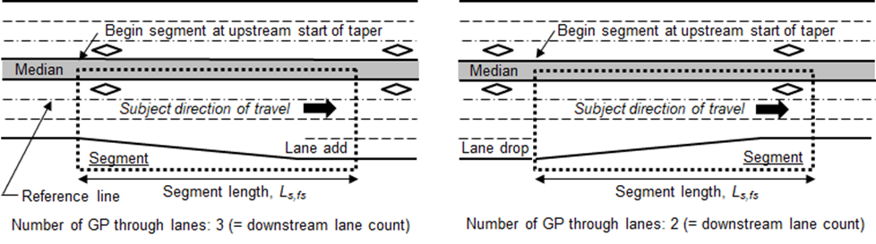
The Steps
Step 4—Determine geometric design features, traffic control features, and site characteristics for all sites in the project limits
Criterion
Lane-add by taper
Lane-drop by taper
When a lane is added or dropped by taper, begin a new segment at the upstream start of taper

Slide 31
The Steps
Step 4—Determine geometric design features, traffic control features, and site characteristics for all sites in the project limits
  Number of HO lanes
    Only needed for speed-change lane sites
    Limited to one to four HO lanes
  Length of segments
    Measured in miles
    Speed change lane measured from gore point to taper point
Notes:
Number of HO lanes (at speed-change lane sites)—The number of HO lanes in the portion of freeway adjacent to the speed-change lane. The predictive models are limited to freeways with one to four HO lanes. The definition of “HO lane” is provided in Section 20.4.1.
Length of freeway segment, length of speed-change lane site, and length of speed-change lane (if present)—As discussed in Section 20.4.1, a speed-change lane site has a length that is less than or equal to that of the associated speed-change lane. The speed-change lane length is measured from the gore point to the taper point. Figure 20‑3 illustrates these measurement points for a ramp entrance and a ramp exit speed-change lane with the parallel and taper design, respectively.

Slide 32
The Steps
Step 4—Determine geometric design features, traffic control features, and site characteristics for all sites in the project limits
  Presence of horizontal curve
    Presence of horizontal curve
    Length of horizontal curve
  Speed limit
    Regulatory speed limit for passenger cars in travel direction
    Based on the nearest upstream posted speed limit sign
Notes:
Presence of horizontal curve—If a curve is present, then the two data elements described in the following list are needed.
Length of curve—Curve length is measured along the reference line from the point where the tangent ends and the curve begins (i.e., the PC) to the point where the curve ends and the tangent begins (PT). If the curve PC and PT do not lie on the reference line, then they must be projected onto this line and the curve length measured between these projected points along the reference line.
If the curve has spiral transitions, then measure from the “effective” PC point to the “effective” PT point. The effective PC point is located midway between the TS and SC, where the TS is the point of change from tangent to spiral and the SC is the point of change from spiral to circular curve. The effective PT is located midway between the CS and ST, where CS is the point of change from circular curve to spiral and ST is the point of change from spiral to tangent.
Length of curve in site—The length of the curve within the boundaries of the site (i.e., segment or speed-change lane). This length cannot exceed the site length or the curve length.
Speed limit—Regulatory speed limit for passenger cars traveling on the freeway in the subject direction of travel. Based on the posted speed limit sign at the site (or just upstream of the site if a sign is not present at the site).

Slide 33
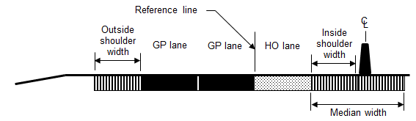
The Steps
Step 4—Determine geometric design features, traffic control features, and site characteristics for all sites in the project limits
  Lane Line Separation
  Inside shoulder width
  Outside shoulder width
  Median width
Notes:
These cross section data elements should not be measured where one or more edges are discontinuous or tapered. Rather, they should be measured where the cross section is constant, such as along line A or B in Figure 20‑5. If a width varies along the segment or speed-change lane site (but not enough to justify beginning a new site), then compute the length-weighted average width.
Shoulder width—This width represents only the paved width.
Median width—This width is measured between the edges of the traveled way for the two roadways serving opposing directions of travel. The median width includes the width of the inside shoulders that are present in the subject and opposing travel directions. The median width does not include the width of the HO lane(s), buffer width, or the barrier support width between the GP lane and the HO lane.

Slide 34
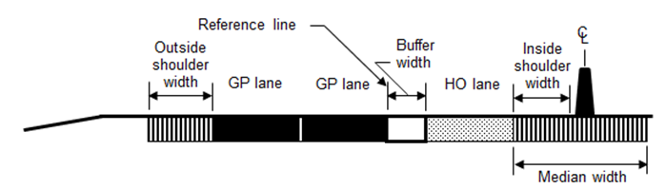
The Steps
Step 4—Determine geometric design features, traffic control features, and site characteristics for all sites in the project limits
  Buffer Separation
  Buffer width
  Inside shoulder width
  Outside shoulder width
  Median width
Notes:
These cross section data elements should not be measured where one or more edges are discontinuous or tapered. Rather, they should be measured where the cross section is constant, such as along line A or B in Figure 20‑5. If a width varies along the segment or speed-change lane site (but not enough to justify beginning a new site), then compute the length-weighted average width.
Buffer width—This width is needed only if the lateral separation type is “flush buffer.”
Shoulder width—This width represents only the paved width.
Median width—This width is measured between the edges of the traveled way for the two roadways serving opposing directions of travel. The median width includes the width of the inside shoulders that are present in the subject and opposing travel directions. The median width does not include the width of the HO lane(s), buffer width, or the barrier support width between the GP lane and the HO lane.

Slide 35
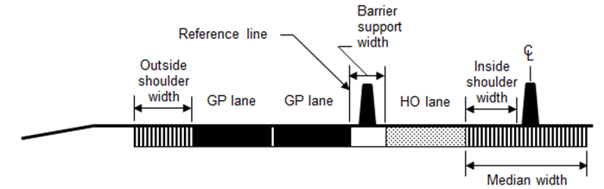
The Steps
Step 4—Determine geometric design features, traffic control features, and site characteristics for all sites in the project limits
  Barrier Separation
  Inside shoulder width
  Outside shoulder width
  Median width
Notes:
These cross section data elements should not be measured where one or more edges are discontinuous or tapered. Rather, they should be measured where the cross section is constant, such as along line A or B in Figure 20‑5. If a width varies along the segment or speed-change lane site (but not enough to justify beginning a new site), then compute the length-weighted average width.
Shoulder width—This width represents only the paved width.
Median width—This width is measured between the edges of the traveled way for the two roadways serving opposing directions of travel. The median width includes the width of the inside shoulders that are present in the subject and opposing travel directions. The median width does not include the width of the HO lane(s), buffer width, or the barrier support width between the GP lane and the HO lane.
Barrier support width – This represents either the physical width of the barrier.

Slide 36
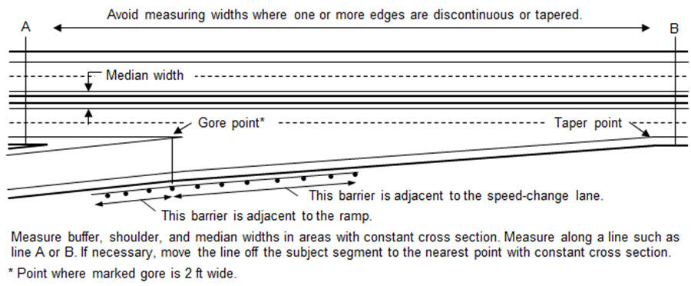
The Steps
Step 4—Determine geometric design features, traffic control features, and site characteristics for all sites in the project limits
  Length of Barrier
  Median
  Roadside
Notes:
Length of the barrier in the median and the barrier on the roadside—This length is measured for each piece of barrier “associated” with the subject site (i.e., freeway segment or speed-change lane). A barrier is associated with the site if its offset from the near edge of traveled way is 30 ft or less. Barrier adjacent to a ramp (as shown in Figure 20‑5) but also within 30 ft of the freeway traveled way should also be associated with the subject site.
Each piece of barrier is represented once for a site. Barrier length is measured along the reference line.

Slide 37
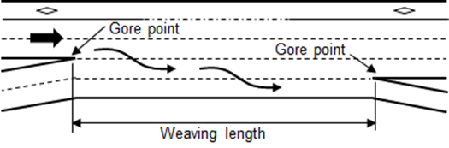
The Steps
Step 4—Determine geometric design features, traffic control features, and site characteristics for all sites in the project limits
  Presence of Type C Weaving Section
  Both entrance and exit ramps on right-side
  Only applies if Type C weave less than 0.85 miles in length
Notes:
Presence of a one-sided Type C weaving section—This weaving section has the following characteristics: (a) one of the two weaving movements can be made without making any lane changes, (b) the other weaving movement requires two or more lane changes, and (c) the ramp entrance and ramp exit associated with the weaving section are located on the right side of the freeway. The typical one-sided Type C weaving section is shown in Figure 20‑6.
If the subject freeway travel direction has the aforementioned characteristics within a length of 0.85 mi (4,500ft) or less, then a one-sided Type C weaving section is consider to be present. This length is measured along the edge of the freeway traveled way from the gore point of the ramp entrance to the gore point of the next ramp exit, as shown in Figure 20‑6. If the measured gore-to-gore distance exceeds 0.85 mi (4,500 ft), then a weaving section is not considered to exist. Rather, the entrance ramp is a “lane add” and the exit ramp is a “lane drop.”

Slide 38
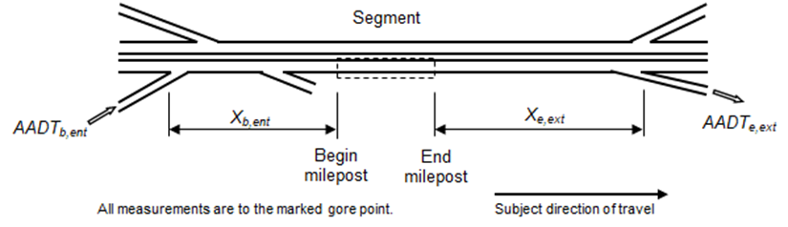
The Steps
Step 4—Determine geometric design features, traffic control features, and site characteristics for all sites in the project limits
  Upstream Entrance
  Distance
  Ramp AADT
  Downstream Exit
  Distance
  Ramp AADT
Notes:
Distance to nearest upstream entrance ramp—The value assigned to this data element represents the distance from the segment boundary to the ramp gore point, as measured along the reference line. The distance to the nearest upstream entrance ramp is shown in Figure 20‑7 using the variable X_{b,ent}. If the ramp entrance is located at the start of the subject segment (as in Figure 20‑7b), then the corresponding distance is equal to 0.0 mi. If the ramp does not exist or it is located more than 2.0 mi from the segment, then this distance can be set to 2.0 mi in the predictive method to obtain the correct results.
Figure 20‑7a shows a freeway segment with an upstream exit ramp serving travel in the subject direction of travel. Upstream exit ramps are not of interest to the evaluation of the subject segment and data are not needed for them if they exist in the vicinity of the segment.
Distance to nearest downstream exit ramp—The measurement technique and maximum value for this data element is the same as for upstream entrance ramps. This distance is shown in Figure 20‑7 using the variable X_{e,ext}. Downstream entrance ramps are not of direct interest, and their data are not needed.
Entrance ramp AADT volume, Exit ramp AADT volume—The annual average daily traffic volume of the ramp. This volume includes vehicles using the GP lanes and the HO bypass lane (if present) on the ramp. The evaluation of a freeway segment requires the nearest upstream entrance ramp AADT volume (if within 2.0 miles of the segment) and the nearest downstream exit ramp volume (if within 2.0 miles of the segment). The evaluation of a ramp entrance speed-change lane requires the entrance ramp AADT volume and the nearest downstream exit ramp volume (if within 2.0 miles of the site). The evaluation of a ramp exit speed-change lane requires the exit ramp AADT volume and the nearest upstream entrance ramp volume (if within 2.0 miles of the site).

Slide 39
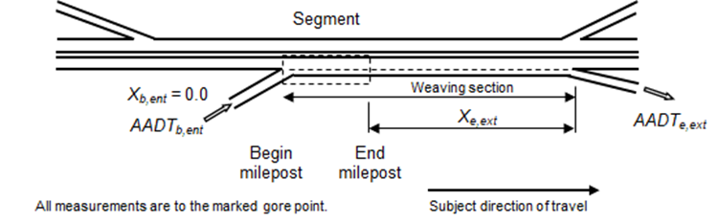
The Steps
Step 4—Determine geometric design features, traffic control features, and site characteristics for all sites in the project limits
  Upstream Entrance
  Distance
  Ramp AADT
  Downstream Exit
  Distance
  Ramp AADT
Notes:
Distance to nearest upstream entrance ramp—The value assigned to this data element represents the distance from the segment boundary to the ramp gore point, as measured along the reference line. The distance to the nearest upstream entrance ramp is shown in Figure 20‑7 using the variable X_{b,ent}. If the ramp entrance is located at the start of the subject segment (as in Figure 20‑7b), then the corresponding distance is equal to 0.0 mi. If the ramp does not exist or it is located more than 2.0 mi from the segment, then this distance can be set to 2.0 mi in the predictive method to obtain the correct results.
Figure 20‑7a shows a freeway segment with an upstream exit ramp serving travel in the subject direction of travel. Upstream exit ramps are not of interest to the evaluation of the subject segment and data are not needed for them if they exist in the vicinity of the segment.
Distance to nearest downstream exit ramp—The measurement technique and maximum value for this data element is the same as for upstream entrance ramps. This distance is shown in Figure 20‑7 using the variable X_{e,ext}. Downstream entrance ramps are not of direct interest, and their data are not needed.
Entrance ramp AADT volume, Exit ramp AADT volume—The annual average daily traffic volume of the ramp. This volume includes vehicles using the GP lanes and the HO bypass lane (if present) on the ramp. The evaluation of a freeway segment requires the nearest upstream entrance ramp AADT volume (if within 2.0 miles of the segment) and the nearest downstream exit ramp volume (if within 2.0 miles of the segment). The evaluation of a ramp entrance speed-change lane requires the entrance ramp AADT volume and the nearest downstream exit ramp volume (if within 2.0 miles of the site). The evaluation of a ramp exit speed-change lane requires the exit ramp AADT volume and the nearest upstream entrance ramp volume (if within 2.0 miles of the site).

Slide 40
The Steps
Step 4—Determine geometric design features, traffic control features, and site characteristics for all sites in the project limits
  Proportion of hours in average day with lane volume exceeding 1,000 veh/hr/lane
    Can be obtained from traffic counting station
    Equation for default value provided based on major road AADT and number of GP lanes
    Note that Chapter 18 uses proportion of AADT rather than hours
  Average speed differential between inside GP lane and the HO lane(s)
    Only applies to facilities with lane line or buffer lateral separation
    Represents average of the course of the year
    Can be obtained from measured spot speeds
    Equation for default value provided based on major road AADT and number of GP lanes
Notes:
Proportion of hours in the average day where the lane volume exceeds 1,000 vehicles per hour per lane (veh/h/ln)—The lane volume for hour i (LV_{i}) is computed as LV_{i} = HV_{i}/n_{GPL} where HV_{i} is the volume during hour i (i = 1, 2, 3, ... , 24) and n_{GPL} is the number of GP through lanes. The desired proportion P_{hvh} is computed as P_{hvh} = (Σ m)/24 where Σ m is the count of hours where the lane volume exceeds 1,000 veh/h/ln. The HV and n_{GPL} variables represent the subject travel direction (i.e., they are one-directional values). These data will typically be obtained from the continuous traffic counting station that (a) is nearest to the subject freeway and (b) has similar traffic demand and peaking characteristics. A default value can be computed using the following equation.
Note that proportion of hours in this context differs from Chapter 18 of the HSM, which uses proportion of volume during high-volume hours.
Average speed differential between the inside GP lane and the HO lane(s)—This average is computed using the measured spot speed of the motorized vehicle traffic stream in the inside GP lane and in the HO lane(s). For a given month i, the speed of each vehicle using a lane of interest is measured. These speeds are then averaged for the GP lane and for the HO lane(s). Their difference (∆_{v,i} = Speed_{HO,i} – Speed_{GP,i}) is computed for month i. This process is repeated for all months of the year. The 12 monthly speed differences are then averaged for the year of interest and, if this annual average difference is negative, it is set to 0.0.
The speed data used for this calculation can be obtained from the continuous traffic counting station that (a) is nearest to the subject freeway and (b) has similar traffic demand and peaking characteristics. Data for a sample of representative days of the month and months of the year can be used to reduce the amount of data needed for this calculation. A default value can be computed using the following equation.

Slide 41
The Steps
Step 4—Determine geometric design features, traffic control features, and site characteristics for all sites in the project limits
  HO Lane Access Restriction
  Partial: Lane may be restricted for certain hours of the day and then revert to GP or mixed-use lane
    Directional peak period
    AM and PM peak period
    AM through PM peak period
  24-Hour: Lane restricted for all times of day
Notes:
HO lane access restriction by time of day—A through lane may operate as a part-time HO lane or a full-time HO lane. A part-time HO lane operates as an HO lane during specific times of day (e.g., peak hours) and as a GP lane during the other hours of the day. In contrast, a full-time HO lane operates as an HO lane throughout the day (i.e., it operates as an HO lane during all 24 hours of the day). This data element is used to indicate whether the subject site has a part-time HO lane or a full-time HO lane.

Slide 42
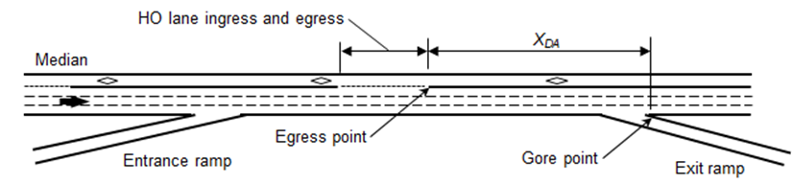
The Steps
Step 4—Determine geometric design features, traffic control features, and site characteristics for all sites in the project limits
  Distance from last HO lane egress point to next exit ramp
  Not necessary for continuous access
  Limited to values between 0 and 0.25 miles or more per lane
Notes:
Distance from the last HO lane egress point to the next exit ramp—The value assigned to this data element represents the distance between the last egress point of the HO lane and the gore point of the next exit ramp. This distance is measured along the reference line. It is shown in Figure 20‑8 using the variable X_{DA}. This variable is required when the HO lane has at-grade entrance and exit zones and the subject site begins and ends within the distance X_{DA} [i.e., it is not needed if (a) the HO lane has continuous access, (b) the site ends before or at the egress point, or (c) the site starts at or after the gore point].

Slide 43

The Steps
Step 5—Divide the freeway into sites
Based on individual homogenous sites
Freeway segments
Entrance speed-change lane segments
Exit speed-change lane segments
The segmentation process is very important
Notes:
Divide the freeway into individual sites (i.e., freeway segments and speed-change lanes) using the information from Step 1 and Step 4.

Slide 44
The Steps
Step 5—Divide the freeway into sites
A homogeneous site has the same basic character for its full length bounded by changes in:
Number of GP lanes
Number of HO lanes
Speed limit
Buffer width
Outside/inside shoulder width
Median width
Lateral separation
HO lane access restriction
HO lane egress point
Notes:
This slide provides an indication of the factors used to divide segments into homogeneous sites. Changes in the factors provided serve as boundaries for homogeneous segments.

Slide 45
Segmentation Practices

Slide 46
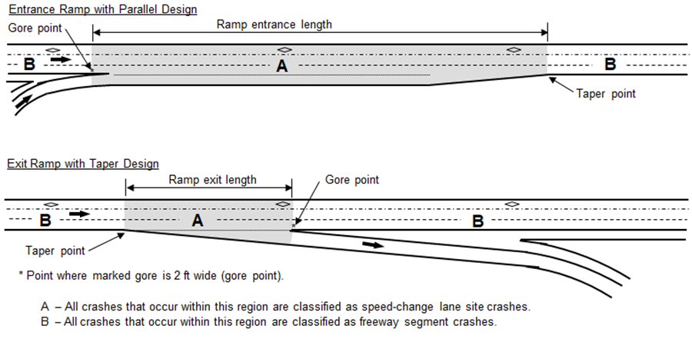
Segmentation Process
Freeway speed-change lane
Notes:
This slide provides a specific definition for entrance and exit speed-change lanes. The entrance speed-change lane shows an example parallel design. The speed change lane is shown by the shaded area marked A defined by the gore and taper points. The exit speed-change lane shows an example taper design. Again, the speed change lane is shown by the shaded area marked A defined by the paint-based gore and taper point.

Slide 47
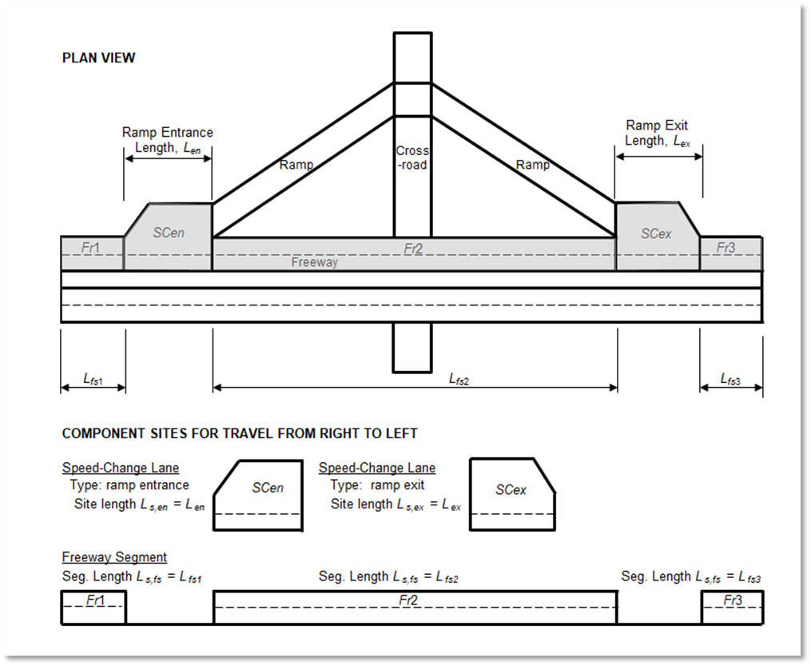
Freeway Segment Definition
Overview
Divide roadway into homogenous segments
All segments directional
Speed change lanes apply from gore to taper
HO lane present
Notes:
As a first step of the segmentation process, the freeway in the subject direction of travel is subdivided into sites. A speed-change lane site begins at the gore (or taper) point and ends at the associated taper (or gore) point. These points are shown in Figure 20‑10. Any site that is not a speed-change lane site is a freeway segment. A freeway segment or a speed-change lane site can be subdivided into two or more sites if dictated by the segmentation guidelines described in subsequent paragraphs.

Slide 48
Segmentation Process
Begin new segment when:
Number of GP or HO lanes changes
Posted speed limit changes
HO lane lateral separation type changes
HO restriction period changes
If flush buffer changes (round to nearest 0.5 ft)
Rounded shoulder width changes (round to nearest 1 ft)
Ramp is present (gore point defines start of segment)
Rounded median changes (round to nearest 10 ft)
at downstream end of zone where egress is allowed (if at-grade access)
Define segments based on the goal of the analysis
Notes:
As a second step of the segmentation process, the sites identified in the first step are further subdivided (if needed) to ensure that they are homogeneous with respect to characteristics such as traffic volume, key geometric design features, and traffic control features. A new site begins where there is a change in at least one of the characteristics identified in the following list. The phrases “GP through lanes” and “HO lane” are defined in Section 20.4.1. The listed characteristics are described in Section 20.5.2.
Number of GP through lanes—Begin a site at the gore point if the GP lane is added or dropped at a ramp. Begin a segment at the upstream start of taper if the GP lane is added or dropped by taper. Guidance in this regard is described in the text accompanying Figure 20‑2.
Number of HO lanes—Begin a site at the gore point if an HOV or HOT lane is added or dropped at a ramp. Begin a site at the upstream start of taper if an HOV or HOT lane is added or dropped by taper.
Speed limit—Begin a site at the point where the posted speed limit sign is located that indicates a change in the regulatory speed limit.
Buffer width—If a flush buffer is used for lateral separation, measure the buffer width at successive points along the roadway. Compute an average buffer width for each point and round this average to the nearest 0.5 ft. Begin a new site if the rounded value for the current point changes from that of the previous point (e.g., from 3.0 to 3.5 ft).
Outside shoulder width—Measure the outside shoulder width at successive points along the roadway. Compute an average shoulder width for each point and round this average to the nearest 1.0 ft.
Begin a new site if the rounded value for the current point changes from that of the previous point (e.g., from 6 to 7 ft).
Inside shoulder width—Measure the inside shoulder width at successive points along the roadway. Compute an average shoulder width for each point and round this average to the nearest 1.0 ft. Begin a new site if the rounded value for the current point changes from that of the previous point (e.g., from 6 to 5 ft).
Median width—Measure the median width at successive points along the roadway. Round the measured median width at each point to the nearest 10 ft. If the rounded value exceeds 90 ft, then set it to 90 ft. Begin a new site if the rounded value for the current point changes from that of the previous point (e.g., from 30 to 20 ft).
Ramp presence—Begin a site at the ramp gore point.
Lateral separation—As shown in Table 20‑1, four types of lateral separation are addressed by the predictive method (i.e., lane line, flush buffer, pylon buffer, and barrier). Begin a site at the point where there is a change in lateral separation type.
HO lane access restriction by time of day—If the HO lane access hours change from part-time to full-time (or vice versa), begin a site at the point where the change occurs.
HO lane egress point—If the HO lane has at-grade entrance and/or exit zones, begin a site at the downstream end of any zone where egress from the HO lane is allowed. Specifically, begin a site at the egress point (as shown in Figure 20‑8).

Slide 49
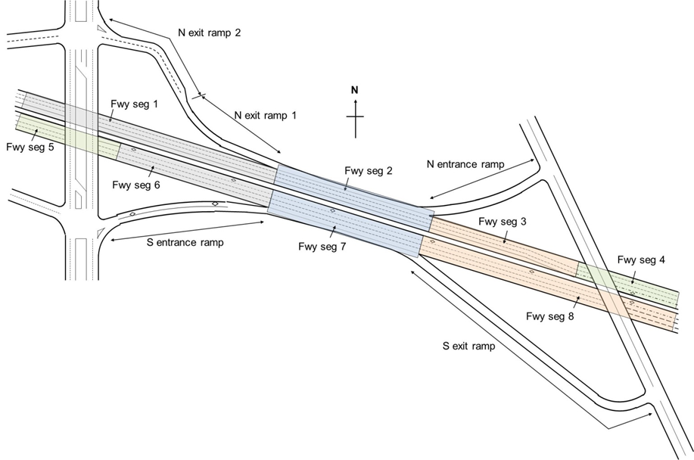
Segmentation Example
Notes:
This slide provides a sample segmentation for both directions of travel. Note that the westbound HOV lane ends with freeway segment 4 and the eastbound begins with freeway segment 6. This section includes one direction of freeway facility with an HOV lane and one direction without. Freeway segments 2 and 4 are Type A weaving sections and there are not speed-change lanes in this sample.

Slide 50
The Steps
Step 6—Assign observed crashes to the individual sites (if applicable)
Step 6 applies if it was determined in Step 3 that the site-specific EB Method is applicable
If the site-specific EB Method is not applicable, then proceed to Step 7
In this step, the observed crash data are assigned to the individual sites
Notes:
Step 6. If sufficient data exist, assign observed crashes to the individual site.
Step 6 applies if it was determined in Step 3 that the site-specific EB Method is applicable.
If the site-specific EB Method is not applicable, then proceed to Step 7.
In this step, the observed crash data are assigned to the individual sites (both freeway segments and speed-change lanes.

Slide 51
The Steps
Step 7—Select the first or next individual site in the project limits. If there are no more sites to be evaluated, proceed to Step 15
Steps 7 through 14 are repeated for each site within the project limits.
Any site can be selected for evaluation because each site is considered to be independent of the other sites.
Good practice to select sites in orderly manner, such as in the order of their physical occurrence in the subject direction of travel.
Notes:
Step 7. Select the first or next individual site in the project limits. If there are no more sites to be evaluated, proceed to Step 15
Steps 7 through 14 are repeated for each site within the project limits.
Any site can be selected for evaluation because each site is considered to be independent of the other sites.
Good practice is to select sites in an orderly manner, such as in the order of their physical occurrence in the subject direction of travel.

Slide 52
The Steps
Step 8—For the selected site, select the first or next year in the period of interest
If there are no more years to be evaluated for that site, proceed to Step 13
Steps 8-12 repeated for each year in evaluation period for site.
Individual years of evaluation period are analyzed one year at a time
  SPFs and some AFs are dependent on AADT volume, which may change from year to year.
Notes:
Step 8. For the selected site, select the first or next year in the period of interest
If there are no more years to be evaluated for that site, proceed to Step 13
Steps 8-12 are repeated for each year in evaluation period for site.
Individual years of evaluation period are analyzed one year at a time. SPFs and some AFs are dependent on AADT volume, which may change from year to year.

Slide 53
The Steps
Step 9—For the selected site, determine and apply the appropriate SPF
SPF determines the predicted average crash frequency for a site with features that match the SPF’s base conditions
Determine appropriate SPF for selected site based on site type and cross section
SPF is used to compute crash frequency for selected year using the AADT volume for that year, as determined in Step 3
Notes:
Step 9. For the selected site, determine and apply the appropriate SPF. The appropriate SPF is based on site type and number of GP lanes.
The SPF determines the predicted average crash frequency for a site with features that match the SPF’s base conditions.
Determine the appropriate SPF for selected site based on site type and cross section.
The SPF is used to compute the crash frequency for the selected year using the AADT volume for that year, as determined in Step 3.

Slide 54
The Steps
Step 9—For the selected site, determine and apply the appropriate SPF
Example SPF: Basic Freeway Segment with HO Lane
where
N_{spf,fs,n,y,as} = predicted average crash frequency of a freeway segment with base conditions, n lanes, crash type y, and all severities (crashes/yr)
L_{s,fs} = length of freeway segment (mi)
a, b = regression coefficients
AADT_{fs} = one-directional AADT volume of freeway segment (including vehicles in the HO lane) (veh/day)
Notes:
This slide provides an example SPF, that for a basic freeway segment with an HO lane. The components of the SPF are defined on the slide.
N_{spf,fs,n,y,as} = predicted average crash frequency of a freeway segment with base conditions, n lanes, crash type y, and all severities (crashes/yr)
L_{s,fs} = length of freeway segment (mi)
a, b = regression coefficients
AADT_{fs} = one-directional AADT volume of freeway segment (including vehicles in the HO lane) (veh/day)

Slide 55
The Steps
Step 9—For the selected site, determine and apply the appropriate SPF
Example SPF: Basic Freeway Segment with HO Lane
Notes:
This slide provides graphical representations of the sample SPF, for a basic freeway segment with an HO lane. The SPFs are based on directional AADT and predict total crash frequency and multiple-vehicle crash frequency.

Slide 56
The Steps
Step 10—Multiply the result obtained in Step 9 by the appropriate Adjustment Factors
Adjustment factors used to adjust the SPF estimate from Step 9
Reflects geometric and traffic control difference from base condition
Appropriate AFs are based on
  Site type
  Geometric design features
  Traffic control features
Multiplicative with Step 9 SPF prediction
Notes:
Step 10—Multiply the result obtained in Step 9 by the appropriate AFs.
Collectively, the AFs are used in the predictive model to adjust the SPF estimate from Step 9 so that the resulting predicted average crash frequency accurately reflects the geometric design and traffic control features of the selected site. The available AFs are described in Sections 20.7.2 and 20.8.2.
All AFs presented in this chapter have the same base conditions as the SPFs in this chapter. Only the AFs presented in Sections 20.7.2 and 20.8.2 may be used as part of the predictive method described in this chapter.
For the selected site, determine the appropriate AFs for the site type, geometric design features, and traffic control features present. The AF’s designation by crash type must match that of the SPF with which it is used (unless indicated otherwise in the AF description). The AFs for the selected site are calculated using the geometric design and traffic control features determined in Step 4.
Multiply the result from Step 9 by the appropriate AFs.

Slide 57
The Steps
Step 10—Multiply the result obtained in Step 9 by the appropriate Adjustment Factors
SPF Adjustment Factor | Freeway Segments | Speed-Change Segments | Unique to this Method
Lateral separation and access type | ✓ | ✓ | ✓
Inside shoulder width | ✓ | ✓
Outside shoulder width | ✓ | ✓
Median width | ✓ | ✓
Median barrier | ✓ | ✓
Outside barrier | ✓ | ✓
Type C weaving section | ✓ |  | ✓
Average speed differential | ✓ | ✓ | ✓
High-volume hours | ✓ |  | ✓
Number of HO lanes |  | ✓ | ✓
Notes:
Step 10—Multiply the result obtained in Step 9 by the appropriate AFs.
The table on this slide provides an overview of the SPF adjustment factors and their applicability for freeway segments and speed-change lane segments. A checkmark in the box means that adjustment factor is applicable for that site subtype. Further, the fourth column provides an indication if the SPF adjustment factor is unique to this predictive method.

Slide 58
The Steps
Step 11—Multiply the result obtained in Step 10 by the appropriate calibration factor
The SPFs and AFs have each been developed with data from specific jurisdictions and time periods
Calibration to local conditions will account for any differences between these conditions and those present at the selected sites
A calibration factor is applied to each SPF in the predictive method
Multiply the result from Step 10 by the calibration factor to obtain the predicted average crash frequency
Notes:
Step 11. Multiply the result obtained in Step 10 by the appropriate calibration factor.
The SPFs and AFs have each been developed with data from specific jurisdictions and time periods.
Calibration to local conditions will account for any differences between these conditions and those present at the selected sites.
A calibration factor is applied to each SPF in the predictive method.
Multiply the result from Step 10 by the calibration factor to obtain the predicted average crash frequency.

Slide 59
The Steps
Step 12—If there is another year to be evaluated in the evaluation period for the selected site, return to Step 8
Otherwise, proceed to Step 13
Notes:
This step creates a loop from Step 8 through Step 12 that is repeated for each year of the evaluation period for the selected site.

Slide 60
The Steps
Step 13—Apply the site-specific EB Method (if applicable) and apply crash distributions
Site-specific EB Method combines predicted average crash frequency with observed crash frequency to produce expected average crash frequency
If EB Method is used, then an estimate of expected average crash frequency is obtained for each year of the crash period
Notes:
The site-specific EB Method combines the predicted average crash frequency computed in Step 11 with the observed crash frequency of the selected site to produce an estimate of the expected average crash frequency. The expected average crash frequency is more statistically reliable than the predicted average crash frequency obtained in Step 11. The procedure for applying the site-specific EB Method is provided in the appendix for Part C.
If the EB Method is used, then an estimate of expected average crash frequency is obtained for each year of the crash period (i.e., the period for which the observed crash data are available). The individual years of the crash period are analyzed one year at a time because the SPFs and SDFs are dependent on AADT volume, which may change from year to year.

Slide 61
The Steps
Step 14—If there is another site to be evaluated, return to Step 7;
otherwise, proceed to Step 15
Notes:
This step creates a loop from Step 7 through Step 14 that is repeated for each site of interest.

Slide 62
The Steps
Step 15—Apply the project-level EB Method (if applicable) and apply crash distributions
The activities undertaken during this step are the same as undertaken for Step 13 but they occur at the project level (i.e., network or facility)
They are based on estimating the project-level predicted average crash frequency
This crash frequency is computed for each year during the crash period
It is computed as the sum of the predicted average crash frequency for all sites
Notes:
The project-level EB Method combines the project-level predicted average crash frequency with the observed crash frequency for all sites within the project limits to produce an estimate of the project-level expected average crash frequency. The project-level expected average crash frequency is more statistically reliable than the project-level predicted average crash frequency.
If the EB Method is used, then an estimate of the project-level expected crash frequency is obtained for each year of the crash period (i.e., the period for which the observed crash data are available). The individual years of the crash period are analyzed one year at a time because the SPFs and SDFs are dependent on AADT volume, which may change from year to year.
Apply the project-level EB Method to a future time period, if appropriate.
Follow the same guidance as provided in Step 13 using the estimate from the project-level EB Method.
Apply the severity distribution, if desired.
Follow the same guidance as provided in Step 13 using the estimate from the project-level EB Method.
Apply the crash type distribution, if desired.
Follow the same guidance as provided in Step 13 using the estimate from the project-level EB Method.

Slide 63
The Steps
Step 16—Sum all sites/years in the study to estimate the total crash frequency
$$N_{e,aS,ac,at,as}^{∗}=\sum_{j=1}^{n_{s}}{\left(\sum_{i=1}^{\text{all} \text{sites}}{N_{e,fs(i),n,at,as,j}}+\sum_{i=1}^{\text{all} \text{sites}}{N_{e,en(i),ac,at,as,j}}+\sum_{i=1}^{\text{all} \text{sites}}{N_{e,ex(i),ac,at,as,j}}\right)}$$
where
N*_{e,aS,ac,at,as} = total expected number of crashes for all sites aS and all years in the study period
(includes all cross sections ac, all crash types at, and all severities as) (crashes);
n_{s} = number of years in the study period (yr);
N_{e,fs(i),n,at,as,j} = expected average crash frequency of freeway segment i with n lanes for year j
(includes all crash types at and all severities as) (crashes/yr); and
N_{e,w(i),ac,at,as,j} = expected average crash frequency of speed-change lane site i of type w
(w = en: ramp entrance speed-change lane; ex: ramp exit speed-change lane) with any cross section
ac for year j (includes all crash types at and all severities as) (crashes/yr).
where
N_{e,aS,ac,at,as} = overall expected average crash frequency for all sites aS and all years in the study period (includes all cross sections ac, all crash types at, and all severities as) (crashes/yr)
Notes:
One outcome of the predictive method is the total (predicted or expected) average crash frequency.
The term “total” indicates that the estimate includes all crash types and severities.
It is computed from an estimate of the total number of crashes, which represents the sum of the total average crash frequency for each site and for each year in the study period.
The total expected number of crashes during the study period is calculated using the equation shown.
The same equation can be used to calculate the total predicted number of crashes by substituting the subscript “p” for the subscript “e”.
Equation is used to compute the total expected number of crashes estimated to occur in the project limits during the study period.
‘CLICK MOUSE’ The next equation is used to estimate the overall expected average crash frequency within the project limits during the study period. The same equation can be used to calculate the total predicted number of crashes by substituting the subscript “p” for the subscript “e”.

Slide 64
The Steps
Step 17— Determine if there is an alternative design, treatment, or forecast AADT to be evaluated
Notes:
Steps 3 through 17 are repeated as appropriate for the same project limits but for alternative conditions, treatments, periods of interest, or forecast AADT volumes.

Slide 65
The Steps
Step 18— Evaluate and compare results
The estimates can be used to:
  assess site and project safety on consideration of crash type and severity
  identify treatments/design changes for reducing crash frequency/severity
  compare the relative safety of alternative designs
Notes:
The crash frequency estimates obtained from the previous steps represent statistically reliable estimates of the (expected or predicted) average crash frequency for each configuration (e.g., existing condition, alternative design) that is evaluated. The estimates are based on the configuration’s specified project limits, study period, geometric design, traffic control features, and AADT volume. The estimates can be used to assess the safety associated with each site and the overall project based on consideration of crash type and severity. The estimates can be used to identify treatments or design changes that have the potential for reducing crash frequency, severity, or both. The estimates can also be used to compare the relative safety of alternative designs.

Slide 66
Application Scope
Applicable to Urban Freeways with Concurrent HO Lanes
Projects Adding HOV or HOT Lanes
Weaving Section Analysis
Alternative Cross Section Analysis
Not Applicable to Left-Side Ramps
Not Able to Predict HOV- or HOT-Related Crash Frequency
Notes:
Applicable to Urban Freeways with Concurrent HOV or HOT Lanes. As indicated by Table 1, the predictive method is applicable to the evaluation of urban freeways with one or more concurrent HOV or HOT lanes. The method does not differentiate between HOV or HOT operation. The HOV or HOT lanes must be located to the left of the GP lanes and have one of the design configurations identified in the following list:
Lane line lateral separation with continuous access or with limited access via at-grade entrance/exit zones.
Flush buffer lateral separation with limited access via at-grade entrance/exit zones.
Pylon buffer lateral separation with limited access via at-grade entrance/exit zones.
Barrier separation with limited access via at-grade entrance/exit zones.
Projects Adding HOV or HOT Lanes. The predictive method described in this chapter can be used to evaluate a freeway facility with one or more HOV or HOT lanes. The predictive method provided in Chapter 18 of the 2014 supplement to the HSM (2) can be used to evaluate a freeway facility without HOV or HOT lanes. Together, they can be used to evaluate the change in crash potential associated with the addition of an HOT or HOT lane. However, the predictive models provided in Chapter 18 and those described in this chapter were developed using data from freeways in different states and different time periods. When the predictions from these models are to be compared or combined, both sets of models must be calibrated for the region of interest to ensure that the results are reliable. Guidance is provided in Section 2.11.2 for using Chapter 18 to evaluate one travel direction of a freeway.
Weaving Section Analysis. The predictive method was developed using data for freeways with and without weaving. Several weaving section types (i.e., configurations) were represented in the data. However, only the “one-sided Type C weaving section” was found to be associated with a change in crash frequency, relative to non-weaving sections. The one-sided Type C weaving section has the following characteristics: (a) one of the two weaving movements can be made without making any lane changes, (b) the other weaving movement requires two or more lane changes, and (c) the ramp entrance and ramp exit associated with the weaving section are located on the right side of the freeway (as shown in Figure 6). Freeways with other weaving section types can be evaluated using this method; however, the method does not include AFs that explicitly address these configurations.
Alternative Cross Section Analysis. The predictive method was developed using data for freeways with lane widths commonly in the range of 11 to 12 feet. However, a correlation between average lane width and crash frequency was not confirmed through statistical analysis of the data. As a result, the method does not include an AF that explicitly addresses lane width. Alternative cross sections can be evaluated with the method provided that the average lane width is in the range of 11 to 12 feet.
Not Applicable to Left-Side Ramps. The predictive method described in this chapter cannot be used to evaluate the safety influence of speed-change lanes that provide left-side access to the GP lanes.
Not Able to Predict HOV- or HOT-Related Crash Frequency. The estimated average crash frequency obtained from the predictive method includes the crashes that occur in the GP lanes plus those that occur in the HOV or HOT lanes. It does not predict the frequency of just the HOV- or HOT-related crashes. The report by Fitzpatrick and Avelar (5) provides some information about the distribution of crashes between the HOV or HOT lanes and the GP lanes. The information in this report may be useful to the analyst desiring some insight as to the frequency of just the HOV- or HOT-related crashes.

Slide 67
Potential Applications
Freeways with Toll Facilities
Evaluation of Freeway Facilities without HOV or HOT Lanes
  HO Lanes in Only One Direction
  Existing Freeway Does Not Have HO Lanes
Notes:
Freeways with Toll Facilities
The predictive method can be used to evaluate a freeway section that is part of toll facility provided that the section is sufficiently distant from the toll plaza that the plaza does not influence vehicle operation. The predictive method is not directly applicable to any portion of the freeway that (a) is in the immediate vicinity of a toll plaza, (b) is widened to accommodate vehicle movements through the toll plaza, (c) experiences toll-related traffic queues, or (d) experiences toll-related speed changes.
Evaluation of Freeway Facilities without HOV or HOT Lanes
When evaluating some freeway facilities with HOV or HOT lanes, it may be useful to evaluate a one-directional site that does not have HO lanes. Two cases are described in the following paragraphs and guidance is provided for using the method described in Chapter 18 of the HSM Supplement (2) to evaluate the one-directional site that does not have HO lanes.
Case A. HO Lanes in Only One Direction
For this case, the freeway facility of interest has one or more HO lanes in one travel direction but not in the other travel direction. In this situation, the predictive method described in this chapter can be used to evaluate the travel direction that provides the HO lanes and the method described in Chapter 18 of the HSM Supplement (2) can be used to evaluate the opposing travel direction that does not have HO lanes.
Case B. Existing Freeway Does Not Have HO Lanes
For this case, the travel direction of interest for an existing freeway facility does not have an HO lane but a proposed alternative is to include one or more HO lanes. In this situation, the predictive method described in this chapter can be used to evaluate the proposed alternative and the method described in Chapter 18 of the HSM Supplement (2) can be used to evaluate the existing condition.

Slide 68
Predictive Method Limitations
Does not address
Freeways in rural areas
Freeways with other managed lane types
Freeways with eight or more directional GP through lanes
Freeways where HO lanes accommodated
  Separate roadway
  Reversible lane
  Contraflow lane
Ramp metering
Toll plazas
Left-side speed-change lanes
Notes:
This section discusses limitations of the predictive models described in this chapter. The predictive method does not account for the influence of the following conditions on crash potential:
Freeways in rural areas
Freeways with managed lanes other than HOV or HOT lanes (e.g., truck-restricted lanes, truck-only lanes, or bus-only lanes)
Freeways with eight or more GP through lanes in the subject travel direction
Freeways where HOV or HOT lanes are accommodated (a) a separate roadway, (b) a reversible lane, or (c) a contraflow lane.
Freeways with concurrent HOV or HOT lanes with a flush buffer and continuous access.
Freeways with HOV or HOT lanes that are accessed by grade-separated entrance/exit points.
Freeways with part-time shoulder use or bus-on-shoulder operation.
Shoulder rumble strip presence
Ramp metering
Toll plazas
Work zone presence
Speed-change lanes that provide left-side access to the freeway
The predictive method does not distinguish between barrier types (i.e., cable barrier, concrete barrier, guardrail, and bridge rail) in terms of their possible unique influence on crash severity.

Slide 69
Sample Problem
1
What is the predicted average crash frequency of the speed-change lane site for the specified study year?

Slide 70
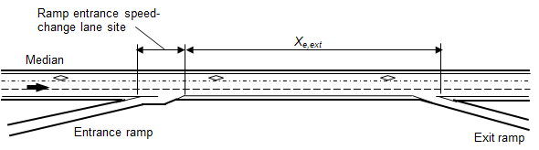
1
Site/Facility: Urban freeway speed-change lane
  Two general-purpose (GP) lanes and a continuous access HOV lane in the subject travel direction
  site extends length of the speed-change lane

Slide 71
1
Study Period: 1 Year
Conditions:
2 GP through lanes
1 HOV lane
0.14-mi site length (same as the length of the speed-change lane, as measured from gore point to taper point)
60-mi/h speed limit
No horizontal curvature
6-ft inside shoulder width (paved)
10-ft outside shoulder width (paved)
22-ft median width
Median barrier extends for the length of the siteNo outside (roadside) barrier
HOV lane is restricted to high-occupancy vehicles 24 hours per day
Continuous access to and from the HOV lane
Lane line separation between GP and HOV lanes
Downstream exit ramp is 0.65 miles from the segment and has an AADT volume of 5400 vehicles per day (i.e., X_{e,ext} = 0.65 mi; AADT_{e,ext} = 5400 veh/day)
Freeway AADT in subject direction of travel is 54,800 vehicles per day
Entrance ramp AADT is 5200 vehicles per day
Calibration factors: C_{en,ac,at,as} = 1.04; C_{en,ac,mv,as} = 1.03; C_{sdf,en} = 1.05

Slide 72
1
Assumptions:
The proportion of hours in the average day where lane volume exceeds 1,000 vehicles per hour per lane: Computed Value: 0.40
The average speed differential between the inside GP lane and the HO: Computed Value: 4.1 mi/h.

Slide 73


1
Assumptions: The crash type distribution is described by the default values presented in table.
Default distribution of crash type for speed-change lanes.
Crash Type Category | Crash Type (j) | Proportion of Crashes by Site Type
 |  | Ramp Entrance | Ramp Exit
Multiple-vehicle | Head-on | 0.004 | 0.003
 | Right-angle | 0.034 | 0.032
 | Rear-end | 0.661 | 0.682
 | Sideswipe | 0.235 | 0.202
 | Other multiple-vehicle crashes | 0.066 | 0.081
 | Total: | 1.000 | 1.000
Single-vehicle | Crash with animal | 0.005 | 0.006
 | Crash with fixed object | 0.775 | 0.777
 | Crash with other object | 0.120 | 0.163
 | Crash with parked vehicle | 0.001 | 0.000
 | Other single-vehicle crashes | 0.099 | 0.054
 | Total: | 1.000 | 1.000

Slide 74
1
Results using the predictive method steps:
Predicted average total (all crash types and severities) crash frequency:
2.1 crashes per year
Predicted average fatal-and-injury crash frequency:
0.7 crashes per year

Slide 75
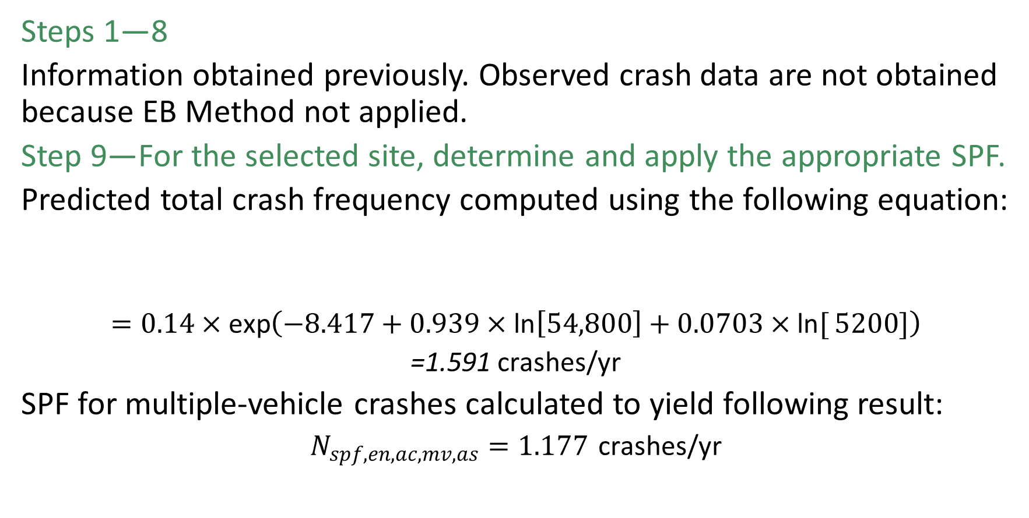
1
Steps 1—8
Information obtained previously. Observed crash data are not obtained because EB Method not applied.
Step 9—For the selected site, determine and apply the appropriate SPF.
Predicted total crash frequency computed using the following equation:
$$=0.14×\text{exp}\left(−8.417+0.939×\text{ln}\left[54,800\right]+0.0703×\text{ln}{[}5200]\right)$$
$$\text{=1.591 }\text{crashes}\text{/}\text{yr}$$
SPF for multiple-vehicle crashes calculated to yield following result:
$$N_{spf,en,ac,mv,as}=1.177 \text{crashes}\text{/}\text{yr}$$

Slide 76
1
Step 10—Multiply the result obtained in Step 9 by the appropriate AFs.
Lateral Separation and Access Type (AF_{1,en,ac,y,as}) = 1.000 total / 1.000 multiple-vehicle
Inside Shoulder Width (AF_{2,en,ac,y,as}) = 0.926 total / 0.919 multiple-vehicle
Outside Shoulder Width (AF_{3,en,ac,y,as}) = 1.000 total / 1.000 multiple-vehicle
Median Width (AF_{4,en,ac,y,as}) = 1.000 total / 1.000 multiple-vehicle
Median Barrier (AF_{5,en,ac,y,as}) = 1.260 total / 1.336 multiple-vehicle
Outside Barrier (AF_{6,en,ac,at,as}) = 1.000 total / does not apply to multiple-vehicle crashes
Average Speed Differential (AF_{8,en,ac,y,as}) = 1.100 total / 1.113 multiple-vehicle crashes
Number of HO Lanes (AF_{10,en,ac,y,as}) = 1.000 total / 1.000 multiple-vehicle crashes
Computed Ramp Entrance Crash Frequency = 2.042 total / 1.610 multiple-vehicle

Slide 77
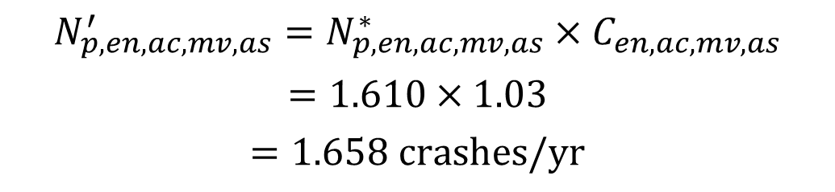
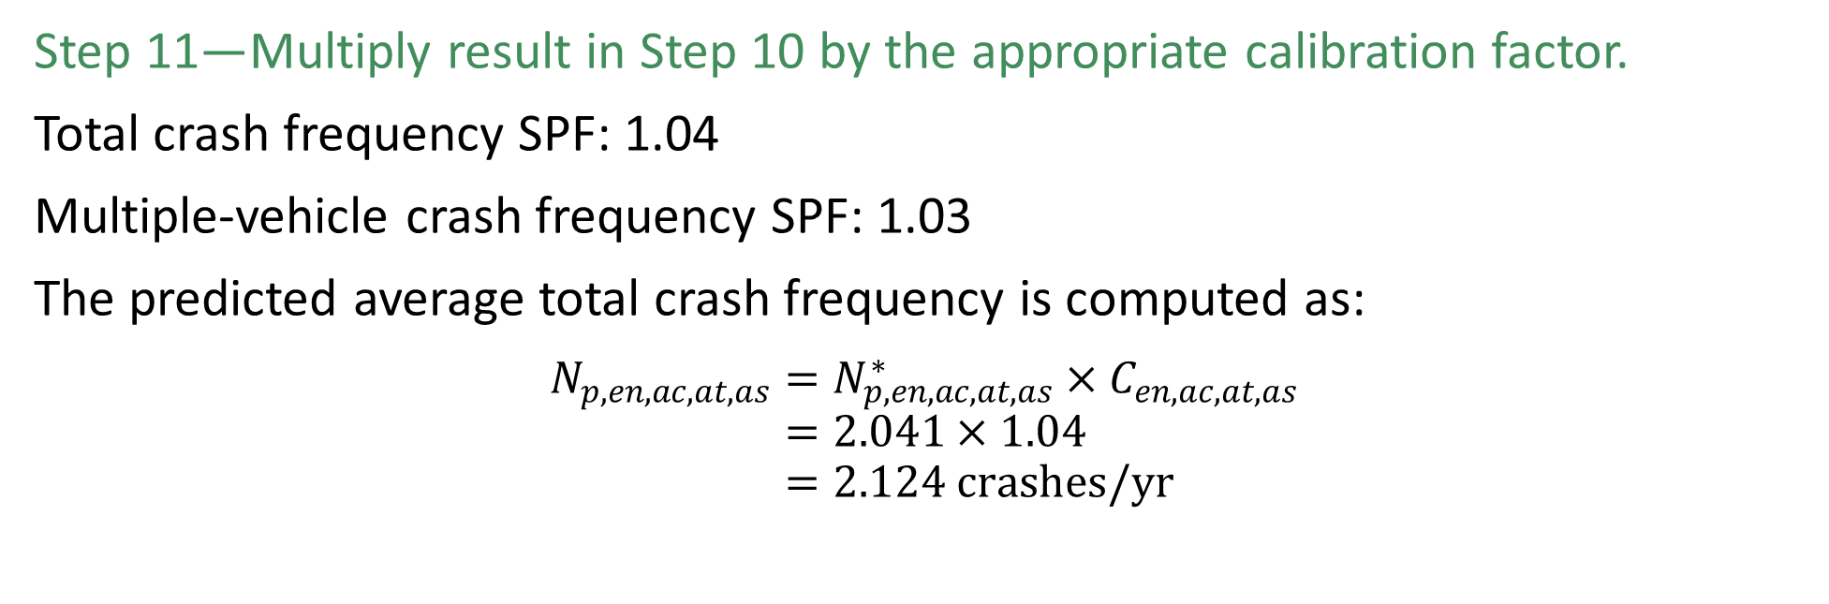
1
Step 11—Multiply result in Step 10 by the appropriate calibration factor.
Total crash frequency SPF: 1.04
Multiple-vehicle crash frequency SPF: 1.03
The predicted average total crash frequency is computed as:
$$N_{p,en,ac,at,as}=N_{p,en,ac,at,as}^{∗}×C_{en,ac,at,as} \\ =2.041×1.04 \\ =2.124 crashes/yr$$
$$N_{p,en,ac,mv,as}^{′}=N_{p,en,ac,mv,as}^{∗}×C_{en,ac,mv,as}$$
$$=1.610×1.03$$
$$=1.658 crashes/yr$$
The unadjusted predicted
multiple-vehicle crash frequency:

Slide 78

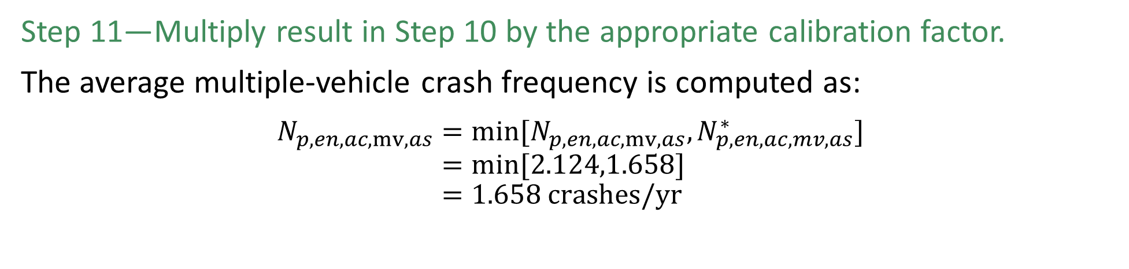
1
Step 11—Multiply result in Step 10 by the appropriate calibration factor.
The average multiple-vehicle crash frequency is computed as:
$$N_{p,en,ac,mv,as}=min[N_{p,en,ac,mv,as},N_{p,en,ac,mv,as}^{∗}] \\ =min[2.124,1.658] \\ =1.658 crashes/yr$$
The average single-vehicle crash frequency is computed as:
$N_{p,en,ac,sv,as}=N_{p,en,ac,at,as}−N_{p,en,ac,mv,as}$
$=2.124−1.658$
$=0.466 crashes/yr$

Slide 79
Implementation Spreadsheet

Slide 80
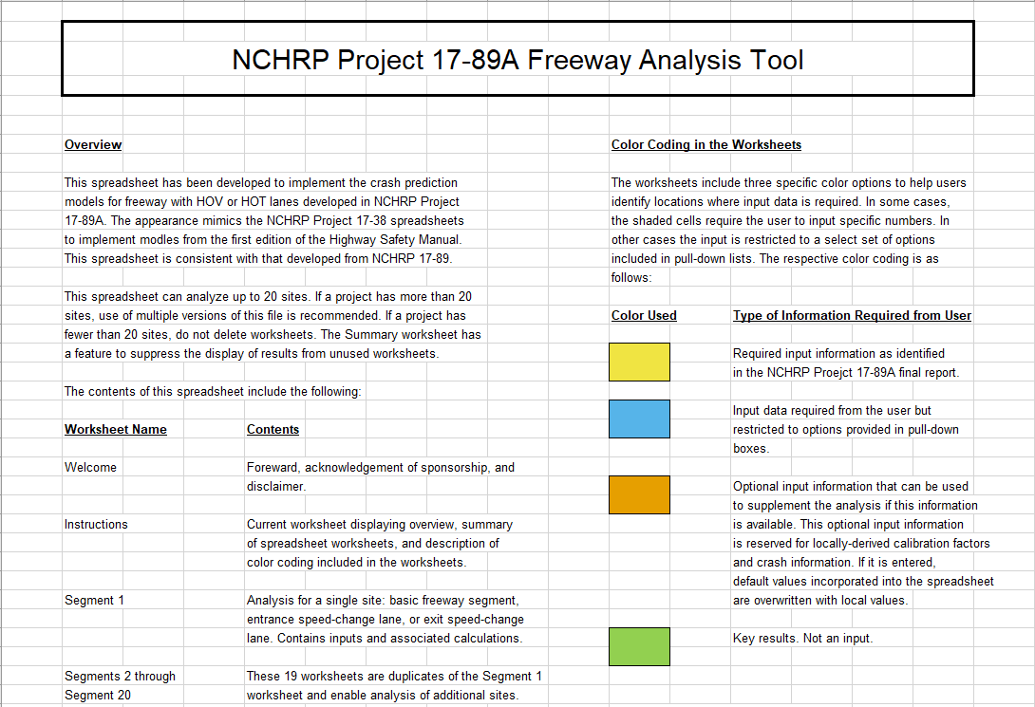
Implementation Spreadsheet
Instructions:
  Overview of the tool and the worksheets contained within
  Review of the color coding in the worksheets (and associated type of information required)
  Cell protection in the worksheet
  Input guidance
Notes:
The NCHRP 17-89A project team developed a spreadsheet-based implementation tool for the predictive methodology .
The spreadsheet tool provides:
predicted SV and MV crash frequencies,
FI and PDO crash frequencies, the distribution of FI crashes by severity level,
the distribution of crash types for SV and MV crashes.
a direct application of the predictive methodology and does not include any additions or extensions.

Slide 81
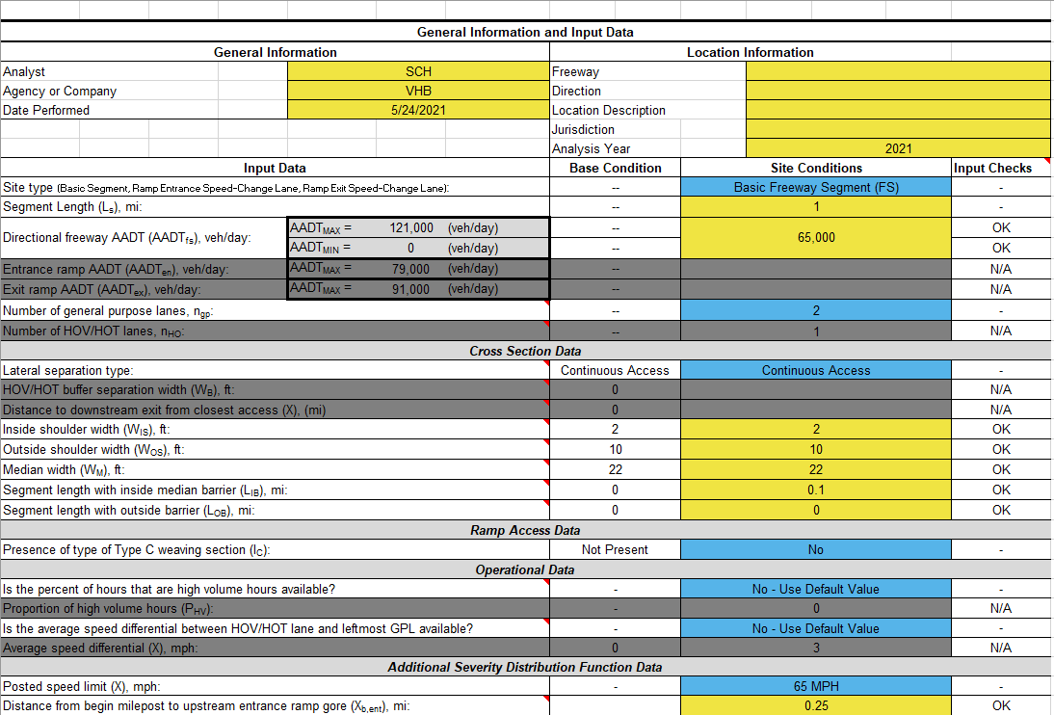
Implementation Spreadsheet
Segment 1 through Segment 20
contains input data for:
crash frequency and severity models for basic freeway segments
Entrance and exit speed-change lanes
Detailed calculations and results by crash type and severity from the predictive method
Notes:
provides guidance on entering data into the main Segment worksheets.
The analyst only needs to use the number of worksheets for which there are segments being analyzed; however, if more than 20 worksheets are needed, then the analyst will need to use multiple workbooks to complete the analysis. The results on the summary sheet can be aggregated separately.
Figure provides a sample partial screenshot of Segment input data. Under the General Information section, the analyst may input their name, their agency or company, and date the analysis was performed (the worksheet defaults to the current date). The worksheet also allows the analyst to enter location information for the study segment and analysis year.
For the segment data, there are several items for which the analyst should be aware, including the following:
Cell color: has an important meaning for input data requirements and types. However, the analyst should be further aware of two colors:
Grayed-out rows. Based on prior inputs, some cells will be grayed-out because they are not applicable for the given circumstances. For example, when the segment is a basic freeway segment, the entrance ramp AADT and exit ramp AADT are not applicable. If the analyst does not have operational data available, the input row will be grayed-out since the default will be selected instead. Analysts should note that while the row is grayed-out, data can be entered but will not be used by the spreadsheet. If the analyst changes an input value leading to the row no longer being grayed-out, the data element will be used by the tool.
Red cells. If data exceed the bounds of the predictive method or fails an input check, the data entry cell will turn red. Additionally, the input check will provide an indication of the issue. This is intended as a warning to the analyst, but the spreadsheet will still complete the calculation.
Base condition: When applicable, this cell provides the assumed base condition for the predictive method
Input checks: For most data elements, the spreadsheet employs simple logic (not macro-based) to compare entered site conditions against a minimum or maximum value (when applicable) or against other values as appropriate. For example, if the length of segment with inside median barrier is longer than the total segment length, the spreadsheet will assume a maximum proportion of segment with inside median barrier of 1.0 but will alert the analyst that the segment length with inside median barrier is too large. If the input check does not find any errors, it will return “OK”. If there is no applicable value the analyst may enter, the input check will return “N/A”.
Notes: To support the analyst when entering data, the spreadsheet provides data entry notes. The cells with red markers in the upper right-hand corner include notes with supporting information.
Default values: For operational data elements, it is possible the analyst will not have access to supporting data. The analyst may select yes to enter operational data if available, or may choose to use a default value if the answer is no. The spreadsheet calculates the default value for operational measures using freeway mainline AADT with the equations provided in Chapter 2.

Slide 82
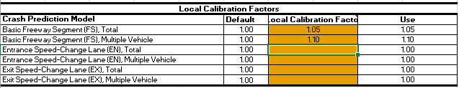
Implementation Spreadsheet
Local Values worksheet: Contains input fields (orange cells) allowing the analyst to include locally derived calibration factors, severity distributions or functions, and crash type distributions
Data entered applied to all 20 segment worksheets
If analyst leaves orange cells blank, spreadsheet will apply default values
Notes:
Shown is a sample application of local calibration factors entered into the LocalValues worksheet. If available, local calibration values are preferred for use in the predictive models.

Slide 83
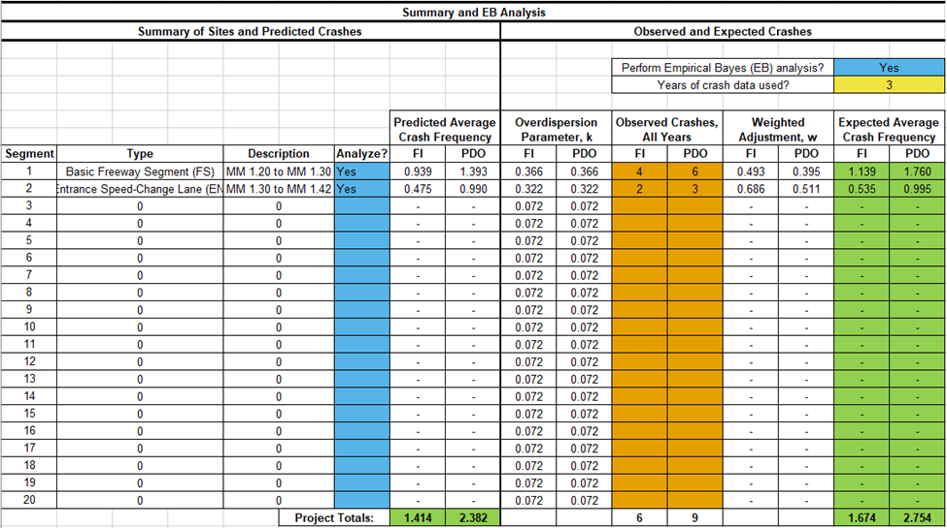
Implementation Spreadsheet
Summary:
Select yes to conduct a site-based EB analysis and enter the number of years of crash data
Automatically calculates the overdispersion parameter and weighted adjustment
The analyst enters the crash data in orange cells for each row (separately for FI and PDO crashes)
Determines expected FI crashes and expected PDO crashes and calculates project totals
Notes:
Figure provides an example screenshot of the summary worksheet.
This worksheet aggregates the predicted average crash frequency for all segments in which analysts enter data. The segment type and description for each segment also translates to the summary worksheet.
The analyst may choose to select yes for the option to conduct a site-based EB analysis and enter the number of years of crash data.
The spreadsheet automatically calculates the overdispersion parameter and weighted adjustment.
The analyst enters the crash data (all years combined for each site) in the orange cells for each row (separately for FI and PDO crashes).
From this, the spreadsheet determines expected FI crashes and expected PDO crashes.
The spreadsheet calculates project totals as shown in green cells.

Slide 84
Takeaways and Conclusions

Slide 85
Key Predictive Method Relationships
Narrow flush buffers associated with crash increase
Pylon and barrier lateral separation associated with crash decrease
Crash frequency increases as speed differential increases
The presence of two or more HO lanes associated with crash increase
Shorter distances per lane from HO lane egress to ramp exit associated with crash increase
Presence of Type C weaving section associated with crash increase
Notes:
There are several key relationships from the predictive method for freeway facilities (including speed change lane segments) with HO lanes, including the following:
Compared to a base condition of a lane line lateral separation type, narrow flush buffers (approximately less than 3.5 feet) are associated with an increase in total crash frequency, while wider flush buffers are associated with a decrease in total crash frequency.
Compared to a base condition of a lane line lateral separation type, pylon and barrier lateral separation are associated with a decrease in total crash frequency.
For facilities with lane line lateral separation and flush buffer separation, total crash frequency is expected to increase as the speed differential between the HO lane and the left-most GP lane increases.
For speed change lane segments, the presence of two or more HO lanes is associated with higher total crash frequency.
For facilities with access to and from HO lanes and the GP lanes via at-grade entrance and exit points, shorter distances from the HO lane access point to the nearest downstream right-side exit gore are associated with higher total crash frequency.
The presence of a Type C weaving section is associated with higher total crash frequency.

Slide 86
Key Predictive Method Relationships
Higher posted speed limit associated with more severe outcomes
Facilities with at-grade access associated with less severe outcomes
Facilities with median and outside barrier associated with lower probability of fatal or serious injury crash
Facilities with 24-hour access restriction associated with increased probability of more severe outcomes
Facilities with a higher proportion of horizontal curves associated with increased probability of more severe outcomes
Notes:
There are also several key relationships between geometric elements and crash outcome severity. The following summarizes those for freeway facilities (including speed change lane segments) with HO lanes.
Higher posted speed limits are associated with an increased probability of more severe crash outcomes.
Facilities with at-grade entrance and exit zones are associated with less severe crash outcomes.
Facilities with median and outside barrier are associated with a decreased probability of fatal and serious injury crash outcomes.
Facilities with 24-hour access restriction are associated with an increased probability of more severe crash outcomes.
Facilities with a higher proportion of horizontal curves are associated with an increased probability of more severe crash outcomes.

Slide 87
Key Recommendations
Future efforts should refine findings on freeways with reversible HO lanes
Future efforts should expand dataset for barrier and pylon protected HO lanes
An expanded dataset will allow further validation and inclusion of variables in predictive method
Future efforts should include ramp segments with HOV lanes

Slide 88
Questions?

