Slide 1
NCHRP 10-99: Framework for Implementing Constructability Across the Entire Project Development Process: NEPA to Final Design
Appendix B
February 2022
Electronic Presentation - This presentation is submitted as part of the NCHRP10-99 final project deliverables, to be used by practitioners as a quick summary of the project findings and tools developed. For further details, refer to last slide with links to other deliverables.
Notes:
Long presentation

Slide 2







Project Team
Dr. Edward Minchin,
University of Florida
Dr. Raymond Issa,
University of Florida
Dr. Daniel Tran,
University of Kansas
Mr. Sidney Scott, HKA
Ms. Linda Konrath, HKA
Dr. Jeffrey Russell,
University of Wisconsin
Dr. Clifford Schexnayder,
Arizona State University
Mr. Daniel D’Angelo,
Applied Research Associates, Inc.
Dr. Ghada M. Gad, California State Polytechnic University, Pomona
Notes:
Students?

Slide 3
Outline
Introduction
Motivation & Objectives
Research Project Phase I
  Literature review
  Benchmarking state of practice
Research Project Phase II
  Decision-making framework & tool
  Workshop
  Training materials
Conclusions
References

Slide 4
Introduction
BEGINNING IN THE 1930s
  Designers & constructors begin to work independently
  Caused miscommunication
IN THE LATE 1980s
  Constructability concept introduced
  Reported benefits
  DOTs applied constructability
TODAY
  Increased Federal & State permit requirements
  Proliferation of Integrated Project Delivery
  Difficulty in maintaining constructability while meeting the demands of both of these
Notes:
EARLY-TO-MID 20TH CENTURY
Age of Specialization caused designers & constructors to perform their work completely independently of each other.
Caused miscommunication between designers and constructors
IN THE 1980s
Concept of constructability introduced as “the optimum use of construction knowledge and experience in planning, design, procurement, and field operations to achieve [the] overall project objective”.
Reported benefits: reduced cost, shorter schedules, improved quality, fewer claims, and fewer change orders.
In highway sector, several DOTs have applied constructability to their projects.
TODAY
Myriad of Federal & State Permit requirements (US Coast Guard, US Army Corps of Engineers, EPA, Fish & Wildlife, etc.)
DOTs find it difficult to discuss any changes as it might require a NEPA Re-Evaluation or a re-do of the environmental permitting process.

Slide 5
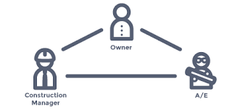


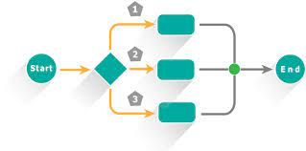
Motivation & Objective
MOTIVATION
Fast-track project delivery systems
Environmental permitting
and requirements
Industry demands
Uniformity of
CR process
OBJECTIVE
Develop a CR decision-making framework that is scalable to all project delivery
methods & complies with all environmental statutory requirements.
Notes:
Motivation
Increasing use of integrated fast-track project delivery systems
Increasingly demanding environmental permitting requirements & NEPA process
CRs lack effectiveness in meeting industry demands for delivering construction documents timely, free from errors, & promoting buildable projects
Lack of uniformity in the CR process from state to state

Slide 6
NCHRP 10-99 Project Phases & Tasks
  Task 1-1: Literature review
  Task 1-2: Define the current state of practice
  Task 1-3: Develop Conceptual Framework
  Task 1-4: Prepare Interim Report
  Task 1-5: Face-to-face meeting
Phase I
  Task 2-1: Develop CRP Decision-making Framework
  Task 2-2: Conduct Workshop
  Task 2-3: Develop Training Materials
  Task 2-4: Develop Electronic Presentation
  Task 2-5: Develop Final Report
  Task 2-6: Submit final deliverables
Phase II

Slide 7
Project Phase I:
Literature Review

Slide 8




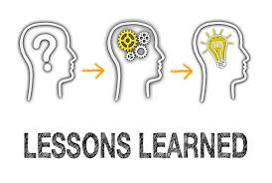

Project Phase I:
Task 1-1: Literature Review
CR Approaches
State Transportation Agencies
Innovative Contracting Approaches
TQM, VE, & CRs
Lessons Learned
Technology Use
* For further information and resources, visit the National Academies Press website (nap.nationalacademies.org) and search for NCHRP Web-Only Document 388: Framework for Implementing Constructability Throughout Project Development from NEPA to Final Design.
Notes:
CR Approaches
At different stages of project, and vary in terms of formality of CRP (11; 12).
Tools and checklists used in CRs (15)
Impact & relationship between design & construction activities (Khan 2016; 18)
Lack of involvement of contractor in CRP in public sector (19)
STAs & CRs
Only one-quarter of DOTs used formal programs (21)
Attempts to evaluate Cost/Benefits of CRs implementation (7; 22;).
Development of a CR database to allow Kentucky a systematic method for inputting and analyzing the CR (7; 23)
Elements to successfully implement a continuous CR process in WSDOT (22)
Innovative Contracting Approaches & CRs
CR concepts inherently embedded in these methods (25)
Integration between designers & contractors achieved by using DB & CM/GC, as well as ATCs (24)
Proper selection of a CRP depends on selected strategy for project delivery (25)
TQM, VE, & CRs.
CR when integrated with TQM & VE is the optimum tool to reduce factory investment risks and obtain the recommended quality (26).
A framework integrating TQM & VE to CRs developed to measure Cost/Benefit of constructability & cost-risk shifting (27)
Lessons Learned Databases
Importance of lessons-learned in development of constructability practices at program and project level (28)
Development of knowledge-based systems that collects lessons-learned from construction projects to enhance constructability, thus quality (29; 30),
Shortage of proper documentation systems prevent organizations from building a complete set of knowledge (28).
Technology use in CRs
Technology use to improve coordination and communication during CRs, such as application of Building Information Modeling (BIM) (31), 3D and 4D design models and construction simulation (32; 33), GIS-based frameworks (35), and Neural Network techniques (36)

Slide 9





Project Phase I:
Task 1-2: Define Current State of Practice
150 short phone conversations
29 Interviews
47 Surveys
6 Focus Groups
5 Case Studies
* For further information and resources, visit the National Academies Press website (nap.nationalacademies.org) and search for NCHRP Web-Only Document 388: Framework for Implementing Constructability Throughout Project Development from NEPA to Final Design.
Notes:
Define the current state of practice through data collected from:
29 interviews with DOT district personnel, private sector designers, CEI consultants, and contractors
47 surveys completed
Six focus groups of 4-5 participants, led by 1-3 team members (60-90 minutes)
Five case studies: Florida DOT, Connecticut DOT, VDOT Hampton Roads Bridge Tunnel, Caltrans, and Utah DOT

Slide 10





Project Phase I:
Task 1-2: Define Current State of Practice
Existing
effective practices
Tools/methods effectively used
Platforms for knowledge transfer/lessons learned
Challenges
Improvements
* For further information and resources, visit the National Academies Press website (nap.nationalacademies.org) and search for NCHRP Web-Only Document 388: Framework for Implementing Constructability Throughout Project Development from NEPA to Final Design.
Notes:
Existing Effective Practices
Full time CR staff/group with extensive construction experience - UDOT
Focal points for environmental agencies & employing innovative methods- Caltrans
Two-pronged system: “Optimized Limits of Disturbance” and “The Merged Process.” – VDOT (LOR- Submitting an oversized project footprint to FHWA for the NEPA process)
“Plans in Hand” review between the 60% and 90% plans stage on all D-B-B jobs- District Design Offices in Florida and Connecticut DOTs
Biddability reviews – VDOT & UDOT
Tools/Methods Effectively Used
CRP Checklists - Caltrans & ConnDOT
Project online database common platforms for CRs- Caltrans
Guidelines for CRP- a 12-step process for gaining contractor input into the design labelled the “Industry Constructability Review Process”- MnDOT
Moving from paper to digital review comments has helped with holding designers accountable. On paper, it was easy for them to simply not respond, but digitally they get an automatic email prompting them to look at comments, and they are emailed until they respond. This has helped foster better communication and puts everyone on the same page.
Platforms for knowledge transfer/lessons learned
Web-based databases for the review process- Caltrans
Web portals for industry input into plans; Project Review Website – UDOT https://sites.google.com/utah.gov/udot-project-previews/home
Challenges
Availability of experienced construction professionals to conduct CRs- Caltrans
30-35% of change orders were with quality control issues in plans; often where designers ignored comments. This resulted in change orders; trying to tag CRs to change orders- FDOT
No data to measure CRP effectiveness
Knowledge transfer in general
Expense associated with 3D & 4D modeling use in CRP
Time allotted for CRs
Improvements
Use of CR metrics- Caltrans
Tag CRs to Change order- FDOT
More training on CRPs – UDOT
Formal lessons learned system - UDOT

Slide 11
Project Phase I:
Task 1-3: Develop Conceptual Framework
Mostly developed as part of Phase 1
Final Decision-Making Framework built on this foundation, plus:
  Comments from panel
  Input from Workshop
Final version was quite different in scope and presentation from the conceptual model.

Slide 12
Project Phase I:
Task 1-3: Develop Conceptual Framework
Phase 1: Constructability
Analysis Input
Phase 2: Constructability
Review Processing
Phase 3: Constructability Outcomes
Recommendation
Project-related factors
Informal
CR (1)
CR Levels of Formality Recommended
PIP,
final
design
Semi-formal
CR (2)
Constructability Resources, Tools, Teams, and Analysis
CR Teams and Tools Recommended *
CR Selection & Delivery Methods
PIP, prelim,
interim, and final design, construction
Update Constructability Program
Project Goals and Objectives
Agency-related factors
Formal
CR (3)
PIP, prelim,
interim, and final design, construction,
post-construction
Document B/C, LL, and KPI*
* These were done as part of Phase 2, Task 2-1

Slide 13
Project Phase I:
Task 1-3: Develop Conceptual Framework
Phase 1: Constructability
Analysis Input
Phase 2: Constructability
Review Processing
Phase 3: Constructability Outcomes
Recommendation
Project-related factors
Informal
CR (1)
CR Levels of Formality Recommended
PIP,
final
design
Semi-formal
CR (2)
Constructability Resources, Tools, Teams, and Analysis
CR Teams and Tools Recommended *
CR Selection & Delivery Methods
PIP, prelim,
interim, and final design, construction
Update Constructability Program
Project Goals and Objectives
Agency-related factors
Formal
CR (3)
PIP, prelim,
interim, and final design, construction,
post-construction
Document B/C, LL, and KPI*

Slide 14
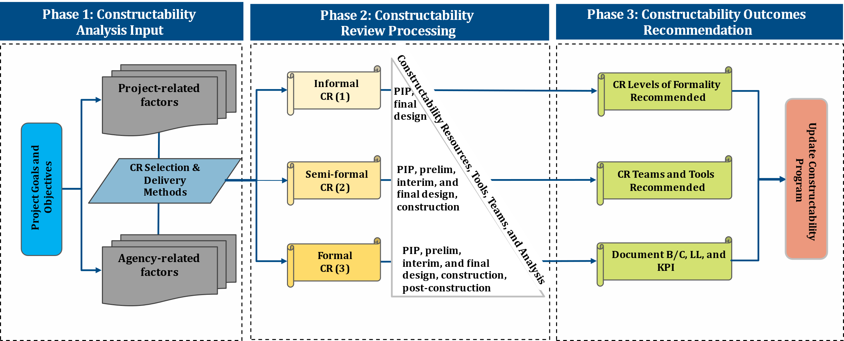
Project Phase I:
Task 1-3: Develop Conceptual Framework
ROW/utility impact
NEPA investigations level
Traffic issues
Impact on existing H/V alignment
Others
  Staff skill sets
  Tools available to support CRs
* For further information and resources, visit the National Academies Press website (nap.nationalacademies.org) and search for NCHRP Web-Only Document 388: Framework for Implementing Constructability Throughout Project Development from NEPA to Final Design.

Slide 15
Project Phase I:
Task 1-3: Develop Conceptual Framework
Phase 1: Constructability
Analysis Input
Phase 2: Constructability
Review Processing
Phase 3: Constructability Outcomes
Recommendation
Project-related factors
Informal
CR (1)
CR Levels of Formality Recommended
PIP,
final
design
Semi-formal
CR (2)
Constructability Resources, Tools, Teams, and Analysis
CR Teams and Tools Recommended *
CR Selection & Delivery Methods
PIP, prelim,
interim, and final design, construction
Update Constructability Program
Project Goals and Objectives
Agency-related factors
Formal
CR (3)
PIP, prelim,
interim, and final design, construction,
post-construction
Document B/C, LL, and KPI*

Slide 16
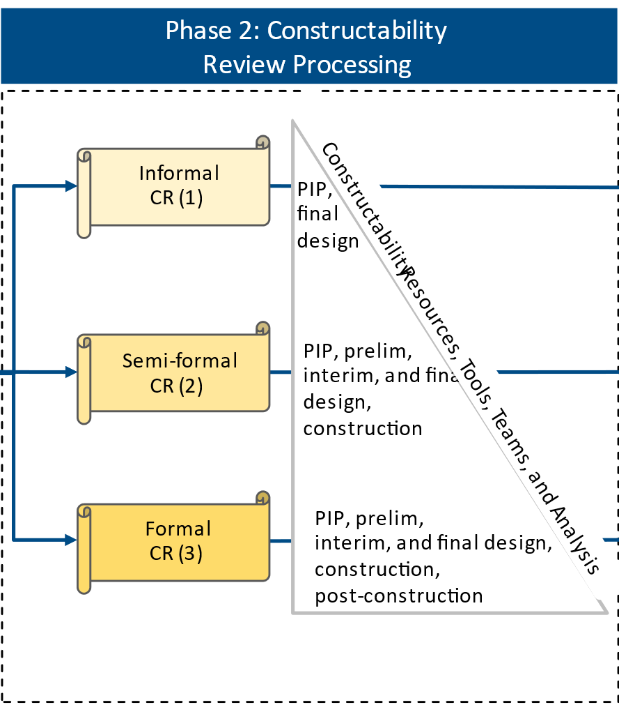
Project Phase I:
Task 1-3: Develop Conceptual Framework
  This stage involves assessing:
  CR processes & activities
  CR team members*
  CR tools*
* These were done as part of Phase 2, Task 2-1

Slide 17
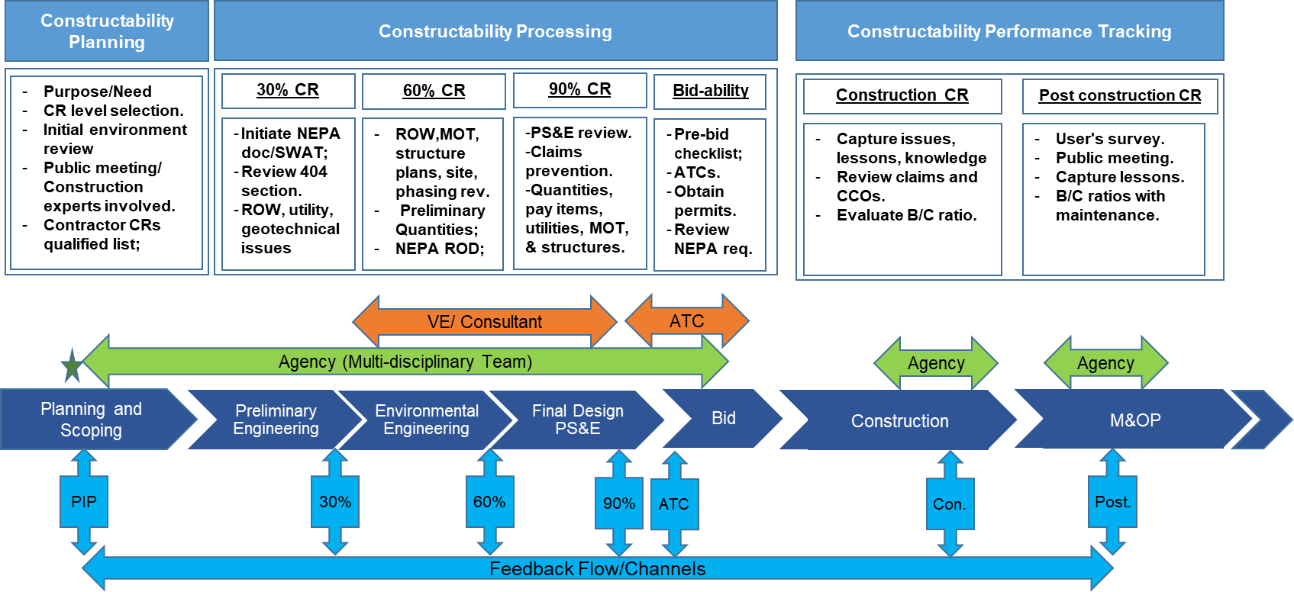
Project Phase I:
Task 1-3: Develop Conceptual Framework
1. CR Processes & Activities – sample for a DBB project

Slide 18
Project Phase I:
Task 1-4: Prepare Interim Report
Task 1-5: Face-to-face Meeting with Panel
Meeting with Panel introduced the Conceptual Decision-making Framework
Allowed Panel input for Phase II
  Specifically regarding a new focus for the final Decision-making Framework
Moved the team to Phase II

Slide 19
Project Phases & Tasks
  Task 1-1: Literature review
  Task 1-2: Define the current state of practice
  Task 1-3: Develop Conceptual Framework
  Task 1-4: Prepare Interim Report
  Task 1-5: Face-to-face meeting
Phase I
  Task 2-1: Develop CRP Decision-making Framework
  Task 2-2: Conduct Workshop
  Task 2-3: Develop Training Materials
  Task 2-4: Develop Electronic Presentation
  Task 2-5: Develop Final Report
  Task 2-6: Submit final deliverables
Phase II

Slide 20
Project Phase II:
Decision Making Framework

Slide 21
Project Phase II:
Task 2-1: Develop CRP Decision-Making Framework
When should the CRP commence? And at what milestones should the CRP be revisited?
Aims at answering the following questions:
To what level of formality should the CRP be conducted for a given project?
Who should be involved in the CRP?
What tools should be used in performing the CRP?

Slide 22
Project Phase II:
Task 2-1: Develop Framework
  This stage involves assessing:
  CR processes & activities*
  CR team members
  CR tools
* This was done as part of Phase 1, Task 1-3

Slide 23
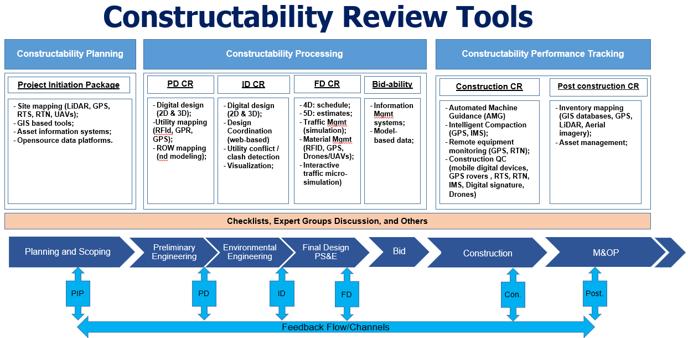
Project Phase II:
Task 2-1: Develop Framework
CR Tools

Slide 24
Project Phase II:
Task 2-1: Develop Framework
People - CR Team Members Skillset
  Determine the source of construction knowledge for CR
  Staff availability: Number of staff available vs. required
  Staff experience: Experience of staff available vs. required
  Staff willingness to learn, grow and develop.
  Outsider input: input from industry perspective

Slide 25
Project Phase II:
Task 2-1: Develop Framework
Phase 1: Constructability
Analysis Input
Phase 2: Constructability
Review Processing
Phase 3: Constructability Outcomes
Recommendation
Project-related factors
Informal
CR (1)
CR Levels of Formality Recommended*
PIP,
final
design
Semi-formal
CR (2)
Constructability Resources, Tools, Teams, and Analysis
CR Teams and Tools Recommended
CR Selection & Delivery Methods
PIP, prelim,
interim, and final design, construction
Update Constructability Program
Project Goals and Objectives
Agency-related factors
Formal
CR (3)
PIP, prelim,
interim, and final design, construction,
post-construction
Document B/C, LL, and KPI
* This was done as part of Phase 1, Task 1-3

Slide 26
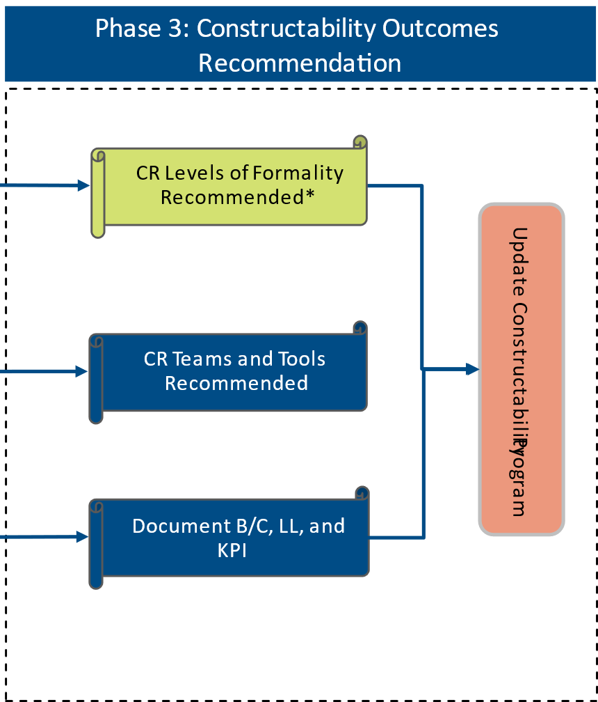
Project Phase II:
Task 2-1: Develop Framework
  A series of Analytical Hierarchy Process (AHP) activities was performed to determine
    Important levels/weights of each CR input factor
    Relationships between the CR input factors and outcomes
* This part of the Framework was done as part of Phase 1, Task 1-3; other two parts of Framework, and all AHP executed as part of Task 2-1
Notes:
This is not the conceptual, correct??

Slide 27
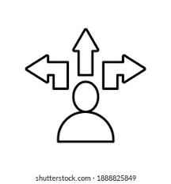
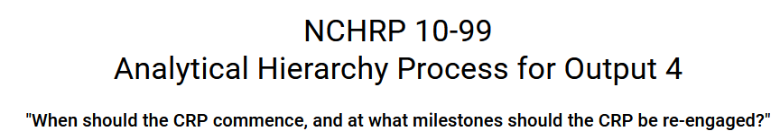
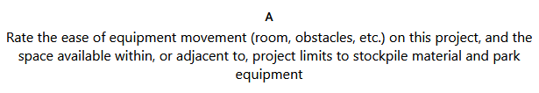

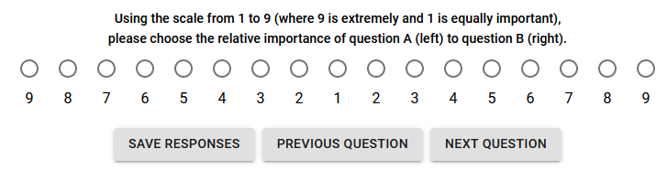
  Decision-Making Tool
Sample AHP Example

Slide 28
Project Phase II:
Task 2-1: Develop CRP Decision-Making Framework
  Decision-Making Tool
A total of 29 questions categorized into 5 sections
General Information
Physical Characteristics
Intangible Features
Local Circumstances
Agency Capabilities

Slide 29
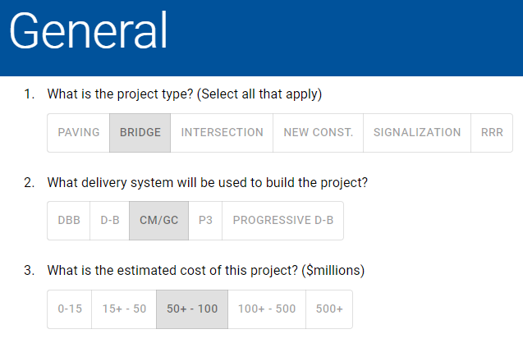
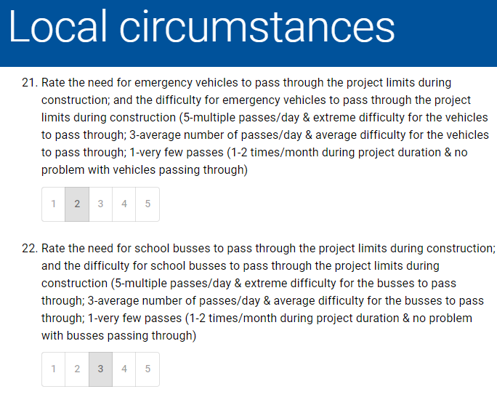
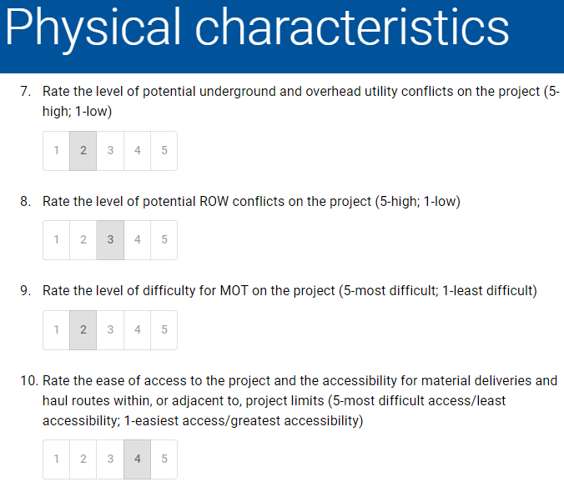
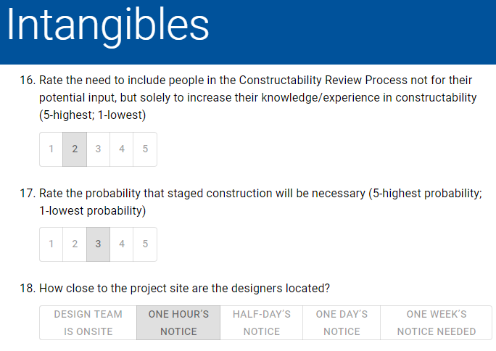
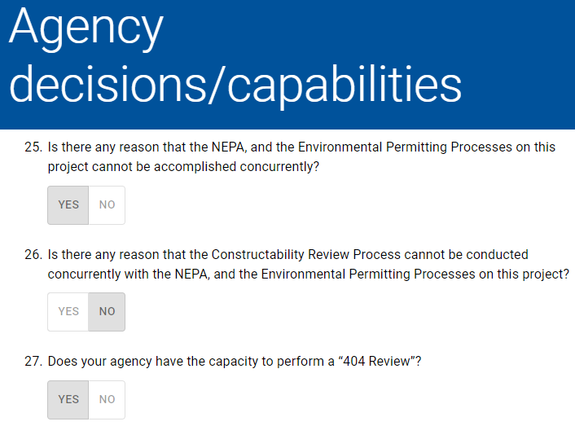
  Decision-Making Tool
Sample Factors Inputs
(A total of 6 questions)
(A total of 4 questions)
(A total of 9 questions)
(A total of 5 questions)
(A total of 5 questions)

Slide 30
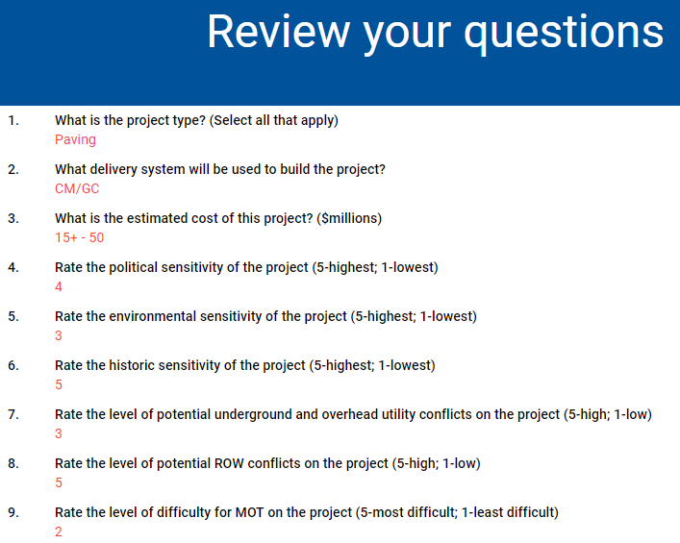
  Decision-Making Tool
Sample Summary of CRP Input

Slide 31
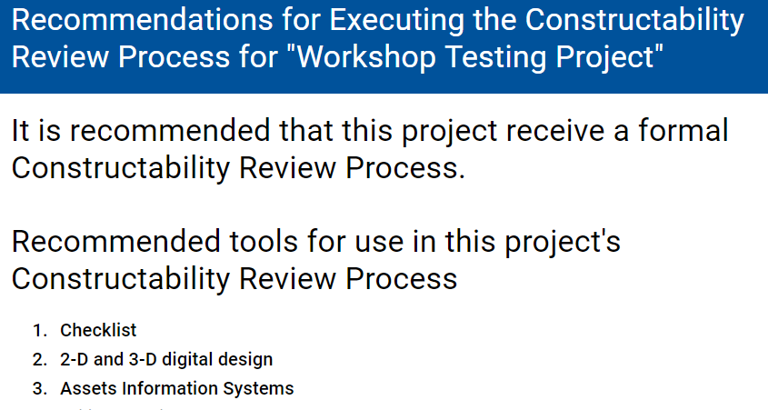

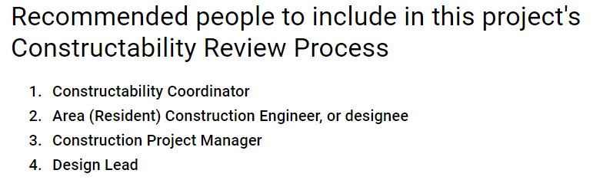
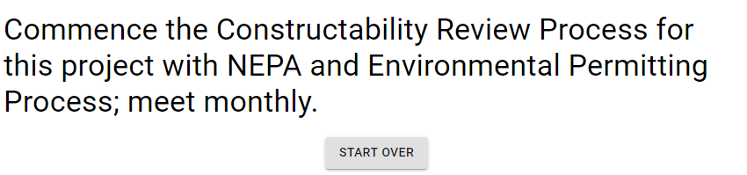
  Decision-Making Tool
Sample CR Outcomes/Recommendations

Slide 32
Project Phases & Tasks
  Task 1-1: Literature review
  Task 1-2: Define the current state of practice
  Task 1-3: Develop Conceptual Framework
  Task 1-4: Prepare Interim Report
  Task 1-5: Face-to-face meeting
Phase I
  Task 2-1: Develop CRP Decision-making Framework
  Task 2-2: Conduct Workshop
  Task 2-3: Develop Training Materials
  Task 2-4: Develop Electronic Presentation
  Task 2-5: Develop Final Report
  Task 2-6: Submit final deliverables
Phase II

Slide 33
Project Phase II:
Task 2-2: Workshop
Introduce and vet the framework
Solicit experts’ information and recommendations
Educate delegates on progressive CRP practices
Identify “champions” to help implement the framework
Workshop Goals
Notes:
GOALS:
Extract from experts information and recommendations to strengthen and increase the robustness of the Framework.
Introduce the framework to individuals from DOTs and other STAs from across the country.
Identify a “champion” within each DOT, to encourage the utilization of the framework by their agency upon release.
Educate the delegates on the most important progressive CRP practices found during this research work.

Slide 34

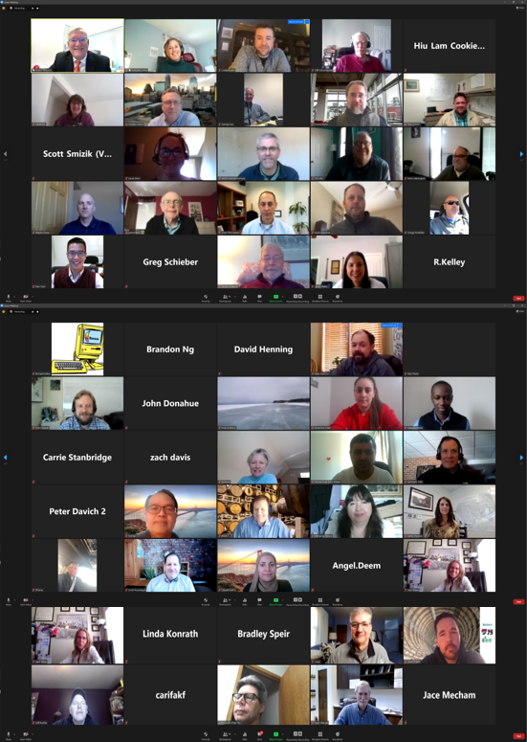
Project Phase II:
Task 2-2: Workshop*
9.5 hours over 4 days during an 8-day period
75 participants
Virtual Workshop
Attendance per session ranged from 49 – 67 participants
6 outstanding speakers on constructability
Other sessions
* For further information and resources, visit the National Academies Press website (nap.nationalacademies.org) and search for NCHRP Web-Only Document 388: Framework for Implementing Constructability Throughout Project Development from NEPA to Final Design.
Notes:
Other sessions were used to gather data and recommendations from the delegates to strengthen the framework

Slide 35
Project Phase II:
Task 2-2: Workshop*
The Speakers- Six Experts in Constructability
“Constructability, Permitting,
and NEPA”
by Kimberly Lesay
Chief of the Bureau of Policy & Planning, CTDOT
“MnDOT Industry Constructability
Process”
by Jay Heiptas
Assistant Commissioner Operations, MnDOT
“Virginia NEPA &
Section 404
Merged Process”
by Angel Deem
Director of the Environmental Division, VDOT
“Constructability and Virtual Design & Construction”
by Dr. Ralph Teyeh,
Post-Doctoral, University of Florida
“NEPA Limits of Disturbance: Providing Flexibility for Future Design and Maintaining NEPA Schedules”
by Scott Smizak,
Assistant Director of VDOT’s Environmental Division
“Use of Contractors in Constructability, Pre-Bid Letting”
by Sara Snow,
CRP Consultant
UDOT
* For further information and resources, visit the National Academies Press website (nap.nationalacademies.org) and search for NCHRP Web-Only Document 388: Framework for Implementing Constructability Throughout Project Development from NEPA to Final Design.

Slide 36
Project Phase II:
Task 2-2: Workshop
Early team involvement increases CRs benefits
Use of tools, such as virtual design and GIS enhance the CR process
Leadership support increases the chances of CRs effectiveness
Alternative project delivery helps with CRs implementation
Early “buy-in” from environmental agencies mitigates risks
CRs are about risk mitigation in all project aspects
It is challenging to evaluate CRs long-term value
Workshop Main Takeaways
Notes:
Constructability is about risk reduction theme to all project aspects – NEPA process, project delivery method, cost, scope, schedule, quality, reputation (agency), safety, environment. Constructability has some features of safety; the value and benefits have to document and consistently communicated to leaders and managers.
It is challenging to evaluate the long-term value of constructability reviews. There is limited empirical data available to identify and evaluate cost and/or time savings resulted from constructability reviews.
The earlier the constructability strategy can be developed the more likely maximum benefits will accrue. It is important to get the industry involved early and maintain the core team members of constructability reviews during the project development process. Use of technology and construction expertise from within and outside the DOT will increase the impact of constructability reviews.
DOTs should get “buy-in” from NEPA and other environmental permitting agencies early to minimize potential risk involved during the constructability review process and enhancing industry input and innovation.
It appears that alternative contracting delivery methods (D-B, CM/GC) helps facilitate the implementation of constructability reviews by supplementing with the essential staff, experience, knowledge, and coordination among team members that may result in better constructability review performance and effective risk allocations.
Senior DOT leadership support and project leadership increases chances of success.
Virtual design and construction using civil information modeling (CIM) and GIS tools can enhance project engineering, improve project management and reduce surprises during project execution.

Slide 37
Project Phases & Tasks
  Task 1-1: Literature review
  Task 1-2: Define the current state of practice
  Task 1-3: Develop Conceptual Framework
  Task 1-4: Prepare Interim Report
  Task 1-5: Face-to-face meeting
Phase I
  Task 2-1: Develop CRP Decision-making Framework
  Task 2-2: Conduct Workshop
  Task 2-3: Develop Training Materials
  Task 2-4: Develop Electronic Presentation
  Task 2-5: Develop Final Report
  Task 2-6: Submit final deliverables
Phase II

Slide 38
Project Phase II:
Task 2-3: Training Materials*
The workshop had a major impact on the
development of training materials
Training materials fall under two categories:
1. Use of the framework model
2. Adaptation (Customization) guide
* For further information and resources, visit the National Academies Press website (nap.nationalacademies.org) and search for NCHRP Web-Only Document 388: Framework for Implementing Constructability Throughout Project Development from NEPA to Final Design.

Slide 39


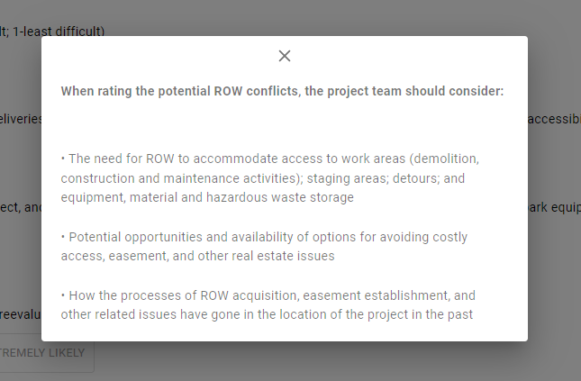
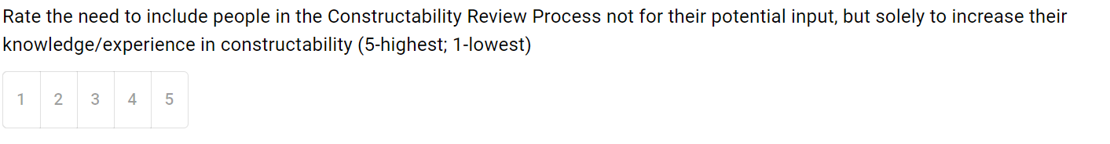
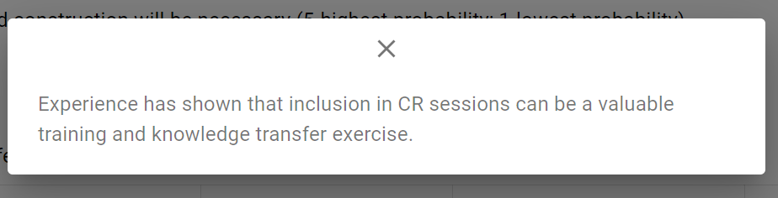
Project Phase II:
Task 2-3: Training Material
1. Use of the framework model.
Notes:
Take a shape of a pop-up to help the user with:
things to consider when formulating their answer
alleviating any misconceptions about what is meant by certain terms in this context
explaining a question further
what the outputs are and mean, and provide more references and resources
Another example of a pop-ups that explain the question>>
Question: “Rate the environmental sensitivity of the project.”
Pop-up message:
“When rating the environmental sensitivity of a project, the project team should consider:
Potential for work within wetlands or waterways
Potential for noise pollution, particularly if the construction area is near residential areas or occupied buildings
Need to protect private property from runoff
Need to maintain existing storm drains
Potential for flooding
Potential for discovery, during construction, of hazardous materials such as gasoline, or a landfill beneath the surface of the ground
Proximity of the project to sinkholes and/or caverns.”

Slide 40
Project Phase II:
Task 2-3: Training Materials
2. CRP Framework Operation guide*
3. Adaptation guide*
* For further information and resources, visit the National Academies Press website (nap.nationalacademies.org) and search for NCHRP Web-Only Document 388: Framework for Implementing Constructability Throughout Project Development from NEPA to Final Design.
Notes:
An agency may desire to customize the model to make it better fit their terminology and practices. If so, users can make changes to the tool.
Example shown on the slide

Slide 41
First Steps in CRP Framework Operation Guide
Enter the Project Description i.e., Project Title.
(Optional) If an existing local custom CRP file is available, Press ‘Load Custom CRP file’;
    Choose the relevant custom CRP file
    Press ‘Open’. Your customized CRP framework will be loaded.
Press ‘Continue’ to begin answering the CRP framework questions.
Fill in all questions in each section before advancing to the next one by pressing ‘Next Section’.
    For more information and guidance about a particular question, press the ‘Information’ Icon located on the right. A popup modal will appear.
    To head back to a previous section, press ‘Previous Section’.
To access the entire procedure, go to the National Academies Press website (nap.nationalacademies.org) and search for NCHRP Web-Only Document 388: Framework for Implementing Constructability Throughout Project Development from NEPA to Final Design.

Slide 42
First Steps in CRP Framework Adaptation Guide
(Optional) If existing local custom CRP file is available, Press ‘Load Custom CRP file’;
  Choose the relevant custom CRP file; press Open. Your customized CRP framework will be loaded for editing.
Press ‘Start’ to begin editing.
Press ‘Edit Questions’ to make changes related to the questions in the CRP.
Press ‘Edit Question’ to make changes to a particular question.
  Changes can be made to the question title, answer-options, the tools, and people that each choice will lead to.
To edit the question title or choices, select the corresponding editable textbox and make the required changes.
To edit the tools or people of a particular question choice, select the corresponding dropdown list and check/uncheck the boxes as required.
Press ‘Finish Editing’ to move on to editing another question.
To access the entire procedure, go to the National Academies Press website (nap.nationalacademies.org) and search for NCHRP Web-Only Document 388: Framework for Implementing Constructability Throughout Project Development from NEPA to Final Design.

Slide 43
Project Phases & Tasks
  Task 1-1: Literature review
  Task 1-2: Define the current state of practice
  Task 1-3: Develop Conceptual Framework
  Task 1-4: Prepare Interim Report
  Task 1-5: Face-to-face meeting
Phase I
  Task 2-1: Develop CRP Decision-making Framework
  Task 2-2: Conduct Workshop
  Task 2-3: Develop Training Materials
  Task 2-4: Develop Electronic Presentation
  Task 2-5: Develop Final Report
  Task 2-6: Submit final deliverables
Phase II

Slide 44
Project Phase II –
Task 2-4: Develop Electronic Presentation
Task 2-5: Develop Final Report
Task 2-6: Submit final deliverables
These final deliverables report all the findings and the processes and are available by visiting the National Academies Press website (nap.nationalacademies.org) and search for NCHRP Web-Only Document 388: Framework for Implementing Constructability Throughout Project Development from NEPA to Final Design.

Slide 45
Additional Project Details and Products
Constructability Decision-Making Tool with embedded training materials
Guidelines on tool’s customization to agency’s needs
Final Report documenting all findings and details
Final Report Appendices
Training Materials
Electronic Presentation
For further information and resources, visit the National Academies Press website (nap.nationalacademies.org) and search for NCHRP Web-Only Document 388: Framework for Implementing Constructability Throughout Project Development from NEPA to Final Design.

