Slide 1
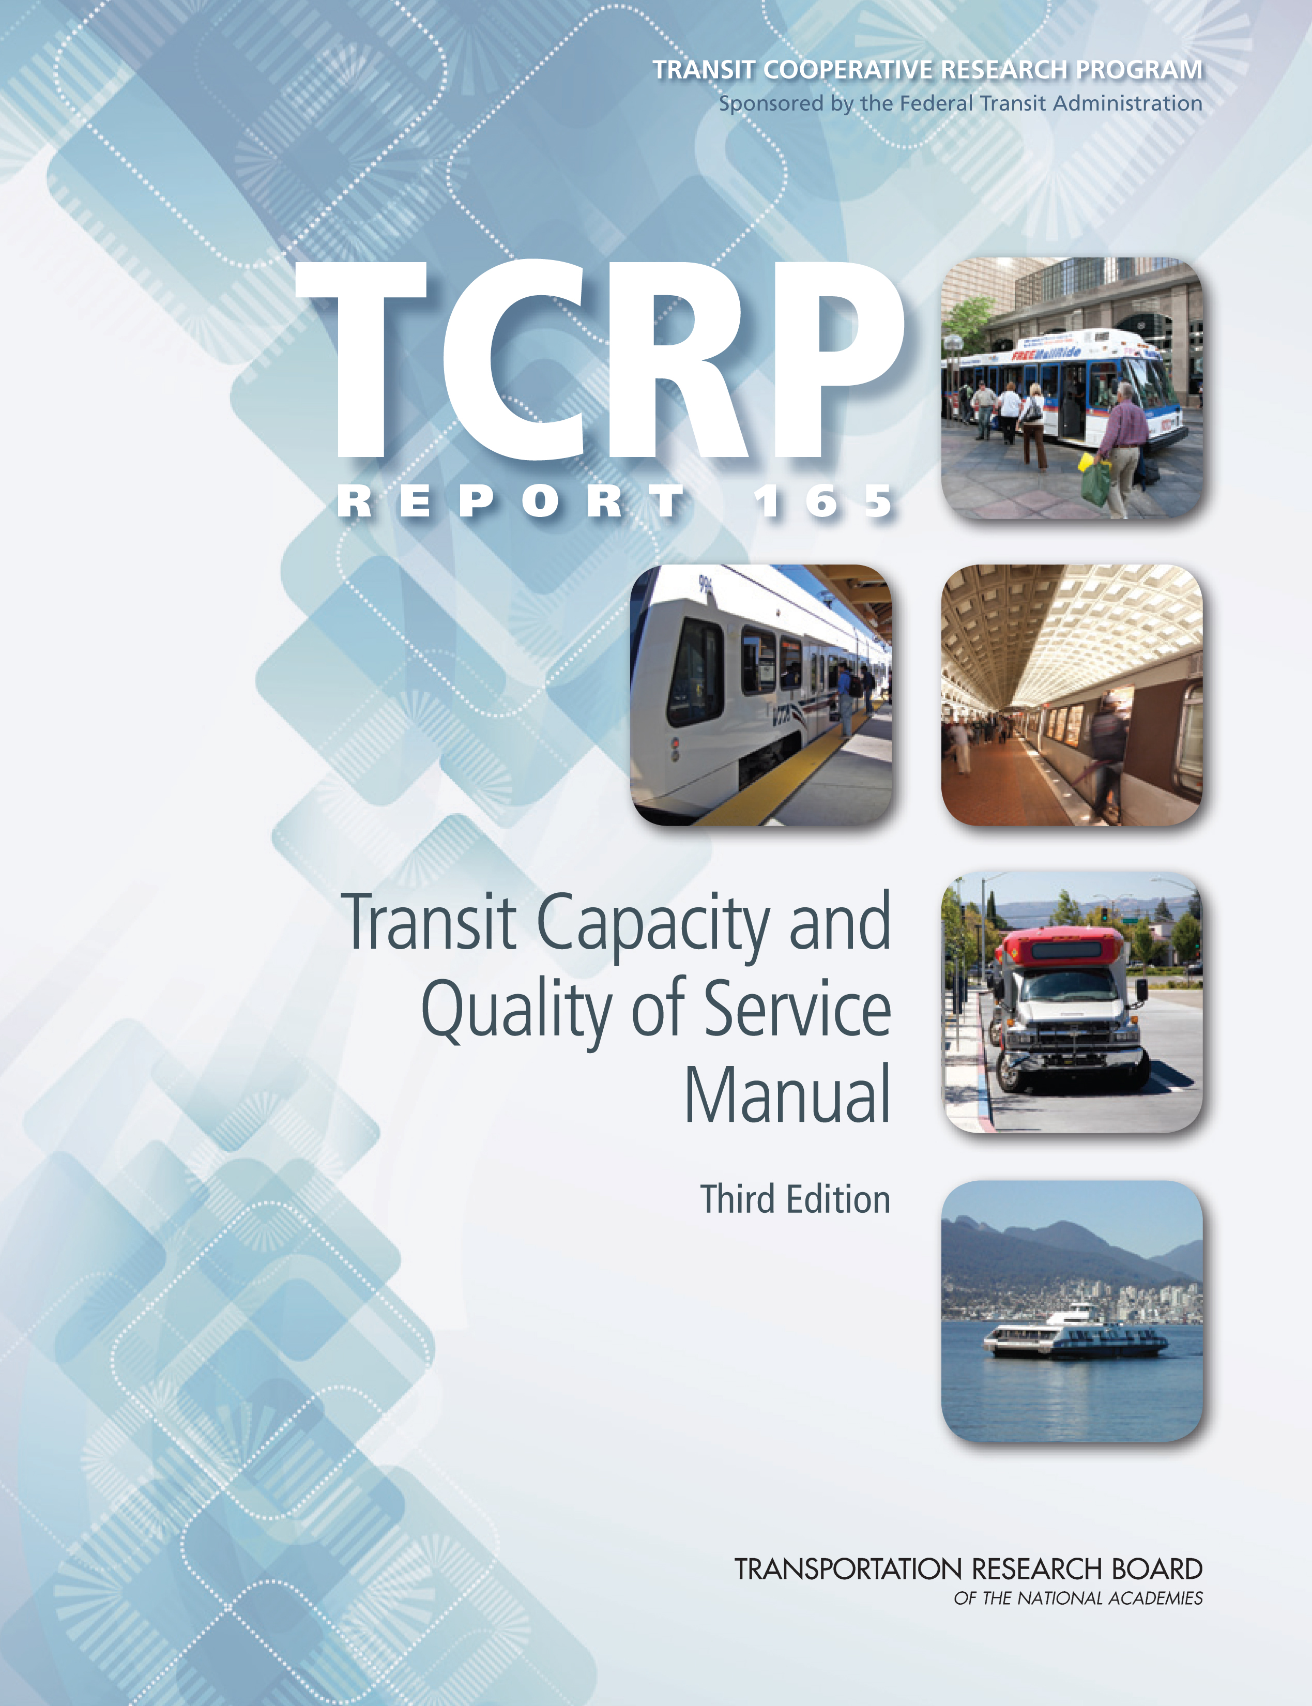
Bus Capacity

Slide 2
Presentation Overview
Learning objectives
Capacity concepts
Capacity calculation process
Speed estimation process
Reliability
Summary of other chapter content

Slide 3
Learning Objectives
Understand why bus capacity is important, even for transit agencies that don’t experience capacity problems
Be able to identify the main factors that influence bus capacity, speed, and reliability
Understand the process involved in calculating bus capacity and speed
Become familiar with potential applications for this chapter’s material

Slide 4
Changes from the 2nd Edition
Transit preferential treatments section split into two
  Preferential treatments (roadway infrastructure treatments)
  Operational tools (transit and traffic operations treatments)
  Information updated based on TCRP Synthesis 83
Capacity and speed methods presented in step-by-step fashion
Busway, bus lane, and mixed traffic capacity methods combined into a single unified method
Base bus speeds can now be calculated directly
Boarding lost time factor added
Passenger service times updated
Reliability material expanded
New table on bus performance characteristics
New section on potential examples of applications of the methods to real-world situations

Slide 5
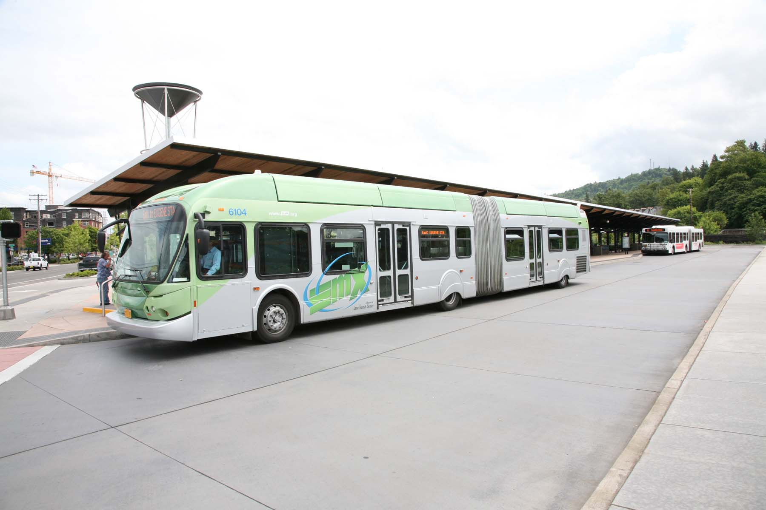
Bus Capacity Concepts

Slide 6
Why Should We Be Interested in Capacity?
The same factors that influence capacity also influence speed and reliability
  Travel time and reliability affects quality of service (and thus ridership)
  Speed and reliability affects the time required for a bus to make a round trip on a route, including schedule recovery time
    Affects the number of buses needed to serve the route at a given headway,
    which directly affects operating costs

Slide 7
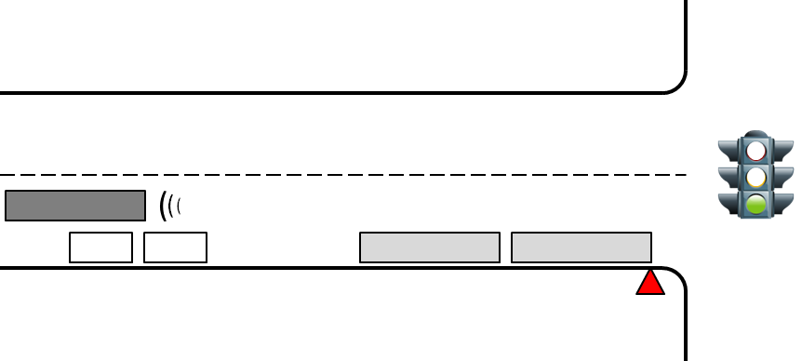
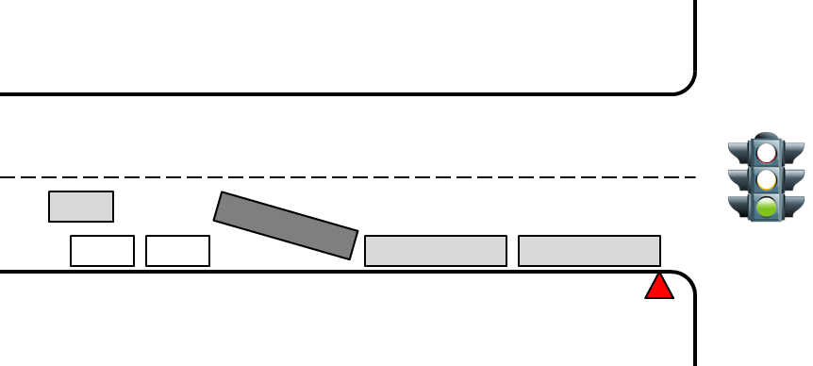
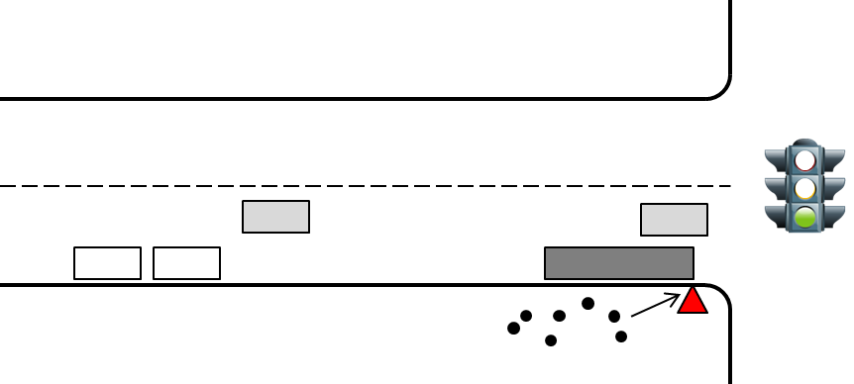
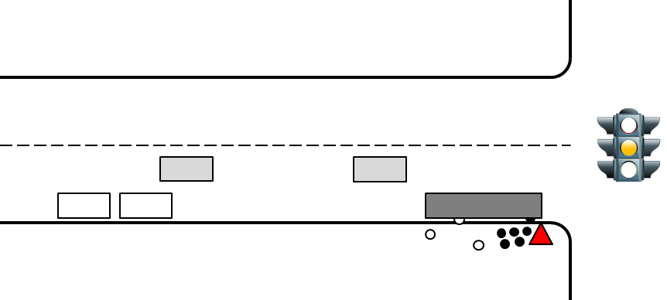
Sources of Bus Delay Associated with Bus Stops
Deceleration
  Time spent slowing to serve the stop
Bus stop failure
  Waiting for other buses to clear the stop
Boarding lost time
  Waiting for passengers to reach the bus
Passenger service time (dwell time)
  Opening the doors, boarding and alighting
  passengers, and closing the doors

Slide 8
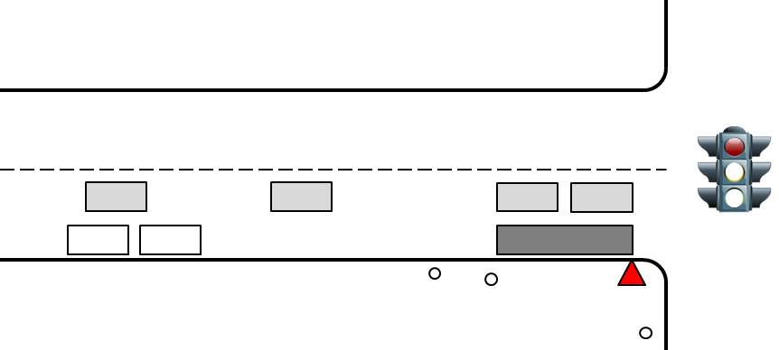
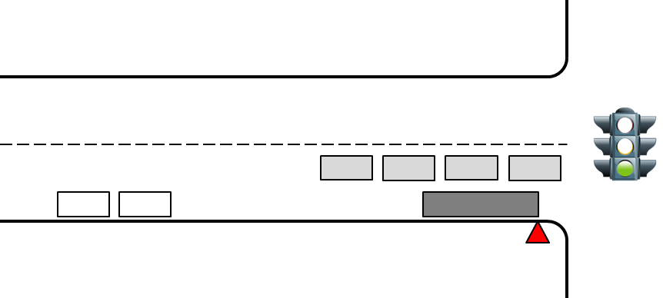
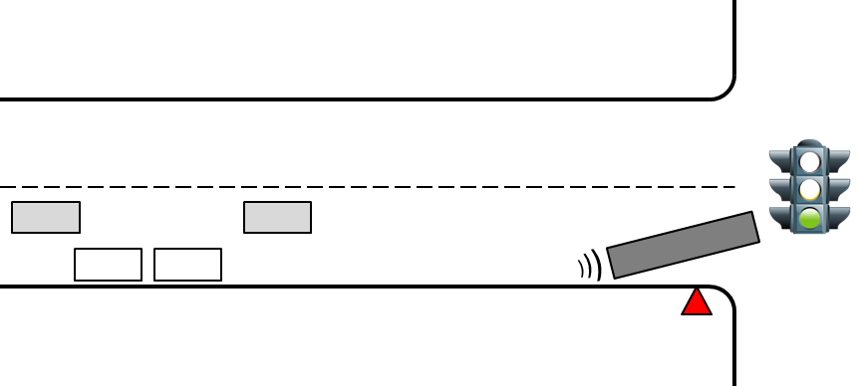
Sources of Bus Delay Associated with Bus Stops (cont’d.)
Traffic signal (traffic control) delay
  Waiting for the signal to turn green,
  or other traffic control delay
Re-entry delay
  Waiting for a gap in traffic
Acceleration
  Time spent getting back up to speed

Slide 9
Deceleration and Acceleration Delay
At urban street speeds, acceleration and deceleration delay amounts to about 10 seconds per stop where the bus would not have had to stop anyway due to traffic control
  Delay is more significant at higher speeds, as buses accelerate more slowly
  Different bus sizes and propulsion systems have different acceleration characteristics
This delay occurs
  Always, at far-side stops at traffic signals and all other stops where the bus is not required to stop due to traffic control (signs, traffic signals)
  Sometimes, at near-side stops at traffic signals and roundabouts, where the bus might have had to stop anyway due to the traffic control
    Traffic control delay includes deceleration and acceleration delay due to the control device—don’t want to double-count the delay
  Never, at near-side stops with stop-sign control
    The bus would have had to stop anyway for the stop sign

Slide 10
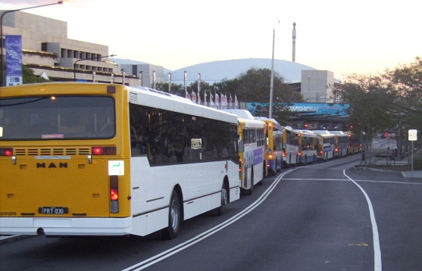
Bus Stop Failure
A situation where a bus arrives at a bus stop to find all loading areas full
  The bus must wait in the street until space becomes available
  Slows down the bus and creates schedule reliability issues
  Delay can range up to the other bus’ dwell and traffic control delay times
Can be measured, but more typically used as a design input when determining capacity
  Design failure rate, based on transit and traffic operations considerations
  TCQSM suggestions:
    Downtown stops: 7.5 to 15%
    (trade off speed for more capacity)
    Other stops: 2.5% (preferred) up to 7.5%
    (minimize transit & traffic delays)

Slide 11
Boarding Lost Time
At curbside bus stops with more than one stopping position (loading area), passengers don’t know exactly where their bus will stop
Passengers choose to wait in a location that minimizes their walk to the bus’ front door when it arrives
  For a stop with 3 loading areas, passengers tend to wait around where the second bus’ door would be, give or take half a bus length
It may take a little time for the first passenger to reach the bus and begin boarding after the bus arrives
  For a stop with 3 loading areas, 4.0 (crowded waiting area) to 4.5 seconds (uncrowded waiting area) are average values
  Research has not yet determined values for stops with 2, 4, or 5 loading areas; analyst judgment is required
    2 loading areas: A value between 0 and 4 seconds
    4 and 5 loading areas: Will depend on how often the rear loading areas are used, but could be significantly longer (e.g., individual passengers could need to walk the length of one or two additional buses)

Slide 12
Dwell Time
Time spent serving passengers, plus the time to open and close the doors
The most important capacity factor
Dwell time is affected by
  Number of passengers to be served
  Number of doors and door channels available for use
  Fare payment method(s)
  Bus floor height relative to platform height
  On-board crowding
Dwell time variability is also important
  Passenger demand variability (generally throughout an hour)
  Passenger demand variability (between routes sharing a stop)
  Wheelchair lift/ramp use
  Bicycle rack use
  Passenger questions to drivers, fare disputes, etc.

Slide 13
Passenger Service Time
Fare payment
Add 0.5 seconds per passenger for steps
(1.0 second for steep steps, such as those on motor coaches)
Add 0.5 seconds per passenger when standees present on-board

Slide 14
Traffic Signal Delay
Potential traffic signal delay is a function of:
  Traffic signal cycle length (time from start of green to start of next green)
  Amount of green time given to the street the bus operates on
  Bus deceleration/acceleration delay
  (when a bus doesn’t need to serve a bus stop at the intersection)
  In general, shorter traffic signal cycle lengths and more green time for the bus’ street reduce bus traffic signal delay
    Traffic operations policies and requirements (particularly auto operations and pedestrian signal timing requirements) are constraints
    Regardless of roadway agency policy regarding transit preference or minimum auto level of service, auto operations will affect buses when queues of vehicles prevent buses from getting through the intersection on the first green
Other types of traffic control also produce delays
  Yield control (e.g., roundabouts)
  Stop control

Slide 15
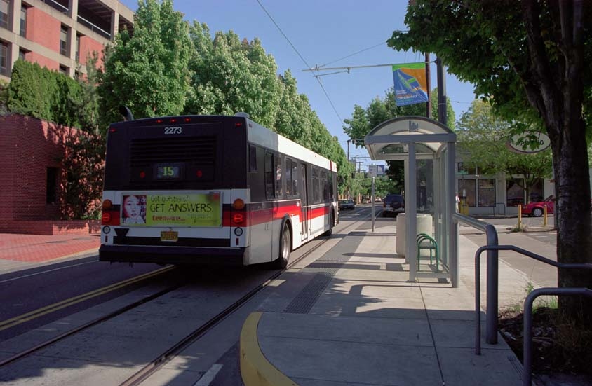
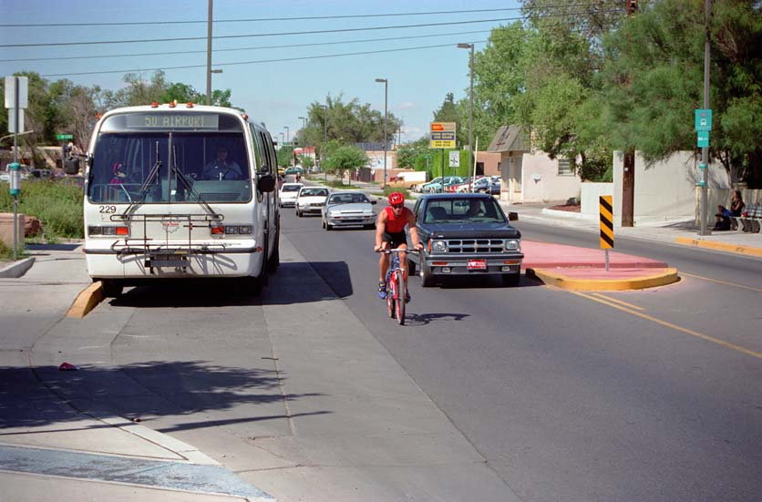
Bus Stop Position
When buses stop out of the traffic lane (“off-line stops”), they may experience “re-entry delay” waiting for a gap to pull back into traffic
Buses that stop in the traffic lane (“on-line stops”) do not experience this delay
Yield-to-bus laws may help reduce delay at off-line stops
All buses require “clearance time” to travel their own length, thus freeing up curb space for the next bus—this time is unusable for serving passengers
On-line
Off-line

Slide 16
Sources of Bus Delay Associated with Bus Facilities
Stop spacing
  How frequently a bus stops to serve passengers
Exposure to other traffic
  Delays caused by other traffic using the facility
Facility design
  Ability of buses to move around each other and other traffic
Bus operations
  Scheduled bus volumes relative to capacity (bus–bus interference)
  Organization of buses and routes (platooning, skip stops)

Slide 17
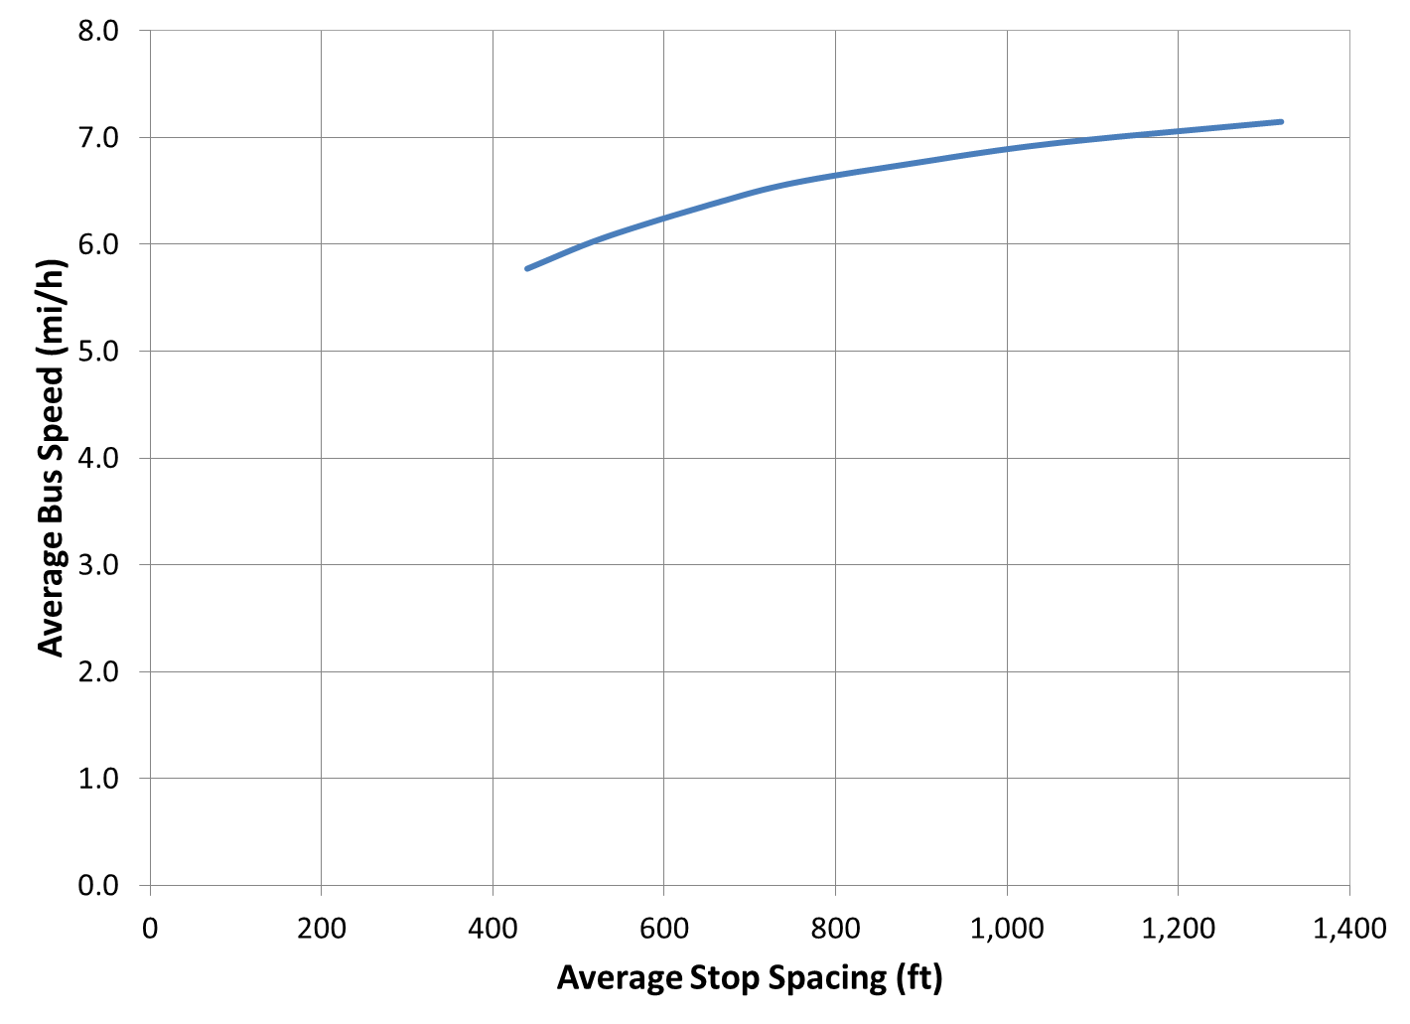
Stop Spacing
The more frequently a bus stops, the more often certain fixed delays occur
  Deceleration/acceleration delay (typically 10 seconds per urban street stop)
  Door opening and closing time (2 to 5 seconds per stop)
Ability to consolidate stops depends on
  Local pedestrian environment
  Passenger characteristics
  (e.g., seniors)
  Neighborhood support
  or opposition
Consider trade-off of
longer walking distances vs.
faster on-board trips

Slide 18
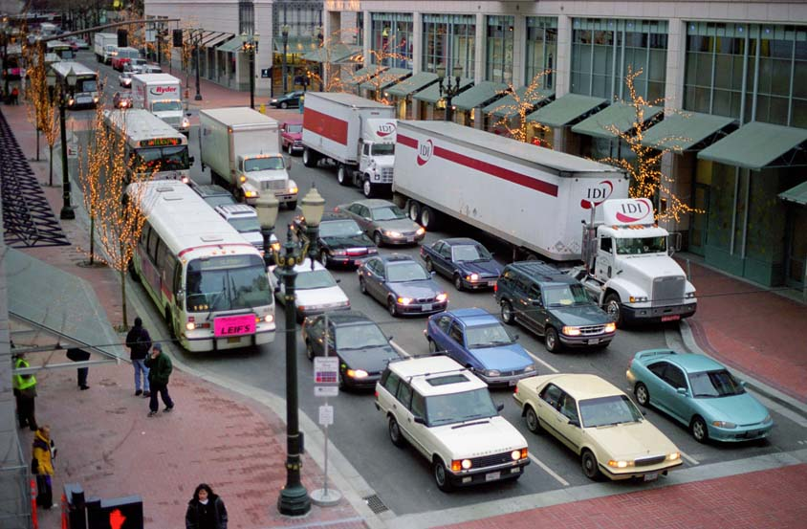
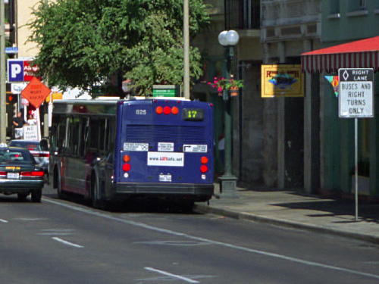
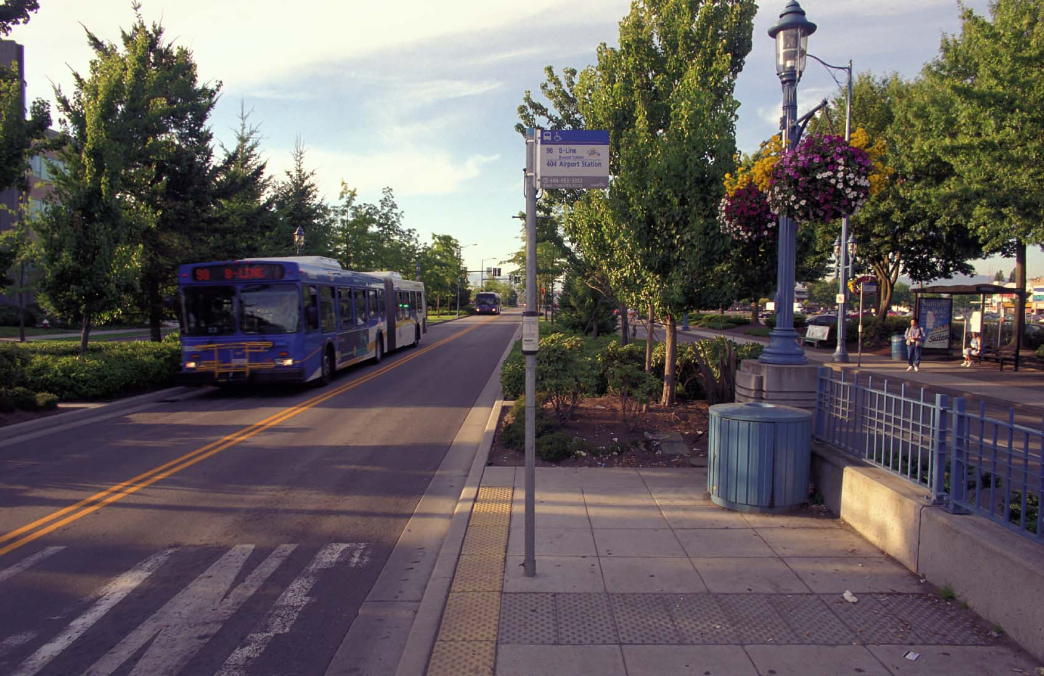
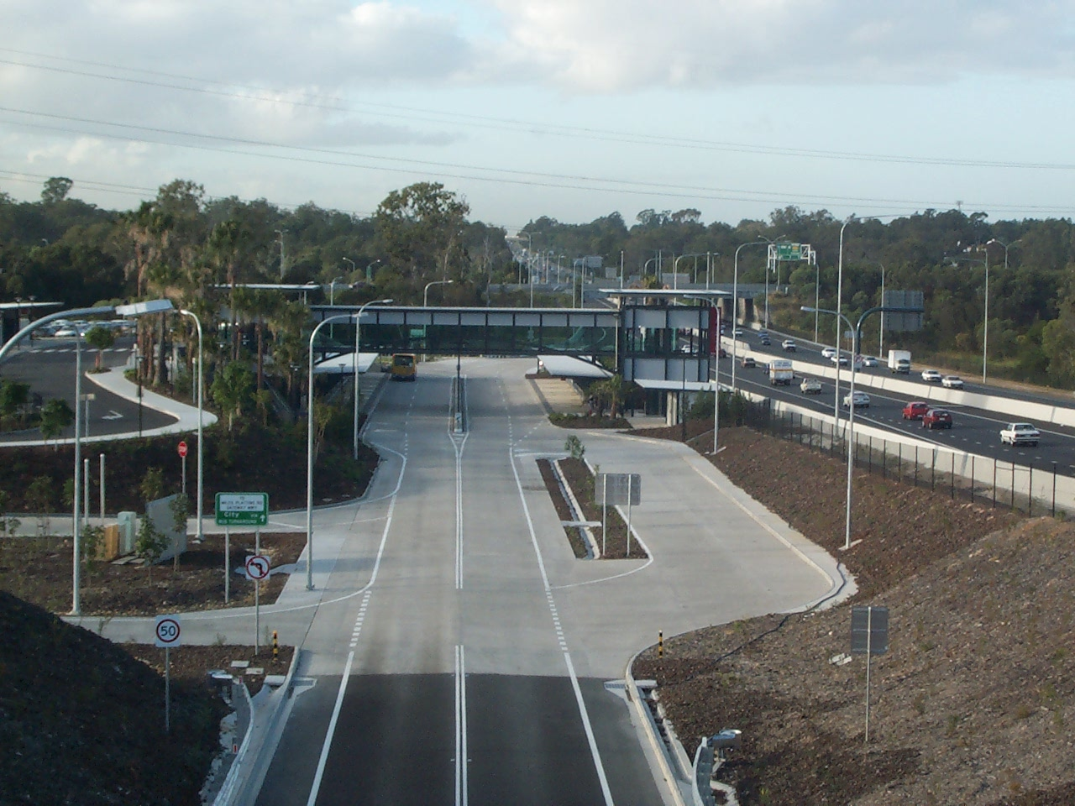
Facility Type
The more exclusive the bus facility, the less traffic-induced delay
Mixed traffic
Semi-exclusive (bus lane with right turns allowed)
Exclusive (median busway)
Grade-separated (off-street busway)

Slide 19
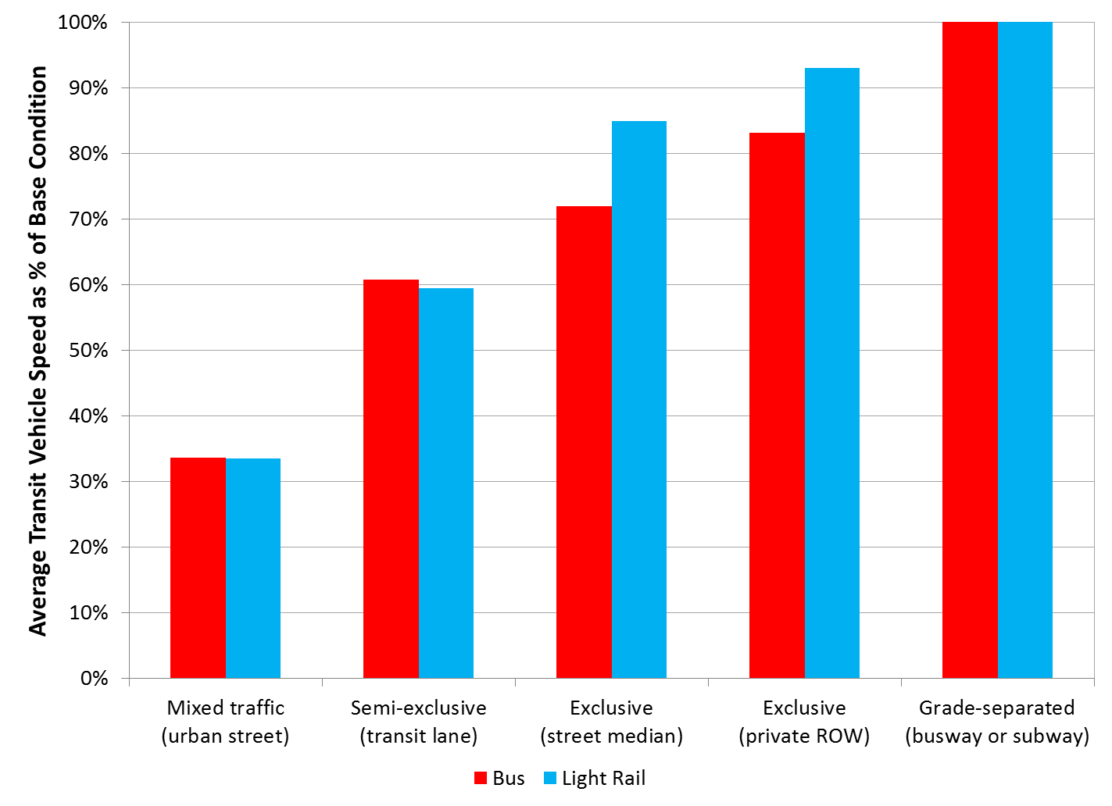
Facility Impact on Speed
More-exclusive bus facilities cost more but provide faster travel times, along with more capacity and better reliability

Slide 20
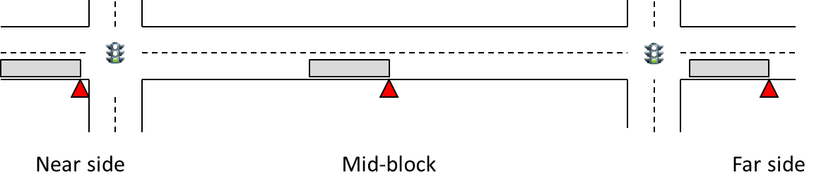
Bus Stop Location
Far-side stops have the least negative impact on speed and capacity, followed by mid-block stops and near-side stops
Many other factors must be considered when locating bus stops
  Vehicle turning volumes, driveways, physical obstructions
  Transfer opportunities, locations of passenger generators
  Signal timing, potential for implementing transit preferential measures

Slide 21
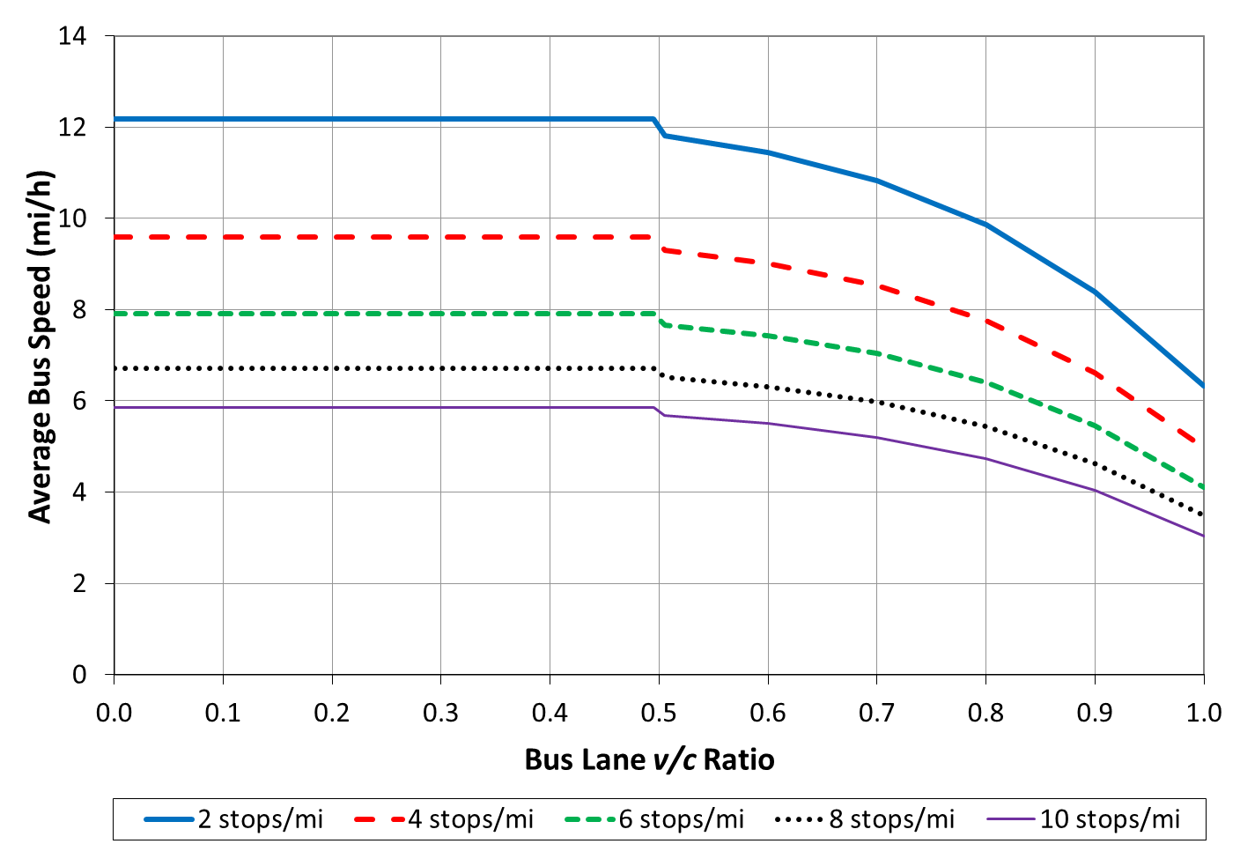
Bus Volumes
When bus volumes exceed half of a facility’s maximum (i.e., theoretical) capacity, bus speeds begin to drop as buses begin to interfere with each other
Note: v/c ratio = volume-to-capacity ratio. Speeds shown reflect assumptions given in TCQSM Exhibit 6-10.

Slide 22
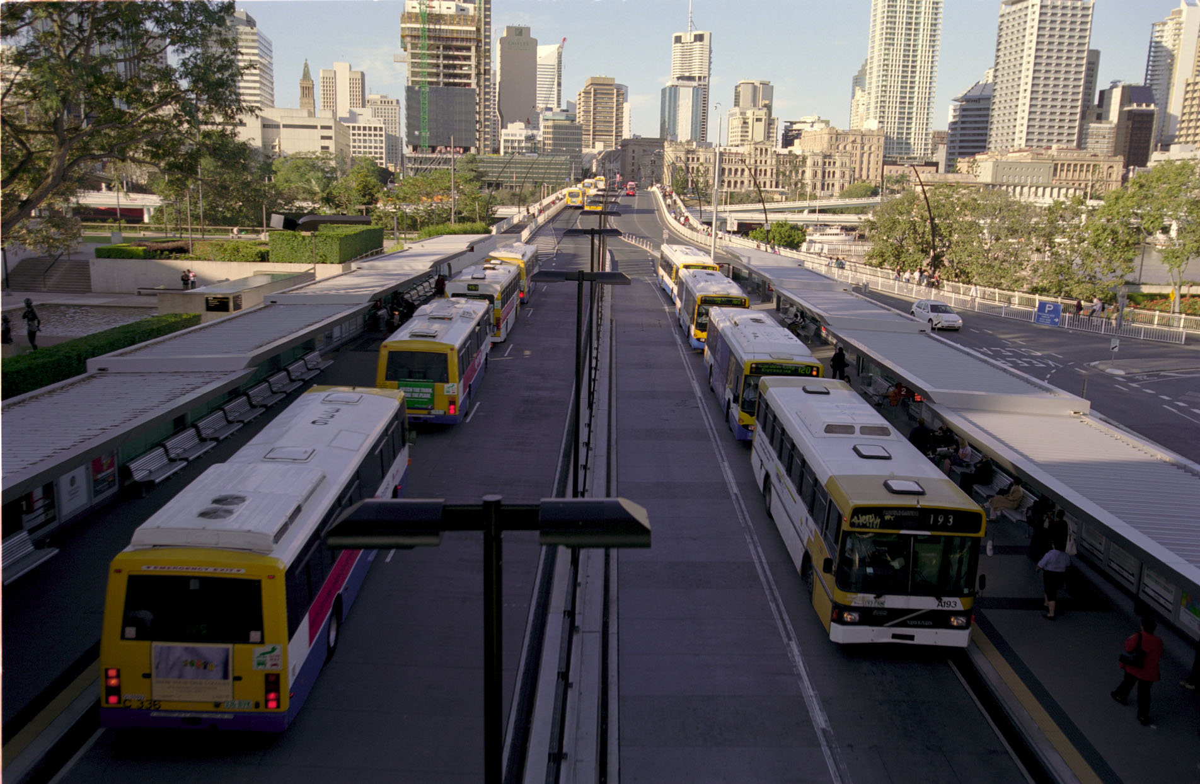
Capacity Calculation Process

Slide 23
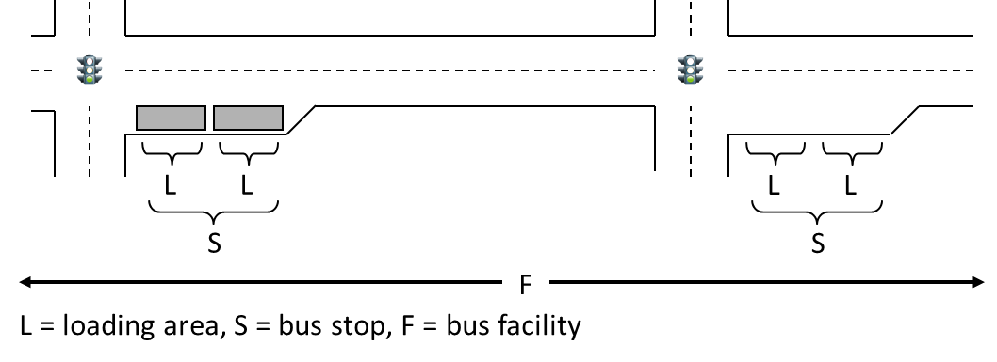
Locations Where Capacity Can Be Calculated
Loading areas (bus berths)
  Curbside space where a single bus can load and unload passengers
Bus stops
  Consist of one or more loading areas
Bus facilities
  Consist of one or more (usually many more) consecutive bus stops

Slide 24
Sequence of Calculations
Loading Area Capacity
Person capacity (p/h) =
Bus facility capacity (bus/h)
Bus passenger capacity (p/bus) ×
Peak hour factor
Passenger capacity can be a weighted average when more than one bus type uses a facility
Peak hour factor reduces person capacity to a design level as an allowance for serving peak-within-the-peak passenger demand
Bus Stop Capacity
Bus Facility Capacity

Slide 25
Loading Area Vehicle Capacity Factors
Seconds in an hour available for bus movement
Capacity =
Seconds that a design bus occupies the stop
Notes:
25

Slide 26
Loading Area Vehicle Capacity Factors
(3,600 s/h) ×(% of time traffic control allows bus to enter/leave stop)
Seconds in an hour available for bus movement
Capacity =
Seconds that a design bus occupies the stop
(Portion of dwell on green) +
(Time waiting for a gap in traffic to leave loading area) +
(Clearance time while a bus travels its own length when leaving) +
(Allowance for particularly long dwells)
Notes:
26

Slide 27
Bus Stop Capacity Factors
Capacity = (loading area capacity) ×
(number of effective loading areas at the stop) ×
(adjustment for traffic blockage)
Notes:
27

Slide 28
Bus Stop Capacity Factors
(each additional physical loading area may add less than
one loading area’s worth of capacity)
Capacity = (loading area capacity) ×
(number of effective loading areas at the stop) ×
(adjustment for traffic blockage)
(function of bus stop location [near-side, far-side, mid-block],
right-turning auto volumes, conflicting pedestrian volumes,
and ability of buses to move around other vehicles)
Notes:
28

Slide 29
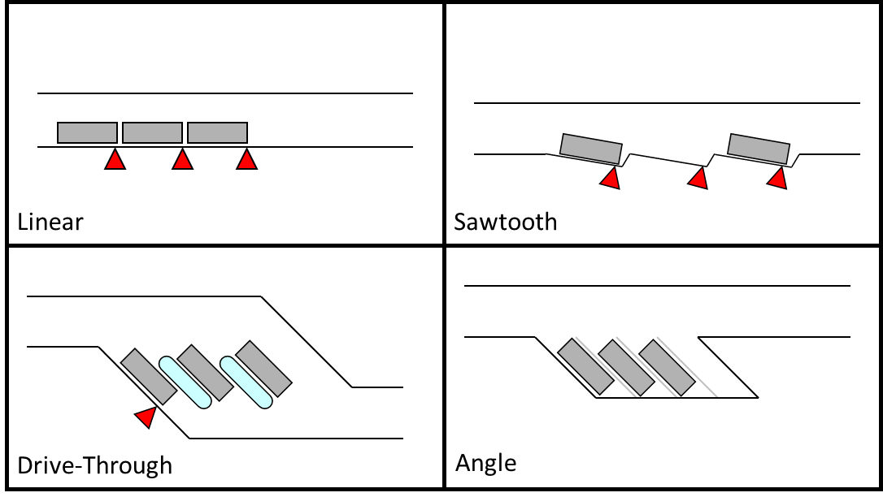
Linear and Non-linear Loading Areas
Buses can move independently in and out of non-linear loading areas
  Sawtooth, drive-through, and angle berths
  All loading areas can be used independently of each other, when buses are not assigned to a specific loading area
The presence of another bus may block access to linear loading areas in front of the bus and may also block the departure of the following bus
  Each loading area cannot be fully utilized
  Each additional physical loading
  area contributes less and less
  additional capacity

Slide 30
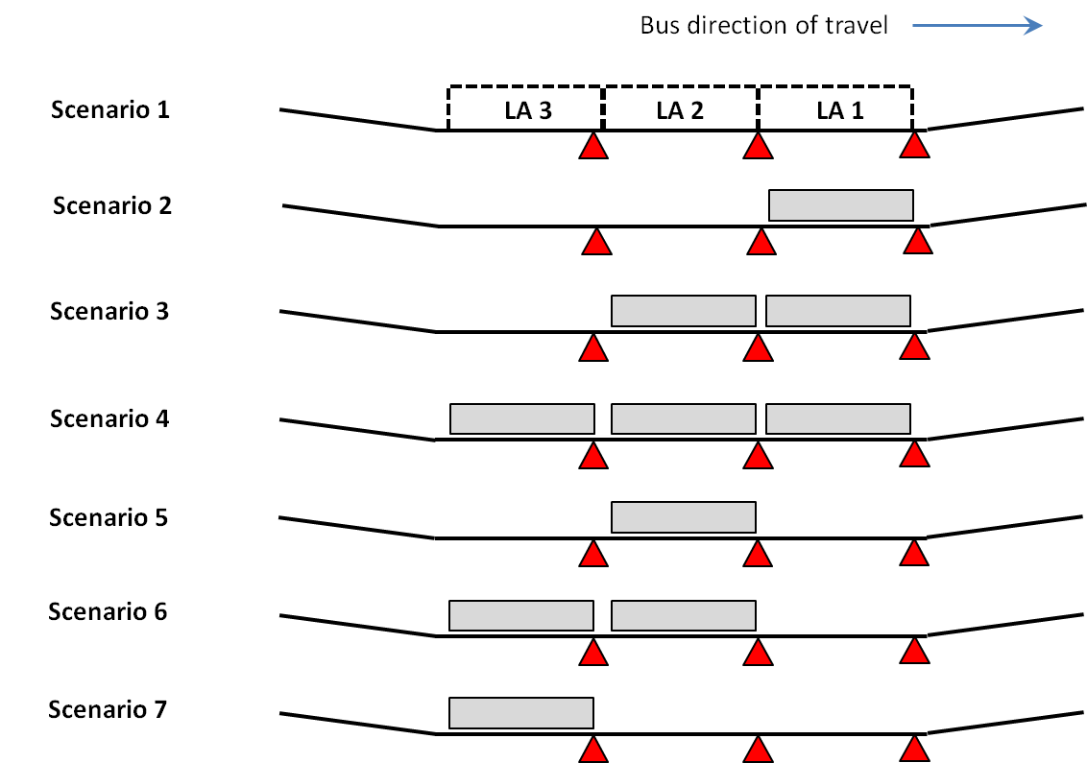
Stopping Patterns at Linear Loading Areas
In Scenario 5, the bus in loading area 2 (LA2) blocks access to the front loading area (LA1) for the next arriving bus—LA1’s capacity is unusable
In Scenarios 6 and 7, if another bus arrives before the rear bus leaves, loading area failure will occur

Slide 31
Effective Loading Areas
On-line loading areas operate on a “first-in, first-out” principle
  A bus stopped in a rear loading area blocks access to loading areas in front
  Adding a fourth or fifth loading area adds very little additional capacity
Off-line loading areas provide a little more operating flexibility
  A bus stopped in a rear loading area blocks access to the loading area immediately in front of it, but not necessarily to others farther forward
  Depending on how closely buses stop to the bus in front, buses may be able to exit a berth independently of the bus in front
  Provide more effective loading areas than on-line bus stops, with the trade-off of potential re-entry delay when exiting the stop

Slide 32
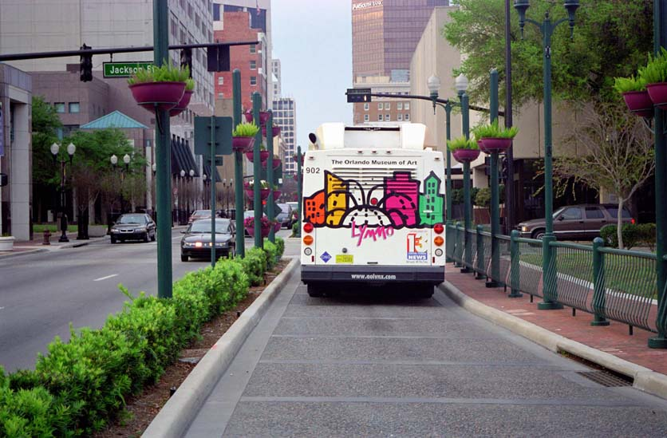
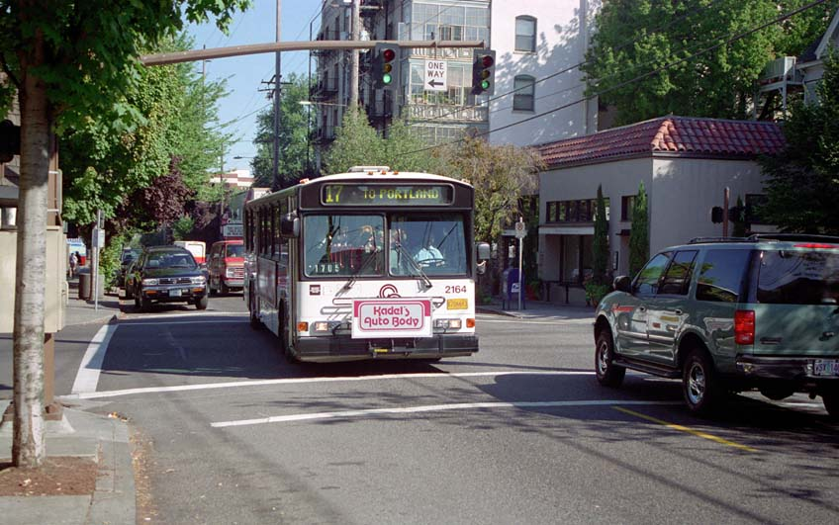
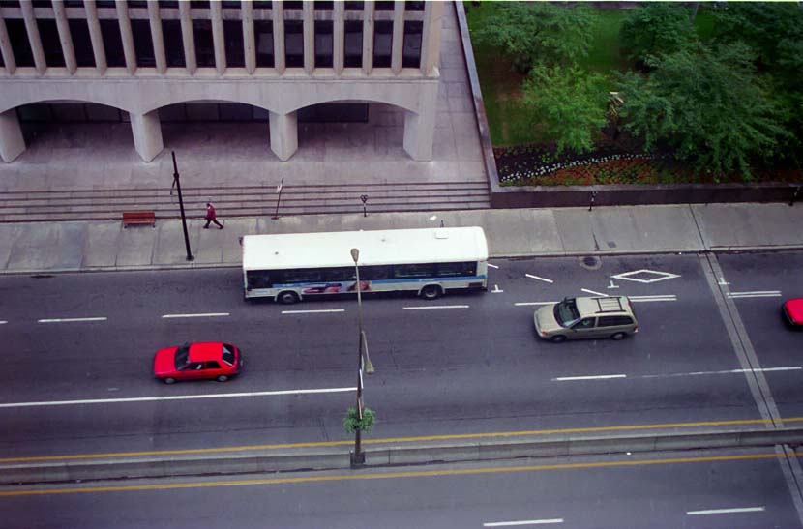
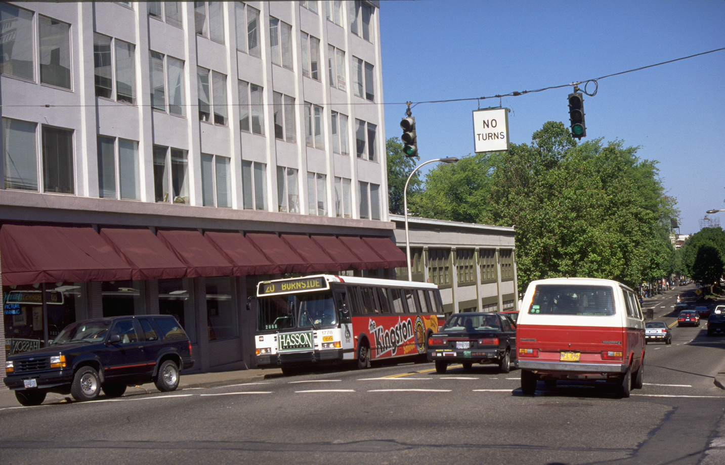
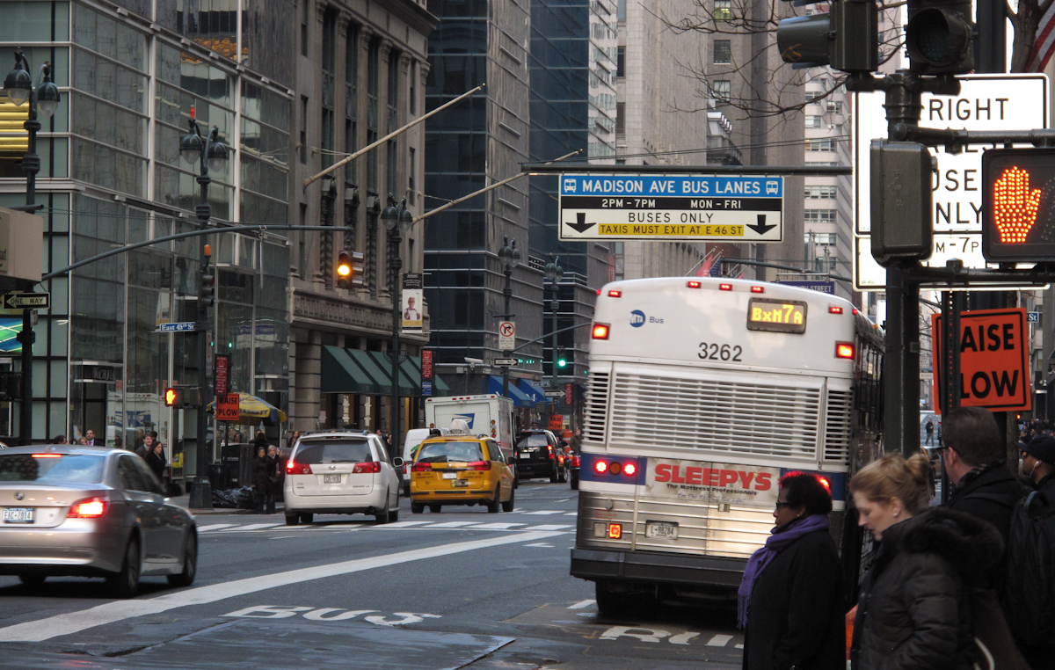
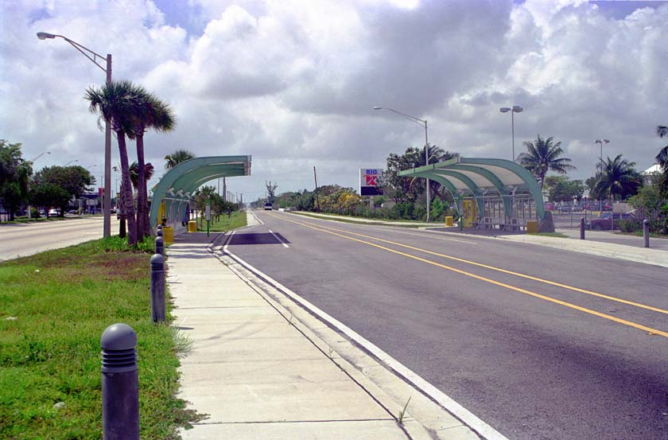
Bus Facility Type
Impact of other traffic on bus stop capacity depends on how exclusive the facility is
Three facility types defined:
  Type 1: One lane in travel direction
  (bus cannot go around other vehicles)
  Type 2: Two or more lanes in travel direction
  (bus may be able to go around other vehicles)
  Type 3: Buses have full use of the adjacent lane
  (includes busways where passing lanes are
  provided at stations)

Slide 33
Bus Facility Capacity Factors: Non-stop Facilities
Non-stop facilities include busways and HOV lanes
The facility itself is often not the capacity constraint
  Facility acts as a pipe
    280 buses per hour on the busiest portions of Bogotá’s TransMilenio BRT
    735 buses per hour on the New Jersey approach to the Lincoln Tunnel
Possible constraints include
  Busway station without a passing lane for other buses
    Brisbane’s Cultural Centre station prior to renovation
  HOV lane capacity used by non-transit vehicles
  Signalized intersection before or after the facility
  Capacity of the terminal(s), transit center(s), and/or street(s) that the buses using the facility end up at
    Port Authority Bus Terminal (New York)
    Downtown Ottawa streets

Slide 34
Bus Facility Capacity Factors: Urban Streets
The critical bus stop capacity sets the bus facility capacity
  Facilities where all buses stop at all stops: the stop with the lowest capacity
  Facilities with a mix of local and limited-stop services: the stop used by all routes with the lowest capacity
The lowest-capacity stop is usually the stop with the longest average
dwell time

Slide 35
Bus Facility Capacity Factors: Skip-stop Operation
Skip-stop operation: Buses are divided into groups that stop at separate sets of stops along the facility
The facility capacity is the sum of the critical bus stop capacities of each group in the skip-stop pattern, times an adjustment factor
  Ideally, a 3-stop pattern could triple a facility’s capacity, compared to a situation where all buses stop at all stops
  Ability to obtain the full benefit of skip stops depends on:
    Bus arrival patterns (platooned, imperfect schedule adherence, poor schedule adherence/poor scheduling)
    Adjacent lane traffic volumes relative to capacity

Slide 36
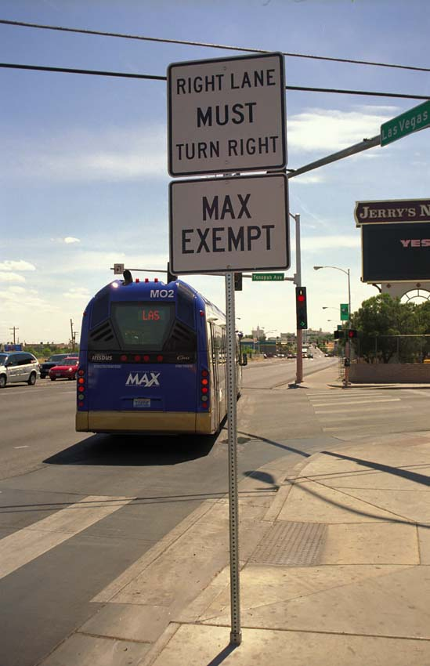
Speed
Estimation
Process

Slide 37
Sequence of Calculations
If necessary, split the facility into sections with similar right-of-way types
Recalculate the critical bus stop capacity for each section based on maximum capacity
  The only time that maximum capacity is used in a TCQSM method
  The “bus-bus” interference factor used later in the process incorporates bus stop failure
Determine the unimpeded bus running time rate
  Time to travel the facility without traffic, stopping only to serve passengers
Adjust the running time rate for traffic signal and traffic delays
If necessary, adjust for skip-stop operation
Adjust for bus-bus interference (bus congestion)
Convert the adjusted running time rate to a speed

Slide 38
Unimpeded Running Time Rate
Accounts for travel time at the facility’s posted speed, plus dwell time and deceleration/acceleration delay
When stops are closely spaced, need to make sure the bus can accelerate to the posted speed before slowing again—if it can’t, set the running speed to be lower than the posted speed
Can be calculated directly from an equation (recommended)
Lookup tables also provided for downtown streets, suburban arterials, and busways
Result in expressed in minutes per mile (km)

Slide 39
Additional Running Time Losses
Accounts for traffic signal and other delays
Pick a value from a lookup table
  Values derived from U.S. and Canadian field observations
  When a range of values is given, consider the quality of traffic progression along the street and the level of bus lane/double parking enforcement
If one has access to AVL data, one could created a calibrated version of this table for one’s city by comparing actual bus speeds to calculated unimpeded bus speeds—the difference is the running time loss, when scheduled bus volumes are less than half the facility’s maximum capacity

Slide 40
Bus-Bus Interference
When the number of buses scheduled exceeds half of a facility’s maximum capacity, buses will begin to interfere with each other
  Bus stop failure, passing/leapfrogging activity
Running time rate is reduced as a result

Slide 41
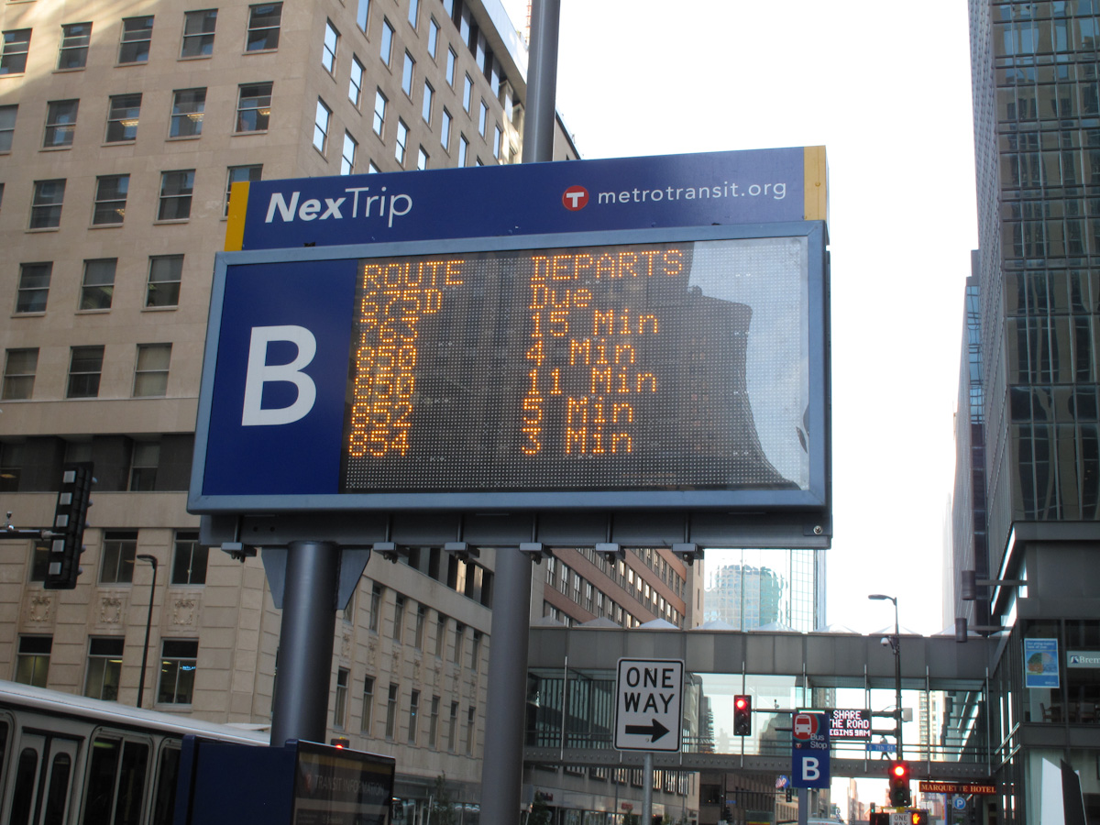
Bus Reliability

Slide 42
Reliability Overview
Comprehensive research is needed to quantify the effects of both external influences and scheduling and control strategies on bus reliability
In the absence of such research, TCQSM presents current knowledge about reliability

Slide 43
Factors Influencing Reliability
Traffic conditions & operations
Road construction & maintenance
Vehicle & maintenance quality
Vehicle & staff availability
Transit preferential treatments
Schedule achievability
Passenger demand fluctuations
Differences in operator experience
Wheelchair lift & ramp usage
Route length & number of stops
Operations control strategies

Slide 44
Transit Preferential Treatments
The Bus Capacity chapter provides two sections discussing ways to improve bus speed and reliability
Preferential treatments
  Bus lanes, busways, HOV lanes
  Transit signal priority
  Queue jumps, queue bypasses
  Boarding islands
  Curb extensions (bus bulbs)
Operational tools
  Bus stop consolidation, bus stop relocation
  Skip-stops, platooning
  Movement restriction exemptions, parking restrictions
  Yield-to-bus
TCRP Project A-39 (to be completed second half of 2014) is investigating these treatments and more in greater detail

Slide 45
Potential Applications for the Bus Capacity Chapter
Alternative mode, service, and facility comparisons
  Compare capacities and/or speeds associated with
    Different street configurations
    Different stop spacings
    Different modes (e.g., light rail)
  Changes in travel time can be used to estimate ridership changes
  Speeds can be used to determine number of vehicles required, which feeds into capital and operating cost estimation
Operational impacts of fare collection technology changes
Transit preferential treatment impacts
Diagnosing and treating capacity issues
Sizing BRT facilities for a given demand

Slide 46
More Information
TCRP Report 165: TCQSM—Chapter 6, Bus Transit Capacity
  A spreadsheet implementing the bus capacity and speed methods is provided on the accompanying CD-ROM
TCRP Report 26 and TCRP Research Results Digest 38
  The basis for many of the chapter’s methods
The TCQSM is available as:
  Free individual printed copies and PDF downloads through the TCRP Dissemination Program
  http://www.tcrponline.org
  Free PDF downloads directly from TCRP
  http://www.trb.org/TCRP/Public/TCRP.aspx (Publications section)
  or simply do an Internet search for the report number (e.g., TCRP Report 165)
  Individual or multiple copy purchases from the TRB Bookstore
  http://books.trbbookstore.org/

Slide 47
Acknowledgments and Permissions
Presentation author
  Paul Ryus (Kittelson & Associates, Inc.)
Photo credits
  Bus stop failure: Justin Jahnke
  Grade-separated facility type: Rory Giles/Queensland University of Technology
  All other photos: Paul Ryus
This presentation was developed through TCRP Project A-15C
  Research team: Kittelson & Associates; Parsons Brinkerhoff, Quade & Douglass; KFH Group; Texas A&M Transportation Institute; and Arup
  This presentation and its contents may be freely distributed and used, with appropriate credit to the presentation authors and photographers, and the Transit Cooperative Research Program

