Slide 1
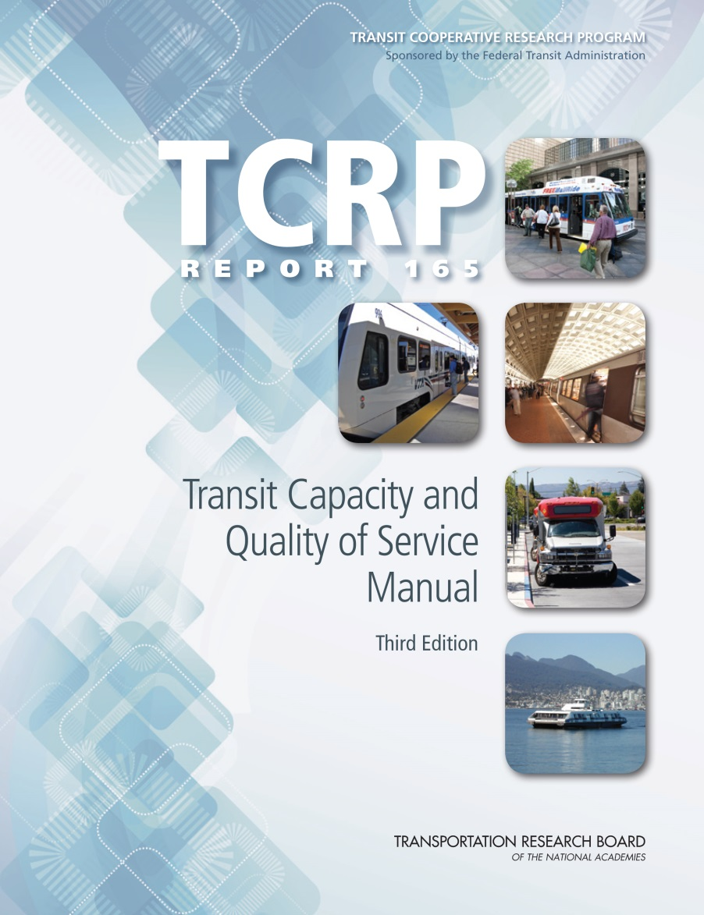
Rail Transit Capacity

Slide 2
Presentation Overview
Learning objectives
Factors that determine rail capacity
Line capacity (number of trains)
Person capacity (number of passengers)
Design capacity
Generalized capacity estimation method
Specialized capacity estimation methods

Slide 3
Learning Objectives
Understand the factors that influence rail transit capacity
Understand the differences between design (practical) capacity and maximum (theoretical capacity), and why the TCQSM focuses on design capacity
Be familiar with the process used by the generalized rail capacity method
Learn about situations when the generalized method needs to be modified, or other analysis tools used

Slide 4
Changes in 3rd Edition
Significant new material on the respective roles of simulation and sketch planning tools in evaluating rail capacity
Discussion of the role of the vehicle–platform interface in influencing capacity
Updated material on on-street rail preferential treatments
Capacity equations adjusted for consistent presentation with other parts of the manual
Equations produce the same results as before
Companion spreadsheets updated

Slide 5
Rail Capacity Factors
Paris Metro

Slide 6
Capacity Defined
Capacity concepts originally presented in the TCQSM Overview presentation
Line capacity definition
The maximum number of trains that can pass a given location during a given time period at a specified level of reliability
Person capacity definition
The maximum number of people that can be carried past a given location during a given time period under specified operating conditions; without unreasonable delay, hazard, or restriction; and with reasonable certainty
Unless otherwise specified, whenever the TCQSM uses the term “capacity”, a design (practical, achievable) capacity is meant
Maximum capacity is only achievable when service is 100% reliable, passenger demand never varies, passengers fill every available space on every trip, etc.
Scheduling for maximum, instead of design, capacity results in unstable, unreliable service
Notes:
We will discuss all three types in this sequence.

Slide 7
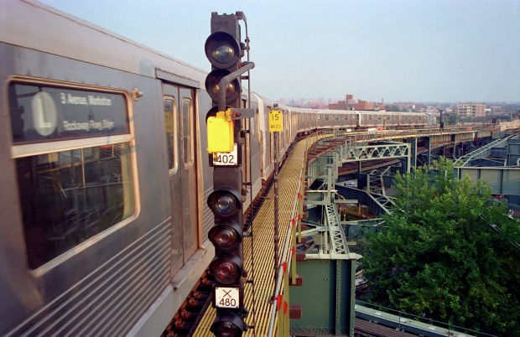
Line Capacity Factors
Dwell time
Signal system
Operating margin
Minimum headway
Junctions
Turnbacks
Power supply
New York City
Notes:
We will discuss all three types in this sequence.

Slide 8
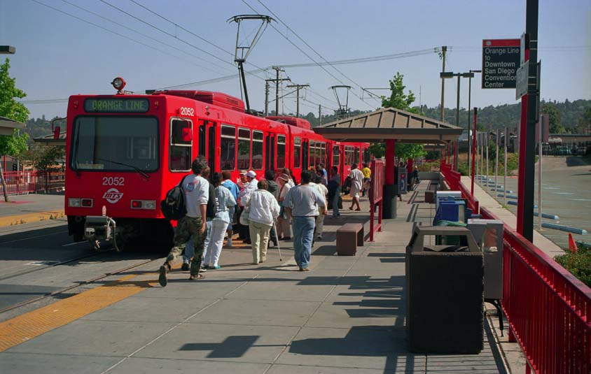
Dwell Time
How long a train is stopped to serve passengers at a station
Station dwell times are the major component of headways at short frequencies
Contributing factors
Passenger volumes
Distribution of passengers along platform
Number and width of train doors
Vehicle height
Wheelchair lift/ramp deployment
On-board crowding
Passenger behavior (stepping aside, holding doors)
On-board fare collection, if used
Unused time with doors open
Waiting-to-depart time with doors closed
San Diego Trolley
Notes:
We will discuss all three types in this sequence.

Slide 9
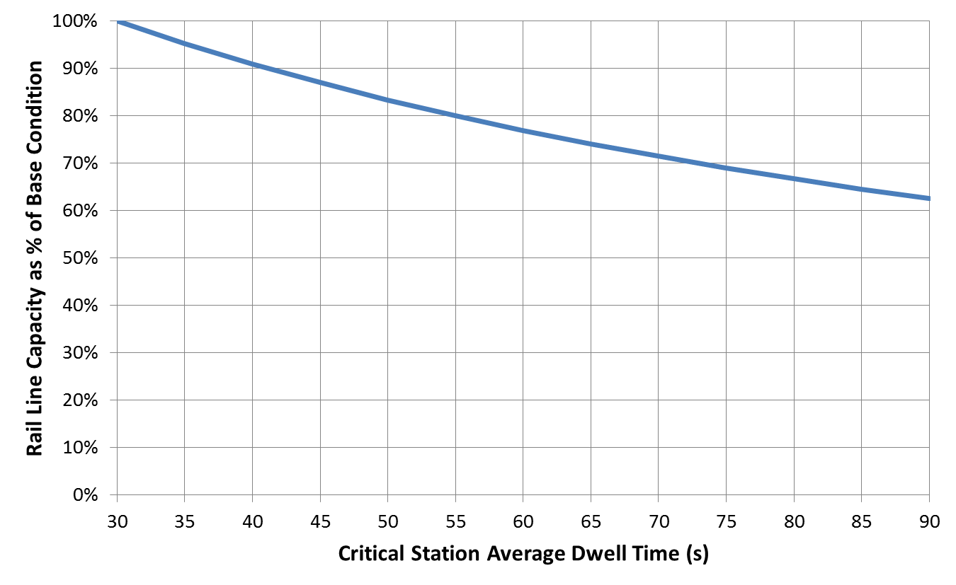
Illustrative Impact of Dwell Time on Line Capacity
Base condition assumes 30-second dwell times, 20-second operating margin, 50-second minimum train separation
Notes:
We will discuss all three types in this sequence.

Slide 10
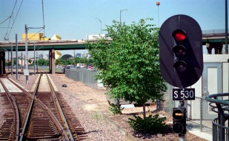
Train Signaling System
Determines the minimum safe spacing between trains
The more accurately a train’s position is known, the closer together that trains can operate, resulting in higher train throughput
Other possible elements:
Positive train control (commuter rail)
Automatic train operation
Automatic train supervision
Denver LRT
Notes:
We will discuss all three types in this sequence.

Slide 11
Signal System Types
Fixed block
Provides a coarse indication of train location
Three-aspect system (red/yellow/green) requires one empty block between trains
Cab signaling
Cab signaling sets authorized, safe train speeds
Authorized speeds displayed in driver’s cab
Problems with signal visibility reduced or eliminated
A typical selection of reference speeds would be 50, 40, 30, 20, and 0 mph
Moving block
Also called transmission-based or communication-based signaling systems
Requires continuous or frequent two-way communication with each train, and precise knowledge of a train’s location, speed, and length, and of fixed details of the line—curves, grades, interlockings, and stations
Computer calculates the next stopping point of each train and commands the train to brake, accelerate, or coast accordingly
Notes:
We will discuss all three types in this sequence.

Slide 12
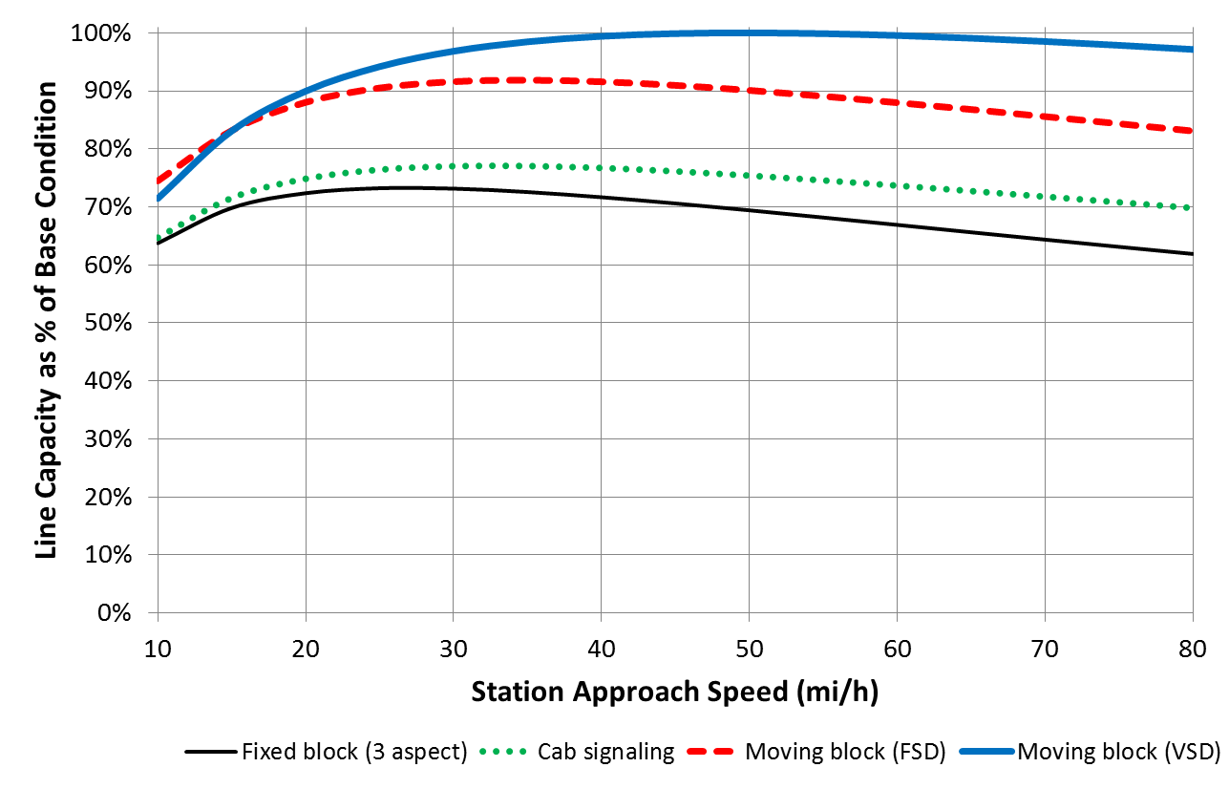
Illustrative Impact of Signaling and Station Approach Speed on Line Capacity
Base condition assumes moving block signals with variable safety distances, 45-second average dwell time, 20-second operating margin, and no grade entering station. FSD = fixed safety distance, VSD = variable safety distance
Notes:
We will discuss all three types in this sequence.

Slide 13
Operating Margin
An allowance for longer-than-average dwells
If a train dwells for more than (average dwell time) + (operating margin) and the following train is scheduled for the minimum headway, the following train will be delayed
If the full line capacity is being used, each succeeding train will be delayed (a cascade of delays) until headways increase to the point that the delay is absorbed
When possible, TCQSM recommends:
Existing operations: 2 standard deviations of dwell time (only 2.5% of dwells will potentially cause delays)
Planning future operations: 15–25 seconds
Notes:
We will discuss all three types in this sequence.

Slide 14
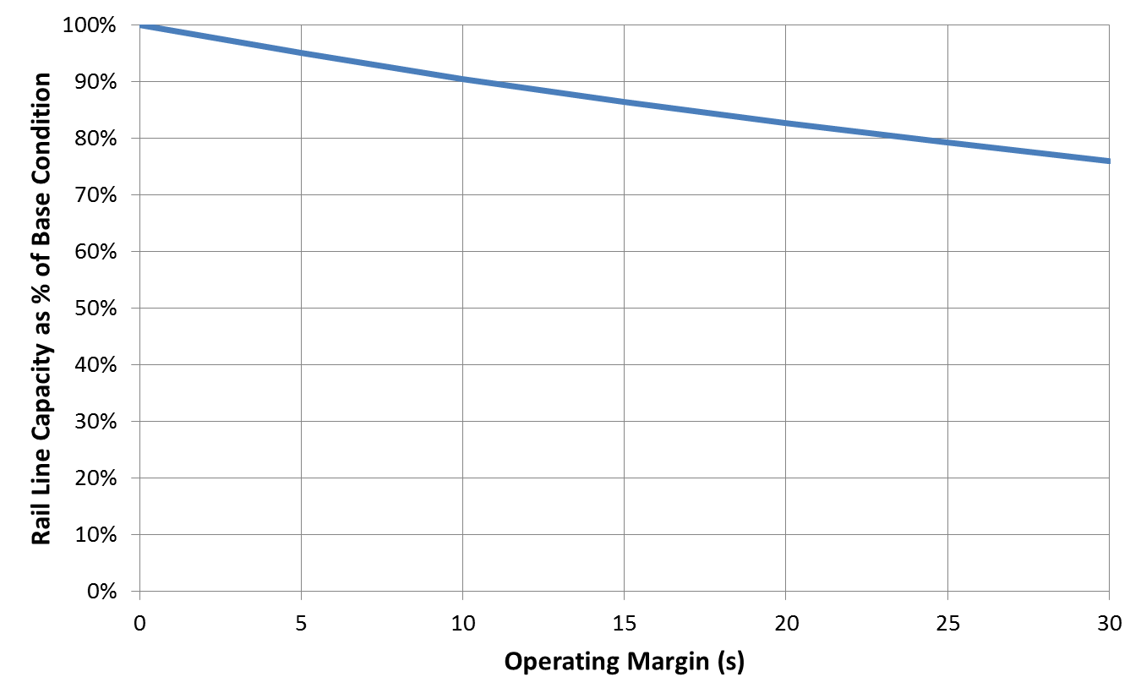
Illustrative Impact of Operating Margin on Line Capacity
Base condition assumes 45-second average dwell time, 0-second operating margin, 50-second minimum train separation
Notes:
We will discuss all three types in this sequence.

Slide 15
Minimum Non-interference Headway
Sum of:
Critical station average dwell time
Operating margin
Safe train separation time (signaling system)
Dividing the non-interference headway into 3,600 seconds per hour and rounding down gives the line capacity
Assumes no sharp curves or steep grades entering the critical station that would reduce capacity (see previous signaling slide graph)
Also need to check junctions, turnbacks, and power supply restrictions that can also constrain capacity (discussed next)
Notes:
We will discuss all three types in this sequence.

Slide 16
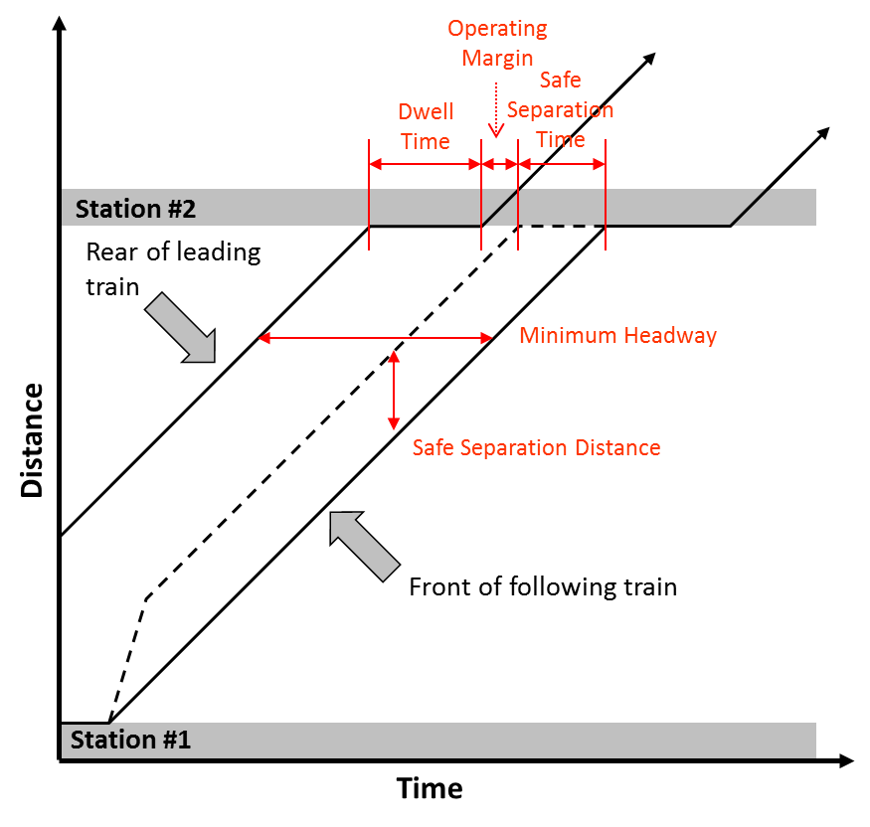
Distance–Time Plot of Two Successive Trains
Source: TCRP Report 13: Rail Transit Capacity Braking and acceleration curves omitted for clarity
Notes:
We will discuss all three types in this sequence.

Slide 17
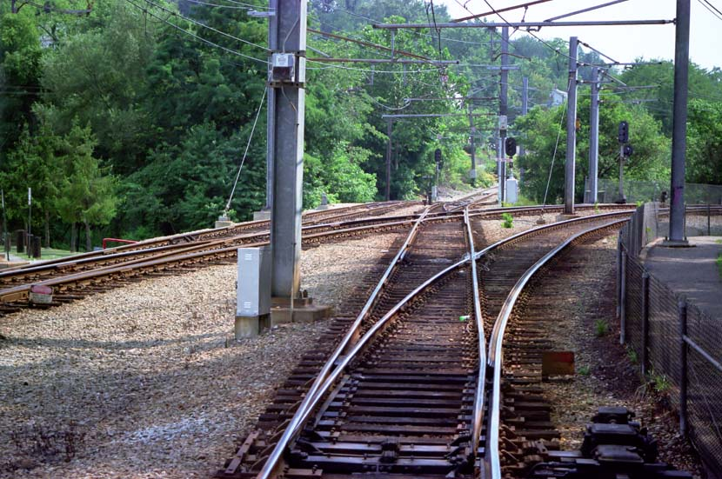
Junctions
Flat junctions: tracks cross at grade
Train movements through conflict points must be controlled
Crossing train movement must be coordinated with train movements in both directions of the line being joined
May support 2-minute headways, but train interference results
Grade-separate junctions at 150- to 180-second headways if possible (flying junctions)
Flat junction, Pittsburgh
Notes:
We will discuss all three types in this sequence.

Slide 18
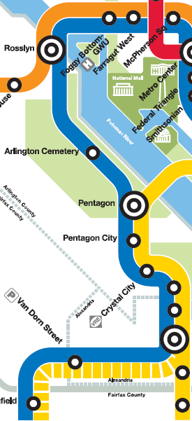
Line Merges
Even with flying junctions, line merges can create operational problems:
Train on one line arrives late to fill its slot, delaying the next train on the other line
May not be able to sustain as much capacity as a similar line that has no line merges
Flying junction, Paris
Blue Line, Washington, DC
Notes:
We will discuss all three types in this sequence.

Slide 19
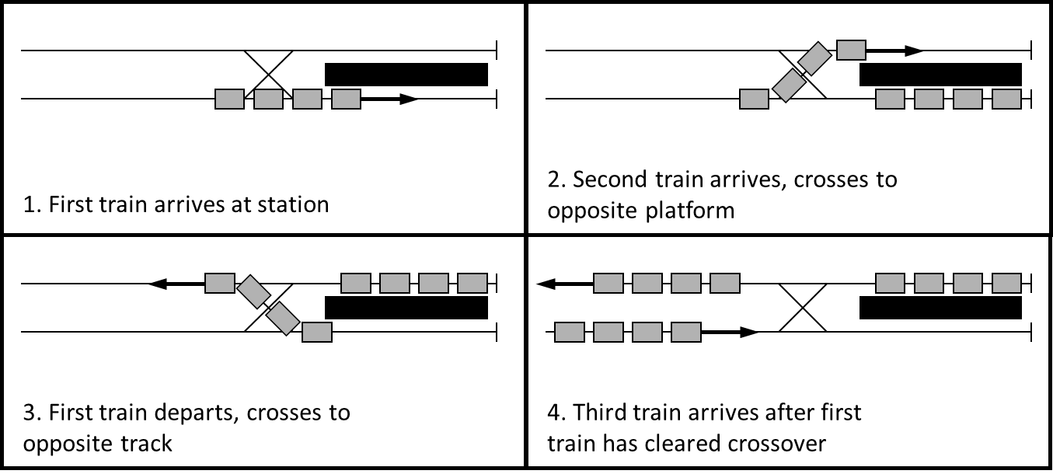
Turnbacks
Typically handle two trains at once in high-capacity situations
Time in turnback cannot exceed twice the line headway without creating a capacity constraint
Notes:
We will discuss all three types in this sequence.

Slide 20
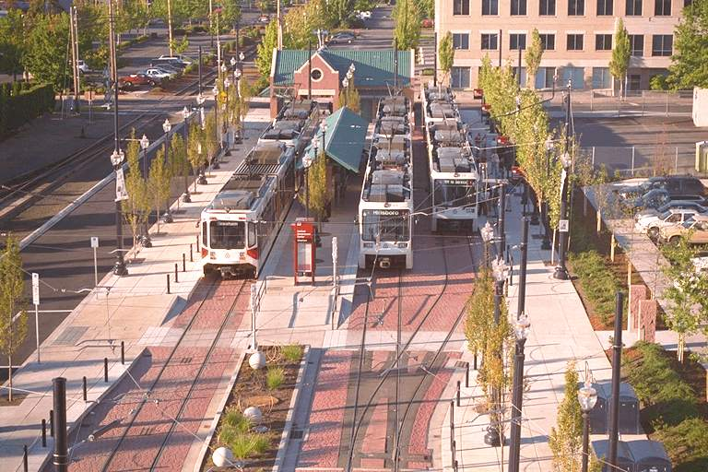
Turnback Operation
Time in turnback includes:
Passenger service time
Time for driver to switch ends of the train and perform inspections (can occur during passenger service time)
Time to clear crossover in advance of turnback
Operating margin
Hatfield Government Center Station, Hillsboro, Oregon
Notes:
We will discuss all three types in this sequence.

Slide 21
Alternative Turnback Configurations
Substitute a new driver, positioned at the opposite end of the platform
Crossovers in front of and beyond terminal station
Multiple drop-off platforms
Turning loop
Notes:
We will discuss all three types in this sequence.

Slide 22
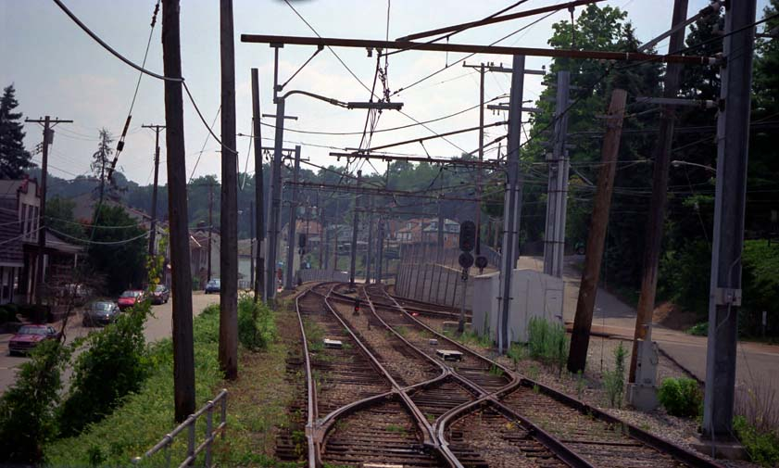
Propulsion Power Constraints
Electrical (traction) power systems
Number of trains in a section of track limited by the capability of the substation serving that section to supply power
Even though the train control system may support short headways continuously, the power supply may only support them temporarily (i.e., until the maximum number of trains the substation is capable of powering has been reached)
Locomotive-hauled commuter rail
Number of cars per train limited by locomotive horsepower and other constraints
Maximum 8 cars per train typical, newer models of high-horsepower trains can pull 10–12 cars
Pittsburgh
Notes:
We will discuss all three types in this sequence.

Slide 23
Typical Line Capacity Values
Light rail, designed for economy, rather than maximum capacity: 20 trains per hour
Fixed-block (red-yellow-green): 30 trains per hour
Cab control, 8-car trains: 30-34 trains/hour
Moving block, 8-car trains: 35-42 trains/hour
All values assume that the critical dwell time is under 60 seconds and there are no line merges
Notes:
We will discuss all three types in this sequence.

Slide 24
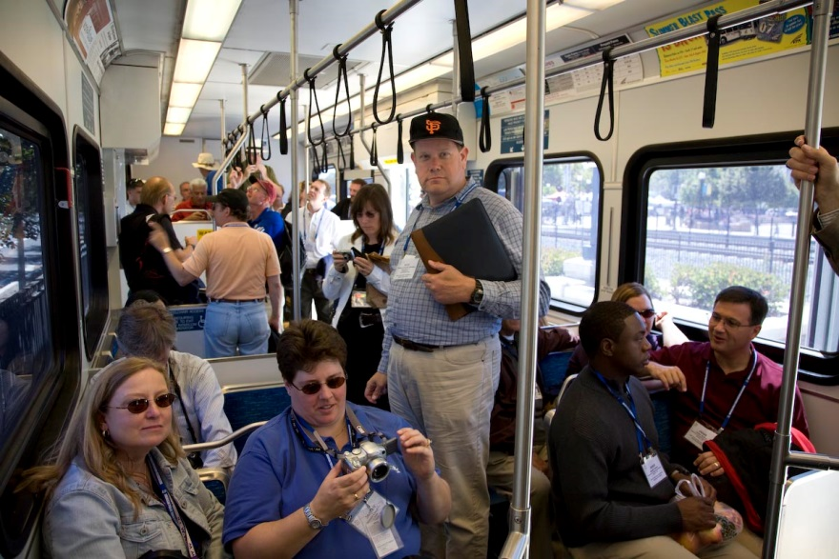
Person Capacity Factors
Line capacity (trains per hour) × Train length (cars per train) × Car passenger capacity (persons per car) × Peak hour factor (decimal) = Person capacity (persons per hour)
Train length can be constrained by
Supply of cars
Station lengths
City block lengths (e.g., street-running light rail)
Car passenger capacity depends on seating configuration and agency loading standard
San Jose
Notes:
We will discuss all three types in this sequence.

Slide 25
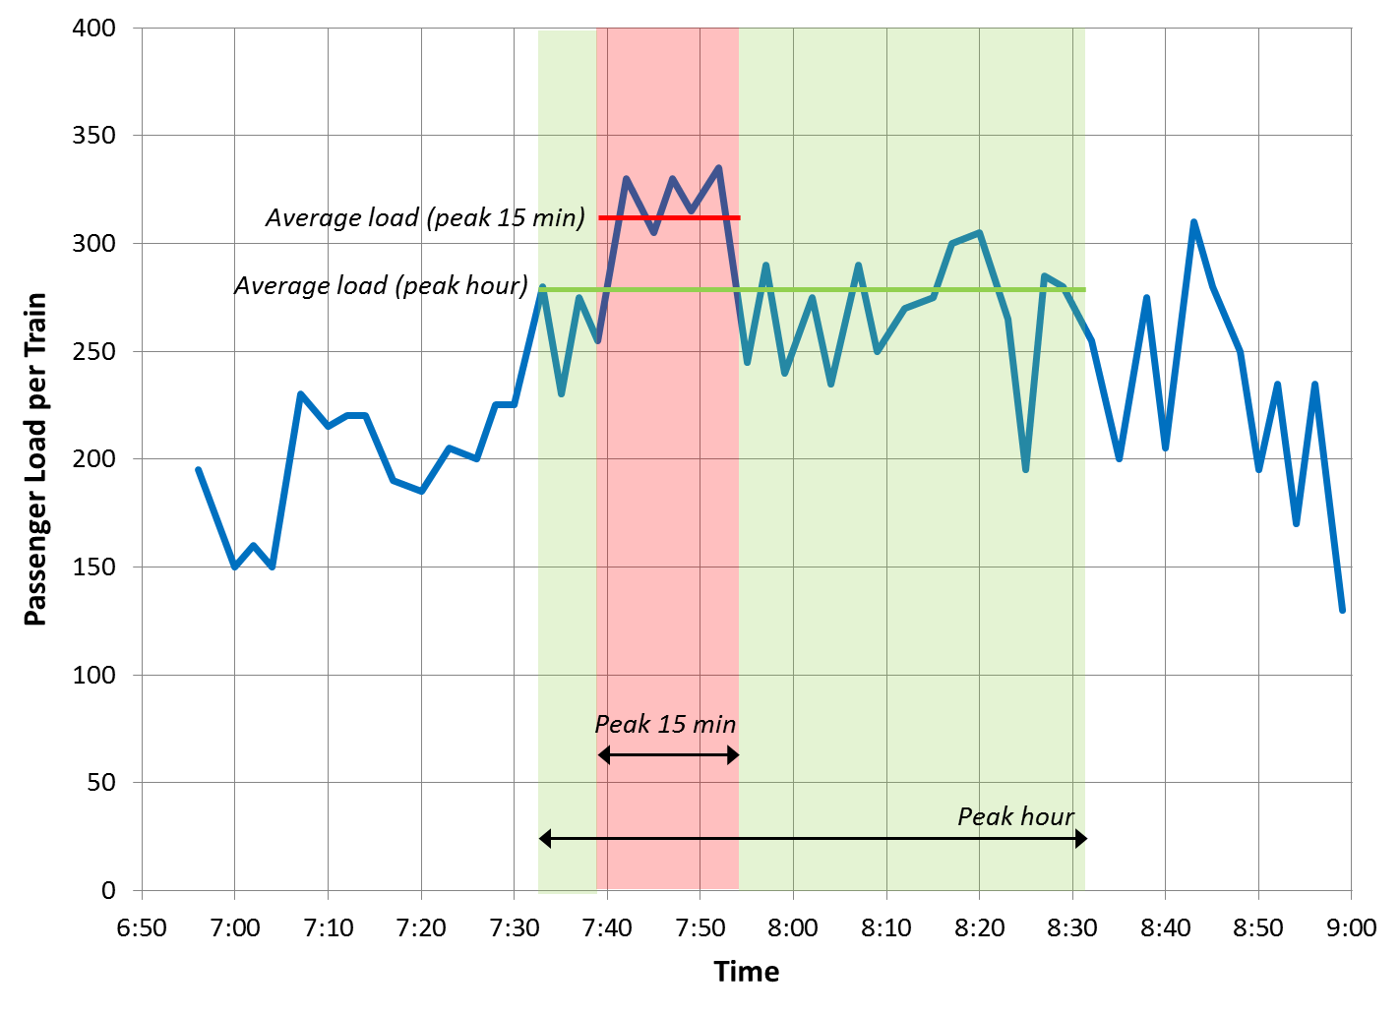
Peak Hour Factor
Peak hour factor accounts for variations in passenger demand during an hour, reserving capacity so that surges in demand do not result in pass-ups or passenger loading standards being exceeded
Typical values (use local values when available):
Heavy rail: 0.80
Light rail: 0.75
Commuter rail: 0.60
Derived from TCRP Report 13: Rail Transit Capacity Vancouver, BC, Broadway Station inbound, 10/27/94
Notes:
We will discuss all three types in this sequence.

Slide 26
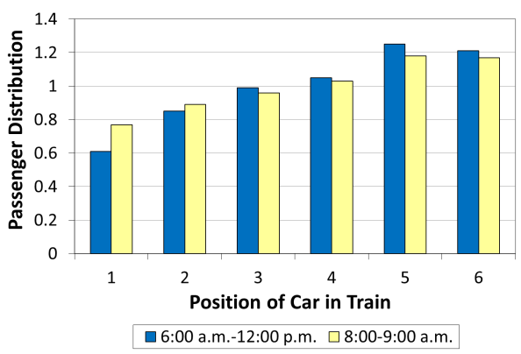
Loading Diversity
Passengers do not arrive at an even rate throughout an hour
Passengers may not be spread out evenly among all cars of train due to:
Distribution of station entrance locations along line
Locations of connections at transfer stations
Not all offered capacity will be used
Toronto, Wellesley Station southbound, 1/11/95 The rear two cars are closest to the platform exit at a major transfer station. Source: TCRP Report 13: Rail Transit Capacity
Notes:
We will discuss all three types in this sequence.

Slide 27
Difference Between Maximum and Design Capacity
Maximum (theoretical) capacity
Based on the shortest time a following train can pass a signal location at the same speed as the preceding train, based on train control and signal system characteristics and critical station dwell time
Maximum person capacity also assumes that every car of every train can be fully loaded with passengers
Design (practical) capacity
Design capacity is less than maximum capacity, due to variations in train operator and equipment performance, the need for recovery time to preserve the operational reliability of the system, and the need to allow for passenger loading diversity
Capacity decreases with higher line speeds, because of increasing safe stopping distances
Notes:
We will discuss all three types in this sequence.

Slide 28
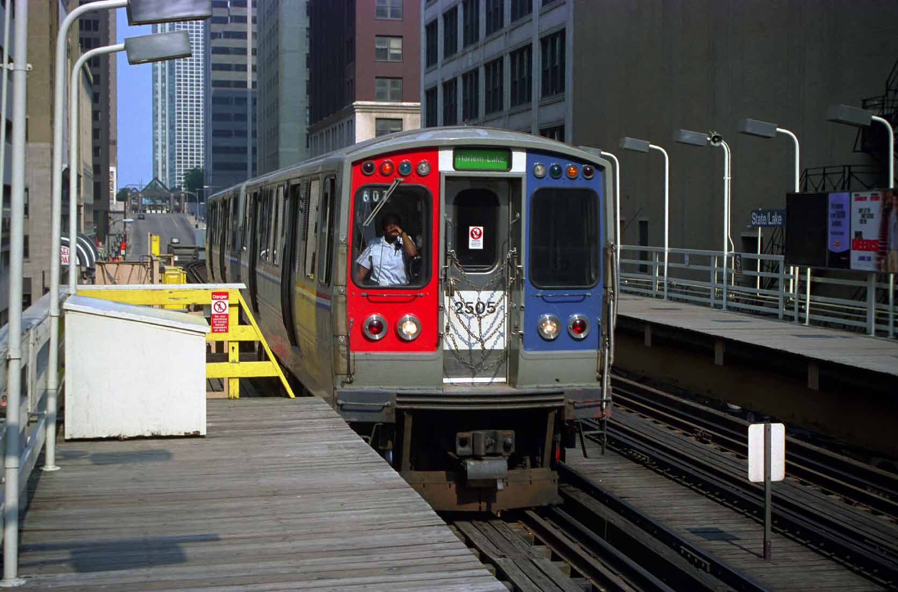
Generalized Rail Capacity Method
Chicago

Slide 29
Generalized Method
Applicable to most types of rail transit
Modifications to the generalized method (discussed later) for
Commuter rail
Automated guideway transit
Separate method for ropeways
Notes:
We will discuss all three types in this sequence.

Slide 30
Step 1: Determine the Non-interference Headway
Determine the maximum load point (critical) station
Determine the control system’s minimum train separation
Determine the average dwell time at the critical station
Select an operating margin
Non-inteference headway = Critical station average dwell time + Minimum train separation + Operating margin
Notes:
We will discuss all three types in this sequence.

Slide 31
Step 2: Determine the Minimum Headway Based on ROW
This step is skipped for grade-separated rail
Right-of-way (ROW) types considered:
Single-track, two-way operation headway
Two times (time for a train to traverse the section + operating margin + average station dwell time in section, if any)
On-street operation headway
Greater of (twice the traffic signal cycle length) or (headway based on average dwell time at critical station)
Station departures adjacent to grade crossings
May need to increase dwell time to account for gate-lowering time, when the gates are manually activated to minimize delay to cross-street traffic
Minimum headway is the highest of the applicable ROW headways
Notes:
We will discuss all three types in this sequence.

Slide 32
Step 3: Determine the Limiting Junction Headway
This step is skipped when there are no at-grade (flat) junctions
Major factors influencing junction headways:
Train control separation
Train length
Maximum line speed
Switch angle (influences speed of trains switching to new track)
Operating margin
Notes:
We will discuss all three types in this sequence.

Slide 33
Step 4: Check Power Supply Limitations
May be a factor when more frequent headways are being considered for an existing rail line
Quality of service improvements
Construction of a new branch that adds more service to an existing line
Original system may have been designed economically, with enough substations to meet short- and mid-term needs, but not enough to support the minimum headway allowed by the train control system
Each situation is unique
Notes:
We will discuss all three types in this sequence.

Slide 34
Step 5: Determine the Controlling Headway
Controlling headway is the highest of the headways determined from
Step 1 (train control system)
Step 2 (right-of-way type)
Step 3 (limiting junction)
Step 4 (power supply)
Notes:
We will discuss all three types in this sequence.

Slide 35
Step 6: Check Terminal Layover (Turnback) Time
Locations to check:
Terminal stations
Intermediate turnback points, if some trains will be short-turned (turned back before the end of the line)
Major factors:
Distance from crossover to the station
Platform length
Terminal layover time
Dwell time
Time for driver to change ends and perform necessary inspections
For a 2-berth station, if the time for train maneuvers and terminal layover time is more than twice the controlling headway, then:
Consider operational or physical changes to improve turnback time
If changes aren’t possible, then the turnback time becomes the headway constraint
Notes:
We will discuss all three types in this sequence.

Slide 36
Step 7: Determine Train Throughput (Line Capacity)
Line capacity = (3,600 / controlling headway), rounded down
Notes:
We will discuss all three types in this sequence.

Slide 37
Step 8: Determine Person Capacity
Person capacity (persons per hour) = Line capacity (trains per hour) × Train length (cars per train) × Car passenger capacity (persons per car) × Peak hour factor (decimal)
Notes:
We will discuss all three types in this sequence.

Slide 38
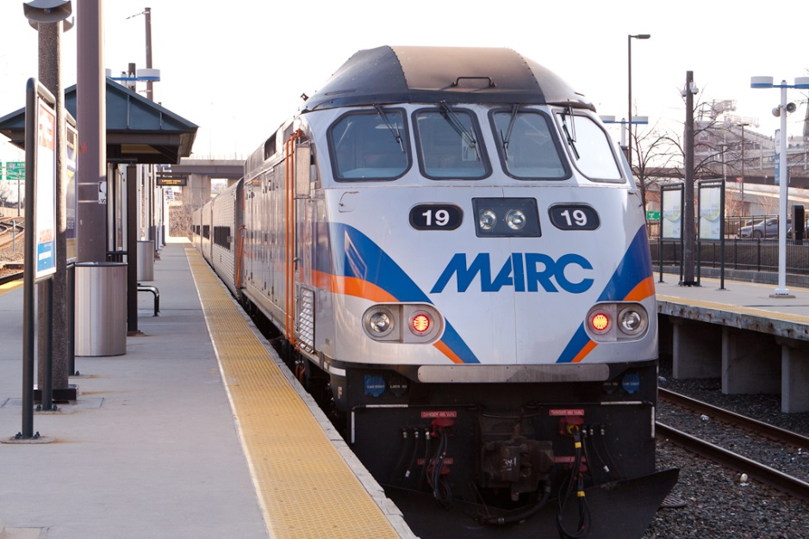
Specialized Rail Capacity Methods
MARC commuter rail, Baltimore

Slide 39
Commuter Rail Capacity
Commuter rail capacity determination is inexact
Many commuter rail operators do not own the tracks they use; therefore the number of trains they can operate will depend on negotiations with the host railroad
Performance of diesel locomotives used by U.S. commuter operators varies considerably
The number of platforms available at terminal stations may constrain capacity
In cases where lines are shared with other users (e.g., freight rail, intercity passenger rail) or where diesel locomotives are used, simulation may be the only way to determine capacity
TCQSM does not provide commuter rail capacity equations, but instead discusses the factors that affect capacity
Notes:
We will discuss all three types in this sequence.

Slide 40
Commuter Rail: Consumers of Track Capacity
Trains (not all use the same amount)
As the number of trains increases—particularly when only a single track is available—the average speed of all trains decreases
Train meets generate delay and increase the chances of additional meets
Impact of meets more severe when different classes of trains (e.g., passenger and freight) with diferent operating characteristics meet
Track patrols
Track maintenance
Track deterioration requiring temporary speed restrictions
Passenger station stops
Industrial switching
Freight yard interactions
Train or train control system failures
Incidents (e.g., crossing accidents, deer, and trespassers)
Weather
Notes:
We will discuss all three types in this sequence.

Slide 41
Commuter Rail: Train Throughput Factors
Mix of trains on the line
Freight trains require longer signal blocks due to train length, resulting in longer times to traverse a block and thus lower capacity
Directionality of trains on the line
Unidirectional service
Service in both directions
Number of tracks
Number of available platforms at terminal stations
Operating practices
All-stop
Zoned express
Train storage capacity after terminal stations
Dwell time generally not as critical as for other types of rail transit
Generally unidirectional passenger flows
Longest dwells typically occur at stations with multiple platforms
Notes:
We will discuss all three types in this sequence.

Slide 42
Commuter Rail: Ways to Improve Capacity
Double tracking
Reduces the number of train meets
Needs to be at least 3 signal blocks in length (4.5–7.5 miles) to be effective
Can be very expensive when bridges, tunnels, or additional right-of-way is required
Adding and lengthening sidings
Relatively short lengths of double track where one train stops and waits for another
Reduces variable delay waiting for the other train to pass
Providing higher-speed siding entries and exits
Trains can enter and exit the mainline faster, reducing fixed delay
Train control system improvements
Infrastructure improvements
Track upgrades may permit higher speeds, but may not add capacity
Junctions, freight yards, switching operations
Notes:
We will discuss all three types in this sequence.

Slide 43
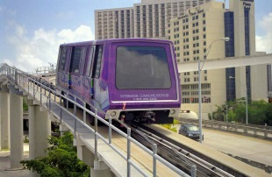
Automated Guideway Transit (AGT) Capacity
All AGT systems are proprietary
Large variations in technology, acceleration characteristics, vehicle sizes
Non-transit AGT systems can have very different passenger demand and loading characteristics from public transit
Airport shuttles: Few seats, passengers with luggage, loading diversity fluctuates with flight arrivals (very crowded to nearly empty)
“Leisure” systems (amusement parks, casinos): All riders seated, passenger queues to board ensure that all seats are filled at peak times or even the entire service day
Possibility for off-line stations
Allows vehicles to overtake each other when not stopping
Generalized method can be applied with suitable modifications to account for these differences
Metromover, Miami
Notes:
We will discuss all three types in this sequence.

Slide 44
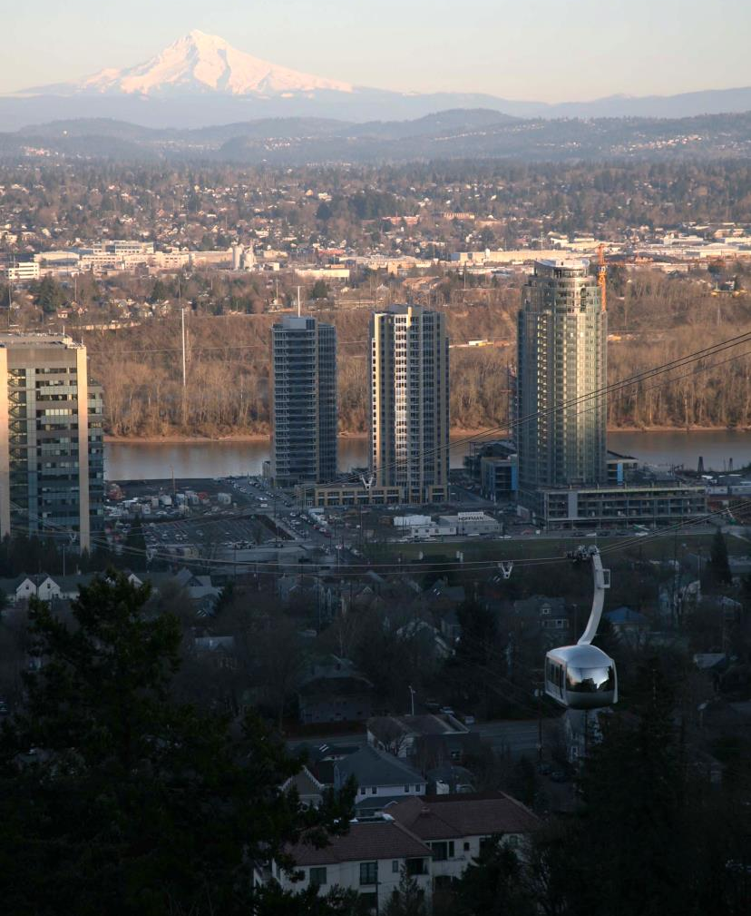
Ropeway Capacity
Vehicles are hauled by a rope (wire cable)
Two main types:
Reversible systems
Aerial trams, funiculars
One or two vehicles shuttle back and forth between the terminal stations
Capacity a function of dwell time, line length, line speed, number of vehicles
Continuously circulating systems
Gondolas, ski lifts, cable-propelled AGT
Fixed set of vehicles circulate around a loop
Capacity a function of line speed, spacing between vehicles/carriers
Generally difficult to add capacity once a system has been installed, without major reconstruction
Portland Aerial Tram
Notes:
We will discuss all three types in this sequence.

Slide 45
Rail Transit Capacity Analysis Tools
Sketch planning tools (e.g., TCQSM)
Initial planning-level analysis
Get an “in-the-ballpark” result that can be confirmed later with simulation
Rapidly reduce multiple alternatives to a small number of promising ones
Comparative analysis of multiple modes
Single-line networks or simple systems, without complex junctions
Projects with limited resources or rapid turnaround times
Dynamic simulation models
Complex networks, with multiple branch lines and junctions
Major or complex terminals
Multiple types of stopping patterns
Non-electric or shared-track commuter rail operations
Investment-grade analysis
Requires sufficient time and resources for detailed analysis
Notes:
We will discuss all three types in this sequence.

Slide 46
More Information
TCRP Report 165: TCQSM—Chapter 8, Rail Transit Capacity
Spreadsheets implementing the generalized method and for single-track, two-way operation provided on the accompanying CD-ROM
TCRP Report 13: Rail Transit Capacity
The basis for many of the TCQSM’s methods
The TCQSM is available as:
Free individual printed copies and PDF downloads through the TCRP Dissemination Program http://www.tcrponline.org
Free PDF downloads directly from TCRP http://www.trb.org/TCRP/Public/TCRP.aspx (Publications section) or simply do an Internet search for the report number (e.g., TCRP Report 165)
Individual or multiple copy purchases from the TRB Bookstore http://books.trbbookstore.org/

Slide 47
Acknowledgments and Permissions
Presentation authors
Foster Nichols (Parsons Brinkerhoff, Quade & Douglass), based on an earlier presentation by Paul Ryus (Kittelson & Associates, Inc.)
Photo credits
MARC train: Dorret Oosterhoff
All others: Paul Ryus
This presentation was developed through TCRP Project A-15C
Research team: Kittelson & Associates; Parsons Brinkerhoff, Quade & Douglass; KFH Group; Texas A&M Transportation Institute; and Arup
This presentation and its contents may be freely distributed and used, with appropriate credit to the presentation authors and photographers, and the Transit Cooperative Research Program

