Slide 1
Briefing
F-26: Improving the Health and Safety of Transit Workers with Corresponding Impacts on the Bottom Line
AUTHOR: Jennifer Stoloff
Contributors: Frankie Clogston, Fred Bellemore, Cynthia Khan, Jeff Pongsiri, and Timothy Beggs TLC staff: Xinge Wang and Karitsa Holdzkom
Econometrica, Inc.
7475 Wisconsin Avenue, Suite 1000
Bethesda, MD 20814
Contract No.: TCRP F-26
Unit/ No.: 913
Subaward No.: SUB0001109
Cooperative Research Programs
Transportation Research Board
National Academies of Science, Engineering and Medicine
500 Fifth Street, NW
Washington, DC 20001
March 19, 2020

Slide 2
Outline of Briefing
Usefulness of Research
Research Approach
Research Design and Literature Review
Prevalence and Costs of Health Conditions
Additional Costs to Individuals, Employers, and Society
Case Studies
Implementation Strategies
Key Findings

Slide 3
Usefulness of Research
Transit agencies can use the findings of this report to help design health and safety programs and incorporate evaluation elements.
The literature review documents the health and safety issues commonly faced by transit workers.
The analysis section of the report illustrates the most common health conditions faced by transit workers and the high costs associated with them.
The case studies detail programs implemented by five agencies.
The implementation section suggests approaches to evaluation that can help determine your “return on investment” (ROI) for any given intervention.

Slide 4
Summary of the Research Approach
The project is organized around three critical questions:
What are the costs associated with key health issues faced by transit workers?
What are the costs and benefits associated with health promotion programs targeted at these key health issues?
What are potential solutions and tools to help agencies improve the health and safety of transit workers with corresponding impacts on the bottom line?

Slide 5
Research Design
We used background research to identify key areas of focus for the analysis.

Slide 6
Literature Review
The literature review provides guidance to transit agencies about where to focus health and safety programs. The topics covered:
Health and safety issues.
Costs of chronic illnesses and injuries.
Programs to mitigate negative health and safety outcomes.
Cost-effectiveness of health and safety intervention programs.

Slide 7
Literature Review: Health and Safety Issues
Operating vehicles (bus, light rail, heavy rail) can lead to musculoskeletal pain, acute back pain, and chronic health conditions such as diabetes.
Many health conditions are exacerbated by fatigue and stress.
Safety challenges include unruly or aggressive passengers, vehicle accidents (potentially exacerbated by chronic conditions that cause insufficient sleep).
Operators are exposed to exhaust fumes and other environmental hazards.
Transit workers are three times more likely than the general public to have an injury that results in days away from work and job transfer or restriction.

Slide 8
Literature Review: Costs of Chronic Illnesses and Injuries
Transit workers have high rates of smoking and obesity, which are associated with higher medical costs.
Injuries and the development of chronic illness in transit workers can create meaningful economic losses from reduced workdays, shortened career spans, and the costs of clinical care.
Costs related to fatal occupational injuries in transit and ground transportation workers were estimated to amount to more than $200 million per year in 2006.
Transit workers suffer disproportionately from chronic illnesses such as diabetes, cancer, and hearing loss, which carry high medical and economic costs.
People with diabetes incur an estimated $7,900 per year in diabetes-related medical expenditures (American Diabetes Association, 2013).
Direct medical costs associated with cancer treatment can range from hundreds to thousands of dollars per month (Yabroff, Lund, Kepka, & Mariotto, 2011).

Slide 9
Literature Review: Programs to Mitigate Negative Health and Safety Outcomes
Many agencies use competition to incentivize improvements in fitness and nutrition. This strategy has become popular in the corporate world because of its relatively low cost and built-in incentive structure.
Incentives combined with supportive practices (e.g., increasing access to care, thorough screenings, onsite treatment, assistance with early risk identification) can lead to longer-term benefits.
Programs or practices that promote a culture of safety can mitigate risks that transit workers face, including aggressive passengers and road accidents.

Slide 10
Literature Review: Cost-Effectiveness of Health and Safety Intervention Programs
There are relatively few studies that measure the indirect costs of occupational health injuries for transit workers and very little data that provide evidence for the effectiveness of wellness intervention programs for the transit worker population.
We found one case with a twofold return on investment and health intervention program for truck drivers that resulted in increased retention.
Overall, the literature is largely inconclusive on the effectiveness of wellness programs to reduce costs in general and specifically for transit agencies.
Most programs are not well supported, funded, or targeted to the unique challenges transit workers face.

Slide 11
Demographic Characteristics
Most transit workers are involved in vehicle operations (72 percent).
Of these, more than 50 percent are bus operators.
Most are male (63 percent), over 45 years of age (66 percent), and White (63 percent).
There are disproportionately more Black transit workers (29 percent) than in the general workforce (12 percent).
Women are underrepresented at 37 percent of the transit industry, compared to 47 percent of the overall workforce.

Slide 12
Demographic Characteristics of the Employed Population and the Bus Service and Urban Transit Industry
Demographic | Employed Population (Those Aged 16 and Over) | Bus Service and Urban Transit Industry
Full-Time | 82.2% | N/A
Male | 53.1% | 62.9%
Aged 40+ | 54.3% | 66.2% (45+)
White | 78.4% | 62.6%
Black/African-American | 12.1% | 29.3%
Asian | 6.2% | 6.0%
Other Race | 3.3% | 2.1%
Hispanic or Latino Ethnicity | 16.9% | 15.9%
Source: (BLS, 2019a).
Note: Bus Service and Urban Transit Industry classification comes from the 2002 Census classification system. This represents NAICS codes 4851, 4852, 4854, 4855 and 4859.

Slide 13
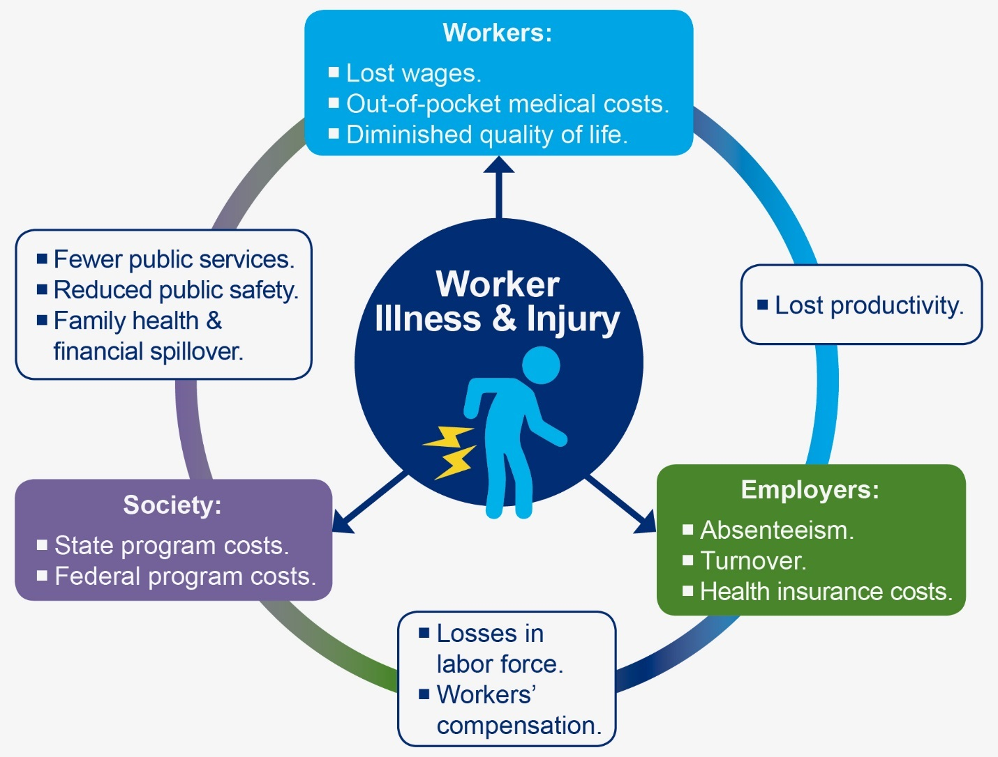
Prevalence and Costs of Health Conditions
This model illustrates the costs of chronic illness and injuries to workers, employers, and society.

Slide 14
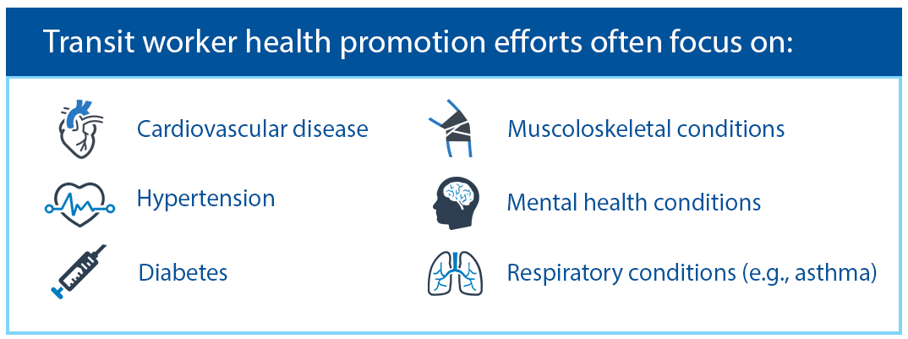
Prevalence and Costs of Health Conditions
The most common health conditions associated with transit workers are:
Cardiovascular disease, hypertension, diabetes, musculoskeletal disorders, mental health disorders, and respiratory conditions (e.g., COPD, asthma).
Rates of smoking and obesity, which are higher in the transit worker population than in the general population.
Costs for transit workers were consistently in excess of those for the general worker population, ranging from tens to hundreds of millions of dollars.

Slide 15
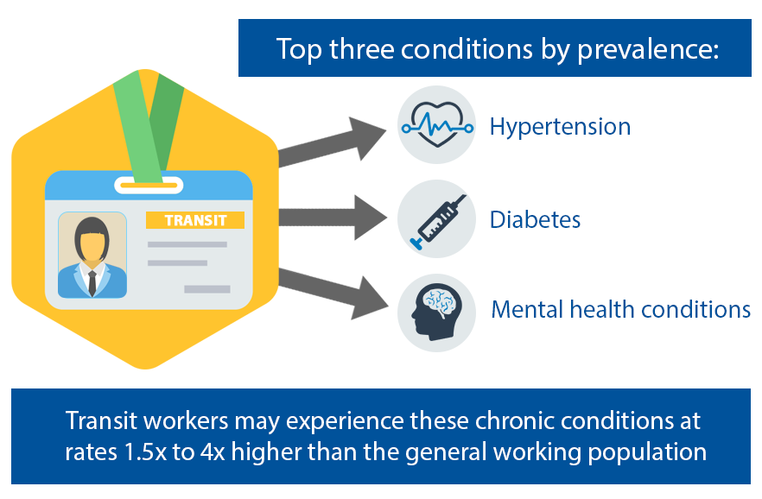
Common Health Conditions Associated With Transit Workers
Prevalence of Chronic Conditions Affecting Transit Workers
Condition | Difference in Transit Worker Rate Over General Population Rate
Cardiovascular | 18%
Diabetes | 57%
Hypertension | 23%
Musculoskeletal | 20%
Mental Health (Depression) | 22%
Respiratory (Chronic Obstructive Pulmonary Disease (COPD)) | 51%
Prevalence of Health Risks in Transportation, Utilities and Warehousing Workers
Risk | Transportation Worker | General Worker
Current Smokingª | 27.8% | 18.8%
Obesity^{b} | 33.1% | 27.6%
Source: Bushnell. (2018, July 25). The Health Status of Passenger Transit Workers: A Comparative Perspective from Group Health Insurance Medical Claims Data in the U.S. Preliminary results presented at a meeting of three NIOSH, National Occupational Research Agenda Councils: Transportation, Warehousing, and Utilities; Cardiovascular, Reproductive, Cancer, and Other Chronic Diseases; and Respiratory Health webinar.
ª (Syamlal, Mazurek, Hendricks, & Jamal, 2014).
^{b} (Luckhaupt, Cohen, Li, & Calvert, 2014).

Slide 16
Medical Expenditure Excess Approximations for Transit Worker Population Over General Population
Condition | U.S. Average Medical Expenditures per Person ($2018) (A) | Percent Difference in Transit Worker Rate Over Populationª (B) | Approximated Excess Expenditures for Transit Workers Over General Population ($2018) (A×B×359,669)
Cardiovascular | $4,943 | 18% | $320,016,177
Diabetes | $3,691 | 57% | $756,701,993
Hypertension | $893 | 14% | $73,865,796
Musculoskeletal | $2,170^{b} | 18% | $156,090,224
Mental Health | $2,161^{c} | 22% | $171,012,449
Respiratory | $1,772^{d} | 20% | $324,991,553
Note: Medical expenditures are population-weighted estimates from MEPS. Calculations based on transit worker population base of 359,669 workers (APTA, 2018).
ª Prevalence rates for all conditions except hypertension are based on claims data from 2014, presented in Table 6. Prevalence rates for hypertension are based on employer claims data (Highmark, Inc., CDC-NIOSH) from 2002–2005.
^{b} Estimated expenditure for “Osteoarthritis and other non-traumatic joint disorders.”
^{c} Estimated expenditure for “Mental disorders.”
^{d} Estimated expenditure for “COPD, Asthma.”

Slide 17
Additional Costs to Individuals, Employers, and Society
Compilation of Cost Estimates (in 2018 Dollars)
Cost Category | Transit Worker Cost | Cost Per Transit Worker | Excess Cost | Excess Cost per Transit Worker
Workers
Injury Costs | $853,768,760 | $2,374 | $403,284,268 | $1,121
Mortality Costs | $189,174,784 | $526 | $61,171,511 | $170
Employers and Society
Absenteeism | $314,301,144 | $874 | $25,144,092 | $70
Workers’ Compensation | $261,780,645–$413,826,181 | $728–$1,151 | $121,139,893–$140,199,032 | $337–$390
Disability (SSDI) | $405,770,309 | $1,128 | $128,342,087 | $357
Disability (SSI) | $115,239,627 | $320 | $36,446,639 | $101
Medicare | $315,484,761 | $877 | $99,780,322 | $277

Slide 18
Case Studies
Case studies included narrative and individual-level data collection for:
RTS: Rochester, New York.
TARC: Louisville, Kentucky.
IndyGo: Indianapolis, Indiana.
DART: Iowa.
LA Metro: Los Angeles, California (descriptive data only).

Slide 19
Program Development and Work Environment
IndyGo added an onsite clinic to avoid steep insurance premium increases.
RTS began with a focus on physical fitness, but added more goals after several years, eventually hiring a full-time health and wellness coordinator.
TARC’s initial focus was on smoking cessation, but the program was expanded to include more general wellness goals.
DART encourages employees to take advantage of all existing programs, including a health savings account, and implemented a comprehensive wellness program for all employees.
LA Metro’s program began as a pilot in 2 locations and expanded to 24 locations.
At all sites, at least 50 percent of the operators work split shifts. This presents challenges for staff, including accessing healthy food choices and finding time for regular exercise. Irregular shifts also contribute to sleep deprivation.
An issue at most sites is restroom access.

Slide 20
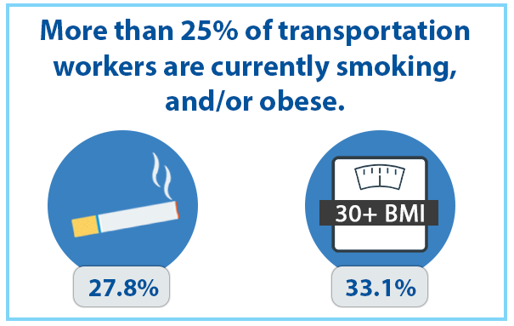
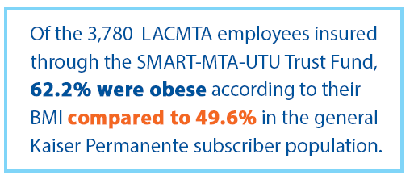
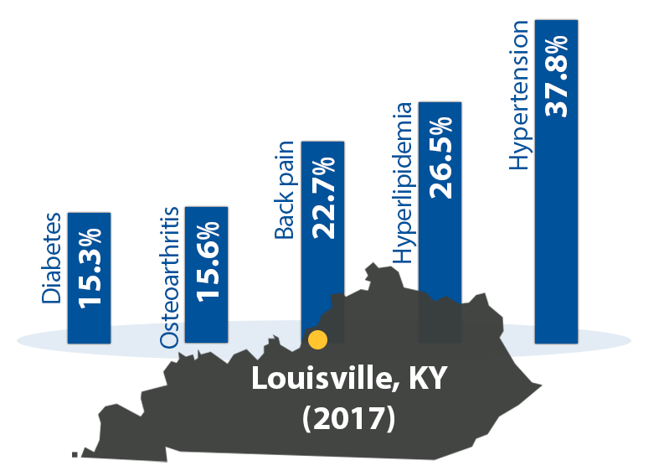
Health, Wellness, and Safety Concerns
Top three health concerns across agencies:
Hypertension
Musculoskeletal disorders
Diabetes
Other frequently mentioned issues:
Sleep apnea
Cardiovascular disease
Injuries from accidents
Obesity
Stress

Slide 21
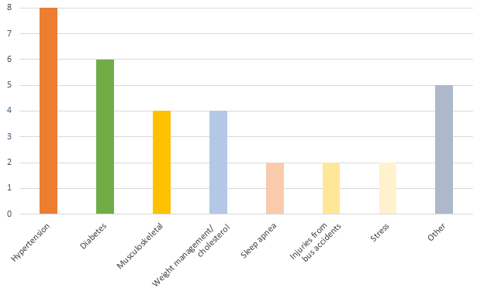
Most Common Health, Wellness and Safety Concerns at Case Study Locations

Slide 22
Program Activities and Elements
IndyGo: To qualify for an insurance discount, participants required to undergo a physical, health assessment, biometric screening, a minimum of four coaching sessions, and participate in a health activity such as gardening, Weight Watchers, exercise classes, walk–run groups, 5Ks, basketball tournaments, or financial or nutrition classes.
RTS: Short workshops onsite, fresh fruit, team activities, different choices in vending machines, blood pressure kiosks, health screenings, and a wellness center that includes a gym.
TARC: Events and programs organized around a theme of interest, an annual “corporate games” weekend, and a “boot camp.”
DART: Different theme each month that corresponds with interests recorded by employees in the initial survey. DART offers two to three workshops every month, as well as one to three wellness challenges. Rewards are given for attending workshops.
LA Metro: Wellness ambassadors; provides incentives, rewards, kickoff events, challenges, and contests. The wellness program features disease management and education, seminars and table topics, fitness challenges, health fairs and screenings, free family sporting events, and a monthly wellness newsletter.

Slide 23
Organization and Budget
IndyGo staffs a clinic with two nurse practitioners, a part-time doctor, and medical assistants. IndyGo operates with a budget of $500,000 per year.
RTS employs one full-time wellness coordinator and funds the program through their operating budget, using third-party vendors and spending approximately $41,000 per year.
TARC’s program is funded by their Human Resources office with a budget of approximately $10,000 per year, though the program receives additional funds via a refund from their health insurance premium.
DART has a relatively low budget of approximately $5,000 annually. They rely on existing staff members to manage the program rather than hiring dedicated personnel.
LA Metro spends approximately $55,000 annually, not including the salary for the program coordinator. The healthcare provider contributes to the budget as part of their premium, though the fund itself is not controlled by the healthcare provider. A union trust fund covers the ambassadors’ pay and the salary of the wellness program manager.

Slide 24
Implementation Strategies
We assessed programs based on the framework provided by the “Roadmap for Transit Health and Safety” from the Transit Cooperative Research Program (TCRP) F-17 project.
The critical areas of concern are the following:
Preparation and commitment.
Team building.
Setting targets.
Implementation and integration.
Evaluation.
Growth.

Slide 25
Implementation Keys
Faced with skyrocketing health premium costs, some transit organizations involved stakeholders from all levels of the organization and partners from outside to tackle the issue.
They paid attention to the underlying causes of the health premium increases: health conditions and health risks and environmental factors. These organizations tried to design programs that would address these causes.
Programs that have strong management and union support, provide strong incentives for employees to participate, and receive the most funding have the longest standing and most positive implementation outcomes.
Analysis did not demonstrate strong statistical findings on the benefit–cost of transit workplace health promotion programs, however.
Organizations and employees recognized tangible and intangible benefits of these programs, regardless of the lack of statistical findings.

Slide 26
Measures and Methods for Benefit–Cost and Cost-Effectiveness Analysis

Slide 27
Implementation Planning
Review the background research on the types of health issues workers are most likely to experience and the programs that are most effective in addressing them.
Critical steps to take prior to initiation regarding program implementation and evaluation are determining the key issues facing employees, the types of programs they would use, and a means of evaluating impacts.
Over time, assess the programs’ ROI and adjust as needed.
Prior TCRP publications include resources to help design and track programs. For example, you can use the spreadsheet “Transit Operator Workplace Health Protection and Promotion Planning, Evaluation, and ROI Template,” available at http://www.trb.org/Publications/Blurbs/171189.aspx.

Slide 28
Key Findings: Health and Safety Issues
The most prevalent chronic conditions in the transit worker population are cardiovascular disease, hypertension, diabetes, musculoskeletal disorders, mental health, and respiratory illnesses.
Other health conditions that may be related to transit work include hearing loss, bladder conditions, and cancer.
Smoking and obesity also disproportionately affect transit workers.
The literature suggests that transit agencies design should health and wellness programs that focus on problems caused by limited bathroom access, split shifts, and sustained sitting, rather than exercise and weight loss, which are more typical.
Changes that could improve safety could include providing enhanced rest opportunities prior to and after shifts. Some agencies provided healthy snacks. Working to create more comfortable seating for operators would also be helpful.

Slide 29
Key Findings: Case Studies
Case study programs offered check-ins with nurses and health screenings and often focused on obesity.
The most common problem, cited by agencies and labor and further underscored by claims data, is hypertension. Following hypertension, diabetes, musculoskeletal disorders, and weight management were identified as the next most common problems.
None of the analyses of individual-level data from the case studies had strong results.
Transit agencies can use the information in this report to help design wellness programs that can benefit the health of transit workers.
The case studies provide models and the research on prevalence and costs can suggest where to focus efforts, but consideration should be given to the specific needs of the workers at any given agency.

Slide 30
Study Limitations
Some cost categories could not be itemized due to lack of available data.
Cost categories can overlap and are not additive as a function of co-morbidities.
Cross-sectional data were used because they were the only data readily available for transit workers.
These data did not include transit workers who had shorter careers resulting from job-related injuries or health issues, or those who have shorter lives or more health problems after retirement or leaving transit work for other reasons.
The study lacked controls for differences in gender and age in most analyses due to data limitations.
The study did not account for differences in local regulations.

Slide 31
Next Steps
When establishing a wellness/health/safety program, plan to gather information on intermediary outcomes related to health, such as changes in hypertension, reductions in type 2 diabetes, and reductions in stress levels.
Understanding how programs impact intermediary health impacts and testing their effects on bottom line measures, such as absenteeism or claims costs, would be a fruitful approach to future research.
Understanding if wellness programs result in a positive ROI could help agencies, unions, and workers decide if they are the best use of discretionary funds.

Slide 32
Thank You!

Slide 33
Following slides may be deleted
Saved these in case we decide to keep them.

Slide 34
Key Characteristics of the Transit Workforce
Total and Percentage of Total Employees by Transit Mode and Function, 2015: Bus, Heavy Rail, and Light Rail
Statistical Category | Bus | Demand Response | Commuter Rail | Heavy Rail | Light Rail | Total | Percent
Employees, Vehicle Operations | 132,076 | 91,983 | 10,953 | 20,387 | 5,242 | 260,641 | 72%
Employees, Vehicle Maintenance | 32,989 | 8,729 | 8,751 | 9,570 | 2,339 | 62,378 | 17%
Employees, Non-Vehicle Maintenance | 7,064 | 2,484 | 7,059 | 17,559 | 2,484 | 36,650 | 10%
Total Employees, Operating (Non-Administrative) | 172,129 | 103,186 | 26,763 | 47,516 | 10,065 | 359,669 | 100%
Source: (APTA, 2018).
Most transit workers are employed as operators (72 percent).

Slide 35
Mean Hourly Wages for Cost Estimates
We used these numbers to calculate the costs for different types of health conditions.
Code | Occupation | Source | Total Employment | Mean Hourly Wage | Mean Annual Wage
NAICS 48–49 | Transportation and Warehousingª | BLS (2017)^{b} | 5,792,400 | $22.94 | $47,200
NAICS 485 | Transit and ground passenger transportation | BLS (2017)^{c} | 494,700 (Mar. 2018) | $18.90 (Feb. 2018) | $39,305
NAICS 4851 | Urban transit systems | BLS (2017)^{d} | 47,000 (May 2017) | $20.51 (May 2017) | $42,660
NAICS 4852 | Interurban and rural bus transportation | BLS (2017)^{e} | 17,690 | $18.56 | $38,600
SOC 53-3021 | Bus drivers, transit and intercity | BLS (2017)^{f} | 176,140 | $20.81 | $43,290
SOC 53-4099 | Rail transportation workers, all other | BLS (2017)^{g} | 2,780 | $28.82 | $59,950
ª NAICS codes 48 and 49 are grouped together as one sector, 48–49, for Transportation and Warehousing.
^{b} (BLS, 2018f).
^{c} (BLS, 2018c).
^{d} (BLS, 2018d).
^{e} (BLS, 2018e).
^{f} (BLS, 2018g).
^{g} (BLS, 2018h).

Slide 36
Categories of Costs of Transit Workers' Health and Injury by Type of Stakeholder
Category of Cost/Stakeholder | Expenditures and Losses
Medical Expenditures From Worker Chronic Illness or Illness Risk Factors
Transit Workers | Out-of-pocket spending
Employers | Employer insurance spending
Society (Federal programs) | Medicare spending Medicaid spending Disability spending
Medical Expenditures From Work-Related Injury
Transit Workers | Out-of-pocket spending
Employers | Employer insurance spending Workers compensation
Society (Federal and State programs) | State workers’ compensation Medicare spending Medicaid spending Disability spending
Productivity Losses From Worker Illness and Injury
Employers | Absenteeism Turnover Health insurance spending Spending on wellness programs

Slide 37
Workforce Characteristics at Each Site
Agency | Operator |  |  | Maintenance
 | Black | Male | Age | Black | Male | Age
IndyGo | 85.7% | 60.9% | 54.7 | 24.1% | 93.1% | 58.5
RTS | 39.3% | 74.9% | 56.8 | 33.3% | 98.1% | 55.6
TARC | 80.6% | 52.3% | 56.8 | 3.6% | 98.2% | 55.6
DART | 31.5% | 82.3% | N/A | 31.0% | 97.6% | N/A
Note: LA Metro did not share individual level data.
Comparison of Average Annual Absentee Hours Across Sites

