Slide 1
TCRP C-23 Assessing and Mitigating Electrical Fires on Transit Vehicles
Report to the Transit Cooperative Research Program
September 24, 2020

Slide 2
Project C-23: Identify Recommendations for Reducing the Incidence of Electrical Fires
Phase I
Task 1: Literature Search
Task 2: Identify Primary Causes and Contributing Factors
Task 3: Identify Recommendations for Reducing the Incidence of Vehicle Fires
Task 4: Identify Additional Research Needs
Task 5: Propose Work Plan for Phase 2
Phase II
Task 6.1: Study Effectiveness of Current Fire Suppression Systems
Task 6.2: Evaluate Fire Suppression Systems for Battery-Electric Vehicles
Task 7: Provide Implementation Recommendations

Slide 3
Task 1: Research available documents related to mitigation and prevention of electrical fires
Document Database Organization
Document Review
Database development and document categorization
Agency outreach
Field Name | Description | Sample Values
Document Title | The commonly known title of the document including the name or abbreviation of the organization that published the document and its identifying number.
Document Development Agency Type (SOURCE) | The type of organization (Federal or State Agency, SDO or SSOA) that promulgated or published the standard and the name/abbreviation of the issuing entity. | Government Agency, Standards Organization, Industry Trade Association, etc.
Document Description | Information taken from the documents' abstract, scope, or objective to summarize what the document addresses, establishes or governs and its applicability to design, construction, manufacturing, operations, maintenance, systems, or facilities.
Document Publish Date | The release date referenced on the document.
Mode | Includes transit modes and other modes referenced in the document in which documents may exist that could be beneficial for transit applications. | Rail, Bus, Truck, Motorcoach, etc.
Document Category | Hierarchical rank of category type. | Standards, Regulations, Recommended Practices, Research, etc.
Document Functional Category | This sub-category is intended to categorize documents as outlined in MAP-21 or FAST requirements. | Operations, SGR, Vehicle, Fire Safety, etc.
Sub-Functional Category | Identifies the functional system addressed in the document | Electrical, training, fire safety, evacuation, etc.
Link | A link to the Uniform Resource Locator (URL) address of the individual document or to the Website from which the document can be downloaded.

Slide 4
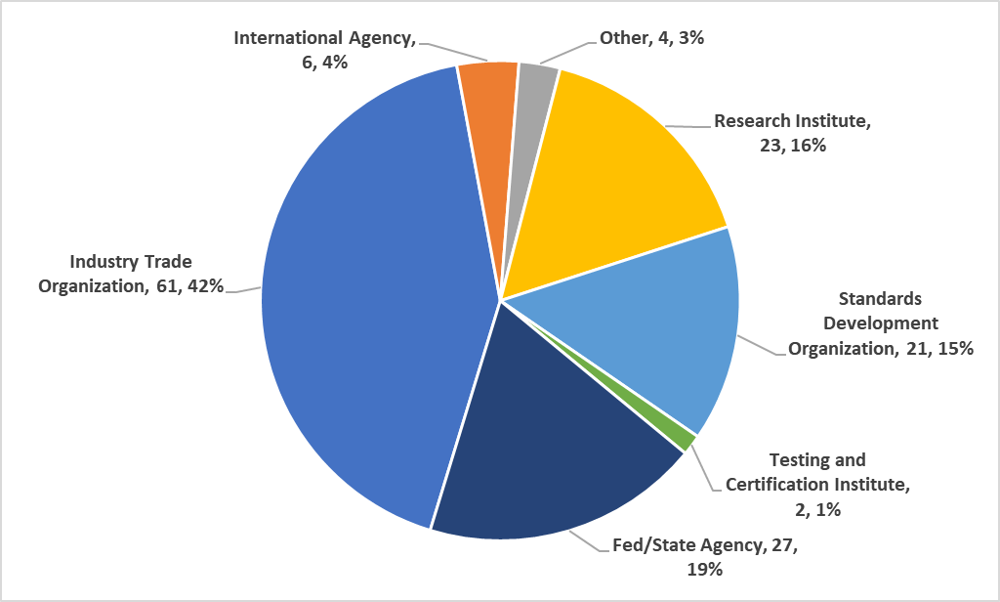
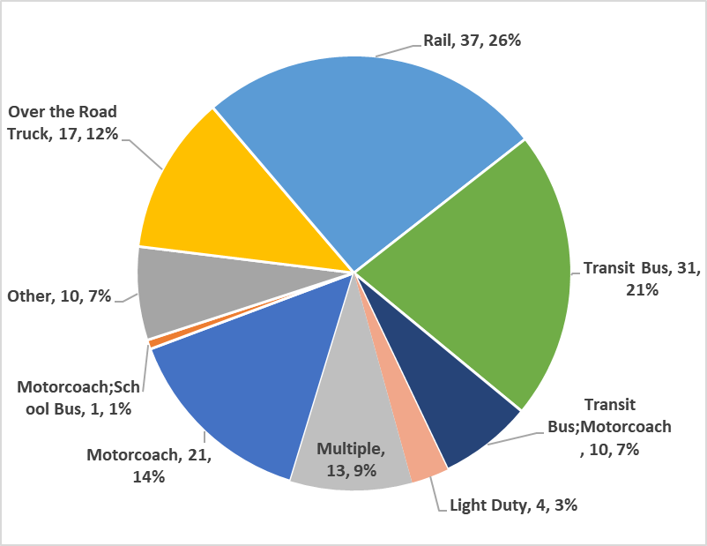
Task 1: Research available documents related to mitigation and prevention of electrical fires
140 relevant documents reviewed and categorized
Document source and transit mode shown below

Slide 5
Task 1: Research available documents related to mitigation and prevention of electrical fires
What did we learn:
Very limited information, scattered throughout many sources
Some generic information dealing with the design of vehicles
No maintenance or training recommendations
Better recommendations for railcars than buses
No clear, concise information available to Transit Agencies
Agency Outreach:
Team received information from over 50 transit agencies on actual transit vehicle fires: 67 rail vehicle incidents and 164 bus incidents.

Slide 6
Task 2- Based on Task 1 Results, Identify Most Frequent Types of Vehicle Fires
Data Analysis from Public Information
Limited to non-existent
Forced shift in strategy to rely on agency investigations
Transit System Feedback
Primary source of analysis
Large variation in details and experience
Agencies recognize the need for additional resources

Slide 7
Task 2- Agency forensic reports used to analyze fire data
Actual Causes of Vehicle Fire, based on Agency forensic reports

Slide 8
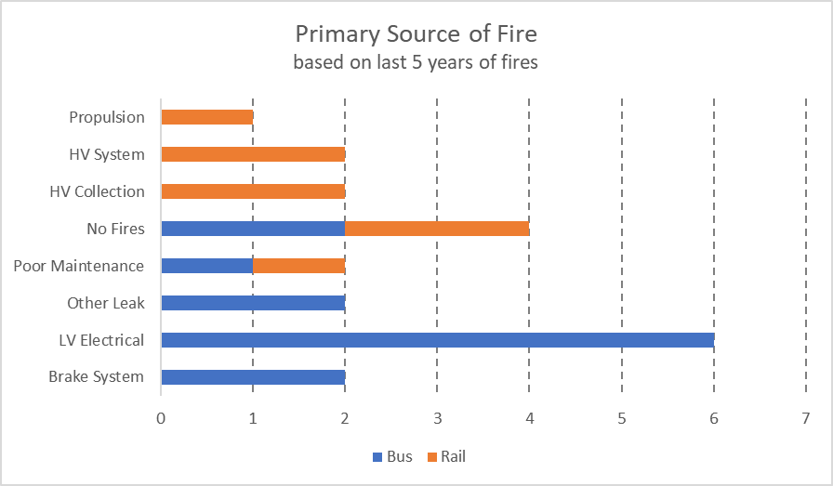
Task 2- Agency forensic reports used to analyze fire data
Perceived Cause of Vehicle Fire, based on Agency Questionnaire Responses

Slide 9
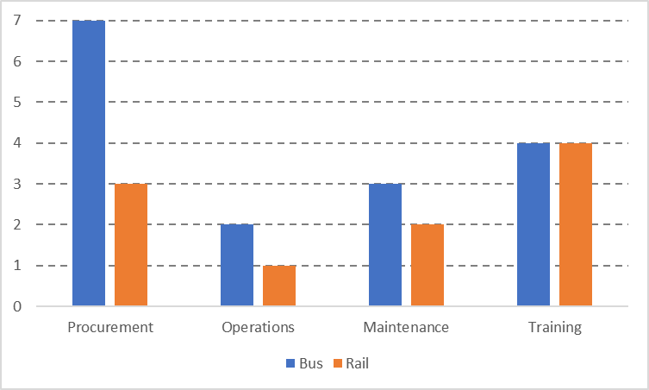
Task 2- Agency Request for additional Guidance
Areas of additional Resources Requested
In general, agencies rated rail guidance favorably, but bus guidance was rated poorly
Specific guidance and information requested on:
Research and information needed to identify efficacy of fire suppression systems and its application to rail cars and electric buses
Training required to help technicians identify fire risks
Best practices & suggestions to share include:
Focusing PMI activities on preventing fire hazards
Training technicians how to identify fire risks
Performing proactive replacement of components to reduce failure induced fires
Reviewing cable and harness clamping and securing, using appropriate blocks and brackets

Slide 10
Task 3- Identify Recommendations for Reducing the Incidence of Vehicle Fires
Work Plan
Agencies self identified ‘maintenance issues’ as primary concern
Fires occurred years after procurement, vehicle design not likely a primary factor
Team refocused on PMI and training curriculum guidelines
Investigation Team Recommendation to update documents relating to:
PM Inspection Guidelines
Inspection Process Design
Inspector Training

Slide 11
Task 3- Updating PM Inspection Guidelines
Successful Preventive Maintenance Programs
Tailored to identify and remedy fire risk factors
Include predictive maintenance/proactive replacement
Include appropriate staff training
Agencies developed their own programs
Share best practices
Agency specific, with baseline standard concepts

Slide 12
Task 3- Updating PM Inspection Process Design
Bus and Rail manufacturers provide basis of a PM program
Incorporate portion of Australian Standard AS5062 as inspection baseline
Modify/Enhance Program to be Agency specific and include:
Clamping and securing of power cables
Proper routing, including vehicle specific pictures in maintenance documents
Insulation condition
Predictive/preventive replacements- robust data capture facilitates this

Slide 13
Task 3- Training PM Inspection Staff
The PM Program is only successful if qualified staff are performing it
Currently, qualifications vary significantly
Try to avoid night shift PMIs (often less qualified) or other practices that puts less experienced personnel on PMIs
Successful programs demonstrate that it takes 4-6 months of training
Pictures are universally touted as excellent training tools- show difference between good vs. bad and progressive damage
Vehicle/fleet specific training
Classroom training followed by hands-on training with a Qualified Inspector

Slide 14
Task 4- Identify Additional Research Products
Based on agency feedback, the team identified key areas that require further investigation
Study effectiveness of current fire suppression systems
Most agencies now require fire suppression on new buses, but are they effective?
Are nozzle locations optimized?
Are the chemical agents appropriate for the types of fires?
Research the viability of fire suppression for battery electric buses
Current trends suggest same type of fire suppression is being installed on battery buses as on diesel buses, is this wise?
How should batteries be isolated in event of fire?
What is the international experience?

Slide 15
Task 5- Develop Work Plan for Phase II
Two critical research needs identified
Task 6.1 Evaluation of effectiveness of current fire suppression systems
Task 6.2 Research on fire suppression systems for battery buses and electric rail transit vehicles

Slide 16
Task 6.1- Work Plan to study effectiveness of current fire suppression systems
Survey bus transit systems who currently use fire suppression systems
Gather data about the type and use of fire suppression systems, including any recent reports of fires on buses equipped with fire suppression systems.
Evaluate the maintenance programs being used by these properties for their fire suppression systems, including cost if possible.
Collect information into data base to perform a value analysis of the installation of fire suppression systems on buses.
We will also attempt to perform a comparative analysis into the types of suppression agents used and the size and placement of system components

Slide 17
Task 6.2- Work Plan to study fire suppression systems for battery buses and electric rail vehicles
Research available fire suppression systems specifically designed for electric fires
Contact the various vendors of vehicle fire suppression systems to collect any test data they have on electric vehicles equipped with their systems.
Research information on installations inside and outside of North America.
Contact electric bus and rail car builders to get their opinions on fire suppression systems. Try to answer why many light rail and heavy rail cars are not presently being equipped with fire suppression systems.
Determine what type of system is most effective for electric vehicles and how the manufacturers isolate power when fires occur.
Goal is to develop recommendations for transit systems to use when specifying fire suppression systems for their new all-electric buses and electric rail cars.

Slide 18
Task 7- Implementation of Research Findings and Products
Upon completion of the research studies (Task 6):
Prepared technical memorandum with recommendations on how to put findings into practice.
Identified organizations and/or committees to promote implementation of findings
Identified potential hurdles and generate potential solutions to implementation.
The team recommended transit vehicle related committees to take leadership roles in advancing the implementation of research findings

