Slide 1
Performance Based Track Geometry Phase III – PBTGTM Technology Evaluation for Transit Systems
Transit Cooperative Research Program D-7
Abe Meddah and Matt DeGeorge
MxV Rail
August 2022

Slide 2
Presentation Overview
PATH Track Geometry Analysis: 2013 vs. 2018, 2013 vs. 2020
NUCARS® Simulations
Neural Network (NN) Modeling Results
Machine Learning (ML) Model Performance
Performance-Based Track Geometry (PBTGTM) Viability Evaluation for Transit Systems
The Way Forward

Slide 3
Notations and Terminology
Notations:
  AI: Artificial intelligence
  ML: Machine learning
  NN: Neural network
AI is a technology (and a broader concept) that empowers machines to simulate human behavior to solve complex problems
ML is an application (and a subset) of AI that learns from past data
NN is one of the machine-learning techniques used to
develop the models during this project

Slide 4
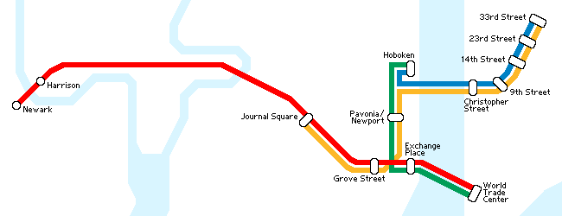
Ride Quality on PATH Track
Highest recorded measurements for ride quality (RQ) in 2013:
  Newark to the World Trade Center (red line)
    Track H: Newark to Exchange Place
    Track G: Exchange Place to Newark
Highest VDV Ride Quality Measurements
PATH Track System

Slide 5
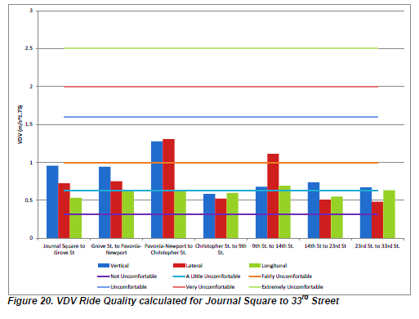
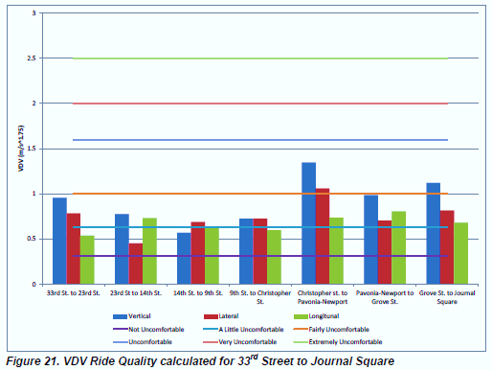
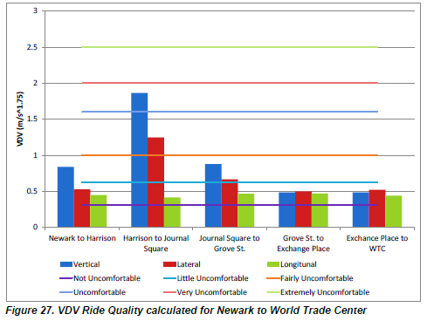
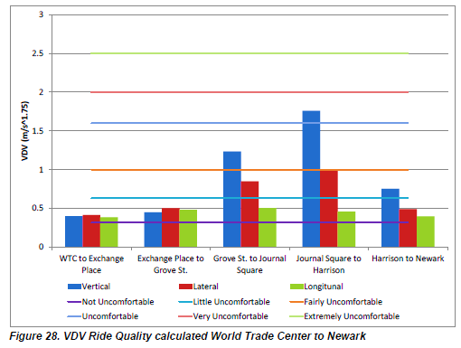
Locations with Ride Quality Issues (2013 on-track test)
Journal Square to 33rd Street (both directions)
World Trade Center to Newark (both directions)
  Track Geometry analysis focus was on this line

Slide 6
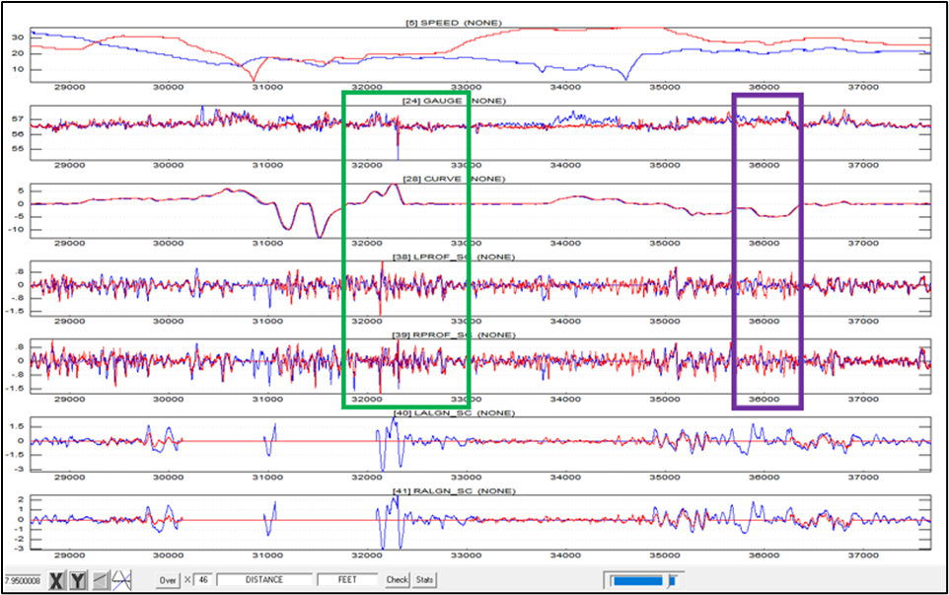
Track Geometry Comparison Analysis 2013 – 2018
Example of track geometry comparison 2013 (blue) vs. 2018 (red)
Track geometry deviations in the data indicated differences between 2013 and 2018
  Differences can affect RQ outputs

Slide 7
Track Geometry Comparison Analysis 2013 – 2020
Track geometry comparison analysis was conducted for the World Trade Center – Newark line
  Track geometry was surveyed with a newly acquired track geometry measurement system
  Late 2020 track geometry data was provided by PATH after completing the commissioning of the new track geometry car
    Track geometry was surveyed in 2013, 2018, and 2020 with technology from same vendor

Slide 8
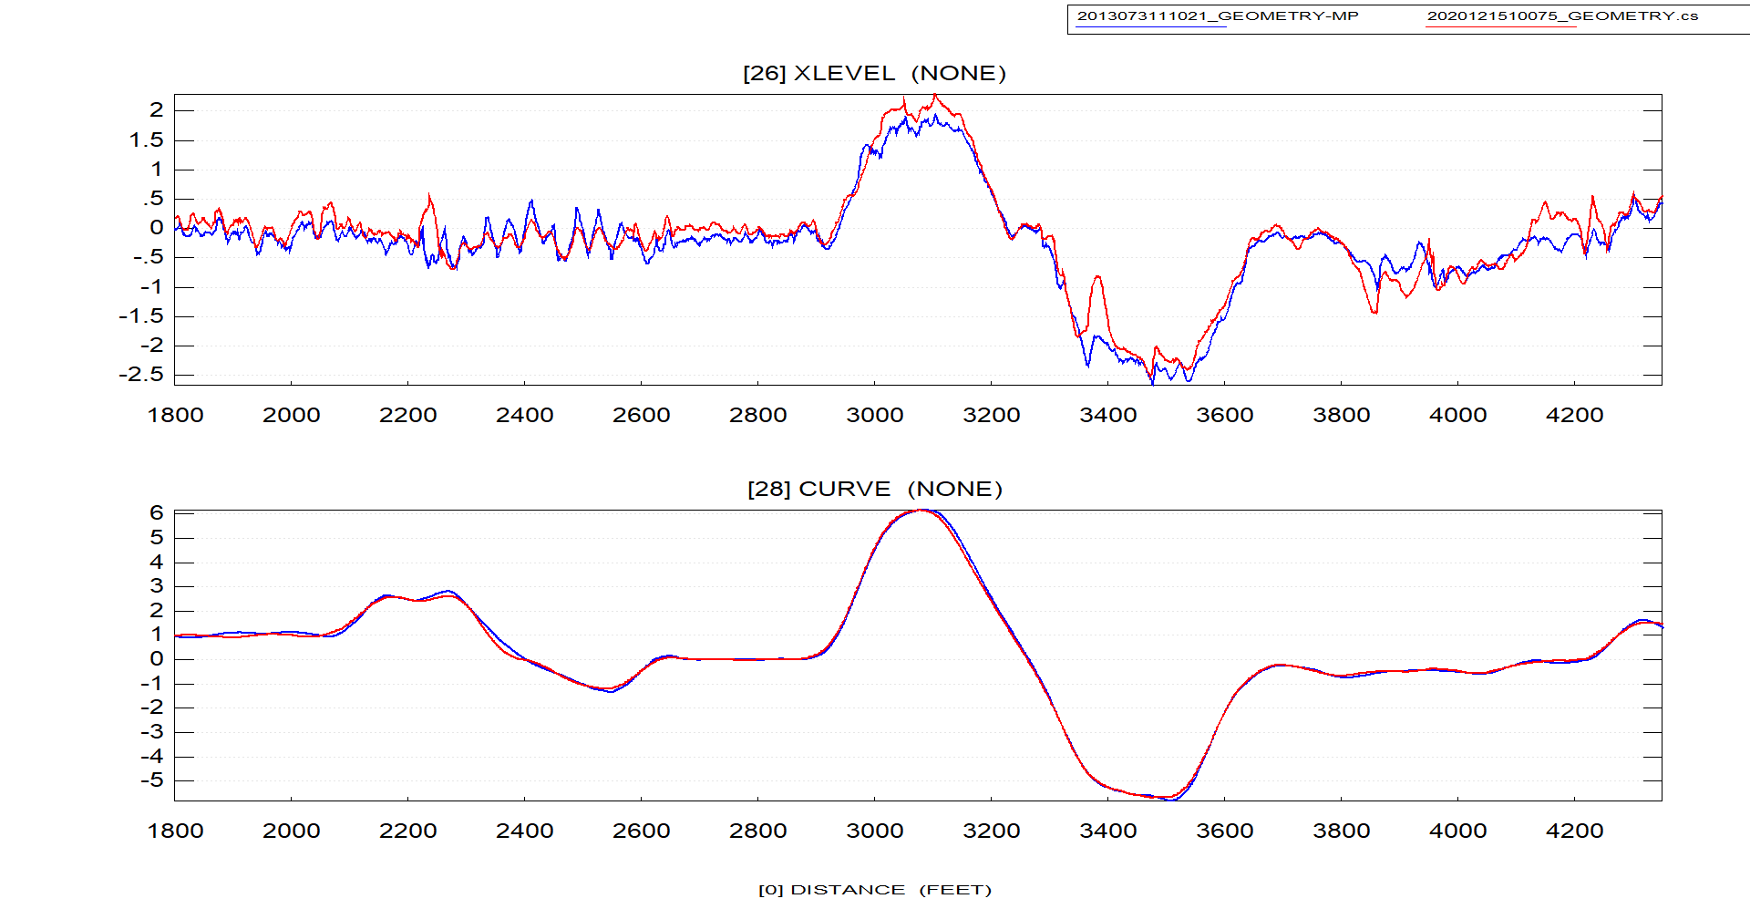
Example of Track Geometry Comparison
2013 (blue) vs. 2020 (red)

Slide 9
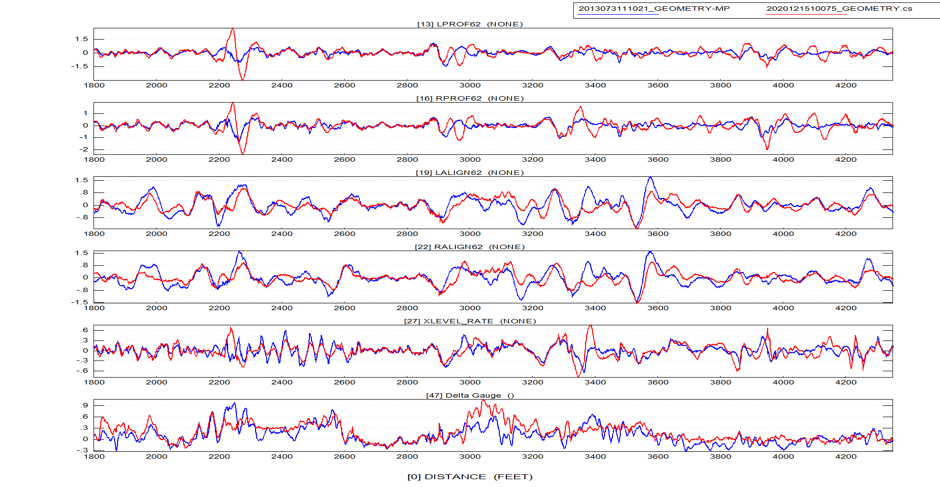
Example of Track Geometry Comparison
2013 (blue) vs. 2020 (red)
Poor TG Matching
Good TG Matching
Poor TG Matching

Slide 10
Example of Track Geometry Comparison
2013 (blue) vs. 2020 (red)
Delta Gage = Gage Deviation

Slide 11
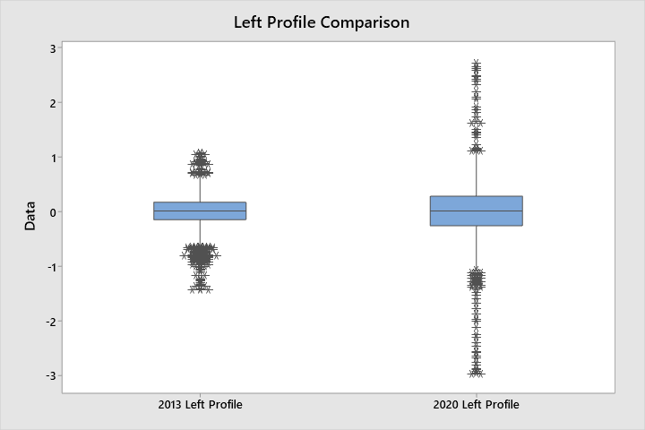
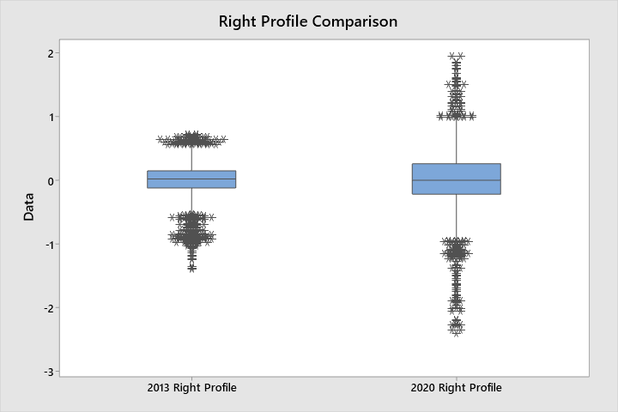
Example of Track Geometry Comparison
2013 (blue) vs. 2020 (red)

Slide 12
Summary of Track Geometry Comparison
2013 vs. 2020
Comparisons were made using chordal data (62-foot chord)
Statistics were calculated for both sets of data
  Similar median and interquartile range (IQR) values
  Significant differences in extreme values (maximums and minimums)
    Adverse ride quality is expected in locations where larger magnitudes of track geometry are present
Most areas with assumed adverse ride quality have a poor match between track geometry in 2013 and 2020

Slide 13
Summary of Track Geometry Comparison
2013 vs 2020
Same vendor for track geometry vehicle measurements
  Vendor was subcontracted by PATH to take measurements regularly before 2020
  New rail-bound vehicle acquired by PATH in 2020 from same vendor
Areas where data matches well provides confidence that there are no large discrepancies between the 2013 vs. 2020 track geometry measurement systems

Slide 14
Summary of Track Geometry Comparison
2013 vs 2020
Multiple track geometry locations display significant changes that occurred in a seven-year time span (2013-2020)
  Some track location deviations show more degradation in
  2020 than in 2013
  Some deviations show more degradations in 2013 than what were measured in 2020
  Ride quality changes are unknown because no acceleration measurements were conducted in 2020

Slide 15
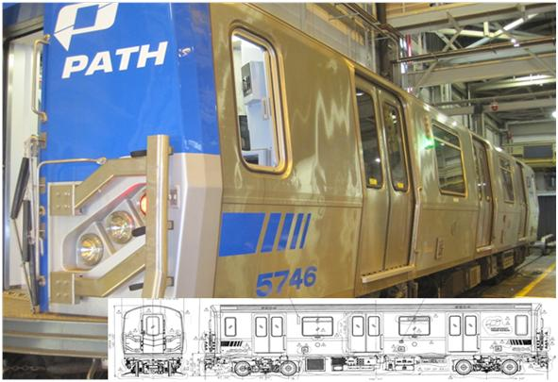
Simulations and PBTGTM
Viability Evaluation for Transit
TCRP D-7 Oversight Panel deemed track geometry variations between 2013 and 2020 acceptable
TTCI engineers were greenlit to use the 2013 PA5 car RQ and geometry data to proceed with the work

Slide 16
NUCARS® Simulations
Objective
  Expand VTI database to generate more data for neural network (NN) acceleration models
  Generate wheel-rail forces data with which to build NN models
Simulation Speeds
  Track allowable speed
  5 mph below track speed
  10 mph below track speed
Note: Phase 2 NUCARS® model used was validated for carbody accelerations only

Slide 17
NUCARS® Simulations (continued)
Simulated accelerations and wheel-rail forces on track line with more ride quality issues
  Track H: Newark to Exchange Place
  Track G: Exchange Place to Newark
Highest VDV Ride Quality Measurements

Slide 18
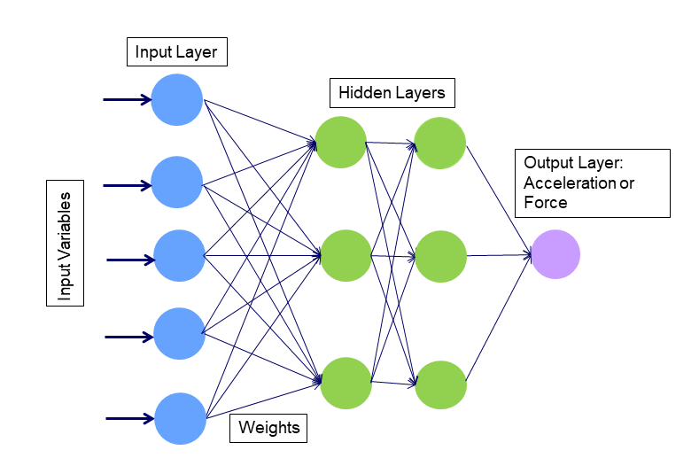
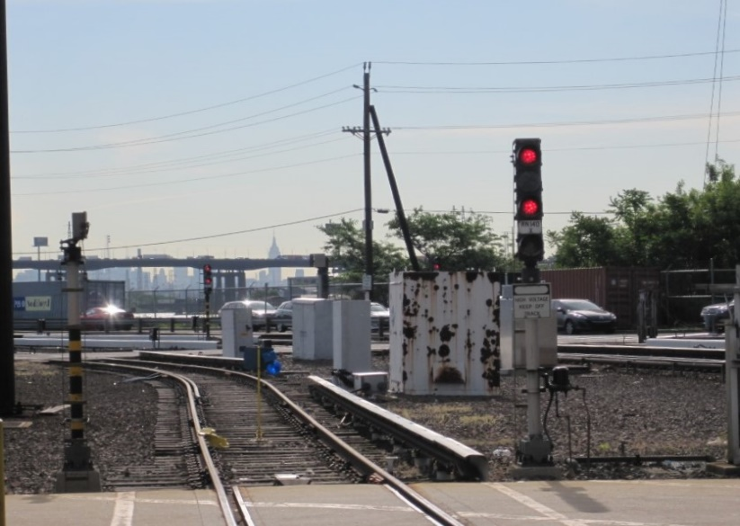
NN Modeling
Model Input:
  Track geometry
    Alignment
    Surface
    Gage
    Superelevation/Cross-level
    Curve
  Speed
  Synthetic channels
Model Output:
  Acceleration and wheel-rail force
PATH Track

Slide 19
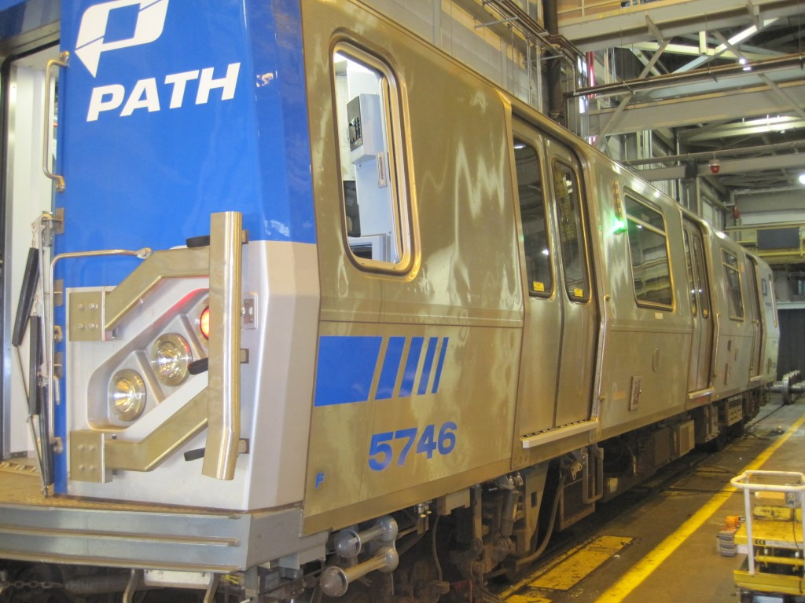
NN Models Developed
Accelerations:
  Driver cab lateral and vertical
  Carbody back-end lateral and vertical
Wheel-rail forces (lead axle)
  Lateral-to-vertical ratio (L/V)
    Criterion to assess wheel climb derailment type
  Vertical force (V)
    Criterion to assess wheel unloading derailment type

Slide 20
PA5 Car Wheel-rail Forces Model (Lead Axle)
The current PBTGTM system for freight vehicles simulates the maximum L/V ratio and the wheel minimum vertical force
  If performance exceedances occur, a track geometry maintenance report is generated, and remedial actions are recommended for track geometry and slow order speed
To evaluate the merit of wheel-rail force models for passenger cars, maximum L/V and minimum vertical force models were developed using NUCARS output

Slide 21
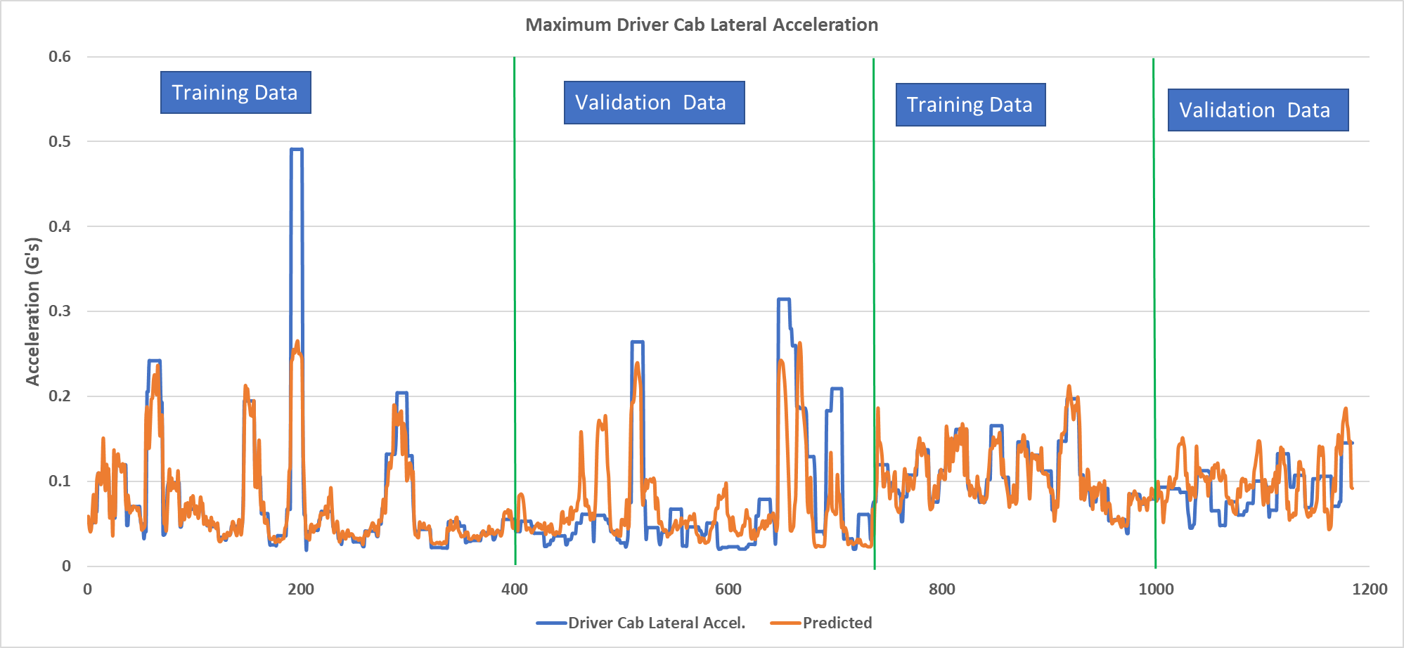
Driver Cab Lateral Acceleration (Maximum Stat)
Prediction confidence: 70%
Validation data is fresh datasets previously unseen by the model during training
Flat peaks in data are due to a 50-foot moving window as data is segmented and variable stats are used.

Slide 22
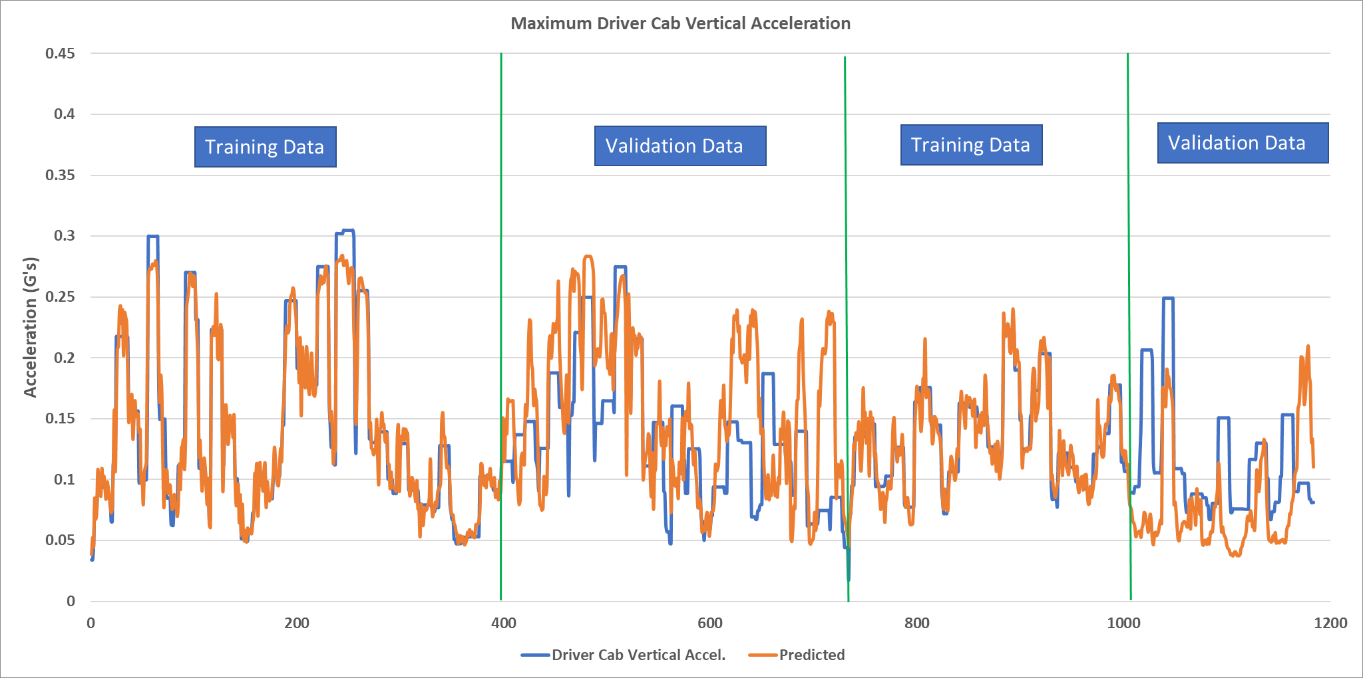
Driver Cab Vertical Acceleration (Maximum Stat)
Prediction confidence: 60%

Slide 23
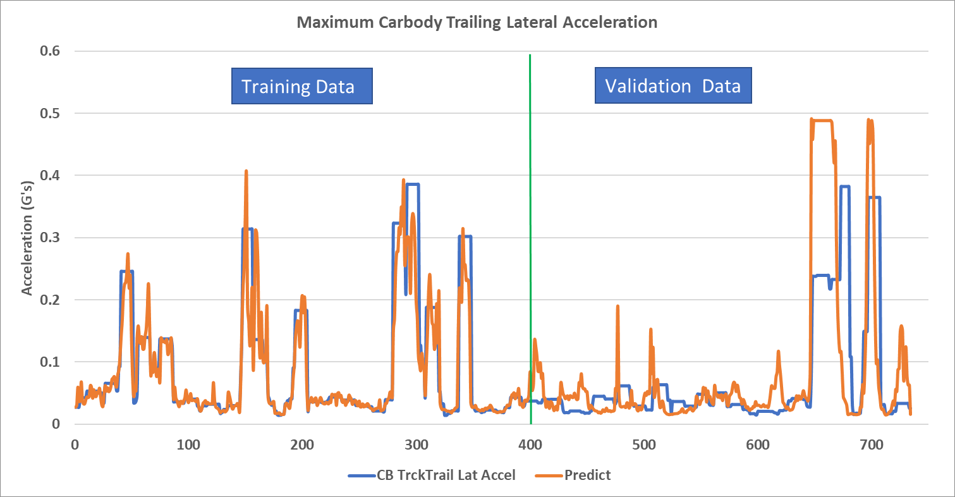
Carbody Trailing Lateral Accel. (Maximum Stat)
Prediction confidence: 64%

Slide 24
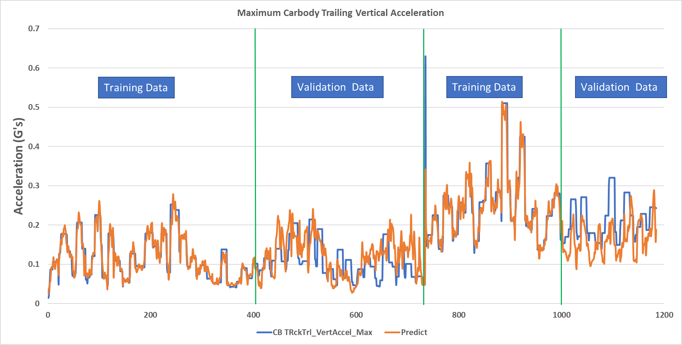
Carbody Trailing Vertical Accel. (Maximum Stat)
Prediction confidence: 60%

Slide 25
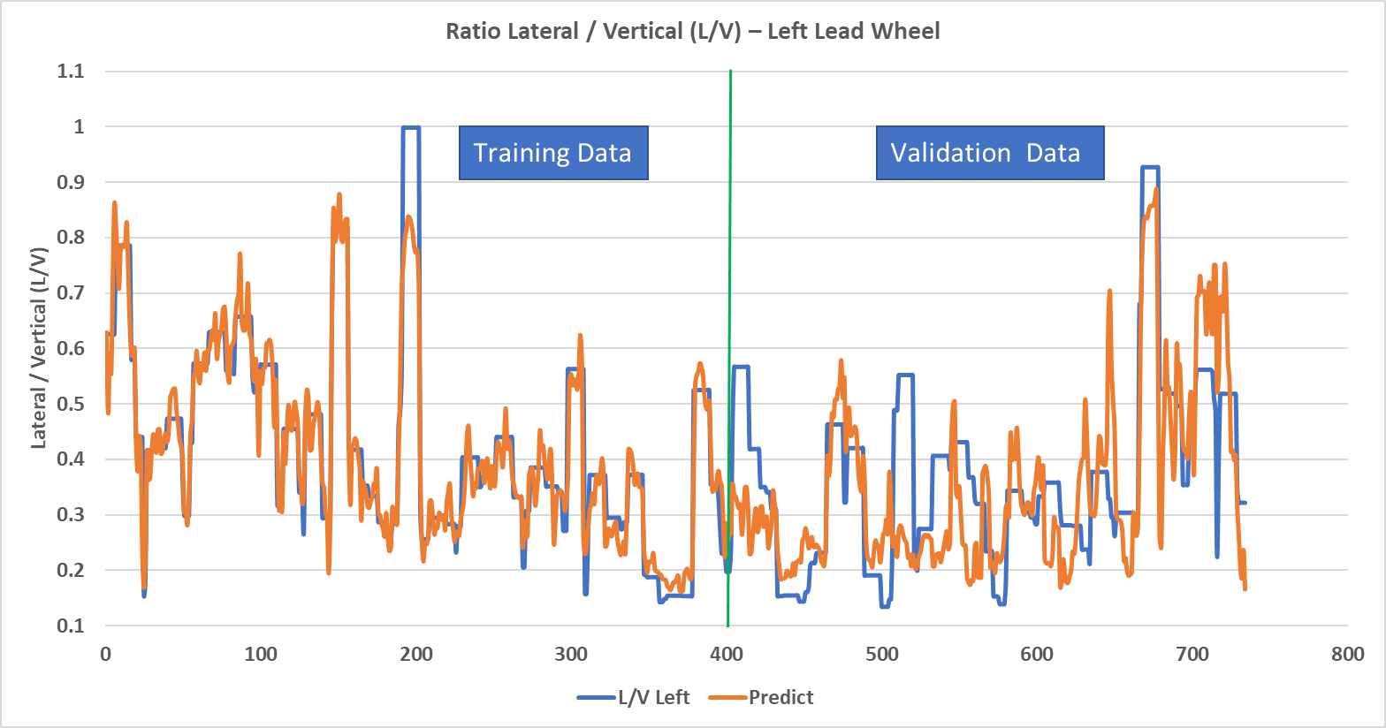
Maximum L/V Ratio Left Lead Wheel
Prediction confidence: 73% (used only NUCARS® data)

Slide 26
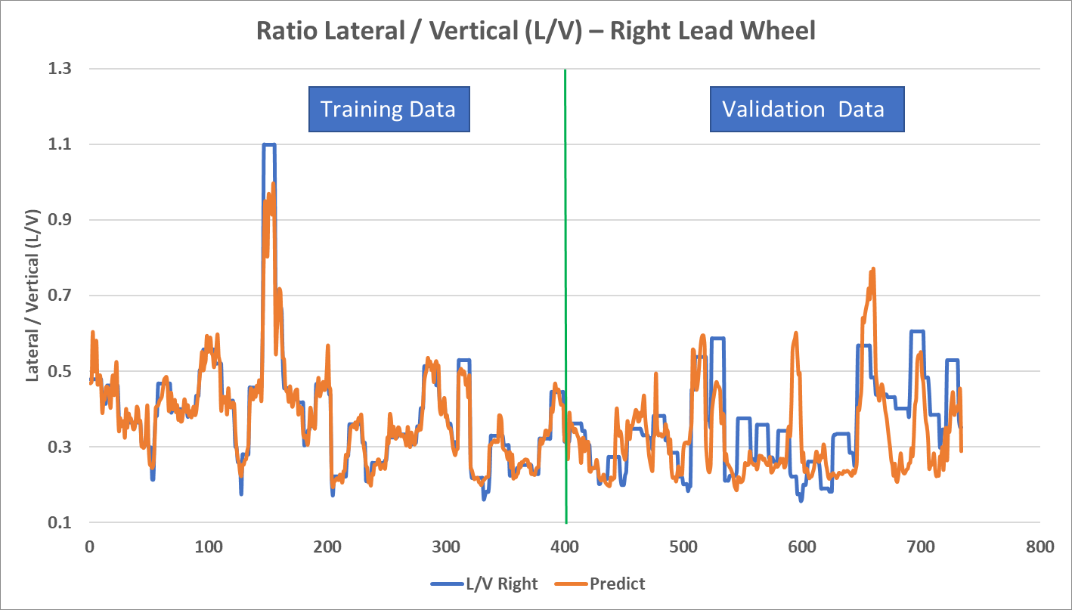
Maximum L/V Ratio Right Lead Wheel
Prediction confidence: 60% (used only NUCARS® data)

Slide 27
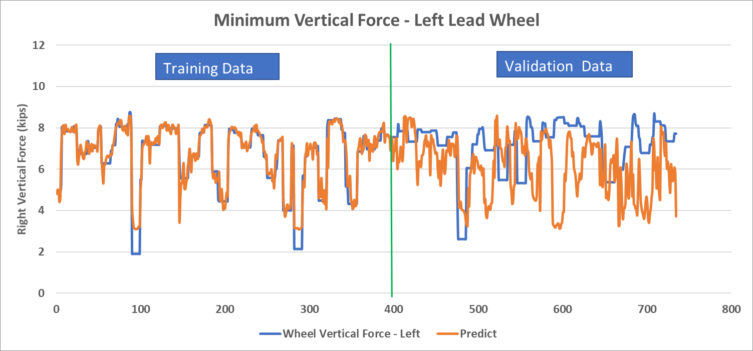
Minimum Vertical Force – Left Lead Wheel
Prediction confidence: 16% (used only NUCARS® data)

Slide 28
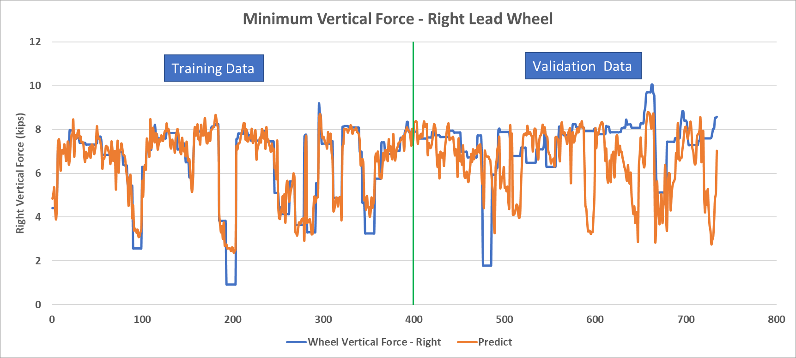
Minimum Vertical Force – Right Lead Wheel
Prediction confidence: 18% (used only NUCARS® data)

Slide 29
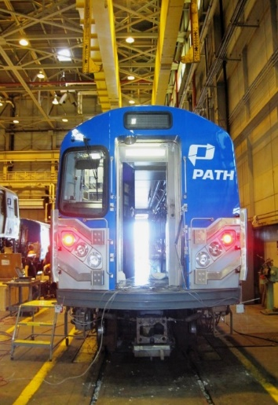
Model Performance and PBTGTM Viability
Carbody acceleration model prediction confidence ranged from 60% to 70%
Wheel-rail forces
  Max. wheel L/V ratio, prediction confidence was 73% for the left wheel and 60% for the right wheel
  Min. vertical wheel force, confidence was 16% and 18% for left and right wheels, respectively
Based on TTCI’s experience, 80% confidence or higher is needed for:
  Production models that can be deployed in revenue service
Model cannot be deployed on PATH
transit system with confidence

Slide 30
Model Performance and PBTGTM Viability (continued)
ML still showed merit, but sufficient defect/response data is required to build robust NN models
  PATH track did not have sufficient track geometry degradation and corresponding adverse vehicle responses to it
The current PBTG™ technology cannot be adapted directly to predict standard weighted r.m.s. RQ criteria
  Significant additional research is needed to:
    Examine adaptation feasibility
    Develop required changes to core PBTGTM technology to predict standard RQ criteria and generate remedial action report for RQ-related issues

Slide 31
The Way Forward
The segment-based approach that the current PBTGTM and NN models were developed with is inadequate for RQ assessment
  The approach aligns the track geometry data with the measured vehicle response based on a defined segment length of track geometry and uses statistics for geometry and dynamic response
Point-by-point approach may be more suitable for frequency-weighted r.m.s. RQ criteria
  The approach would align the track geometry data with the raw measured vehicle response based on 1-foot increments

Slide 32
Way Forward (Cont’d)
Most transit networks are small networks and, individually, may not have sufficient degraded geometry data
Transit agencies with similar tracks and rolling stock can collaboratively and anonymously share data of degraded track conditions
  Shared data repository for training/validation data, accessible to Transit Agencies, researchers, suppliers and other stakeholders
  Accelerate the development of robust AI-powered solutions for RQ and track health assessment

Slide 33
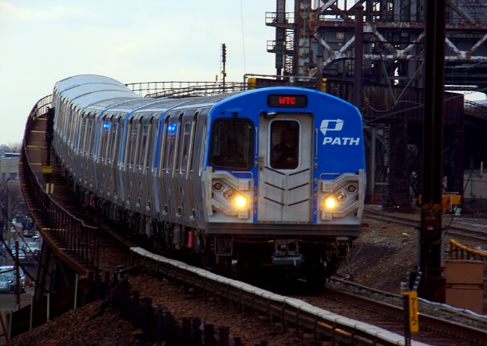
The Way Forward (continued)
To develop optimum AI models, emphasis should be placed on passenger cars that are more prone to generating RQ issues
  AI application that is “universal” and can work with all vehicle types to assess track health and RQ issues is not currently possible
    Wide variation in vehicle dimensions, masses, and suspension characteristics within the North American transit industry
PATH Train
DART Train

